Slide 1

Time Series Forecasting: Final Project PRESENTATION
TEAM 13
ευαγγελος ΟΡΓανΤΖΟΓΛΟΥ ΧαρΑλαμπος ΜΑΛΑΚΟΥΔΗς Χριστοδουλος ΖΕΡΔΑΛης

Slide 2
Project introduction
Predicting residential appliance energy use is crucial due to its impact on costs and carbon emissions. Appliances account for a significant portion of household energy consumption. Time series forecasting helps identify usage patterns based on daily routines and weather conditions. Leveraging historical data enables accurate predictions to enhance energy efficiency.
High energy demand requires smarter energy management.
Appliance energy use impacts costs and environmental sustainability.
Forecasting uncovers trends to optimize energy consumption.

Slide 3
PROJECT OBJECTIVES
The goal of this project is to predict household appliance energy consumption using sensor and weather data. Features like indoor temperature, humidity, and weather conditions are used to create accurate models for energy usage trends. These predictions aim to improve energy management in homes. Advanced techniques, including deep learning and transformers, are utilized to capture complex temporal patterns.
Predict energy consumption trends for better management.
Use sensor data like temperature and humidity.
Implement advanced models like transformers for sequence tasks.
Explore cutting-edge techniques for improved forecasting.

Slide 4
dATA PREPROCESSing
Preprocessing actions:
Date Conversion and Indexing
Missing Value Handling
Outlier Removal
Data Scaling
Trend Visualization
Weekday vs. Weekend Analysis
Seasonal Decomposition
Autocorrelation Analysis
Stationarity Check

Slide 5
MODELS IMPlEMENTED
Gradient Boosting Models
Deep Learning Models
Transformer Models
LSTM
GBM
GRU
TRANSFORMER
XGBOOST
CNN

Slide 6
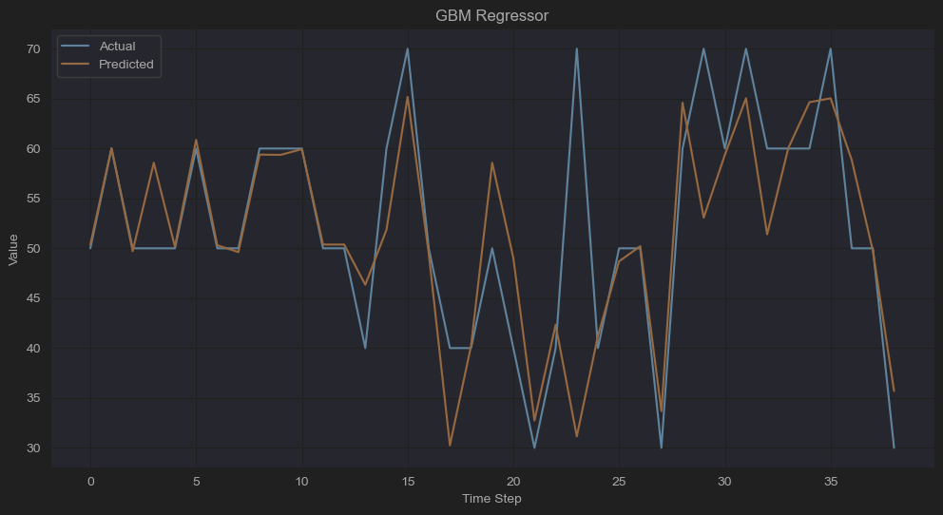
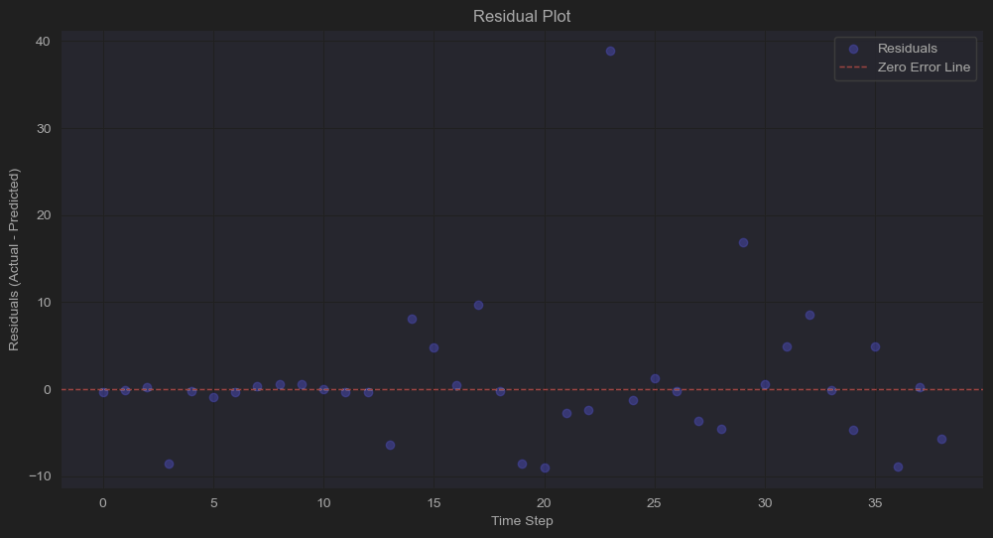
GBM
Predicted vs Actual
Residual Plot
PLOT OBSERVESIONS
No over or under fitting.
Reasonable ability to follow overall data trends.
Model Performance Metrics
RMSE | 8.15
MAE | 4.32
MAPE | 8.22
R^2 | 0.45

Slide 7
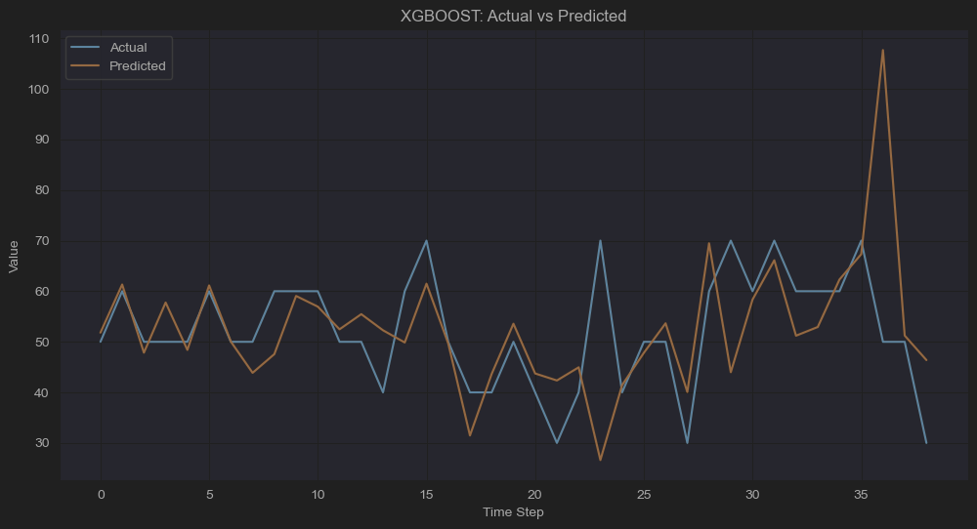
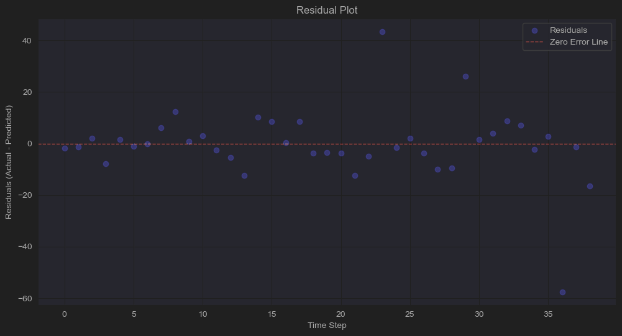
XGBOOST
Predicted vs Actual
Residual Plot
PLOT OBSERVESIONS
Some Underfitting.
Struggles to fully capture sharp peaks.
Model Performance Metrics
RMSE | 10.64
MAE | 7.17
MAPE | 14.86
R^2 | 0.06

Slide 8
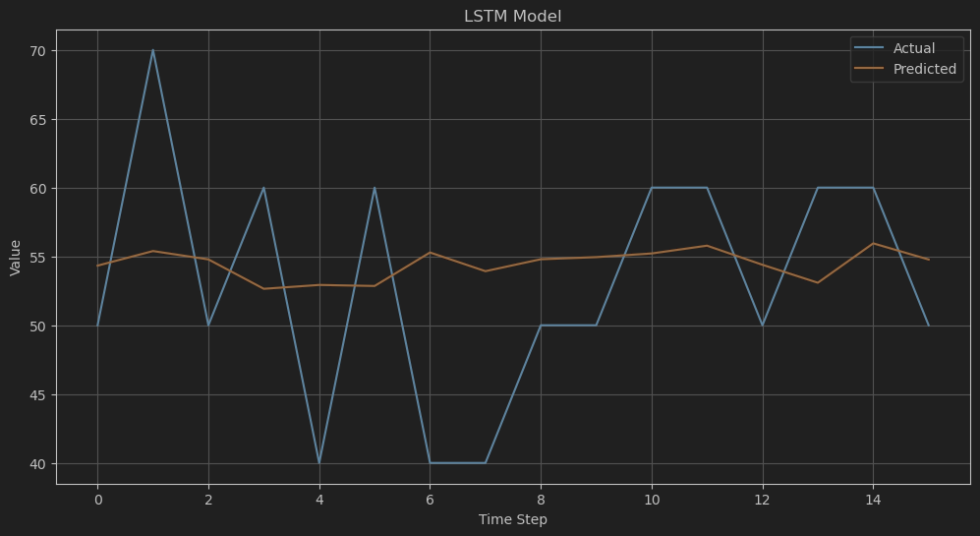
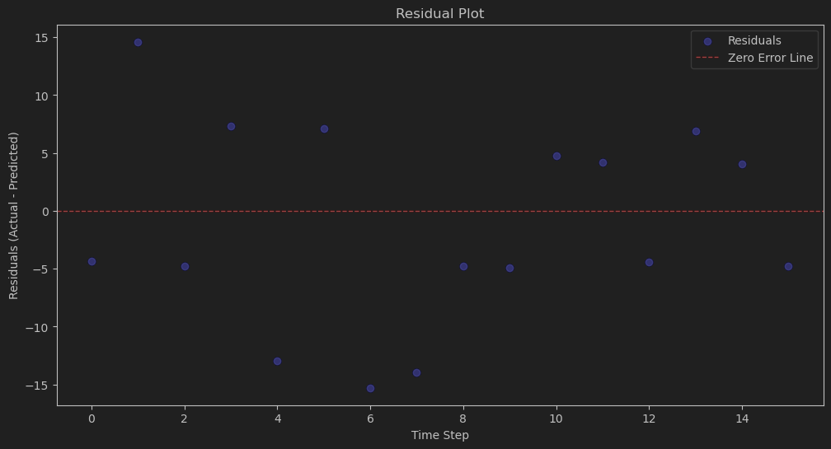
LSTM
Predicted vs Actual
Residual Plot
PLOT OBSERVESIONS
The LSTM model is underfitting the data.
While it captures the general mean value, it fails to follow the actual fluctuations and extreme values.
Model Performance Metrics
RMSE | 9.67
MAE | 7.79
MAPE | 14.67
R^2 | -0.31

Slide 9
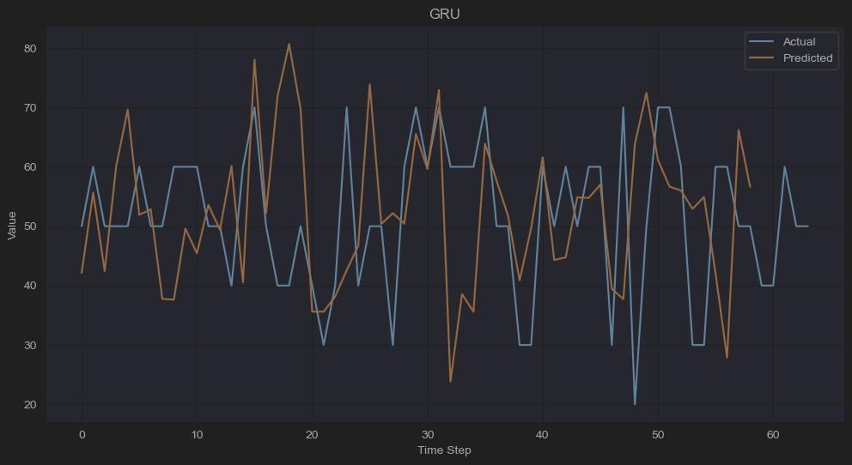
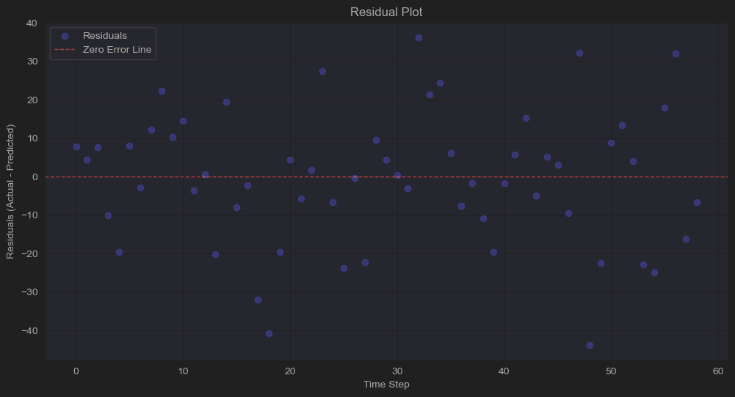
GRU
Predicted vs Actual
Residual Plot
PLOT OBSERVESIONS
Underfitting.
Shows better alignment with fluctuating patterns.
Struggles with extreme values and rapid changes.
Model Performance Metrics
RMSE | 9.70
MAE | 7.68
MAPE | 16.48
R^2 | -0.03

Slide 10
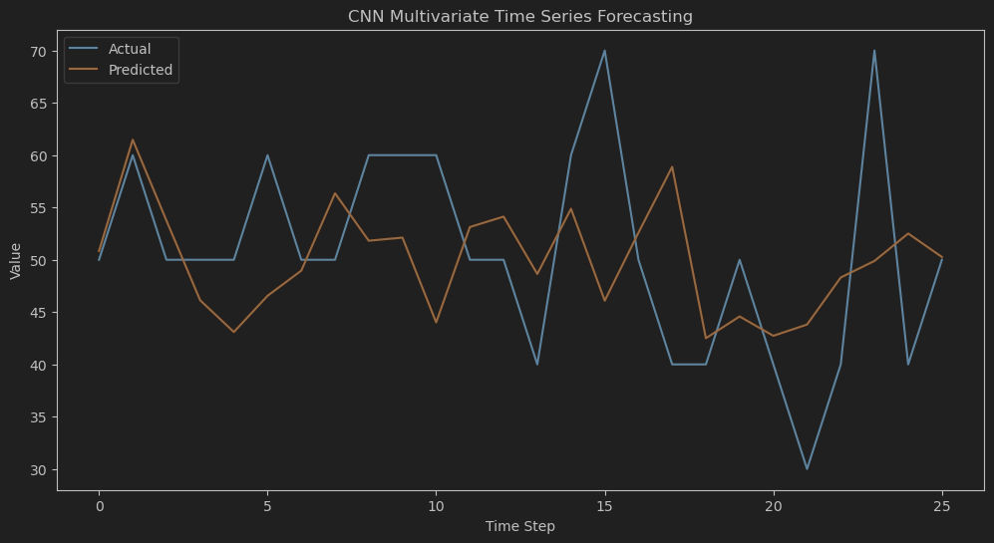
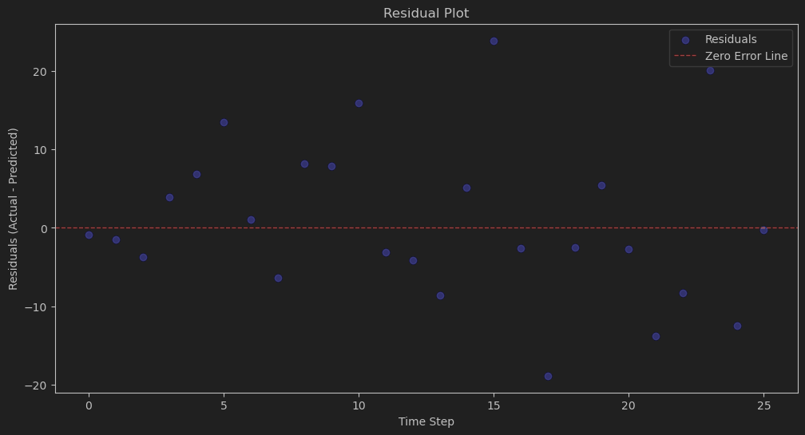
CNN
Predicted vs Actual
Residual Plot
PLOT OBSERVESIONS
Model shows moderate underfitting.
Captures the general trend reasonably but struggles with extreme and rapid variations.
Model Performance Metrics
RMSE | 13.03
MAE | 10.20
MAPE | 22.41
R^2 | -0.25

Slide 11
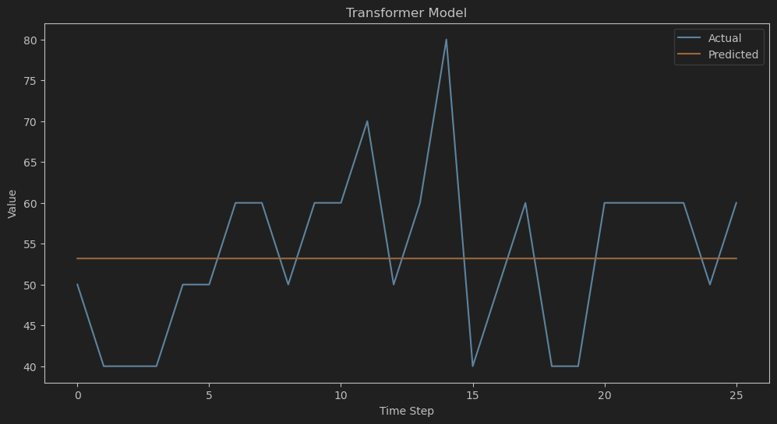
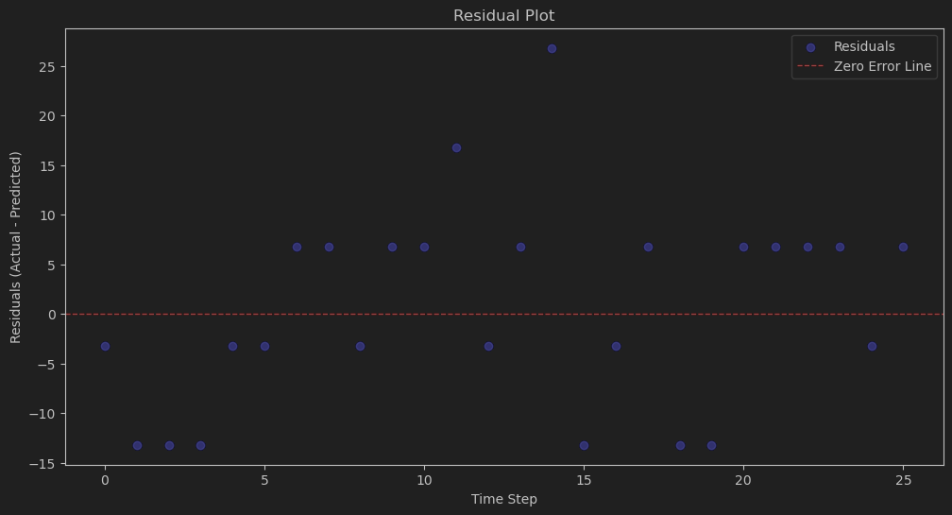
TRANSFORMERS
Predicted vs Actual
Residual Plot
PLOT OBSERVESIONS
Model is heavily underfitting the data.
It fails to learn the variability and trends in the actual data, which results in constant predictions.
Model Performance Metrics
RMSE | 10.05
MAE | 8.46
MAPE | 16.34
R^2 | 0.005

Slide 12
in-depth visual model comparison

Slide 13
Strengths vs Weaknesses
GBM and XGBoost:
Strengths:
Excellent performance on tabular data.
Minimal preprocessing required.
Robust to smaller datasets.
Weaknesses:
Limited time-series dependency handling without feature engineering.
Sensitive to hyperparameters.
LSTM, GRU, CNN:
Strengths:
Capture temporal dependencies and complex patterns.
Suitable for sequential data.
Weaknesses:
Computationally expensive.
Overfitting risks.
Require large datasets.
Transformer Models:
Strengths:
Handle long-term dependencies well.
Parallelizable for faster training.
Weaknesses:
High computational demand.
Struggled with the dataset's size and complexity.
Gradient Boosting Models
Deep Learning Models

Slide 14
Overfitting and Computational Efficiency
Overfitting Analysis:
  GRU, Transformers, LSTM, and CNN exhibited signs of overfitting (low or negative R² scores).
  GBM and XGBoost showed better generalization with fewer deviations.
  Proposed Solutions:
    Increase dataset size or use synthetic data augmentation.
    Apply techniques like dropout, early stopping, and regularization for deep learning models.
Training Time Comparison:
  GBM and XGBoost: Fast training (under 0.3 seconds per epoch).
  Transformers: Most time-intensive (~0.94 seconds per epoch).
  Recommendation: Use tree-based models for time-sensitive scenarios.

Slide 15
Recommendations for Improvement
Data Enhancement:
  Collect more diverse and larger datasets to improve deep learning performance.
  Consider using pre-trained models or transfer learning for resource efficiency.
Feature Engineering:
  Refine time-series features (e.g., lag features, rolling statistics) for GBM and XGBoost.
  Explore additional cyclical and interaction features to improve model accuracy.
Hyperparameter Tuning:
  Fine-tune model parameters like learning rate, number of layers, dropout rates, etc.
  Use automated tools (e.g., Grid Search, Bayesian Optimization) to streamline the process.

Slide 16
Conclusion and Practical Implications
Best Models:
  GBM and XGBoost are most reliable for this dataset and computational constraints.
  Deep learning models show potential but require more resources and data.
Practical Use Cases:
  Real-time energy optimization in smart homes using GBM/XGBoost.
  Deep learning for future large-scale, high-dimensional datasets.
Future Work:
  Explore hybrid models (e.g., combining GBM with LSTM).
  Deploy models in real-world settings and monitor performance over time.

