Slide 1



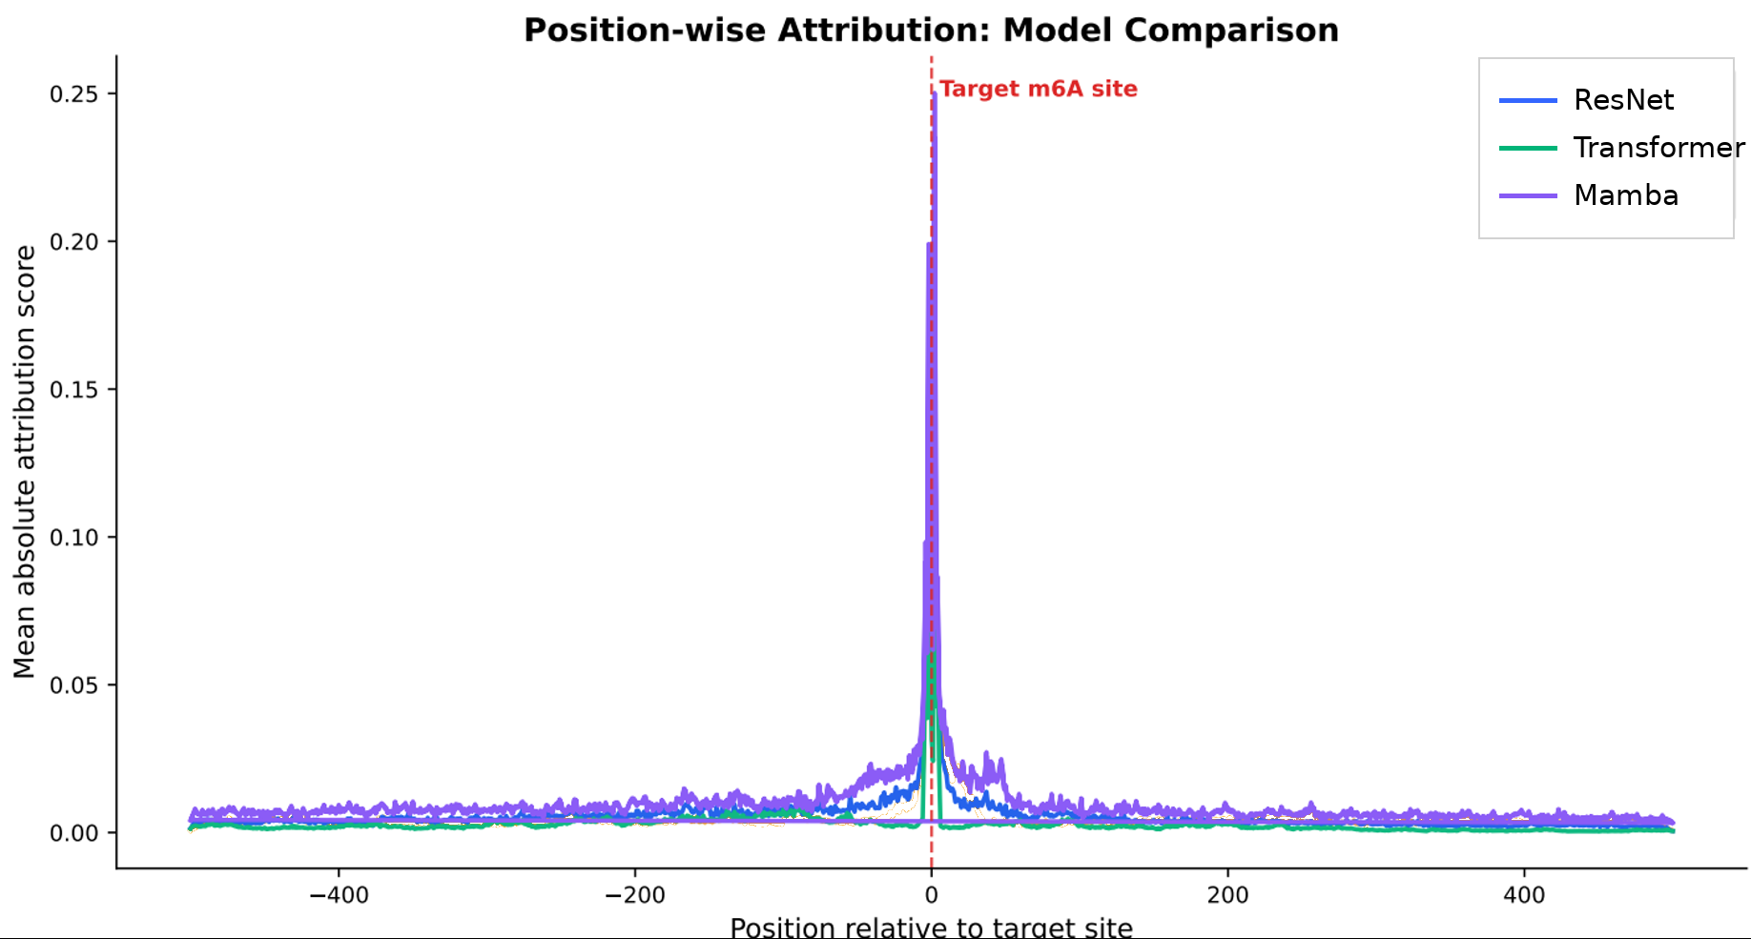
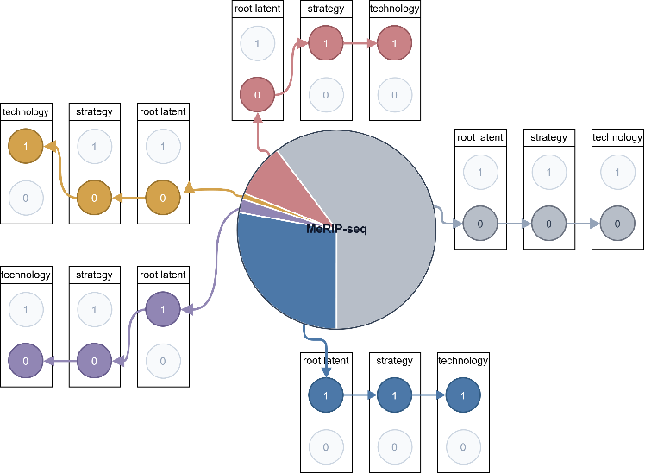
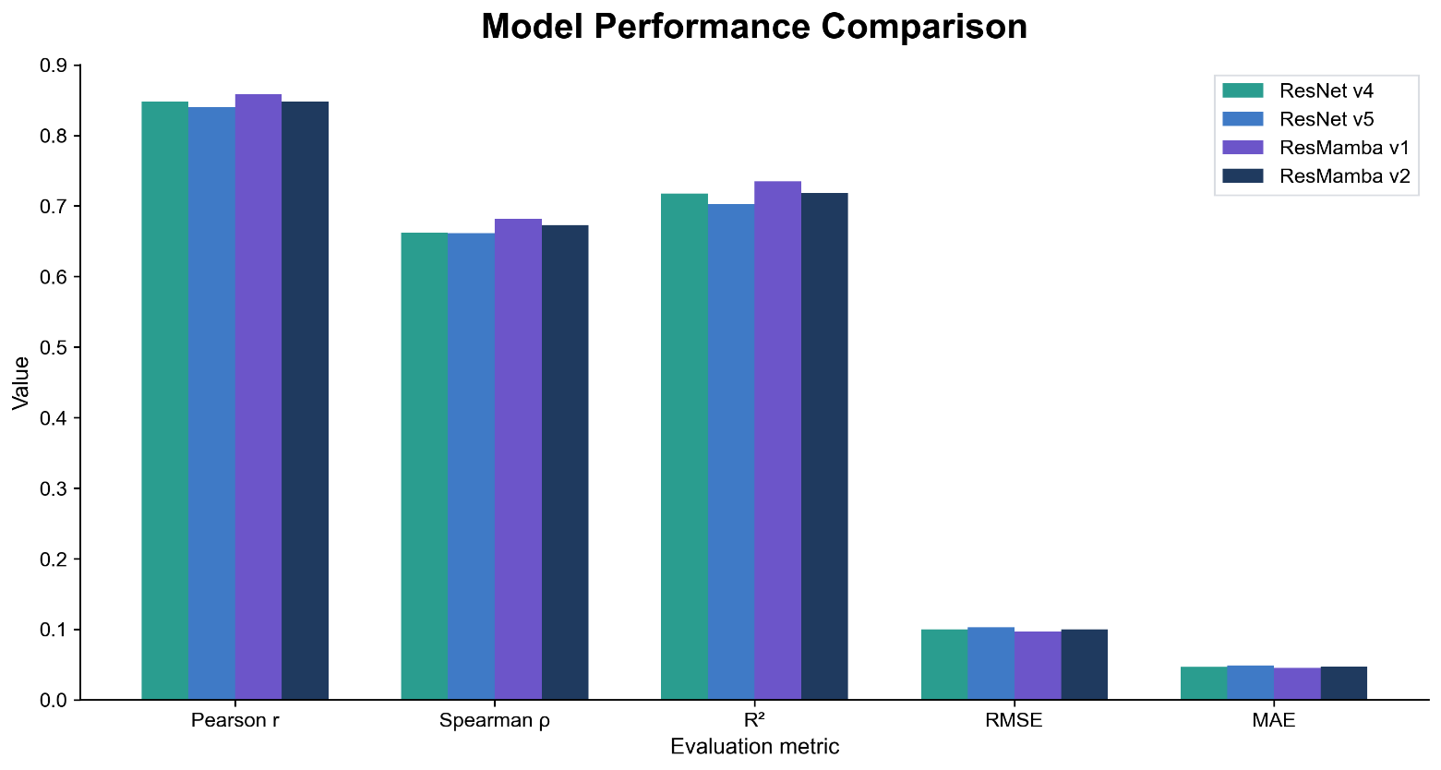
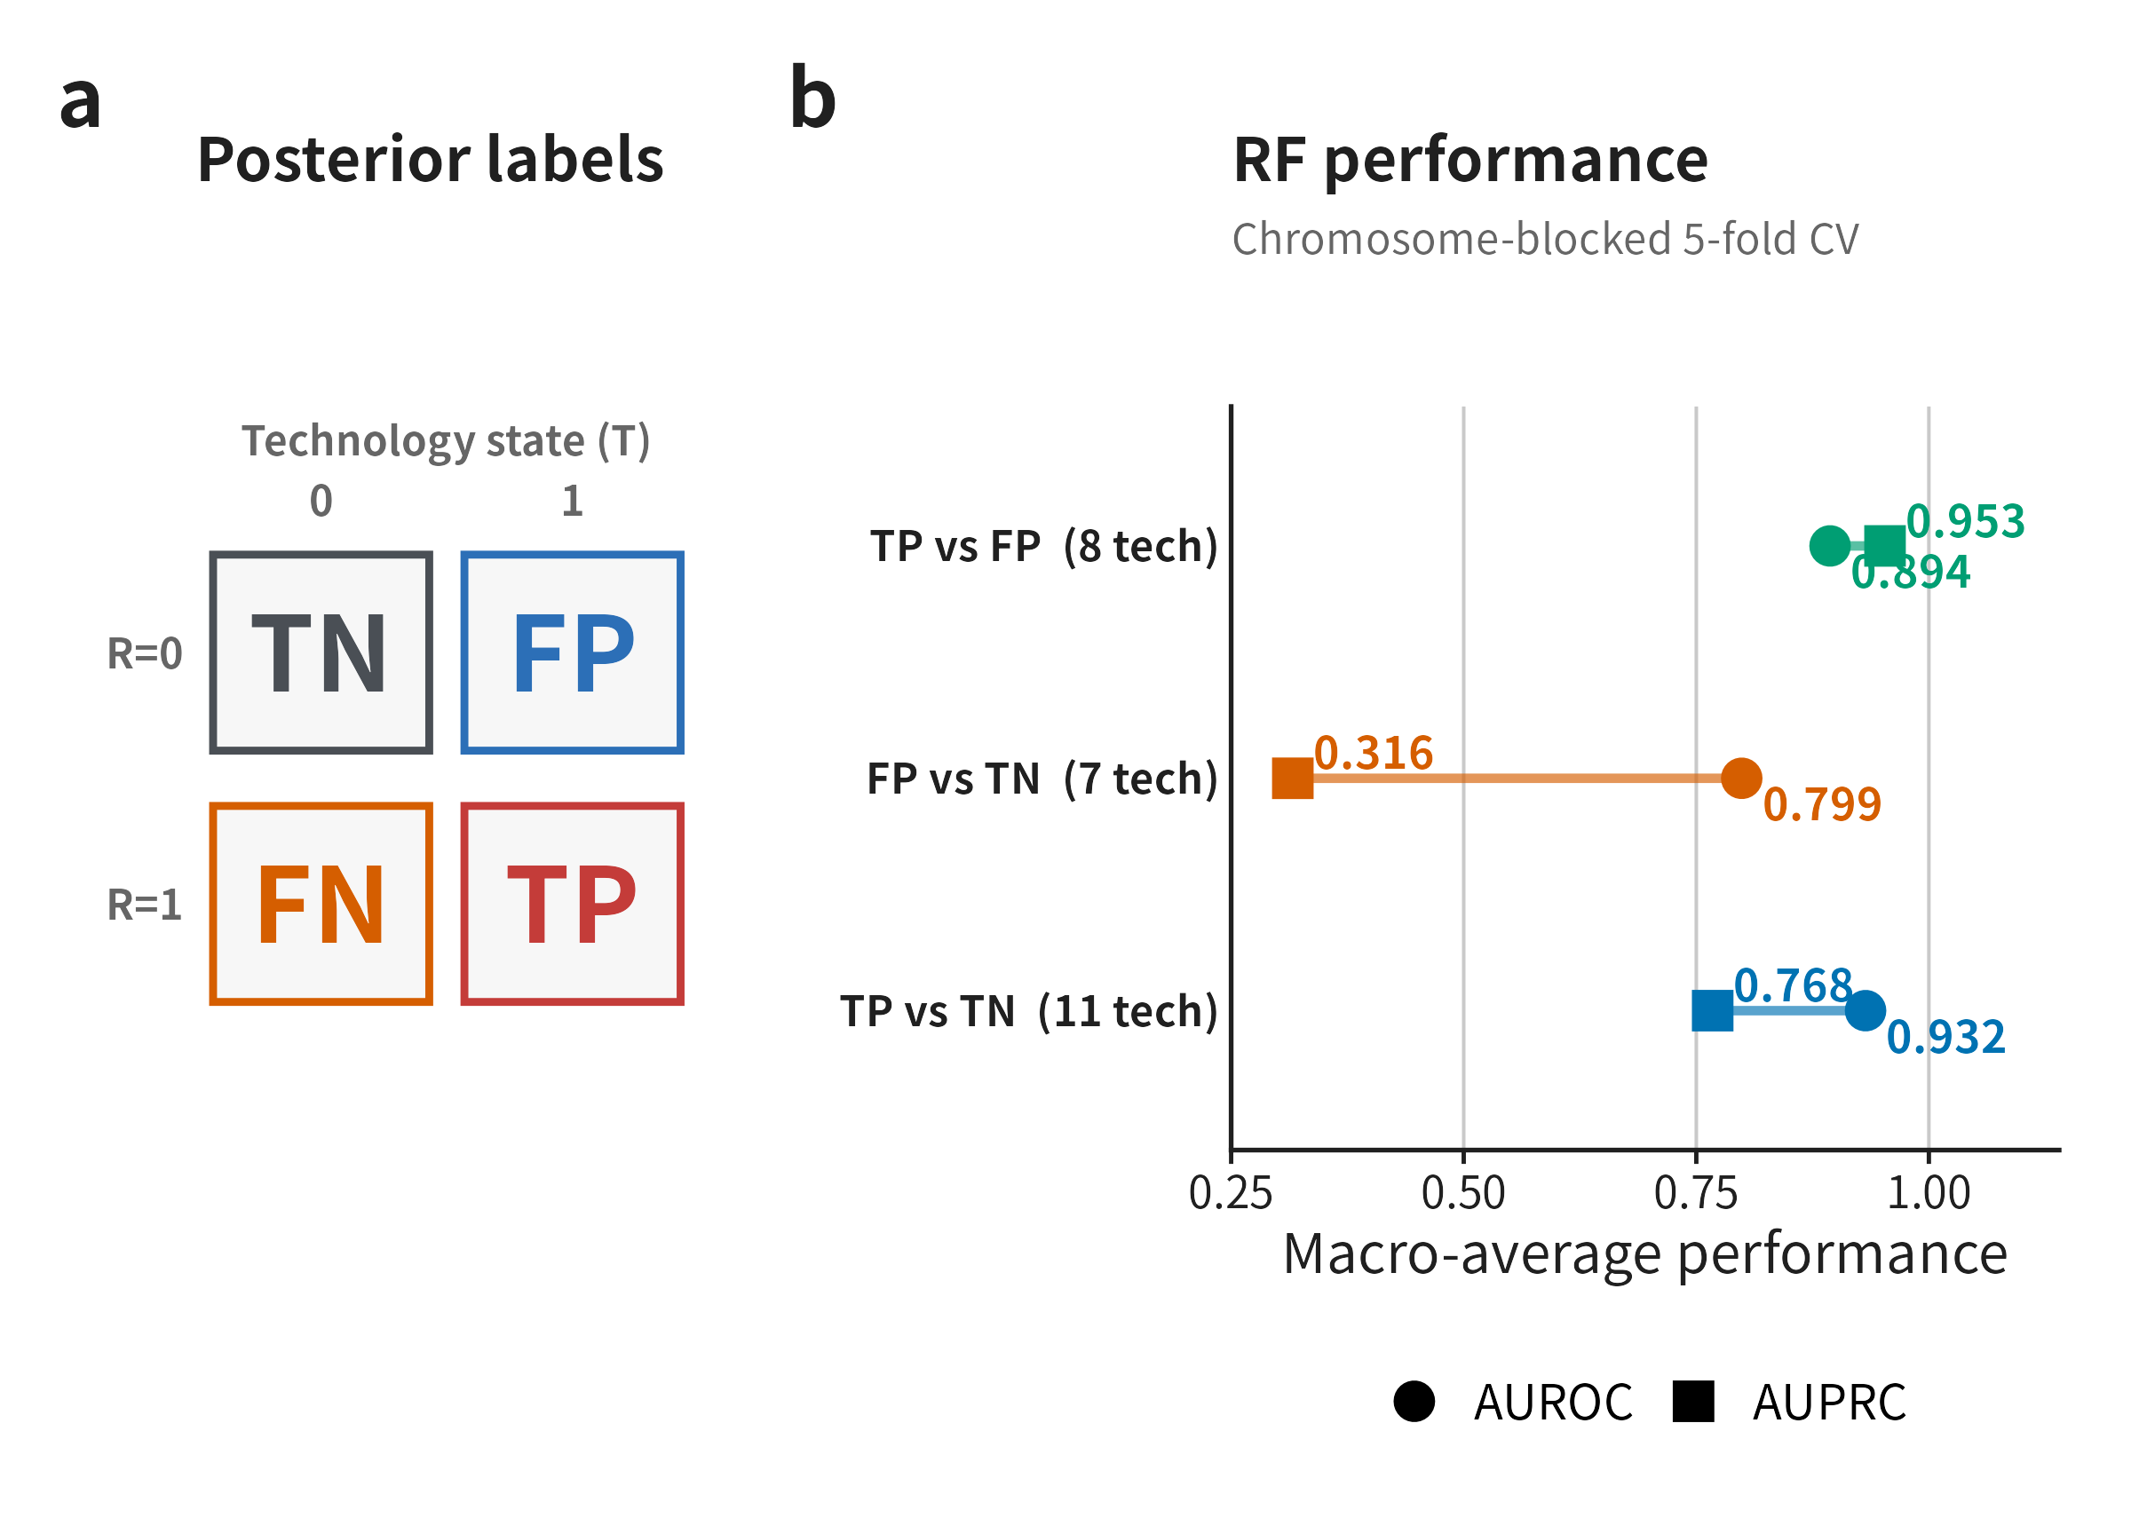

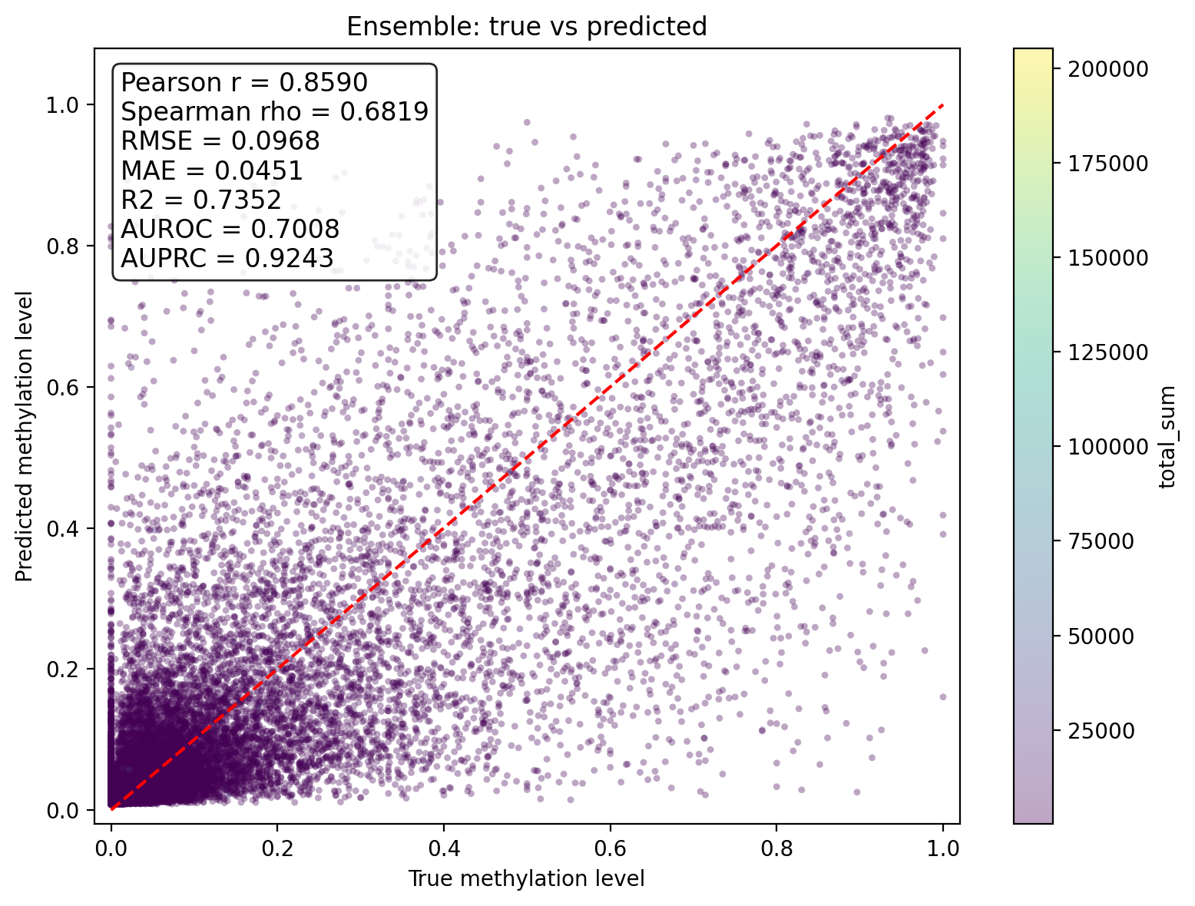
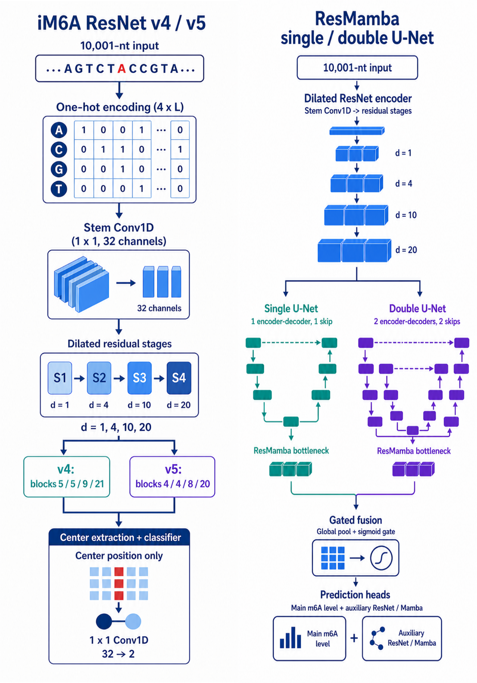
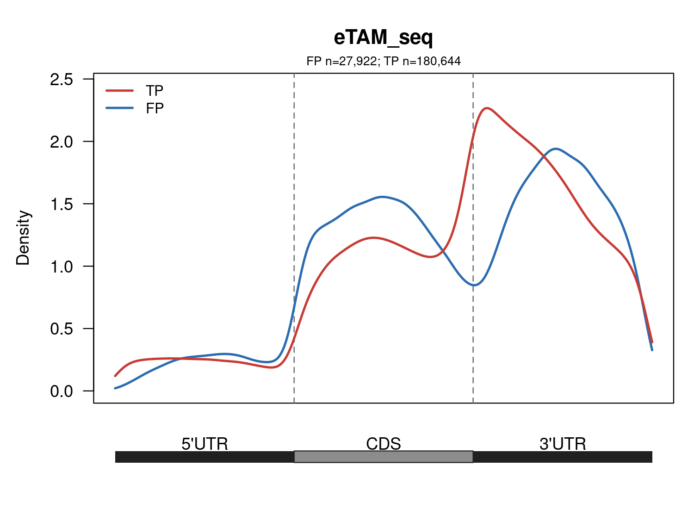
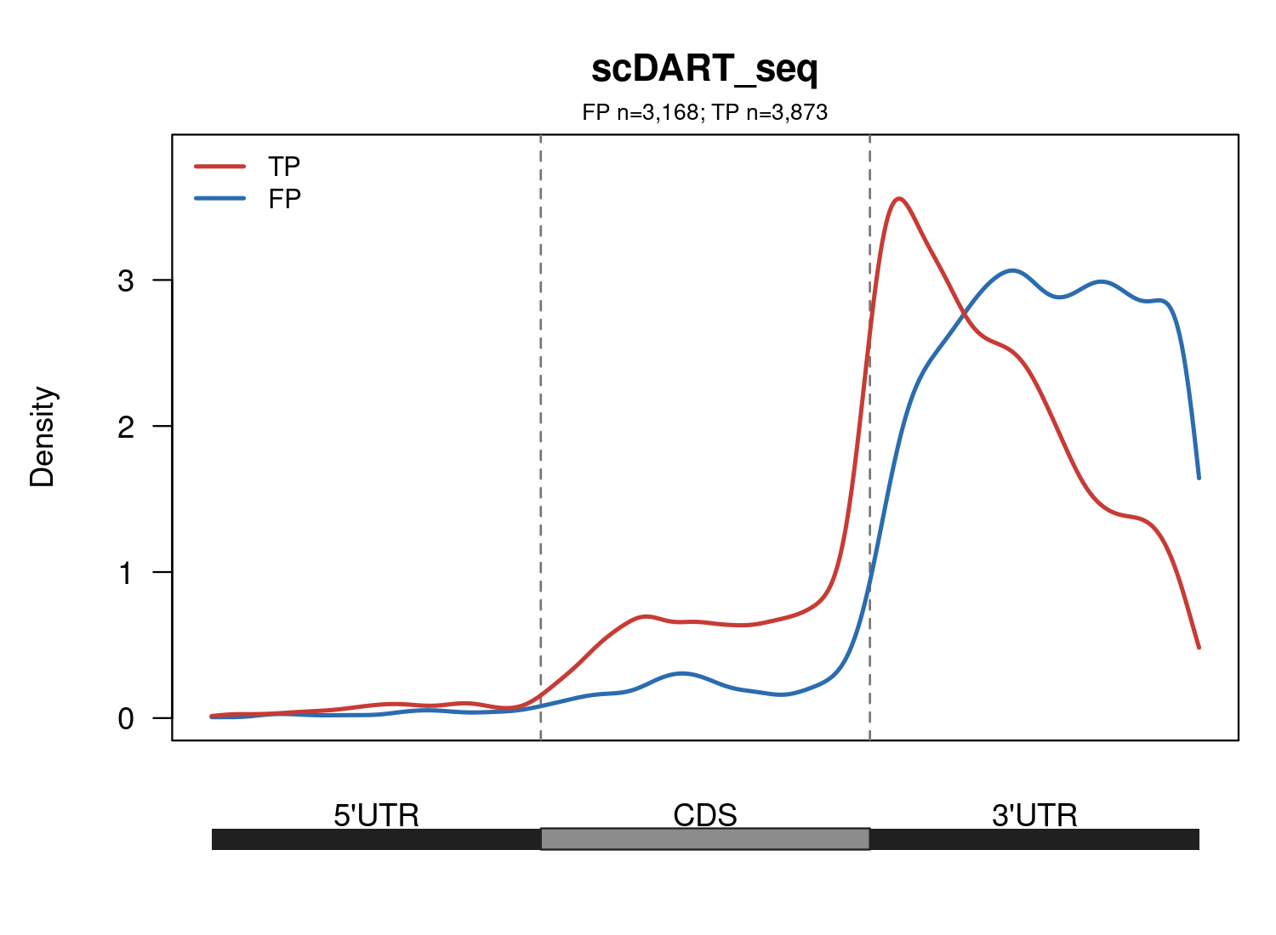
Improving Reliable m6A Analysis through Long-context Deep Learning Prediction and Multi-technology Bayesian Integration
SURF Code: SURF-2026-0485 | Supervisor: Dr. Zhen Wei
SURF Members: Xiyao Chen, Yinuo Feng, Yilin Wu, Yuewei Xu | Volunteers: Shengjie Sun, Zhike Fu
Abstract
Results: Model
Cross-technology and cross-family benchmark
N6-methyladenosine (m6A) regulates RNA fate, but quantitative methylation-level prediction and cross-technology detection remain uncertain.
We compared short-/long-context-based deep learning models for quantitative m6A level prediction, and benchmarked ConquerBN across 14 m6A technologies spanning five technology families.
Among the evaluated models, ResMamba v1 achieved the best quantitative prediction performance (R² = 0.7352).
In leave-one-technology-out (LOTO) and leave-one-family-out (LOFO) evaluations, ConquerBN outperformed IDR, RRA, and RankProduct. Posterior-defined TP, FP, FN, and TN sites were further examined using genomic features and meta-transcript distributions to characterize technology-specific errors.
Short-context attribution evidence
Method | LOTO AUROC | LOTO AUPRC | LOFO AUROC | LOFO AUPRC
ConquerBN | 0.787 | 0.678 | 0.768 | 0.664
IDR | 0.718 | 0.603 | 0.671 | 0.566
RRA | 0.691 | 0.531 | 0.658 | 0.503
RankProduct | 0.678 | 0.523 | 0.641 | 0.492
Table 1. Cross-technology and cross-family benchmark.
ConquerBN achieved the highest macro-average AUROC and AUPRC in LOTO and LOFO.
Fig. 2. Position-wise mean absolute attribution scores for three models with 1,001 bp input.
Viterbi-based exploratory error-pathway analysis
Introduction
With 1,001 bp input, Mamba shows the strongest site-centered attribution peak.
Reliable m6A analysis depends on both accurate computational prediction and robust integration of heterogeneous experimental measurements.
Deep-learning models can capture sequence patterns associated with quantitative m6A levels, while different m6A detection technologies may produce inconsistent signals because of technology-specific biases. We therefore evaluated long-context neural architectures for quantitative m6A prediction and benchmarked a hierarchical Bayesian integration model across multiple m6A technologies.
These motivated two research questions:
  DL Models: Can long-context modeling improve quantitative m6A prediction?
  Integration Benchmark: Can multi-technology Bayesian integration provide robust m6A inference across heterogeneous detection technologies?
Long-context-based model performance
Benchmark m6A integration
Fig. 3. Comparison of five regression metrics across four long-context-based models.
Fig. 5. Viterbi route composition for MeRIP-seq.
All four long-context models used 10,001 bp input.
Among four representative models, ResMamba v1 achieved the best overall performance. ResMamba v2 generally ranked second, whereas ResNet v4/v5 provided strong iM6A-style baselines.
Most errors were technology-level, with occasional strategy-level shifts in enzyme-cleavage methods.
Methodology
Posterior-derived error classes and genomic distribution
Data: The data were derived from GLORI-seq, with 400,000 sites randomly picked from approximately 1,280,000 candidates.
Loss function:
  All loss functions integrate m6A counts as weights
  Short-context models: Mean Square Error (MSE)
  Long-context models: Binary Cross-Entropy (BCE)
Conclusion
c Representative meta-transcript distributions
Fig. 4. ResMamba v1 predictions on the shared test set (n = 40,000). The dashed line denotes perfect calibration.
ResMamba v1 showed the highest Pearson correlation, Spearman correlation, and R², together with the lowest RMSE and MAE. In terms of classification performance, the model additionally achieved an AUROC of 0.7008 and an AUPRC of 0.9243.
The predictions broadly reproduced the strongly right-skewed test distribution, although the scatter showed regression toward intermediate values and underestimation at high methylation levels.
Principally, Mamba identifies sensitive site-centered signals in short windows; U-Net-style ResMamba extends these signals to 10,001-bp inputs by combining ResNet local motifs with BiMamba long-range context.
Fig. 6. Posterior-derived error classes and genomic distribution. (a) Direct four-class labels. (b) Chromosome-blocked RF performance. (c) Representative TP–FP profiles for eTAM-seq and scDART-seq shown side by side.
Conclusion
ResMamba v1 achieved the best quantitative m6A prediction performance (Pearson = 0.8590, RMSE = 0.0968, R² = 0.7352), supporting the benefit of combining local ResNet features with long-range BiMamba modeling.
ConquerBN consistently outperformed IDR, RRA and RankProduct in both LOTO (AUROC = 0.787, AUPRC = 0.678) and LOFO (AUROC = 0.768, AUPRC = 0.664), while posterior-defined error classes enabled genomic and meta-transcript characterization of technology-specific errors.
Together, long-context prediction and multi-technology integration provide complementary strategies for more reliable m6A analysis.
Future work:
  Validate posterior-defined false positives against independent IVT-derived artifacts.
  Explore feature-guided calibration for technologies with limited IVT controls.
Results: Benchmark
Benchmark m6A integration
Fig. 1. Architectures for four m6A prediction models, including the shared iM6A ResNet backbone with v4/v5-specific heads and the single- and double-U-Net ResMamba variants.
2,788,705 candidate sites across 14 m6A technologies and 5 technology families.
MAP calls require technology-specific Total > 10.
Viterbi decoding provides an exploratory view of the most probable error path.
Leave-one-technology-out (LOTO) and leave-one-family-out (LOFO) compare ConquerBN with RankProduct, RRA and continuous IDR on identical evaluation sites.
Direct joint posteriors define TP, FP, FN and TN; each class is called at global FDR < 0.05.
185 genomic features are screened by chromosome-blocked five-fold random forests.
ResNet v4 and v5 mainly differ in residual blocks (40 vs. 36), while ResNet v5 closely reproduces the original iM6A-style architecture.
ResMamba compresses 10,001 bp into shorter tokens, applies BiMamba, then decodes and fuses local/global features.
References
Gu A, Dao T. Mamba: Linear-Time Sequence Modeling with Selective State Spaces. arXiv. 2023; arXiv:2312.00752.
Luo Z, Zhang J, Fei J, et al. Deep learning modeling m6A deposition reveals the importance of downstream cis-element sequences. Nature Communications. 2022;13:2720. doi:10.1038/s41467-022-30209-7.
Feng Y, Xu Y. AI Model for m6A Modification Sites. GitHub repository. 2026. https://github.com/YueweiXu-XJTLU/ai-model-for-m6a-modification-sites.

