Slide 1
CHE 105
Nucleophilic Substitution at the C=O with loss of the Carbonyl Oxygen
Reductive amination
Strecker synthesis of amino acids

Slide 2
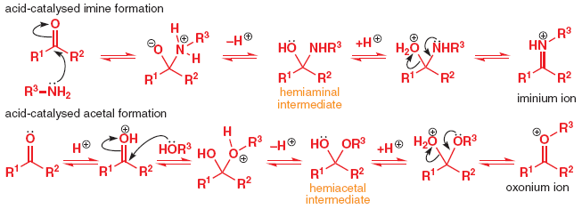
Comparison of Imine and acetal formation
CHE 105

Slide 3
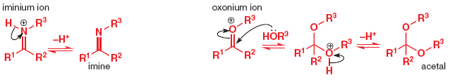
Comparison of Imine and acetal formation
CHE 105

Slide 4
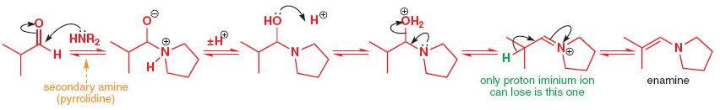
Reaction with secondary amines: Enamine formation
CHE 105

Slide 5
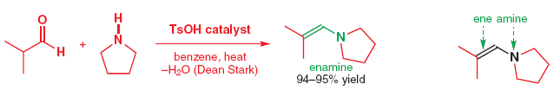
Reaction with secondary amines: Enamine formation
CHE 105
Example

Slide 6
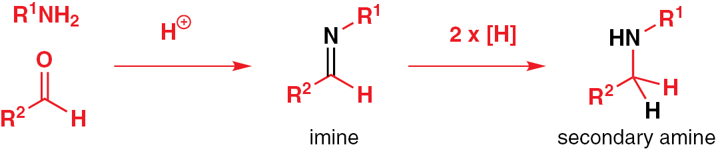
Reductive Amination
CHE 105

Slide 7
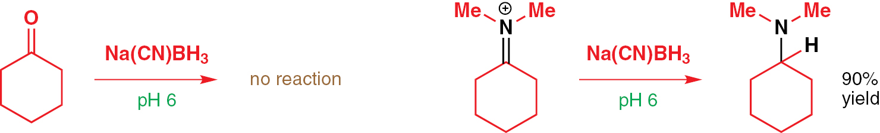
Reductive Amination
CHE 105

Slide 8
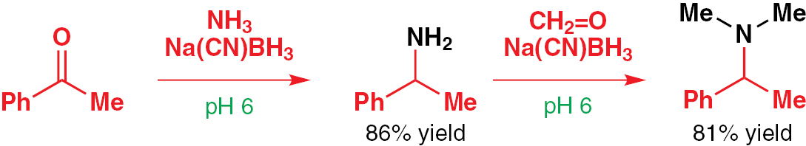
Reductive Amination
CHE 105
Examples

Slide 9
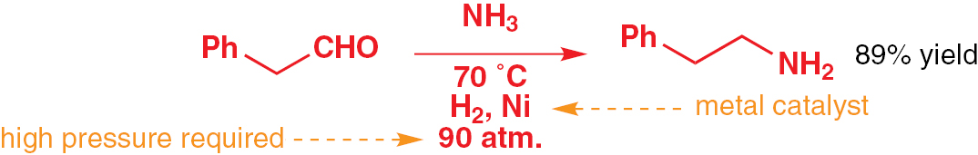
Reductive Amination
CHE 105
Examples

Slide 10
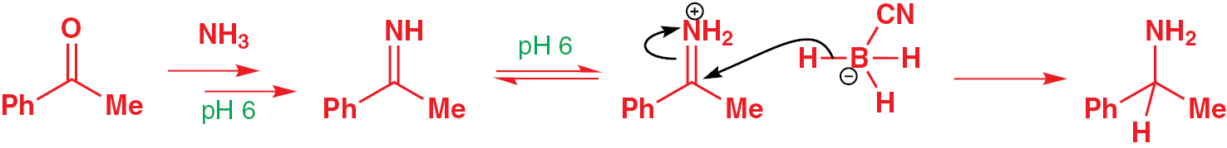
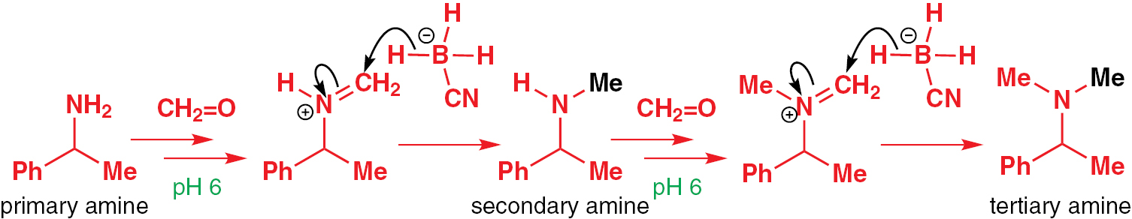
Reductive Amination
CHE 105
Mechanism

Slide 11
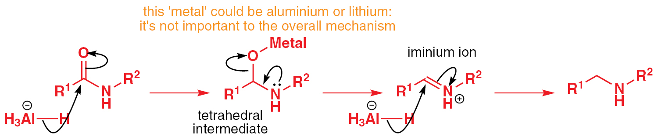
Amide, acyl chloride and nitrile reduction
CHE 105

Slide 12
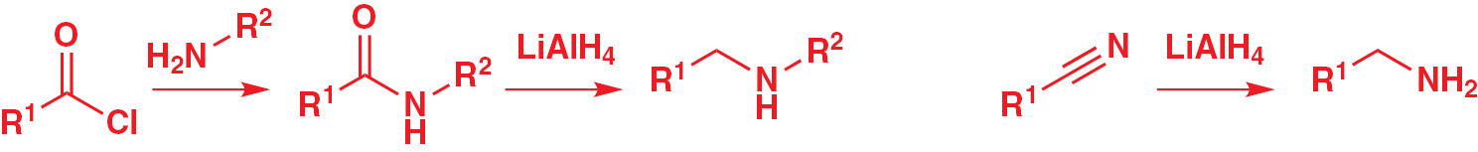
Amide, acyl chloride and nitrile reduction
CHE 105

Slide 13
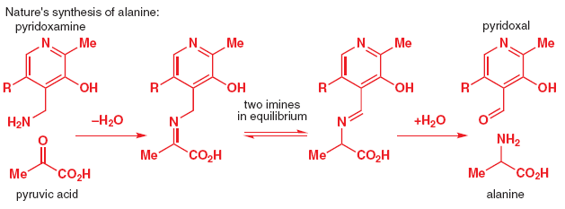
Amino acids Synthesis-The Strecker reaction
CHE 105

Slide 14
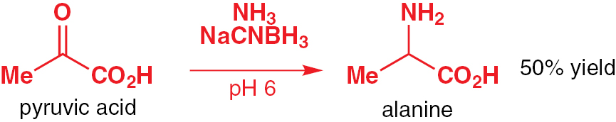
Amino acids Synthesis-The Strecker reaction
CHE 105

Slide 15
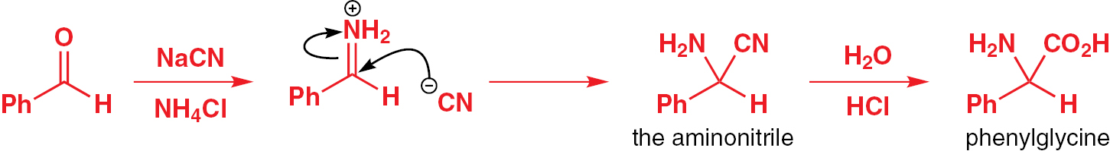
Amino acids Synthesis-The Strecker reaction
CHE 105

Slide 16
CHE 105
Stereochemistry
Three-dimensional shape of molecules
Molecules with mirror images
Molecules with symmetry
How to separate mirror-image molecules
Diastereoisomers
Shape and biological activity
How to draw stereochemistry

Slide 17
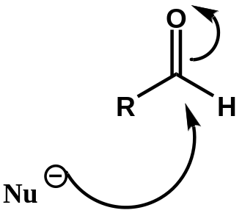
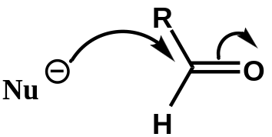
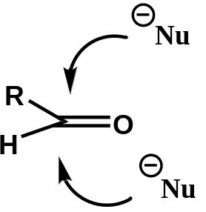
Representation of nucleophilic additions by curly arrows-Stereochemical aspects
CHE 105

Slide 18

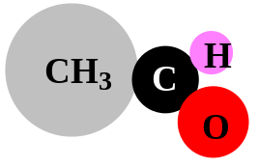
Representation of nucleophilic additions by curly arrows-Stereochemical aspects
CHE 105
Attack from here
Or from here

Slide 19
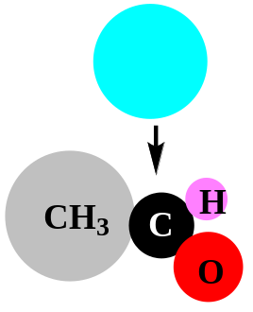
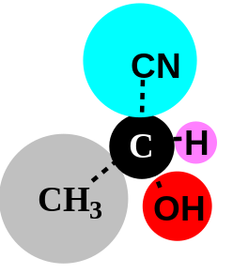
Representation of nucleophilic additions by curly arrows-Stereochemical aspects
CHE 105
Attack from above leads to this molecule
Attack from here
Or from here

Slide 20
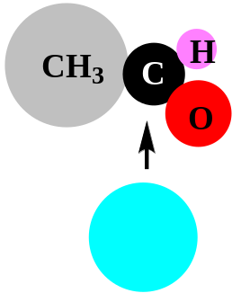
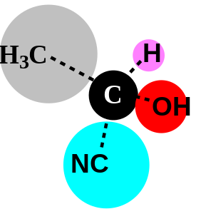
Representation of nucleophilic additions by curly arrows-Stereochemical aspects
CHE 105
Attack from above leads to this molecule
Attack from here
Attack from below leads to this molecule
Or from here

Slide 21
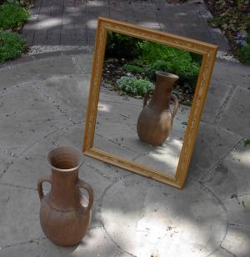
Representation of nucleophilic additions by curly arrows-Stereochemical aspects
CHE 105
Attack from above leads to this molecule
Attack from here
Attack from below leads to this molecule
Or from here

Slide 22
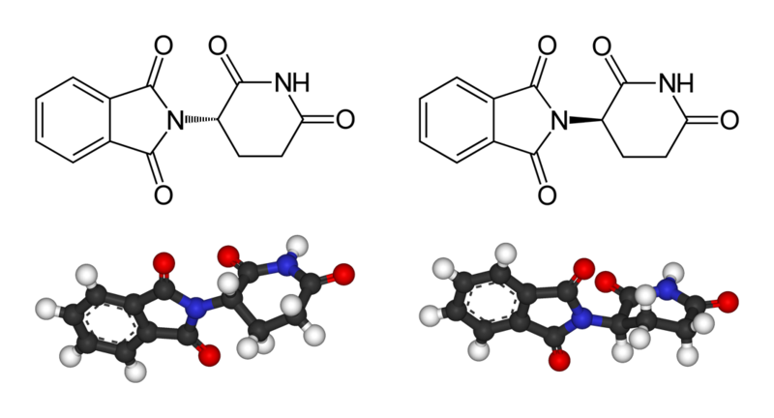
CHE 105
Thalidomide-How stereochemistry affects properties

Slide 23
CHE 105
Thalidomide-How stereochemistry affects properties
R-thalidomide: sedative action,
against morning sickness

Slide 24
CHE 105
Thalidomide-How stereochemistry affects properties
R-thalidomide: sedative action,
against morning sickness
S-thalidomide: a teratogen

Slide 25
CHE 105
Different kinds of isomers
Isomerism
Structural Isomerism
C-C arrangement
Different functional groups
Stereoisomerism
Optical Isomerism
Functional groups position
Geometric Isomerism
Enantiomerism
Diastereoisomerism
Conformational Isomerism

Slide 26
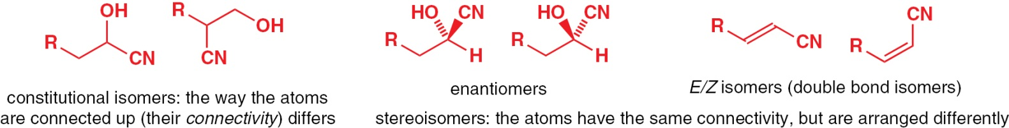
CHE 105
Different kinds of isomers

Slide 27
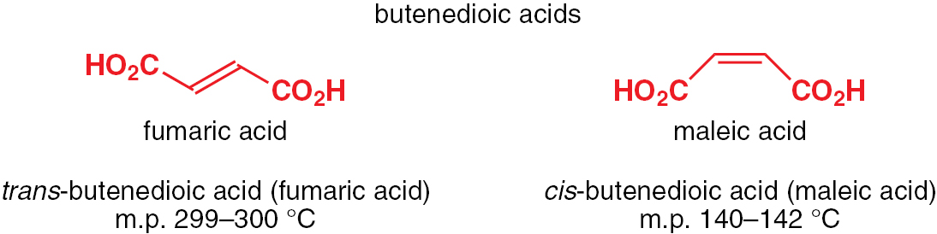
CHE 105
Different kinds of isomers

Slide 28
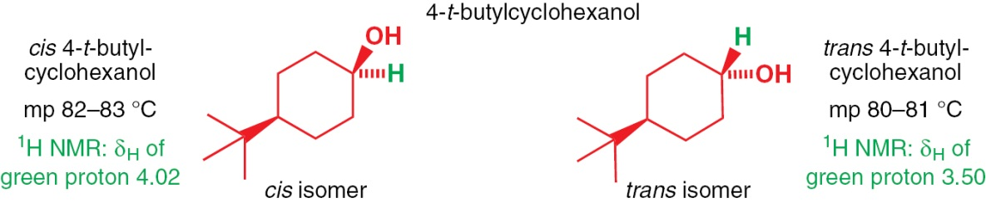
CHE 105
Different kinds of isomers

Slide 29
CHE 105
Stereogenic Centres
Stereogenic or chiral or asymmetric centre:
A C atom with 4 different substituents

Slide 30
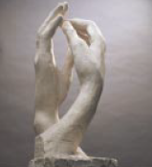
CHE 105
Stereogenic Centres
Stereogenic or chiral or asymmetric centre:
A C atom with 4 different substituents

Slide 31
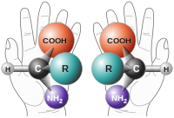
CHE 105
Stereogenic Centres
Stereogenic or chiral or asymmetric centre:
A C atom with 4 different substituents

Slide 32
CHE 105
Stereogenic Centres
Stereogenic or chiral or asymmetric centre:
A C atom with 4 different substituents
Enantiomers

Slide 33
CHE 105
Stereogenic Centres
Stereogenic or chiral or asymmetric centre:
A C atom with 4 different substituents
Enantiomers
Chirality: The property of being chiral, (from Greek cheir=hand)
Chiral is an object that is not identical to its mirror image

Slide 34
CHE 105
Configuration and Conformation
To change a configuration, bonds must be broken
To change a conformation, bonds must be rotated

Slide 35
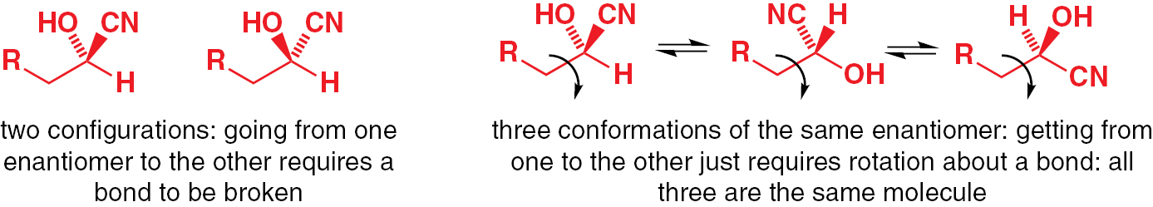
CHE 105
Configuration and Conformation
To change a configuration, bonds must be broken
To change a conformation, bonds must be rotated

Slide 36
CHE 105
How can you assign if a stereogenic center is R or S? The rules
1. Determine priority by atomic numbers
CIP rules

Slide 37

CHE 105
How can you assign if a stereogenic center is R or S? The rules
1. Determine priority by atomic numbers

Slide 38
CHE 105
How can you assign if a stereogenic center is R or S? The rules
1. Determine priority by atomic numbers
2. Rotate the molecule so as Nº4 to point away from you

Slide 39
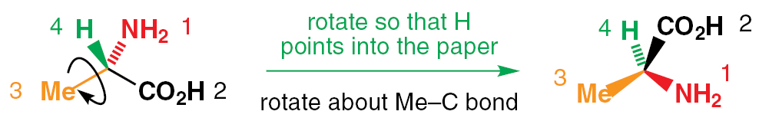
CHE 105
How can you assign if a stereogenic center is R or S? The rules
1. Determine priority by atomic numbers
2. Rotate the molecule so as Nº4 to point away from you

Slide 40
CHE 105
How can you assign if a stereogenic center is R or S? The rules
1. Determine priority by atomic numbers
2. Rotate the molecule so as Nº4 to point away from you
3. If the movement 1 → 2 → 3 is clockwise, then the configuration is R
If it is counterclockwise, then the configuration is S

Slide 41
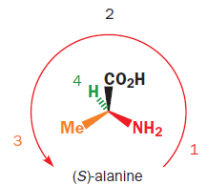
CHE 105
How can you assign if a stereogenic center is R or S? The rules
1. Determine priority by atomic numbers
2. Rotate the molecule so as Nº4 to point away from you
3. If the movement 1 → 2 → 3 is clockwise, then the configuration is R
If it is counterclockwise, then the configuration is S

Slide 42
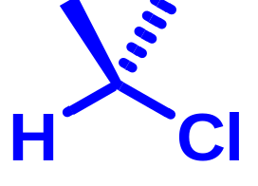
CHE 105
Can you assign if the stereogenic center is R or S? Examples

Slide 43
CHE 105
Can you assign if the stereogenic center is R or S? Examples
No stereogenic center

Slide 44
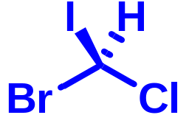
CHE 105
Can you assign if the stereogenic center is R or S? Examples
No stereogenic center

Slide 45
CHE 105
Can you assign if the stereogenic center is R or S? Examples
1
No stereogenic center

Slide 46
CHE 105
Can you assign if the stereogenic center is R or S? Examples
1
2
No stereogenic center

Slide 47
CHE 105
Can you assign if the stereogenic center is R or S? Examples
1
2
3
No stereogenic center

Slide 48
CHE 105
Can you assign if the stereogenic center is R or S? Examples
1
4
2
3
No stereogenic center

Slide 49

CHE 105
Can you assign if the stereogenic center is R or S? Examples
1
4
2
3
No stereogenic center

Slide 50
CHE 105
Can you assign if the stereogenic center is R or S? Examples
1
4
2
3
No stereogenic center
S

Slide 51
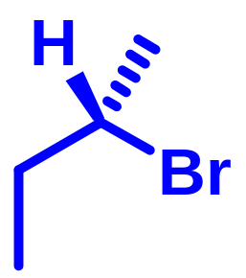
CHE 105
Can you assign if the stereogenic center is R or S? Examples
1
4
2
3
No stereogenic center
S

Slide 52
CHE 105
Can you assign if the stereogenic center is R or S? Examples
1
4
2
3
No stereogenic center
S
1

Slide 53
CHE 105
Can you assign if the stereogenic center is R or S? Examples
1
4
2
3
No stereogenic center
S
2
1

Slide 54
CHE 105
Can you assign if the stereogenic center is R or S? Examples
1
4
2
3
No stereogenic center
S
3
2
1

Slide 55
CHE 105
Can you assign if the stereogenic center is R or S? Examples
1
4
2
3
No stereogenic center
S
4
3
2
1

Slide 56
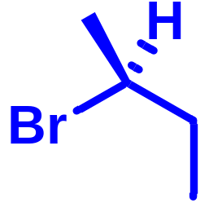
CHE 105
Can you assign if the stereogenic center is R or S? Examples
1
4
2
3
No stereogenic center
S
4
3
3
4
2
1
2
1
S

Slide 57
CHE 105
Can you assign if the stereogenic center is R or S? Examples
1
4
2
3
No stereogenic center
S
4
3
3
4
2
1
2
1

Slide 58
CHE 105
Can you assign if the stereogenic center is R or S? Examples
1
4
2
3
No stereogenic center
S
4
3
3
4
2
1
2
1
S

Slide 59


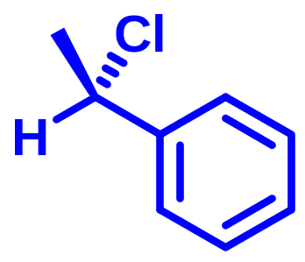
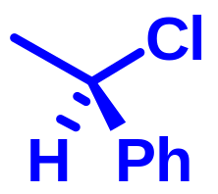
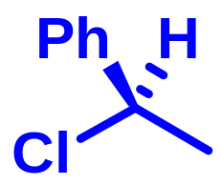
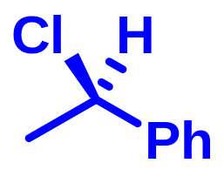


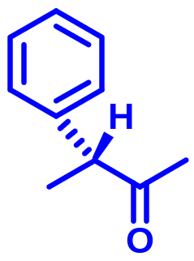
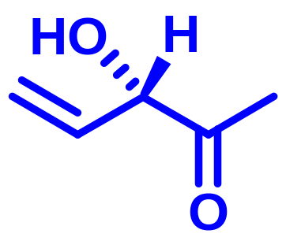
CHE 105
Can you assign if the stereogenic center is R or S? Examples
3
1
1
4
4
2
3
2
R
1
4
2
4
3
1
3
2
R since H is outwards
S since H is outwards

Slide 60
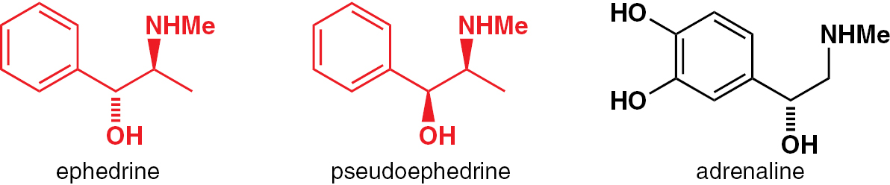
CHE 105
Can you assign if the stereogenic center is R or S? Examples

Slide 61
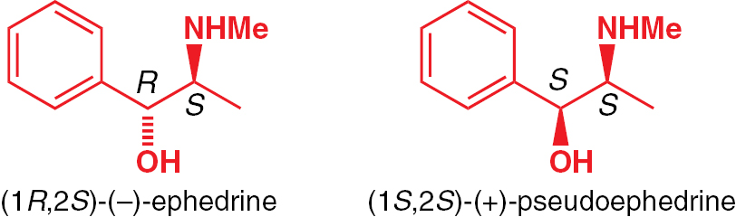
CHE 105
Can you assign if the stereogenic center is R or S? Examples

Slide 62
CHE 105
Can you assign if the stereogenic center is R or S? Examples

Slide 63
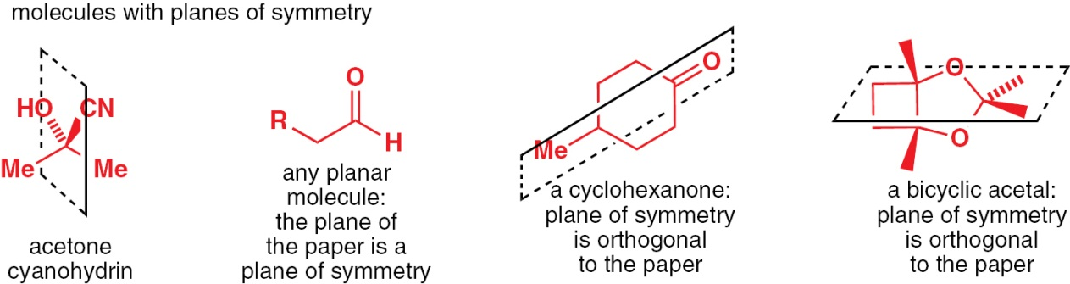
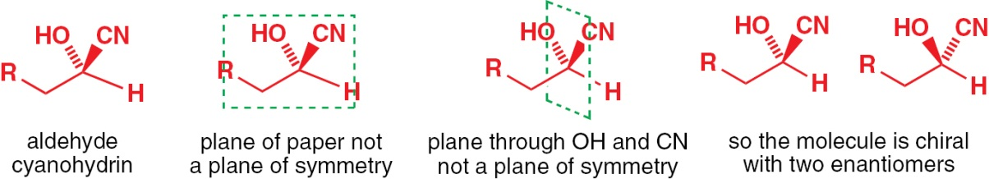
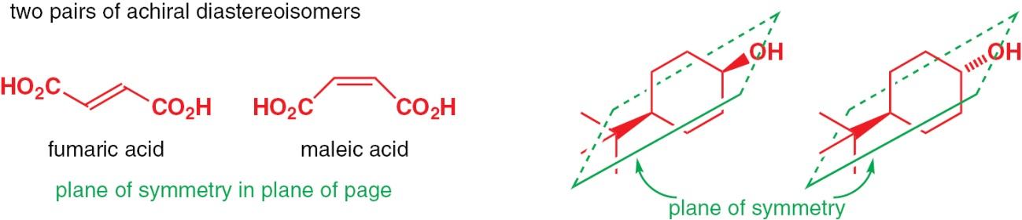
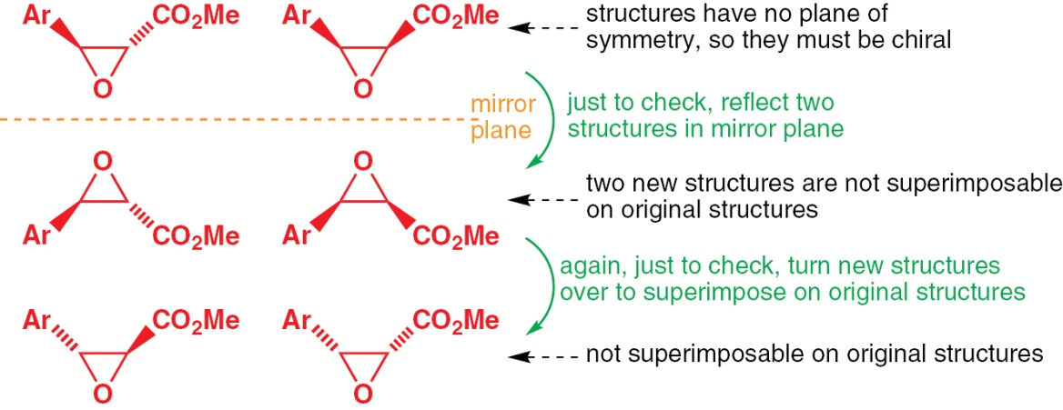
CHE 105
Plane of symmetry

Slide 64
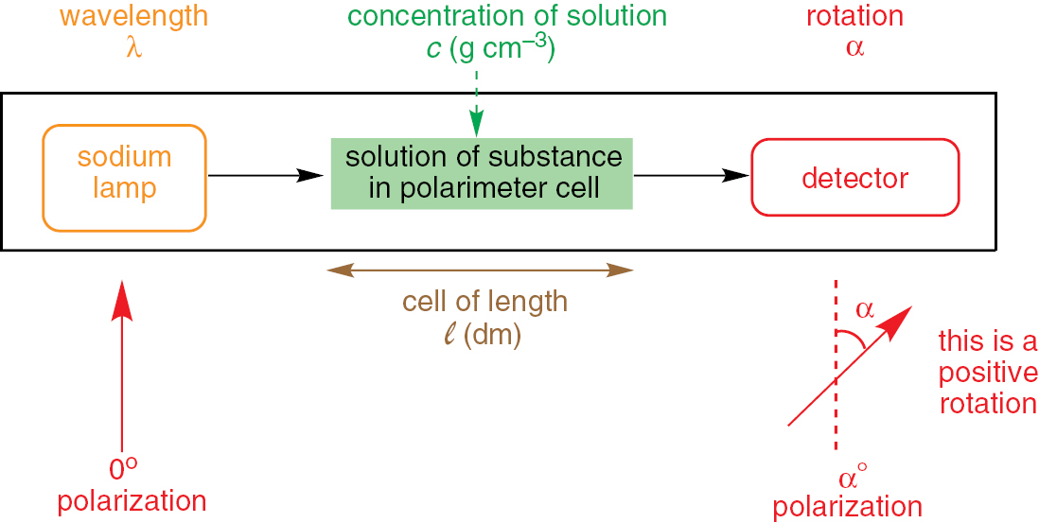
Optical Activity
CHE 105
Chiral molecules are optically active: They rotate the plane-polarized light
Specific rotation

Slide 65




CHE 105
Plane-polarised light

Slide 66


CHE 105
Relationship between (+) and (-), D and L enantiomers, R and S configuration
R and S configuration is defined by the structure, using the rules we have seen
The (+) or d-isomer rotates the plane-polarized light clockwise: dextrorotation (from Latin dexter=right)
The (-) or l-isomer rotates the plane-polarized light counterclockwise: laevorotation (from Latin laevus=left)
D and L nomenclature is used mainly for carbohydrates and amino acids
L-alanine

Slide 67

CHE 105
Diastereoisomers are stereoisomers that are not enantiomers

Slide 68



CHE 105
Meso compounds

Slide 69

CHE 105
Fisher Projections

Slide 70



CHE 105
Conformational Isomers-Newman Projections
Newman projection
Sawhorse projection

Slide 71


CHE 105
Resolution by using covalent diasteroisomers

Slide 72

CHE 105
Resolution by using non-covalent diasteroisomers

Slide 73


CHE 105
Resolution by column chromatography

Slide 74
CHE 105
Summary
Three-dimensional shape of molecules
Molecules with mirror images
Molecules with symmetry
How to separate mirror-image molecules
Diastereoisomers
Shape and biological activity
How to draw stereochemistry

Slide 75
Homework 11
CHE 105
Answer the Questions 1, 5, 6 of Chapter 14
Deadline: 17/12/2018, 16:00
Study Chapter 14 in textbook!

