Slide 1

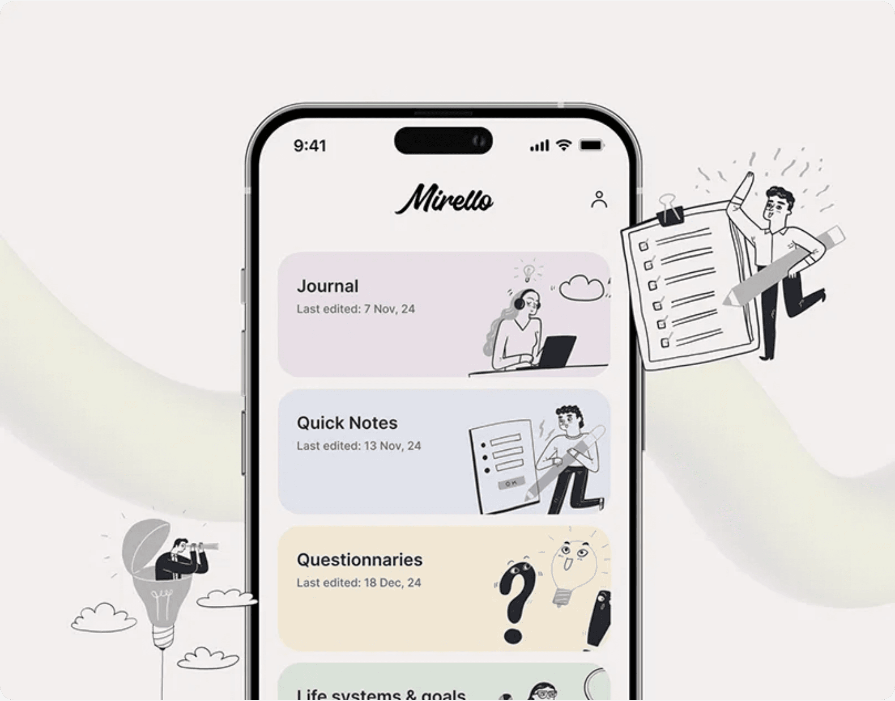
DiaryPro: A Day In My Life Journal
A Full-Stack Web Application for Personal Reflection and Mood Tracking

Slide 2

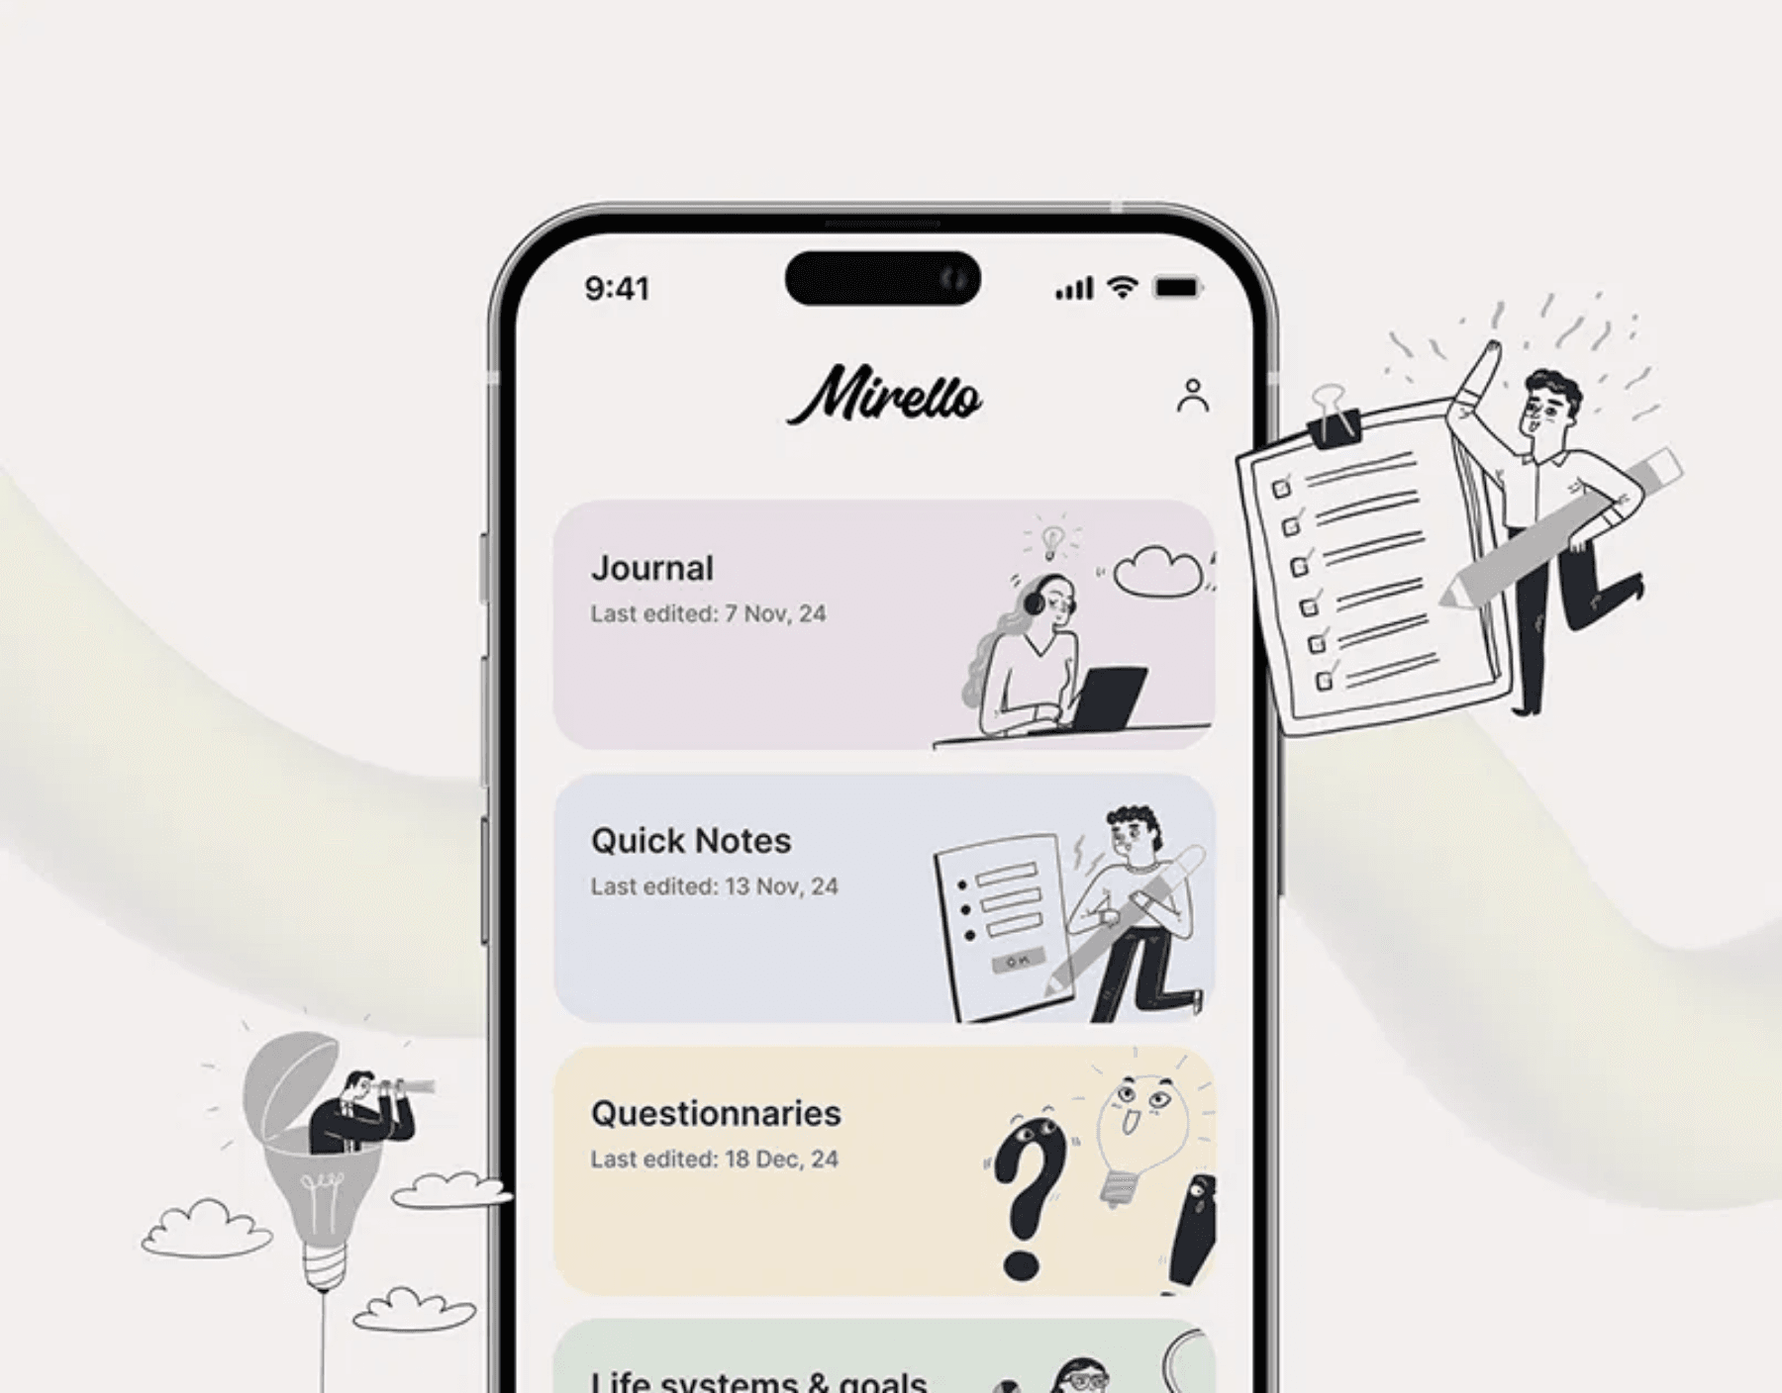
The Challenge: Documenting Life and Tracking Wellness
Business & User Group
DiaryPro serves individuals who seek a private, secure, and multimedia-rich platform for daily journaling and self-reflection. Our target users value mental wellness and personal growth.
The Problem
Traditional journaling is often static and lacks analytical capabilities. DiaryPro solves the problem of fragmented memory and untracked emotional patterns by providing a centralized, digital, and analytical journal.
User Roles
Registered User: Full access to entries, profile, and mood analytics.
Guest User: Limited view of sample entries and quotes for demonstration purposes.

Slide 3
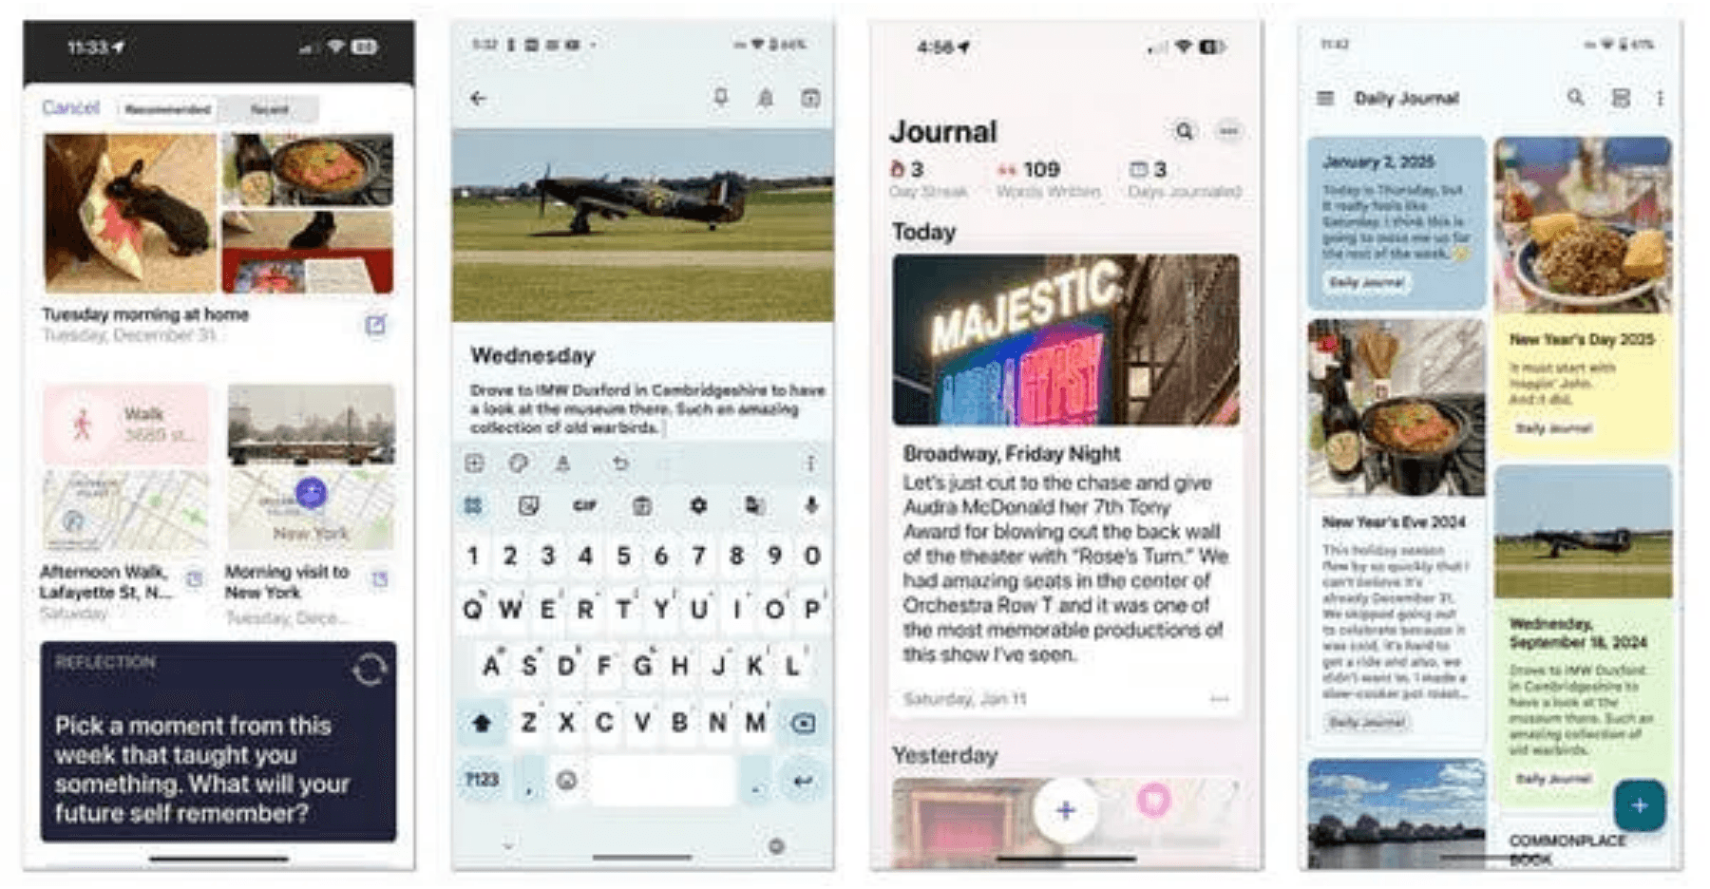
Key Functions: Enabling Comprehensive Personal Documentation
1
Secure User Authentication & Profile Management
Users can sign up, log in, and manage their profiles securely using Supabase Auth.
2
Multimedia Entry Management (CRUD)
Users can Create, Read, Update, and Delete daily entries, supporting text, images, audio, and video uploads.
3
Mood Tracking & Insights
Users can tag entries with moods, and the system provides visual analytics to track emotional trends over time.
4
Dynamic Content & UI
The application features a dynamic calendar dashboard and motivational quotes, utilizing modern client-server communication (AJAX/fetch).

Slide 4

Robust 3-Tier Architecture with Modern Separation of Concerns
Presentation Tier (Client)
1
User Interface & Interaction
Handles all user-facing elements and interactions. Built with standard HTML5, CSS3, and JavaScript for a responsive, accessible experience.
Technologies: HTML5, CSS3, JavaScript
↓
Application Tier (Server)
2
Business Logic & Data Processing
Manages business logic, data validation, authentication, and secure communication between the client and database using server-side scripting.
Technologies: PHP (Server-Side Scripting)
↓
Data Tier (Database)
3
Persistent Data Storage & Security
Provides secure, relational data storage with built-in Row Level Security (RLS) policies. Ensures data integrity through foreign keys, indexes, and triggers.
Technologies: Supabase, PostgreSQL, SQL

Slide 5

Implementation Details: A Modern, Scalable Stack
Frontend Technologies
Database & Backend
Standard HTML5, CSS3, and JavaScript for client-side rendering and interaction.
PHP for server-side logic and Supabase (PostgreSQL) for data persistence.
Programming Languages
Data Model
PHP (Server-Side), JavaScript (Client-Side), HTML, CSS, SQL (Database Schema).
Relational structure with tables for moods, entries, and media_files, linked by Foreign Keys.
PHP

Slide 6

AI in Development: Enhancing Design and Ensuring Responsibility
AI Tool & Application
Tool:
Large Language Model (LLM) used for UI generation and code scaffolding.
Application:
The detailed UI specification in UI.md a prompt used to generate initial code for the previous stack. This prompt informed the design and structure of was the current PHP/CSS/HTML implementation.
Responsible AI Reflection
Benefits of AI Integration
Accelerated the initial design phase and ensured a high-quality, consistent UI/UX standard. The AI tool provided a rapid design blueprint that was translated into the current stack.
Responsible Practices
The AI was used as a tool for design and scaffolding, not for critical business logic or data handling. All code, including the current PHP/CSS/HTML implementation, was subject to human review and integration, ensuring transparency and accountability.

Slide 7

Live Demonstration: A Day in the Life of a DiaryPro User
A registered user logs in to DiaryPro, reviews their mood trends on the dashboard, and creates a new multimedia entry for the day, tagging it with a mood. The system reflects the new entry in real-time across the interface.
1
Login as Registered User
2
Navigate to Dashboard/Calendar
User enters credentials and authenticates via Supabase Auth.
User views the monthly calendar with highlighted entry dates and recent events list.
3
Create a New Entry
4
View Entry in Recent Events
User writes journal text, uploads an image, and selects a mood tag (e.g., Happy, Motivated).
The new entry appears immediately in the recent events list on the dashboard.
5
Show Insights Page
User navigates to the Insights page to view mood analytics and emotional trends over time.

Slide 8

Summary and Next Steps
Project Summary
DiaryPro successfully delivers a secure, full-stack journaling application built with PHP for server-side logic and Supabase for data management. The application provides users with a comprehensive platform for personal reflection, mood tracking, and emotional analysis, all while maintaining the highest standards of data security and privacy through Supabase Row Level Security policies.
Future Work & Enhancements
→
Audio and Video Entry Support
Expand multimedia capabilities to fully utilize the schema's support for audio and video files, enabling users to record voice memos and video reflections alongside text entries.
→
Social Sharing Features
Implement optional, privacy-controlled sharing capabilities that allow users to share selected entries or insights with trusted friends or communities while maintaining strict data privacy controls.
→
Dedicated Mobile Application
Develop native iOS and Android applications to extend DiaryPro's accessibility, enabling users to journal on-the-go with offline support and push notifications for daily reflection reminders.

Slide 9

Thank You
Questions & Discussion

