Slide 1

Decision Tree Algorithm
12.12.2025
Akademia Górniczo-Hutnicza im. Stanisława Staszica w Krakowie
AGH University of Krakow

Slide 2
Comparison
Decision tree
Random forest
Good for simple problems with strongly diversified data
Easily does overfitting fenomenon
Easy to understand
Prediction
One tree’s decision
Regression
Colection of decision trees
Every tree trained on bootstrap subset of data
Prediction:
Tree’s majority decision
Regression

Slide 3
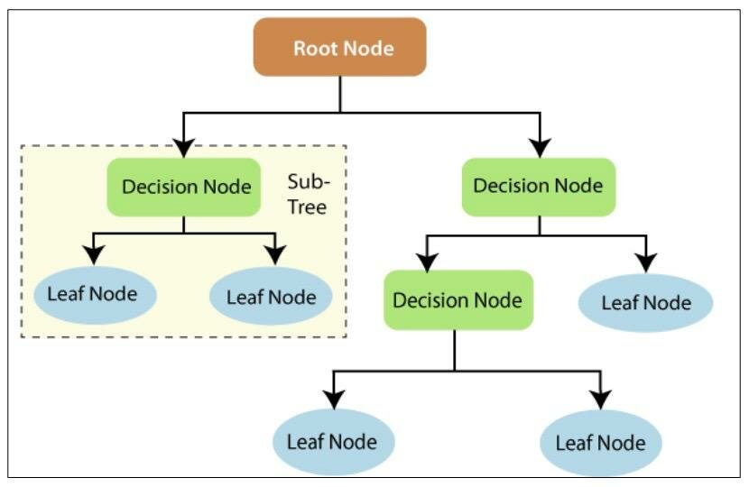
How does it look like?
Tree visualization
Description
Root node – main node of the tree (where it begins)
Decision node – more data to divide
Leaf node – no more data to divide

Slide 4
How does it work?
Algorithm explanation
Tree visualization
Algorithm looks for the best threshold to split data in a node by iterating through a dataset and finds the best condition to ensure the best possible gain (it purefies nodes as much as possible)
Divides data in two based on a condition
Builds and expands tree
Process recursively repeats until there is no more gain in a node

