Slide 1



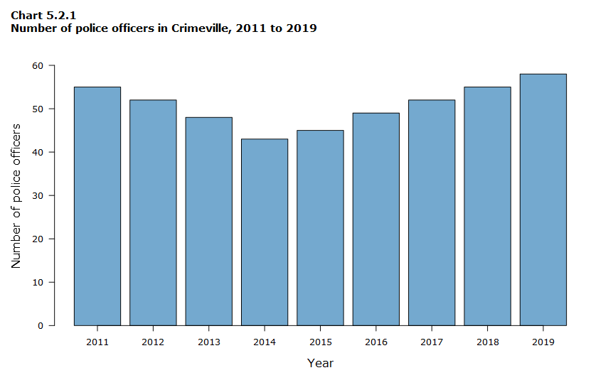

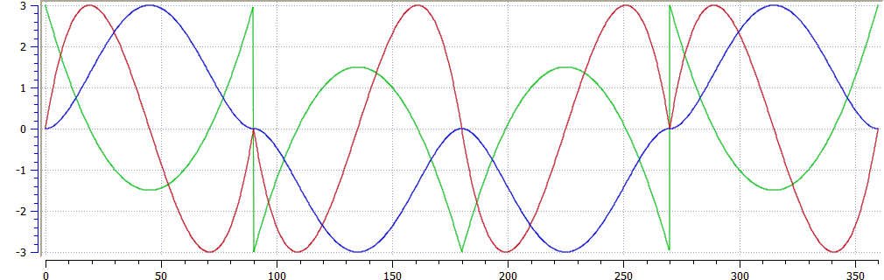


Temperature Sensors Hub
Download the data
Download
20 °C ± 1
25 °C ± 2
15 °C ± 6
Block 1
Block 2
Block 3
Last readings by block
Block 1
Block 2
Block 3
22 °C
Device 3
18 °C
Device 5
Not different
Temperature curves
By block
Mean of blocks
Hour
Day
Week
Month
Block 1
Block 2
Block 3
This tool was developed by the Ciampitti Lab Group

