Slide 1
Nutshell Stuff

Slide 2
What is a class?

Slide 3
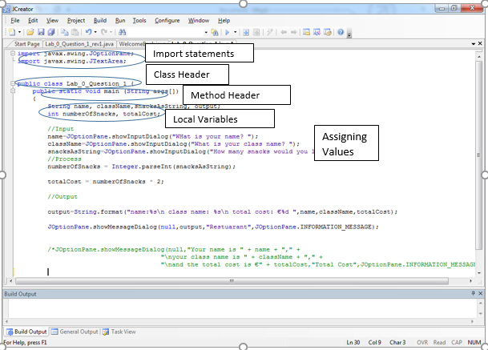
Program parts

Slide 4
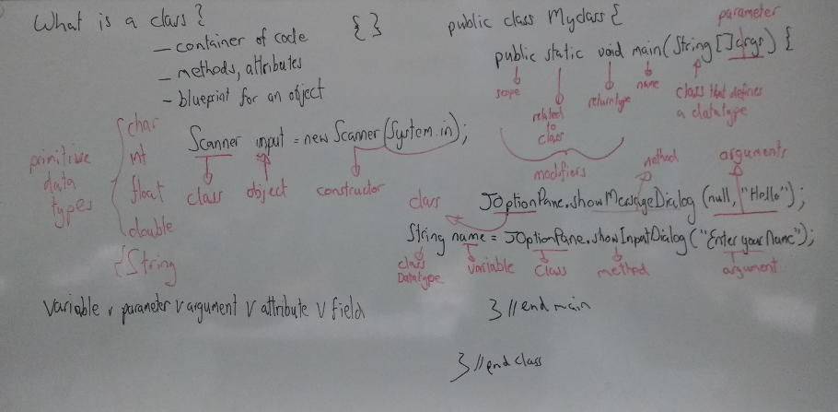

Slide 5
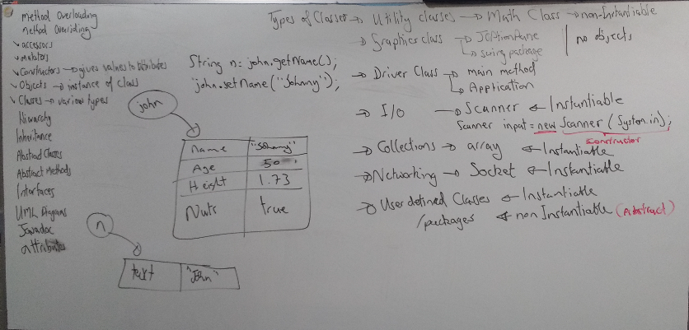
Types of Classes

Slide 6
Concepts of OOP
Encapsulation is the act of providing a public interface and hiding the implementation details. e.g. private attributes, API classes.
Abstraction is the concept of exposing only the required essential characteristics and behavior with respect to a context. e.g user designed class, interfaces, abstract methods.
Inheritance allows classes to inherit commonly used state (non- private attributes) and behaviour (methods) from other classes.
Polymorphism allows a method or object to have multiple forms (change) e.g. all animals ‘move’ but all species do it differently.

Slide 7
What is a method?
A Java method is a collection of statements that are grouped together to perform an operation. When you call the JOptionPane.showMessageDialog method, for example, the system actually executes several statements in order to display a message on the console.

Slide 8
Method Syntax
Method header example
public static void myMethod(String a, int b) { statements }
public static − modifier
void − return type
methodName − name of the method
a, b − formal parameters
int a, int b − list of parameters
Syntax
Modifiers returnType methodName (parameter list){ body}

Slide 9
modifier − It defines the access type of the method and it is optional to use.
returnType − Method may return a value.
nameOfMethod − This is the method name. The method signature consists of the method name and the parameter list.
Parameter List − The list of parameters, it is the type, order, and number of parameters of a method. These are optional, method may contain zero parameters.
method body − The method body defines what the method does with the statements.

Slide 10
Method example
public static int minFunction(int n1, int n2) {
int min;
if (n1 > n2)
min = n2;
else
min = n1;
return min;
}

Slide 11
public class ExampleMinNumber {
public static void main(String[] args) {
int a = 11;
int b = 6;
int c = minFunction(a, b);
System.out.println("Minimum Value = " + c);
}
/** returns the minimum of two numbers */
public static int minFunction(int n1, int n2) {
int min;
if (n1 > n2)
min = n2;
else
min = n1;
return min;
}
}
Method call
Note use of static in
Method header
This implies a class method

Slide 12
Methods
http://www.tutorialspoint.com/java/java_methods.htm

Slide 13
What is an object?
An instance of a class??

Slide 14
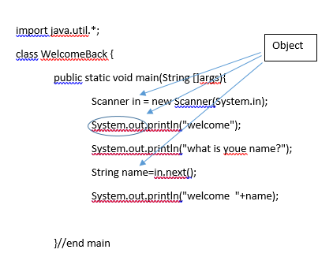
Objects, can you recognise one?

Slide 15
An Instantiable Class
Attributes
Methods
Constructors
Accessors
Mutators
toString
Overloading/Overriding

Slide 16
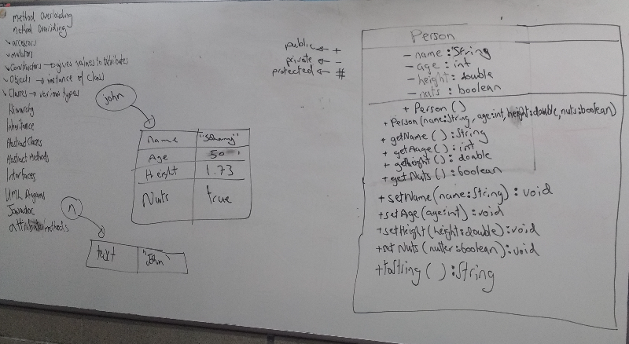
UML Class Diagram

Slide 17
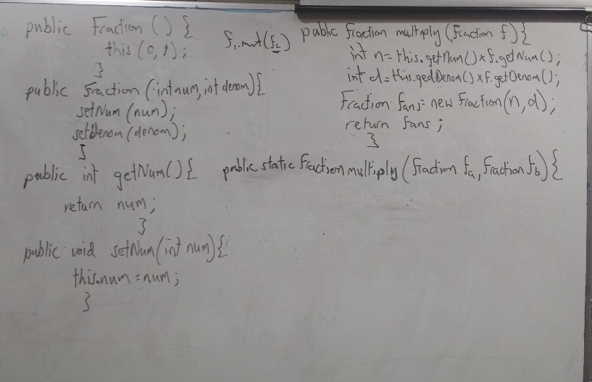
Partial Fraction class

Slide 18

Inheritance (Extract from the Oracle Java Tutorials)

Slide 19
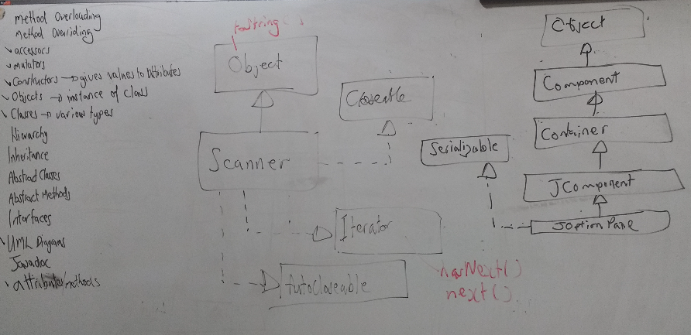
UML/Class Hierarchy API

Slide 20
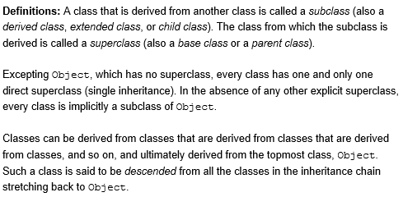
(Extract from the Oracle Java Tutorials)

Slide 21
Interface (Extract from the Oracle Java Tutorials)
There are a number of situations in software engineering when it is important for disparate groups of programmers to agree to a "contract" that spells out how their software interacts. Each group should be able to write their code without any knowledge of how the other group's code is written. Generally speaking, interfaces are such contracts.
For example, imagine a futuristic society where computer-controlled robotic cars transport passengers through city streets without a human operator. Automobile manufacturers write software (Java, of course) that operates the automobile—stop, start, accelerate, turn left, and so forth. Another industrial group, electronic guidance instrument manufacturers, make computer systems that receive GPS (Global Positioning System) position data and wireless transmission of traffic conditions and use that information to drive the car.
The auto manufacturers must publish an industry-standard interface that spells out in detail what methods can be invoked to make the car move (any car, from any manufacturer). The guidance manufacturers can then write software that invokes the methods described in the interface to command the car. Neither industrial group needs to know how the other group's software is implemented. In fact, each group considers its software highly proprietary and reserves the right to modify it at any time, as long as it continues to adhere to the published interface.

Slide 22
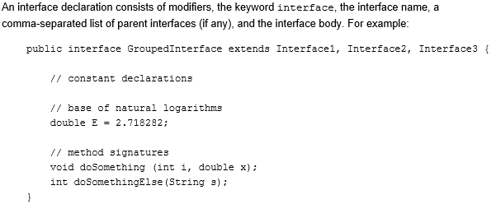
Defining an Interface (Extract from the Oracle Java Tutorials)

Slide 23
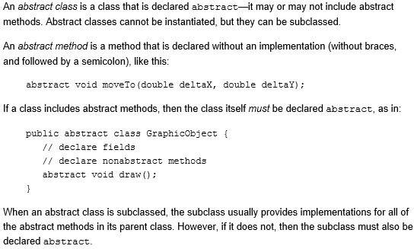
Abstract Methods and Classes (Extract from the Oracle Java Tutorials)

