Slide 1
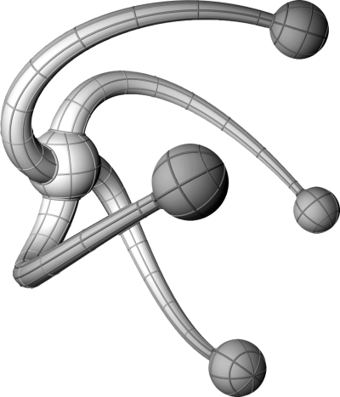

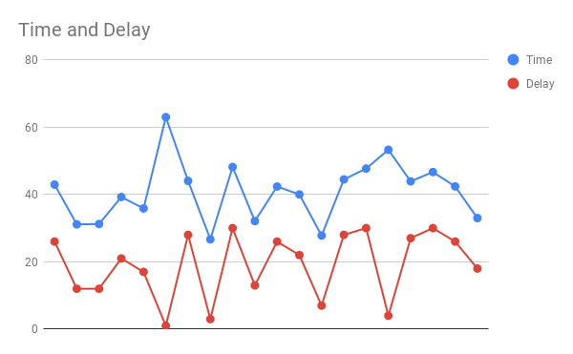
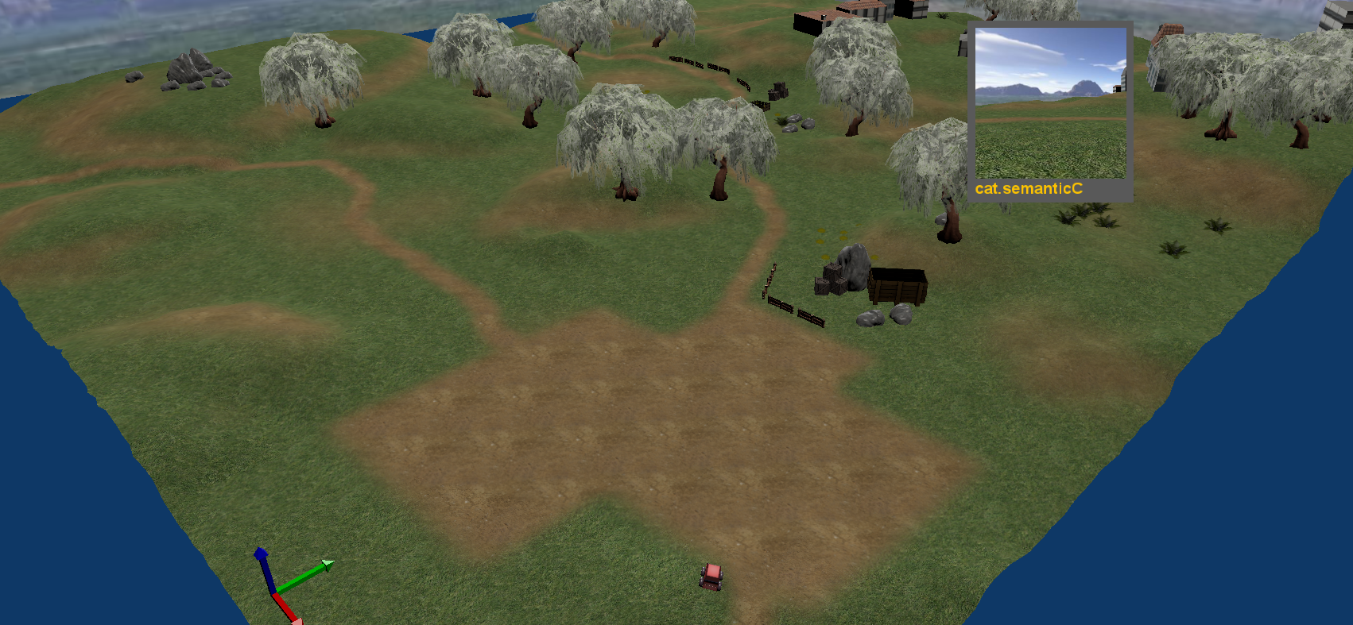
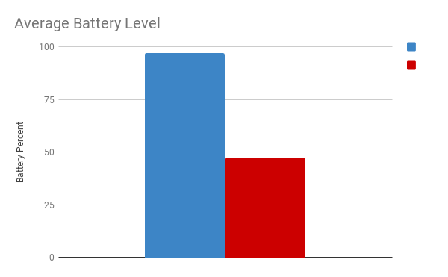
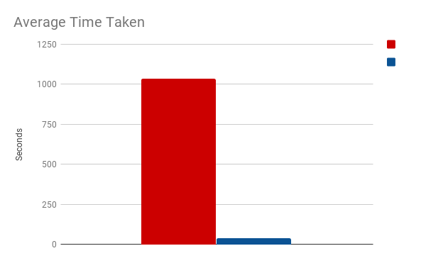
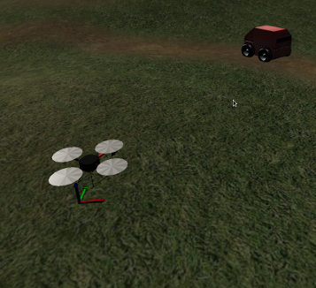
Risk-based Triggering of Bio-inspired Self-Preservation to Protect Robots from Threats
Ciara Gardiner
Supervisor: Prof. Kerstin Eder
Department of Computer
Science
Establish the most biologically sound
methods of escape from pursuit via a literature
review.
Create, simulate and test a proposal for
feasible anti-vandalism or damage preventive
safety mechanisms, that complement and
preserve human safety.
Previous project found the best self-defence strategy for
a ground-based delivery robot is fleeing and hiding
Generally agreed that animals tend to flee when the risk
of remaining is greater than its benefits
Animals calculate an ideal flight initiation distance based
on the level of risk they face
Aim
Objectives
State of the Art
Asses animal behaviour when under threat from prey
and apply the same
principles to delivery robots
with a particular focus
on flight initiation distance
and how animals calculate
when the cost of remaining
outweighs the cost of fleeing
Building and Testing platform: Morse
Main tools:
Flying Cat and Mouse Game
Proximity Sensor, Battery Sensor, Motion Sensor, Collision Sensor
“Outdoor” Blender world
When would a robot need to activate self-defence
mechanisms?
Based on a scenario where a mal-intentioned cautious drone is
pursuing a ground based drone.
Drone attempting to steal entire robot including contents
How can a robot accurately imitate biological anti-predator
behaviours?
Key traits involve accurately assessing risk
Robot must be able to determine
when continuing with its task is higher
risk than fleeing, based on its priorities
How will the scenarios be deployed?
Two robots; one focused on task-completion and not consuming too
much energy; one focused on survival with no regard for energy
Robots will be given reaction of fleeing and hiding when self-defence
mechanisms are activated
When drone is within 10cm of the robot it will be counted as a capture
Methods and Tools
Results
Persistent robot – correlation between starting delay and simulation time.
Type of Robot | Cautious | Reckless
Priorities | Self-preservation: -Survive encounter | Efficiency: - Conserve energy - Complete task quickly
Reactions | - 30m flight initiation distance - Remain in refuge until drone leaves | - 5m flight initiation distance - Remain in refuge for 30 seconds
Comparison of average time and battery consumption between robots
Robots who are more focused on safety tend to be more successful in
avoiding the drone.
Robots who are more focused on battery saving tend to conserve more
energy by the end of the encounter.
Robots who are more focused on battery saving tend to complete their
mission more quickly if they avoid capture.
It is necessary for a robot to be balanced in terms of its priorities in order
to have the best chance of completing its task and surviving a predatory
encounter. Overly persistent robots have very little chance of surviving an
encounter whereas overly cautious robots generally complete the task
with battery levels below 50%.
 | Reached Goal | Reached Hiding Place | Average time take | Average battery usage
Reckless Robot | 4% | 10% | 39.9579 (secs) | 2.60328%
Conclusions
Introduce element of machine learning so robot does not need to be
hardcoded with responses – especially with a fleet of robots
Replicate these tests in a series of different environments with different
obstacles and start and end points
Carry out similar testing on physical robots to ensure simulated
environment does not affect results
Examine self-defence mechanisms when robots face other threats,
e.g .tampering animals or children
Future Work
Risk-based Triggering of Bio-inspired Self-Preservation to Protect Robots fromThreats, Sing-Kai Chiu, Dejanira Araiza-Illan, and Kerstin Eders
Stankowich, T., Coss, R.G.: Eﬀects of predator behavior and proximity on risk assessment bycolumbian black-tailed deer. BehavioralEcology 17(2), 246–254 (2006)
Mart´ın, J., Lo´pez, P.: When to come out from a refuge: risk-sensitive and statedependent decisionsn an alpine lizard. Behavioral Ecology 10(5), 487–492 (1999)
References

