Slide 1
Transformer-Based Electricity
Consumption Forecasting
Multivariate time-series forecasting of household electricity demand
William Peng · Ciara Cameron · Christopher Pedretti
MSML612 — Deep Learning | Final Project | August 2026
Notes:
0:00–0:30 · SPEAKER 1 (suggested: intro + data) CUE: Introduce team and topic in one line. SCRIPT: Good evening — we're William, Ciara, and Chris, and our project is forecasting household electricity demand one hour ahead with a Transformer. The one-line version: deep models in forecasting are often never compared to the forecast you get for free — so we built that comparison in from the start, and we'll show you a live demo of the model beating it.

Slide 2
Introduction — The Problem
Why household-level load forecasting is hard
Electricity cannot be stored cheaply at grid scale — supply must match demand continuously.
Short-term load forecasting drives generation scheduling, demand-response, and home battery dispatch.
Aggregate demand is smooth: thousands of appliance events average out.
A single household is spiky and heavy-tailed — a few discrete, high-draw events dominate.
The variance that matters operationally lives in the peaks, not the daily rhythm.
Our question
Does self-attention capture enough structure in single-household demand to beat the forecasts available for free?
2.08M
4 yrs
raw minute-level readings
of continuous metering
Notes:
0:30–1:45 · SPEAKER 1 CUE: Aggregate-vs-household is why this is hard and why R² is not 0.95. Land the framing question: the bar is 'better than free', not 'low error'. SCRIPT: Why is this hard? Electricity can't be stored cheaply at grid scale, so supply has to match demand continuously — that's why short-term load forecasting drives generation scheduling, demand response, and battery dispatch. But there's a scale problem. National demand curves are smooth, because millions of appliance events average out. One household is the opposite: the series is spiky and heavy-tailed, dominated by a handful of discrete events — an oven, a washing machine, a water heater. The variance that matters operationally lives in those peaks, not in the daily rhythm. So our question is deliberately narrow: does self-attention capture enough structure in a single household's demand to beat the forecasts available for free? Four years of minute-level data, two million readings — and the bar is not 'low error'. The bar is 'better than free', because a model that can't clear that bar has no reason to exist.

Slide 3
Data Preparation
UCI Individual Household Electric Power Consumption
1
Clean & index
2
Resample hourly
3
Calendar features
4
Split & interpolate
5
Scale
Combine date/time into a timestamp index, coerce to numeric, and drop duplicate timestamps.
Convert minute-level readings to hourly means: 2.08M rows → 34,589 hours.
Add sine/cosine encodings of hour, day, and month plus a weekend flag. 7 measured + 7 derived = 14.
Split 70/15/15 chronologically, then time-interpolate missing hours independently within each split.
Fit StandardScaler on training data only; transform validation and test using the training statistics.
Why chronological splitting matters
Neighbouring hours are highly correlated. A shuffled test set would mostly contain hours whose immediate neighbours the model has already seen — reported performance would measure interpolation, not forecasting.
Notes:
1:45–3:15 · SPEAKER 1 CUE: Walk the pipeline quickly; spend the time on the split/scaling box — that is what a grader will probe. Expect a question here. SCRIPT: The data is the UCI Individual Household Electric Power Consumption set: one house near Paris, December 2006 to November 2010, seven electrical measurements every minute. About one and a quarter percent of rows have missing values, marked with question marks. The pipeline: parse timestamps, resample to hourly means — which absorbs most minute-level gaps and cuts two million rows to thirty-five thousand hours — then add seven calendar features: sine-cosine encodings of hour, day-of-week, and month, plus a weekend flag. Sine-cosine because hour 23 and hour 0 are neighbours in reality, and an integer encoding would put them at opposite ends. Three methodology points we were strict about. The split is chronological — never shuffled — because neighbouring hours are nearly identical, and a shuffled split grades interpolation, not forecasting. Scalers are fit on the training split only. And gap interpolation runs after the split, separately per split — run it before, and hours next to the boundary get filled using data from the other side. We actually caught that one in our own pipeline and fixed it; the numbers you'll see are from the clean run.

Slide 4
Proposed Solution
An encoder-only Transformer, and an evaluation designed to be falsifiable
Attention over recurrence
Built for daily patterns
In an LSTM, hour 1 of the window reaches the prediction through 23 sequential state updates. Self-attention connects any two positions in one operation — constant dependency length regardless of separation.
Electricity use usually follows some type of daily pattern, so the previous hour is not always the most helpful for predicting what comes next. With a 24-hour window, the model can look back across the full day, including the same hour yesterday.
Pre-norm encoder layers
Falsifiable evaluation
LayerNorm before each sublayer rather than after: better-conditioned gradients at initialisation, no warmup schedule required.
We report skill against naive persistence, not metrics in isolation. If the model cannot beat repeating the last hour, it is not worth its complexity.
Notes:
3:15–4:45 · SPEAKER 2 (suggested: solution + architecture) CUE: The novelty slide — 3 rubric points. Not 'we used a Transformer'; the argument is attention fits this data for a specific reason, and the evaluation could have proven us wrong. SCRIPT: Our solution has two halves, and the second is as deliberate as the first. The model is an encoder-only Transformer. Why attention for this data? In a recurrent model, information from the far end of the input window reaches the prediction only after passing through twenty-three sequential state updates, decaying at each step. Attention connects any two hours in one step. That matters here because the most informative context is often not the last hour. Within our 24-hour window, the model can look back across the full day, including the same hour yesterday. The second half is the evaluation. We committed upfront to three reference forecasters — persistence, seasonal naive, and the mean, plus a comparably sized LSTM control, and ablations over the main design choices you'll see on the architecture slide. The literature is full of Transformer results that evaporate against simple baselines — Zeng et al. showed that in 2023. So we designed the evaluation to be falsifiable: if attention wasn't earning its complexity here, this setup would have said so.

Slide 5
Tools and Technologies
PyTorch 2.x
scikit-learn
pandas + NumPy
nn.TransformerEncoder, custom positional encoding, Adam, ReduceLROnPlateau
StandardScaler fit on training split, MAE / MSE metrics
Resampling, time-weighted interpolation, cyclical feature engineering
Matplotlib
Streamlit
Git + GitHub
All figures generated from one shared styling module
Live inference demo running on CPU
Public repo, version-bounded requirements, per-run history JSON
Notes:
4:45–5:15 · SPEAKER 2 CUE: Move fast. One rubric point; do not dwell. SCRIPT: Quickly on tooling: PyTorch for the model and training loop, pandas and scikit-learn for the pipeline, matplotlib for figures, and Streamlit for the live demo you'll see in a few minutes. Everything is seeded and version-controlled, every training run writes a history file, and the whole repo reproduces from two commands — train, evaluate.

Slide 6
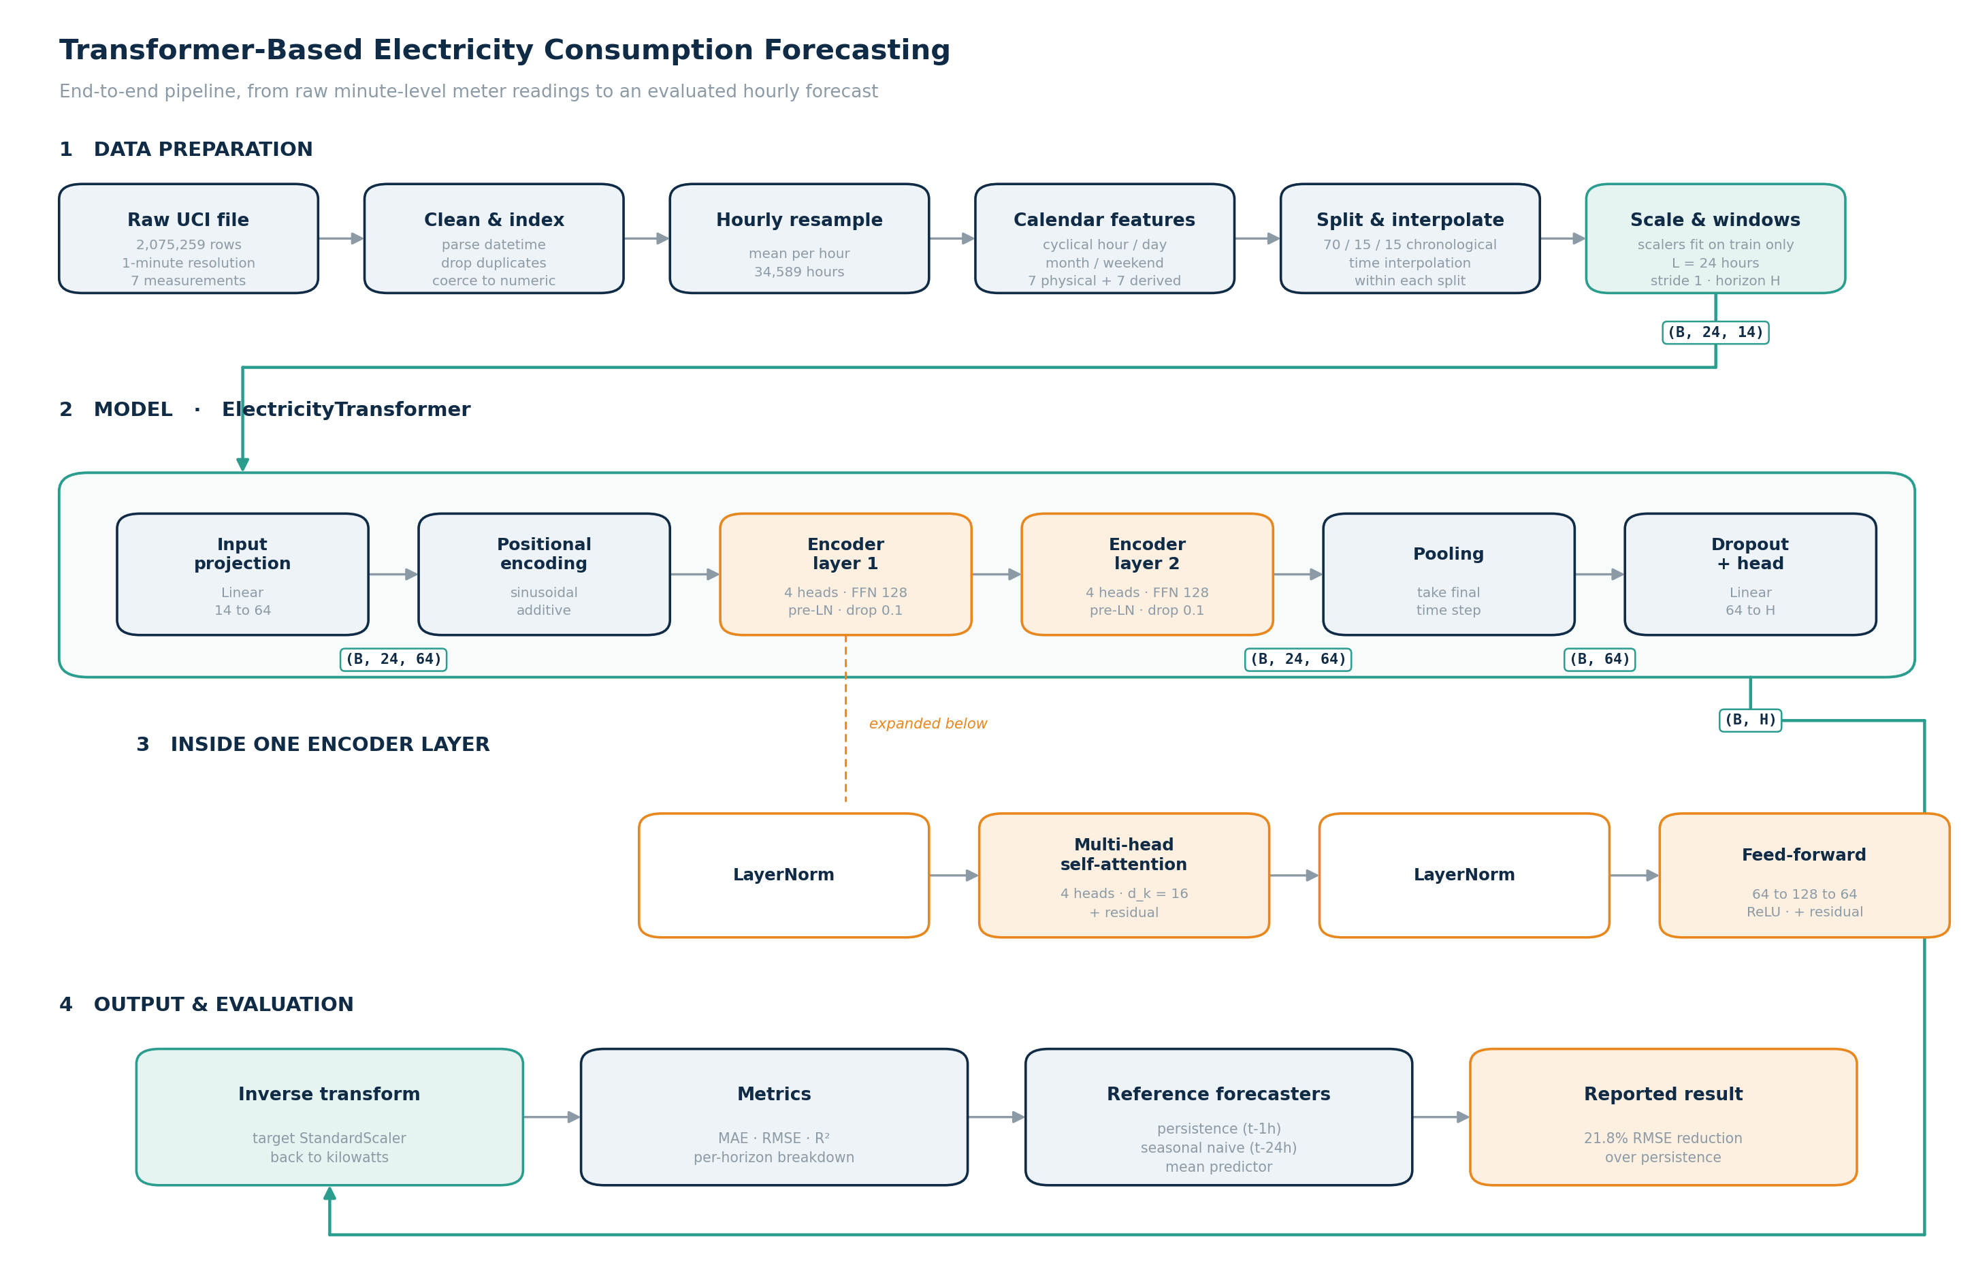
Architecture Diagram
Notes:
5:15–7:00 · SPEAKER 2 CUE: Two rubric points — highest-value slide per second. Trace the path out loud, call out tensor shapes: they show you understand the data flow, not just the diagram. SCRIPT: Let me trace one batch through the diagram, with shapes. Input: a window of 24 hours by 14 features — seven measured, seven calendar. A linear projection lifts each hour to 64 dimensions, so the tensor is batch by 24 by 64. Attention is permutation-invariant — it has no idea hour one comes before hour two — so we add fixed sinusoidal positional encodings; same shape. Then two encoder layers. Each has four attention heads — sixteen dimensions per head — a 128-unit feed-forward, and dropout of 0.1. One detail that matters: layer norm goes before each sublayer, not after — pre-norm, from Xiong et al. — which keeps gradients well-conditioned without a warmup schedule. Out of the encoder: still batch by 24 by 64. We pool by taking the final time step — batch by 64 — then dropout and a linear head to a single number: next hour's load in standardized units, inverted back to kilowatts for every metric you'll see. Total: sixty-eight thousand trainable parameters. That's small on purpose — with about twenty-four thousand training hours, our larger model variants performed worse, which the capacity ablation confirms.

Slide 7
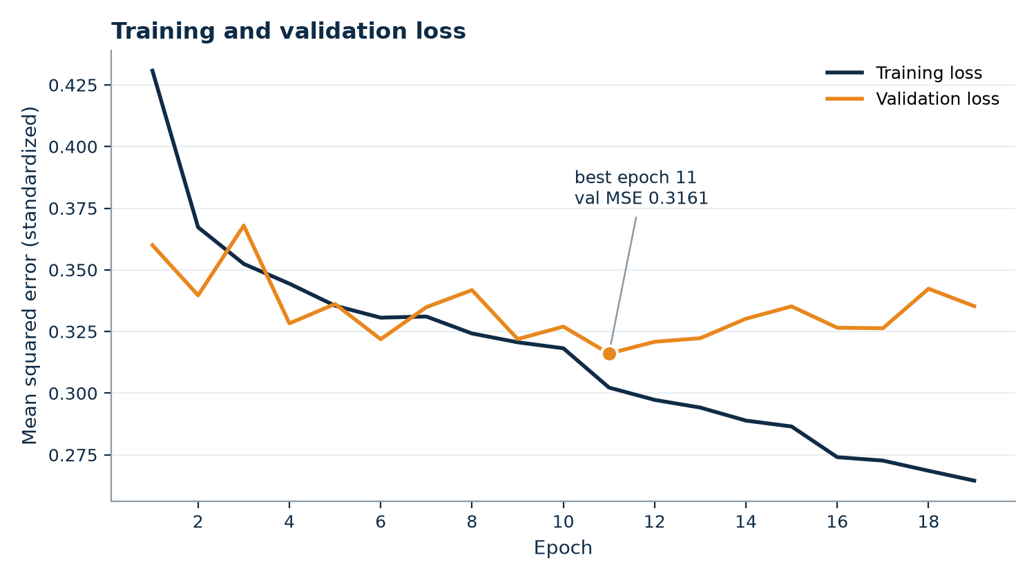
Training
Required plot: training and validation loss vs. epoch
What this curve told us
Our interim run overfit from epoch 9 to 20 — validation rising while training fell. The final run stops that: best validation 0.3161 at epoch 11, LR halved as improvement stalls, training halted at epoch 19.
Adam, learning rate 1e-3, MSE on standardized targets
Gradient-norm clipping at 1.0
ReduceLROnPlateau — halve LR after 3 stalled epochs
Early stopping, patience 8; best checkpoint retained
All seeds fixed at 42; every run writes a history JSON
Notes:
7:00–8:15 · SPEAKER 2 CUE: REQUIRED PLOT — say 'training and validation loss versus epoch' out loud. The overfitting story is a strength: diagnosed on the interim curve, fixed in the final run shown here. SCRIPT: This is our training and validation loss versus epoch — the required plot — and it has a story. Our interim run trained a fixed twenty epochs. Validation loss bottomed out at epoch nine and then climbed for eleven epochs while training loss kept falling — textbook overfitting, visible right there in the curve. So the final training loop earns this slide: Adam with MSE on standardized targets, gradient clipping, a scheduler that halves the learning rate after three stalled epochs, and early stopping with patience eight. In the run you're looking at, validation bottomed at epoch eleven at 0.316, the learning-rate cuts are visible as steps in the curve, and training halted at nineteen instead of wasting eight more epochs memorizing the training set. The checkpoint we evaluate — and demo — is the epoch-eleven one.

Slide 8
Evaluation Methodology
A deep model is only interesting if it beats the forecast you get for free
Naive persistence
Seasonal naive
Mean predictor
Predict the previous hour
Predict the same hour yesterday
Always predict the series mean
The standard benchmark for hourly load — and a strong one
Tests whether the daily cycle alone is predictive
The R² = 0 reference point
Metrics: MAE, RMSE, and R², all computed in kilowatts after inverse-transforming predictions. MAE and RMSE together are informative — their ratio shows how much error is concentrated in a few large misses. Headline measure: skill score, the percentage RMSE reduction against persistence.
Notes:
8:15–9:15 · SPEAKER 3 (suggested: results + demo) CUE: Make the case that this is the honest way to evaluate. Zeng et al. 2023 if asked why we bothered. SCRIPT: Before the numbers, the rules. Every prediction is inverse-transformed back to kilowatts, so every error you'll see is in physical units. We report MAE, RMSE, and R² — MAE and RMSE together, because their gap tells you whether the error is spread evenly or concentrated in a few big misses. And we compare against three forecasters that cost nothing. Persistence: predict the previous hour — for hourly load, that's a genuinely strong baseline. Seasonal naive: predict the same hour yesterday. And the series mean, which is the R-squared-equals-zero floor. Our headline metric is the skill score — the percentage RMSE reduction against persistence. If a deep model can't beat the previous hour repeated, it has no business being deployed. That's the bar.

Slide 9
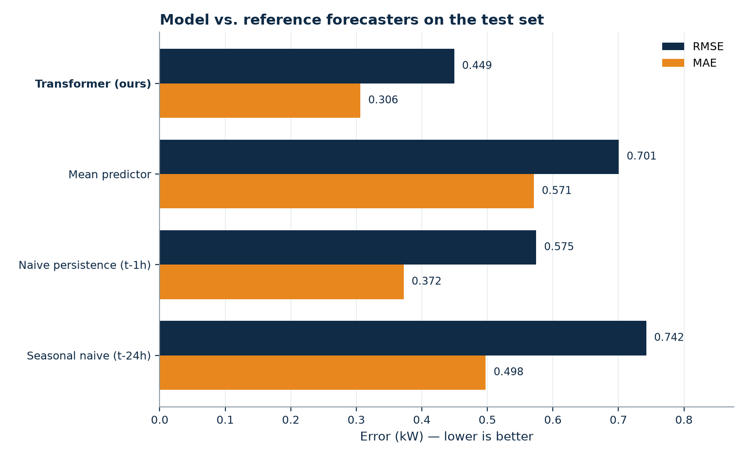
Results
5,165 held-out hourly predictions the model never saw in training
Model | MAE (kW) | RMSE (kW) | R²
Transformer (ours) | 0.3062 | 0.4494 | 0.589
Naive persistence (t−1h) | 0.3724 | 0.5745 | 0.327
Mean predictor | 0.5711 | 0.7005 | 0.000
Seasonal naive (t−24h) | 0.4976 | 0.7424 | −0.121
21.8%
RMSE reduction vs. naive persistence
Two things worth noticing
Seasonal naive scores worse than the mean predictor — a negative R². Household routines vary too much day to day for yesterday's 7pm to predict today's.
Our margin is larger in RMSE (21.8%) than MAE (17.8%): the gain is concentrated exactly where persistence fails worst.
Notes:
9:15–10:30 · SPEAKER 3 CUE: Lead with 21.8%. The negative-R² observation for seasonal naive is your best 'we actually looked at this' moment. SCRIPT: The headline: a 21.8 percent RMSE reduction over naive persistence, on five thousand one hundred sixty-five held-out predictions the model never saw in training. MAE 0.306 kilowatts, RMSE 0.449, R² 0.589 — better than every reference forecaster on every metric. Two things in this table are worth a second look. First, seasonal naive — repeat yesterday's same hour — is worse than just predicting the mean. Negative R². One household's routine varies too much day to day for yesterday's 7 p.m. to predict tonight's. The daily cycle you can see by eye is not, by itself, predictive at this scale. Second, our margin over persistence is bigger in RMSE — 21.8 percent — than in MAE — 17.8. RMSE weights big errors more, so the model's advantage is concentrated exactly where persistence fails worst: the transitions into and out of demand peaks, where the previous hour tells you least.

Slide 10
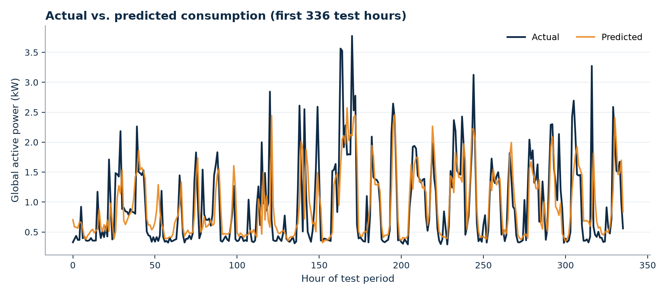
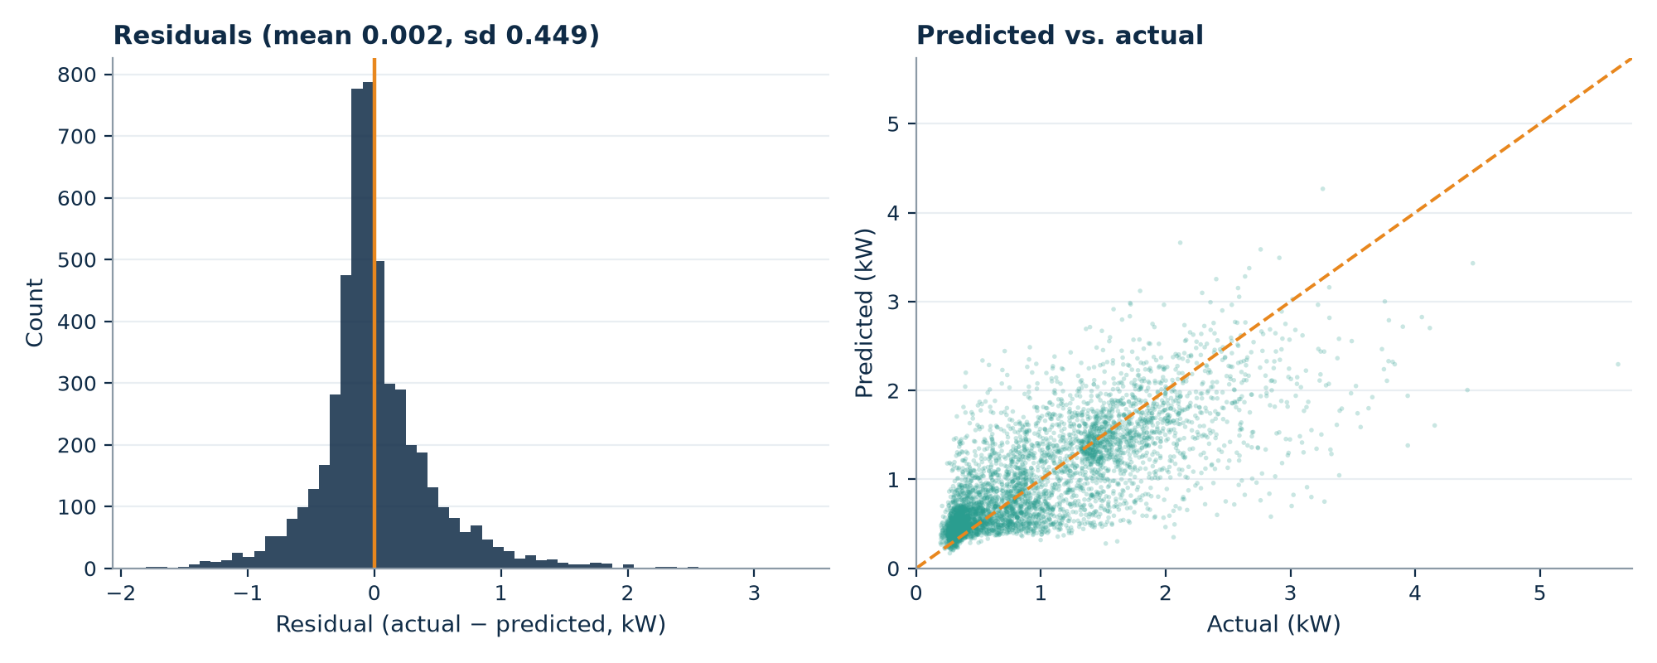
Where the Model Still Struggles
Peak under-prediction
The model tracks the daily cycle and event timing, but consistently under-shoots peak magnitude — predicted maxima reach 4.3 kW against observed 5.6 kW.
Residuals are right-skewed; the scatter falls below the diagonal at high load.
This is rational under MSE. A confident spike that lands an hour off is punished twice — missed peak plus false peak — so hedging toward the mean is optimal wherever the data is most volatile.
This pattern may be related to the MSE objective, while our capacity ablations suggest that simply making the model larger does not solve it.
Notes:
10:30–11:30 · SPEAKER 3 CUE: The defence against 'why is R² only 0.59?'. MSE makes hedging optimal; the fix is a quantile loss, not a bigger model. Say that explicitly. SCRIPT: Now the honest part — where the model still struggles. Look at the traces: it tracks the daily cycle and the timing of demand events well, but it consistently under-shoots peak height — predicted maxima around 4.3 kilowatts against observed peaks above 5.6. The residuals are right-skewed, and the scatter falls below the diagonal at high load. Every diagnostic points the same way: the model hedges toward the mean when demand is high. Here's the key point: that is rational behaviour under squared error, not a capacity failure. A confident peak prediction that lands an hour early gets punished twice — once for the missed peak, once for the false one. Hedging gets punished moderately either way. So MSE makes shrinking toward the mean optimal exactly where the data is most volatile. The fix isn't a bigger model — it's a quantile loss that can express uncertainty about peaks. That's our top-listed future work, and you'll see the behaviour live in the demo right now.

Slide 11
Live Demo
Forecasting from any point in the held-out test period
streamlit run demo/app.py
Pick a moment in the test period — the model forecasts the next hour from the previous 24
Prediction, ground truth, and absolute error against the surrounding load curve
Performance tab: live baseline comparison · About tab: architecture and training curve
Notes:
11:30–14:00 · SPEAKER 3 CUE: REQUIRED — 3 rubric points. App already running before the talk starts; never launch live. Two forecasts: calm overnight hour, then evening peak — own the weakness. Fallback video ready. SCRIPT (alt-tab to the browser): This is the model you just saw evaluated, running live — the epoch-eleven checkpoint, forecasting from the held-out test period. I pick any moment with this slider; the model sees only the preceding 24 hours. First, a quiet overnight hour. [Set slider to a pre-chosen 3 a.m. origin.] Prediction, actual, absolute error — a few hundredths of a kilowatt. Routine load, and the model nails it. Now the hard case — an evening peak. [Set slider to the pre-chosen origin.] You can see exactly what the error analysis predicted: timing right, magnitude short. We're showing you the failure mode on purpose — it's systematic, we understand why it happens, and we know what fixes it. [Optional if time: Performance tab — the live-computed table matches slide 9.] [Alt-tab back to the deck.] REHEARSAL NOTE: choose and write down both slider origins beforehand; do not hunt for good examples live.

Slide 12
Ablations
Every row is an independent train-and-evaluate cycle
Study | Final choice | RMSE | Alternatives | RMSE
Window | 24 hours | 0.4494 | 48 h / 168 h | 0.4543 / 0.4553
Capacity | d=64, 2 layers | 0.4494 | 2× depth / 2× width | 0.4539 / 0.4560
Positional | Sinusoidal | 0.4494 | Learnable / none | 0.4573 / 0.4542
Features | With calendar | 0.4494 | Without calendar | 0.4617
Architecture | Transformer | 0.4494 | LSTM control | 0.4579
What the grid says
Calendar features are the biggest single factor — dropping them costs more than any architecture change.
More capacity only hurts: the constraint is data, not expressiveness.
Transformer beats the LSTM control, 21.8% vs. 20.3% skill.
Every config still beats persistence by ≥ 19.6% — the conclusion is robust.
Notes:
14:00–14:30 · SPEAKER 3 CUE: The evidence the architecture was chosen rather than assumed — real weight under 'difficulty of NN design'. SCRIPT: Every row here is an independent train-and-evaluate cycle — one design decision changed at a time, everything else held fixed. Three takeaways. The calendar features matter most: dropping them costs more RMSE than any architecture change. More capacity only hurts — doubling depth or width makes things worse, so the constraint is data, not expressiveness, which is why our model is deliberately small. And the Transformer does beat a comparably sized LSTM — 21.8 versus 20.3 percent skill. A real margin, and an honest one: every configuration in this grid still beats persistence by at least 19.6 percent, so the conclusion doesn't hinge on any single design choice.

Slide 13
Limitations and Future Scope
Limitations
Future work
Single household in a single location — no claim about aggregate or cross-household performance
No exogenous variables; temperature is the strongest known driver of residential demand and is absent
Point forecasts with no uncertainty bounds — the wrong output format for the peak problem
One-hour horizon; operational scheduling needs 24 hours ahead
Single seed — small differences between ablation rows should not be over-read
Quantile / pinball loss — let the model express uncertainty about peaks instead of hedging
Join hourly weather for Sceaux over the collection period
Multi-step forecasting to 24 hours; the code already supports the horizon parameter
Visualize attention weights to see which parts of the previous 24 hours the model relies on most
Evaluate on a multi-household dataset to test transfer
Notes:
14:30–14:50 · SPEAKER 3 CUE: Be brisk. The quantile-loss point is strongest — it follows directly from the error analysis. SCRIPT: Limitations, briefly and honestly: one household, so no claims about generalization. No weather data — temperature is the strongest known driver of residential demand and it isn't in this dataset, which caps achievable accuracy. And point forecasts only. That's why the top future-work item is a quantile loss — it attacks the peak-hedging you just watched — followed by weather features and multi-hour horizons, which the code already supports.

Slide 14
References
[1] Vaswani et al. Attention is all you need. NeurIPS, 2017.
[2] Hochreiter & Schmidhuber. Long short-term memory. Neural Computation, 1997.
[3] Zhou et al. Informer: Beyond efficient transformer for long sequence time-series forecasting. AAAI, 2021.
[4] Wu et al. Autoformer: Decomposition transformers with auto-correlation. NeurIPS, 2021.
[5] Zeng et al. Are transformers effective for time series forecasting? AAAI, 2023.
[6] Lim et al. Temporal fusion transformers for interpretable multi-horizon forecasting. IJF, 2021.
[7] Kong et al. Short-term residential load forecasting based on LSTM RNN. IEEE Trans. Smart Grid, 2019.
[8] Hyndman & Athanasopoulos. Forecasting: Principles and Practice, 3rd ed. OTexts, 2021.
[9] Hébrail & Bérard. Individual Household Electric Power Consumption. UCI ML Repository, 2006.
[10] Kingma & Ba. Adam: A method for stochastic optimization. ICLR, 2015.
[11] Xiong et al. On layer normalization in the transformer architecture. ICML, 2020.
[12] Nie et al. A time series is worth 64 words. ICLR, 2023.
Notes:
14:50–15:00 · SPEAKER 3 CUE: Do not read these. Leave up while transitioning to questions. SCRIPT: These are the works that shaped the design — happy to point at any of them in questions. Thank you — what would you like to ask?

Slide 15
Questions
github.com/Ciaracam/612-Group-Project
William Peng · Ciara Cameron · Christopher Pedretti
Notes:
Anticipated questions: · Why a Transformer over an LSTM? — constant dependency length; see the LSTM control in the ablation. · Why only ~22% over persistence? — appliance events are driven by human decisions that leave no trace in prior meter readings. · What does attention actually learn? — untested; attention-weight visualisation is named as future work. Do not overclaim. · Why window length 24? — one full daily cycle; see the window ablation. · Did you try a linear baseline? — no, and Zeng et al. 2023 says we should. Concede it.

