Slide 1
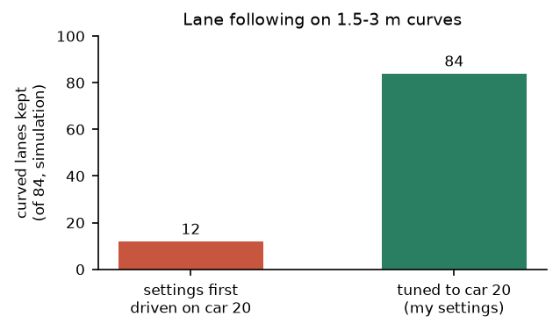
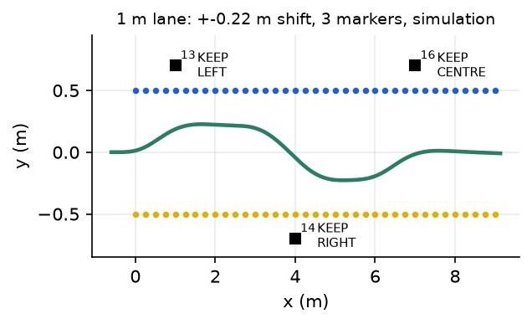
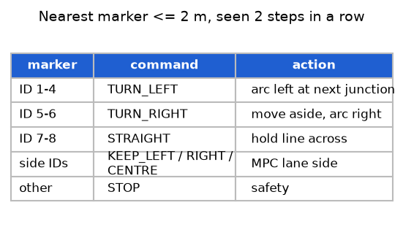
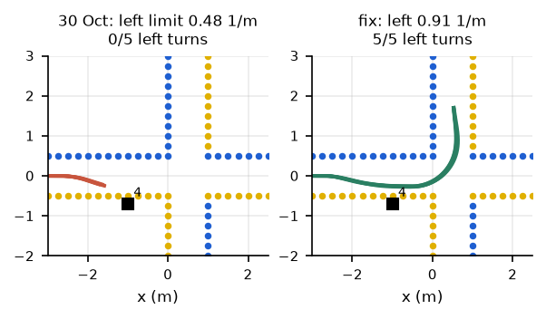
Toby Lee MPC sub-team: car 20 tuning, lane shifting, marker actions and turns
1 MPC tuned to car 20
2 Lane shifting
84 / 84
L · C · R
simulated curves kept with car 20's real steering limits
keep left, centre or right, moving across smoothly
Car runs: stays between the cones
Car 20, 20 Oct: kept to the left
3 Markers -> actions
4 Why left turns failed
ID -> action
R = 2.08 m
nearest marker within 2 m, seen twice
too wide for a 1 m crossing; fix: left turns 2/40 -> 39/40
Car 13, 27 Oct: "Marker 14: KEEP_RIGHT"
Simulation; car test pending
Green = shown on a real car; amber = simulation so far. Details, evidence and the hows and whys: logbook, Toby's section.
Notes:
About 100 seconds. Point at each card as you reach it.
[1] I'm Toby, in the MPC sub-team. Peiyu built our MPC. I wrote the Stage 1 test cases we tuned it on, and measured the
real car's delay and cone noise from recorded drives so the simulation behaved like the car. Then I tuned the MPC to
car 20 with Chris's measured steering limits: 0.48 per metre to the left and 0.92 to the right. With those limits it
kept every one of the 84 simulated curves, and the steering became about three times smoother.
[2] Next, lane shifting. Instead of the lane centre, the MPC can follow a line beside it, so the car keeps left, centre
or right, and it moves across gradually, at most 0.3 metres sideways per metre driven. On car 20 on 20 October,
changing only that setting to left kept the car on the left. In the lab's narrow lanes the shift was hard to see, so I
worked out how much room there really is and retuned it: 40 out of 40 in simulation.
[3] Then I connected the ArUco markers to the policy. Only the nearest marker within two metres counts, and only once
it has been seen in two steps in a row. Its ID means keep a side, turn left, turn right or go straight. A turn is its
own manoeuvre: move to the outside of the lane, drive a planned arc, then hand back to lane following. On car 13 the
policy acted on a keep-right marker.
[4] Last, four car sessions of testing. Left turns kept failing on car 20 while right turns worked. I reproduced the
same pattern in simulation and traced it to the steering: car 20 can only turn left on a 2.08 metre radius, and that
doesn't fit a one-metre crossing. With more steering range, left turns go from 2 out of 40 to 39 out of 40 in
simulation. A full turn on a car is still to be shown.

