Slide 1
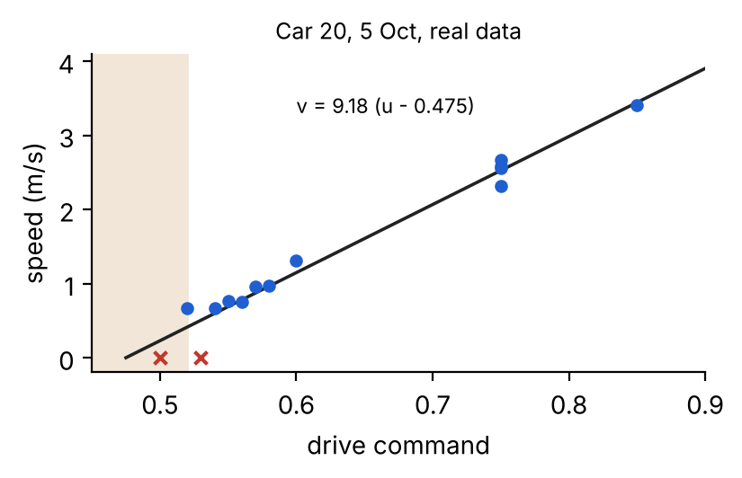
Yifei Xia
Car control testing, marker recognition and camera investigations
1 Speed and steering
2 ArUco ID detection
3 Camera calibration & sim
4 Battery monitoring
Image test | ID output
Image 1 | 0
Image 2 | 2
Image 3 | 5
Image 4 | 8
Direction | Command
Left ~90° | −0.35
Forward ~0° | 0.32
Right ~90° | 1.00
Supply | Powers
8.4 V NiMH | Motor system
5 V power bank | Computer
Separate supplies
No charge sensor identified
Shared tests; plot and analysis: Chris
Four stored-image examples, 9 Nov
Approximate physical observations
•
Helped Chris test drive-to-speed and steering response on car 20.
•
Verified live marker-ID output and diagnosed a missing camera image stream.
•
Identified the forward-facing camera command as 0.32.
•
Investigated remaining-charge measurement to explain changing speed response.
•
Worked with Chris on the PI speed-control loop using wheel-speed feedback.
•
Investigated counter-rotation as the vehicle turns.
•
Decoded IDs 0, 2, 5 and 8 from stored images.
•
Identified the need for additional sensing hardware.
•
Built an interactive simulation using the existing controller, with a repeatable 20 s run and CSV export.
•
Supported calibration and troubleshooting during team vehicle tests.
•
Handed ID output to the team for subsequent manoeuvre decisions.
•
Stopped at feasibility assessment because vehicle modifications were not permitted.
Shared car tests with Chris
Car 20, 5 Oct
Live ID output + offline examples
No accuracy benchmark
Physical calibration + simulation
Stabilisation still unverified
Feasibility investigation
No charge estimator implemented
Green: demonstrated testing/output. Amber: partial or exploratory work. Evidence and limitations: Yifei’s logbook.
Notes:
Suggested 1–2 minute talk:
I worked with Chris on vehicle speed and steering tests, including the shared car 20 calibration session. We investigated how commands translate into physical motion and used wheel-speed feedback in a PI control loop. Chris documents the final controller implementation and numerical analysis.
I also tested ArUco marker IDs. On the car, I traced missing output to an image topic with no publisher. Later I used stored images to verify IDs 0, 2, 5 and 8. My contribution was ID output for the team's decision logic.
For the camera, I found that 0.32, rather than zero, pointed forwards. I investigated counter-rotation and developed a local simulation that reuses our controller. Physical stabilisation remains unverified.
Finally, I investigated battery monitoring. The motor and computer use separate supplies. Extra sensing hardware would be needed, but modifications were prohibited, so I documented feasibility rather than implementing a charge estimator.
Sources: docs/logbook/yifei-xia.md; docs/logbook/chris-wang.md (shared-test date and control evidence); chris/figures/slide_sysid.png (Chris's plot and analysis); Yifei/figure/camera-pan-calibration.png; Yifei/figure/aruco-photo-detection-results.png; Yifei/yifei/camera-game/README.md. Offline examples are not a recognition-accuracy benchmark. Pan points are approximate and have no uncertainty estimates. No comparative simulation performance improvement is claimed. AI assisted code, troubleshooting, and presentation preparation.

