Slide 1
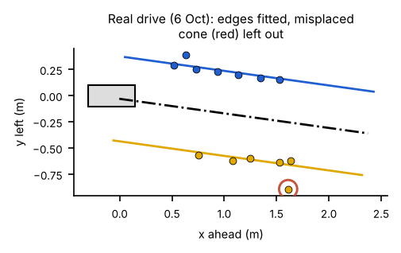
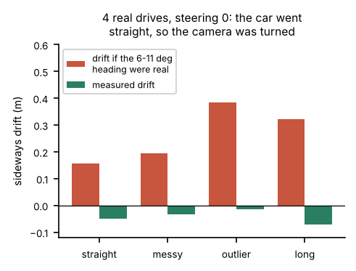
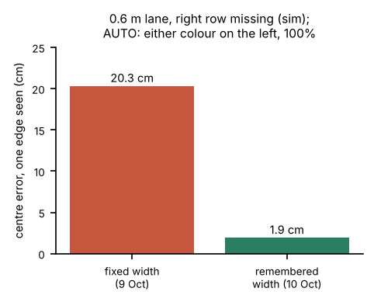
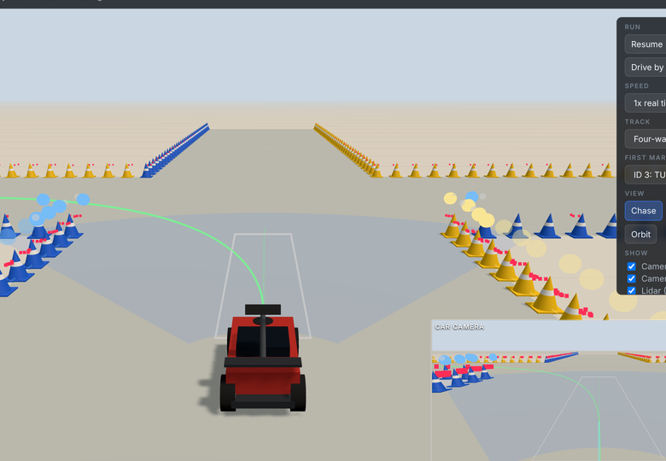
Thanh Long Nguyen Lane estimation, and making the whole system visible and testable
1 Lane estimation
2 Camera pan bias
3 Working on the lab floor
4 Whole-system simulator
• Built the block that turns cones into the lane: both edges fitted together as concentric arcs, misplaced cones left out
• Defined its output (LaneDetection) that the MPC, obstacle avoidance and intersection turns all use
• With a short row, 0.7° heading error against 3.0° for fitting each row alone (sim)
• Every recorded drive read the lane 6-11° turned, yet the car didn't drift
• So the cones were rotated, not the car: the camera pan was never commanded
• The policy now holds the pan at 0 in every step (Toby measured the same 7°)
• AUTO: works out which colour is on which side, because the lab used both ways round
• Remembers the measured width, so one visible edge still gives the centre
• Limit: with short rows, one wrong-colour cone can stop the car or bend the lane
• Runs our real MovementPolicy and settings on 6 tracks against the measured car-20 model, in 3D
• 76 of 90 seeded runs passed, none touched a cone; junctions are the weakest part
• Its camera is optimistic (20 cones a step against 14 on the car): pass rates are an upper bound
Ran on car 20, 9 Oct (no log kept)
Found in real drives; fix on dev since 14 Oct
On dev, so in every car run since 14 Oct
Simulation only; branch not merged
Green = shown on a real car or in real recordings; amber = simulation so far. Details and evidence: logbook, Thanh Long's section.
Notes:
About 1 minute 45 seconds (about 250 words). Point at each card as you reach it.
Hi, I'm Thanh Long. I owned lane estimation: the block that turns the cone detections into the lane, where the edges are, where the centre line is, and where the car sits in it. The MPC, the obstacle avoidance and the intersection turns all steer from its output.
[Card 1] I fit both edges together, as two arcs around one centre. That way a short row borrows the long row's direction: in simulation, with a three-cone row, the heading error fell from three degrees to under one compared with fitting each row alone. Misplaced cones are dropped and the fit is repeated.
[Card 2] On the real drives, every recording said the lane was turned six to eleven degrees, but the car drove straight. If that heading were real, the car would have drifted up to 38 centimetres; it moved less than seven. So the camera was turned, not the car: the pan servo was never commanded. The policy now holds it at zero, and in my simulator that much yaw would have failed every junction.
[Card 3] To work on the lab floor, it finds which colour is on which side and learns the lane width, so one edge is enough. A limit I measured: in a short row, one wrong-colour cone can stop the car.
[Card 4] Last, I built a whole-system simulator that runs our real policy on six tracks in 3D. It showed the junctions are our weakest part. Its camera is optimistic, so I treat its pass rates as an upper bound.

