Slide 1
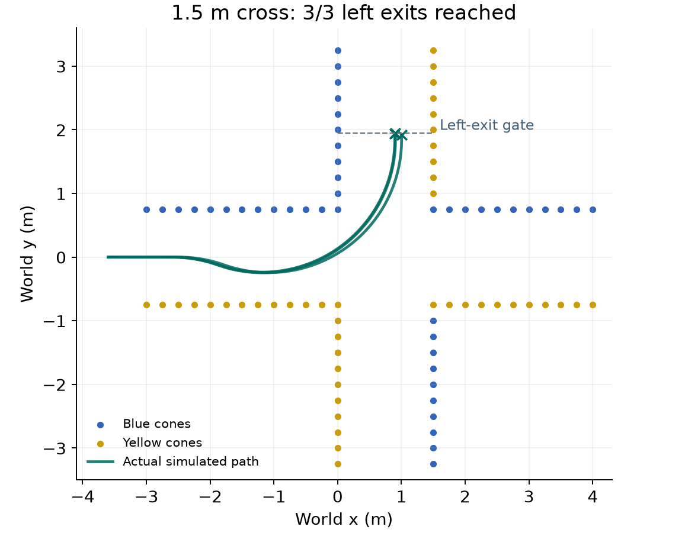
YUHAO LIU
Driving policy and intersection stopping
Measured-speed MPC
1.2–3.5% lower lateral RMS
in 30 synthetic comparison runs
Marker-turn integration
6/6 requested left exits reached
on 1.5 m cross/T roads
Persistent stop latch
6/6 narrow-road runs stopped
without simulated contact
Synthetic sensors and provisional kinematics. Physical turning and braking remain unverified.
Notes:
Personal contribution summary for the assessed 1–2 minute slot. Remaining slides are discussion backups. Contribution period: 6 Oct–2 Nov 2026. Fresh simulation rerun prepared 10 Nov. I contributed measured-speed prediction, experimental route work, grouped direction IDs, earlier/tangent-aware turn preparation, and persistent stops. This is shared work: Peiyu built the MPC framework, Toby built the default marker turner and simulator, Chris/team supplied control/calibration inputs. The new 12-case rerun tests the integrated default marker manoeuvre at source 488ec30, not my individual changes in isolation. 1.5 m cross/T cases each reach the left-exit gate in seeds 0–2, 6/6 combined. The 1.0 m cases each stop in seeds 0–2. All 12 have zero recorded cone contacts and no sampled body-corner departure. The plant follows requested speed/curvature with lag, not a calibrated motor/servo model.
Sources: https://github.com/CiaranGruber/robotic-car-ai/blob/488ec30/tests/policy/marker_simulation.py
https://github.com/CiaranGruber/robotic-car-ai/pull/35
https://github.com/CiaranGruber/robotic-car-ai/pull/36
Fresh data and reproduction settings: /private/tmp/ai4r-slide-simulation-20261110/data/manifest.json and marker_matrix.json. Historical MPC experiment: docs/mpc-simulation-evaluation.md, f7052b2.

Slide 2
DISCUSSION BACKUP 1: SYSTEM ROLE
My contribution to the driving policy
01
02
03
Observe
Plan
Command
Cone rows and lidar returns
Predict with measured speed
CarController maps targets
ArUco poses, wheel speed
Select an intersection path
to drive and steering.
and IMU heading
Check space to turn or stop
DREAM owns vehicle enable.
MY CONTRIBUTION
I developed prediction, path selection and stop decisions.
DREAM provides sensor interfaces and controls vehicle enable.
02
Notes:
The repository is the student ROS 2 policy that consumes DREAM interfaces. Sensor observations feed MovementPolicy. MPC follows the lane or an experimental selected centre path, while the enabled default intersection turn uses bounded pursuit. CarController maps the speed and curvature targets to normalized vehicle actions. DREAM owns hardware services and vehicle enable.
Yuhao's commit trail connects measured-speed prediction, cone-memory manoeuvres, junction path selection, marker-command integration and stop handling. See the individual slides for shared-work attribution.
https://github.com/CiaranGruber/robotic-car-ai/blob/37b7b39/README.md
https://github.com/CiaranGruber/robotic-car-ai/blob/37b7b39/policy/action_policy/policy.py
https://github.com/CiaranGruber/robotic-car-ai/blob/37b7b39/policy/control/control.py
https://github.com/CiaranGruber/robotic-car-ai/pull/14
https://github.com/CiaranGruber/robotic-car-ai/pull/35
https://github.com/CiaranGruber/robotic-car-ai/pull/36
Discussion backup. Use for questions following the one-slide personal summary.

Slide 3
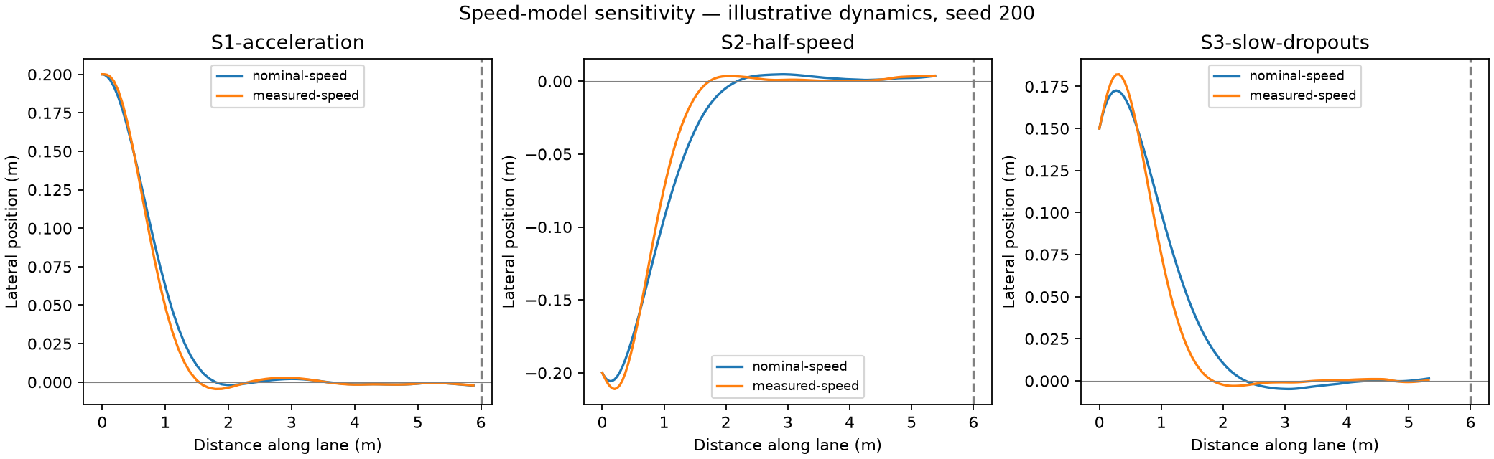
DISCUSSION BACKUP 2: CONTROL THEORY AND SIMULATION
Measured speed improves MPC tracking
30 runs, same controller. Nominal versus measured-speed input.
Acceleration | Half achieved speed | Slow with dropouts
1.2% lower lateral RMS | 1.7% lower lateral RMS | 3.5% lower lateral RMS
0.2 s delay, 1 cm cone noise and invented speed dynamics. Curvature responds ideally.
03
Notes:
My contribution: use fresh wheel speed in the MPC prediction matrices, delay propagation and cached-plan progress. The same controller receives nominal or measured speed, so this comparison isolates the speed input. Five seeds per mode and scenario, 30 runs total. Lateral RMS is distance-weighted over the first 4.5 m. Table values are across all five seeds. Figure shows representative seed 200. These development sensitivity scenarios use invented first-order speed dynamics, perception delay and noisy cones. Curvature responds ideally, with no CarController or DREAMGym dynamics. The small tracking benefit does not establish endpoint completion or broad robustness.
Sources: prior chat “Proceed with MPC integration”, 01a10f56-d2c5-7611-983f-6ad139b02911. Local figure build/mpc-speed-evaluation/trajectories.png, metrics.csv and summary.json.
https://github.com/CiaranGruber/robotic-car-ai/pull/14
https://github.com/CiaranGruber/robotic-car-ai/commit/f7052b2
https://github.com/CiaranGruber/robotic-car-ai/blob/37b7b39/docs/mpc-simulation-evaluation.md
Discussion backup. Use for questions following the one-slide personal summary.

Slide 4
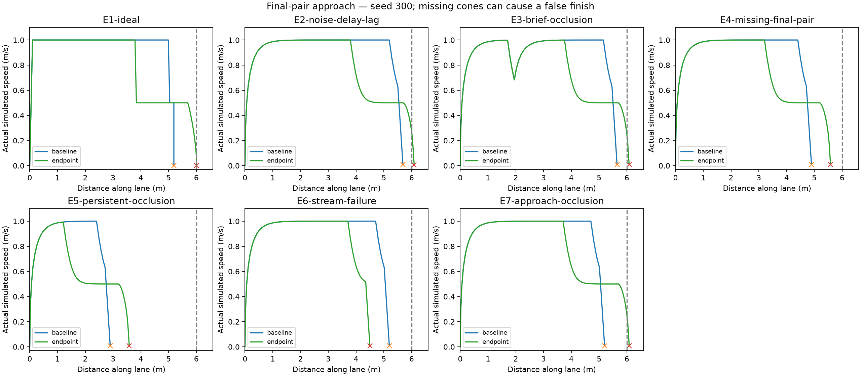
DISCUSSION BACKUP 3: OFFLINE ENDPOINT PROTOTYPE
A final cone pair can give a false finish
Speed envelope: v × t + v² / (2a) ≤ d
20/20 finishes with the final pair visible
10/10 false endpoints in two hiding cases
Hidden cones make the finish ambiguous
70 runs. Baseline already uses measured speed. Assumed reaction 0.3 s, deceleration 0.5 m/s².
04
Notes:
I tested an opt-in final-cone-pair estimator and distance-based stopping envelope. The ROS MovementPolicy retained ordinary MPC. Three distinct acquisition times confirm a consistent hypothesis, not the absence of hidden cones. The 70-run development experiment uses seven cases, two modes and five seeds. Across the four finish-visible cases, the prototype passed 20/20 and baseline 0/20. E4 hides the final pair and E5 hides all cones from x=4 m. Each causes 5/5 false endpoint declarations, for 10/10 combined. The two figures are crops of E1 and E4, representative seed 300, not the complete batch. E4 alone accounts for 5/5 false declarations. Stream failure is a separate expected abort. The speed envelope assumes t=0.3 s and a=0.5 m/s². These values do not measure vehicle brake performance.
Sources: prior chat “Proceed with MPC integration”, 01a10f56-d2c5-7611-983f-6ad139b02911. build/mpc-endpoint-evaluation/stopping-profiles.png and summary.json.
https://github.com/CiaranGruber/robotic-car-ai/commit/32723db
https://github.com/CiaranGruber/robotic-car-ai/commit/7390c92
https://github.com/CiaranGruber/robotic-car-ai/blob/37b7b39/docs/mpc-simulation-evaluation.md
Discussion backup. Use for questions following the one-slide personal summary.

Slide 5
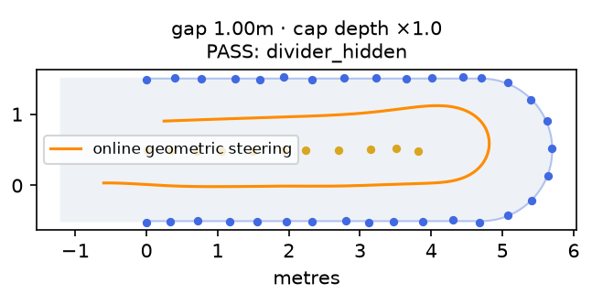
DISCUSSION BACKUP 4: BRANCH EXPERIMENT
Cone memory through a U-turn
10/12
Varied layouts completed
Two stopped at the clearance guard.
Wheel and gyro motion preserve
cone memory through vision loss.
Example: hidden divider, return lane reached
0.50 m radius and 2.2 m⁻¹ left limit are simulation assumptions.
Offline geometric controller. No learned model or physical U-turn validation.
05
Notes:
This was branch-only work on feature/cone-memory-continuity. The geometric follower estimates a connected cap from live observations and motion-compensated cone memory. The path and frame freeze at commitment. Feedback updates steering at the current estimated pose. Only fresh, supported return geometry can replace the return path.
The 12 varied layouts changed lane spacing, cone spacing, jitter, start poses and missing detections or cones. The two 0.9 m-gap failures stopped at the lidar/braking-footprint guard. No cone contacts or full-body excursions occurred in this simulation. A separate shape probe completed 3/4. Steering was hypothetical and the experiment did not run on a vehicle.
https://github.com/CiaranGruber/robotic-car-ai/commit/e908d73
https://github.com/CiaranGruber/robotic-car-ai/commit/fd01806
https://github.com/CiaranGruber/robotic-car-ai/blob/fd01806/docs/acceptance.md
Reused figure: build/connected-realtime/evaluation.png, top-right panel, with report.json and trajectory-1.csv through trajectory-12.csv. Prior chat “Find Foxglove 2D map replay”, 01a151e5-51ef-7832-bcb9-2f8108d34883. The figure is a representative successful case with divider hidden, not all 12 outcomes. The two stopped varied layouts use 0.9 m gaps. Separate noncircular shape probes are not included in 10/12. The committed path/frame persists through occlusion, while steering updates every tick. No continuous replanning or physical stopping claim.
Discussion backup. Use for questions following the one-slide personal summary.

Slide 6
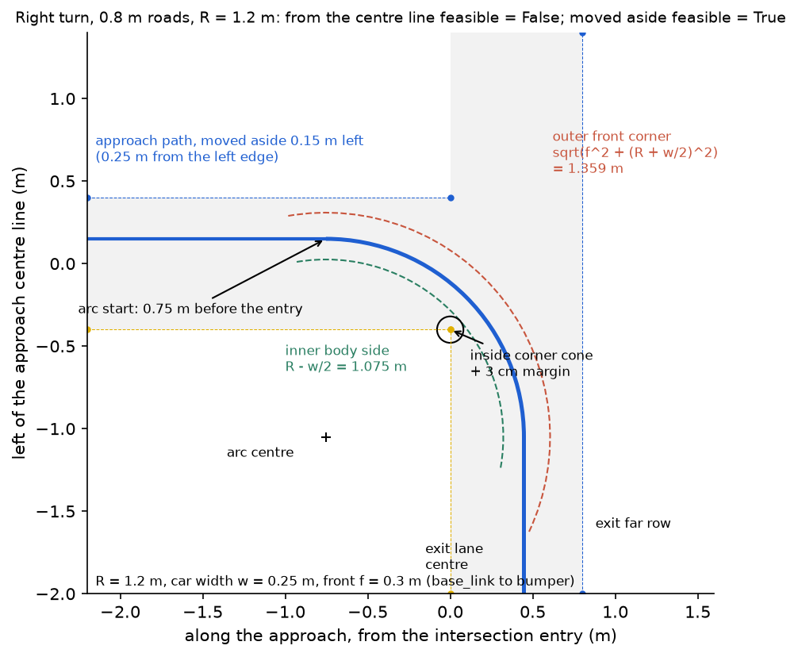
DISCUSSION BACKUP 5: MERGED POLICY · PR #35
ArUco commands and turn preparation
Marker IDs | Command
1–4 | Left
5–6 | Right
7–8 | Straight
Other confirmed IDs | Stop the run
A confirmed direction persists after the
marker leaves view. Turn preparation
moves toward the outside of the lane.
The planned arc starts tangent to the
car’s actual heading.
Right-turn illustration by Toby Lee
06
Notes:
PR #35 combined Toby Lee’s marker-based intersection implementation with my grouped direction IDs, outside-lane preparation, steering-limit-aware tangent admission and exit search from the planned arc endpoint. The diagram is Toby’s geometric right-turn example. It illustrates the shared turn geometry and is not an on-car trace.
The nearest fresh, posed marker ahead must be within 2.0 m and appear in two policy steps. The detector first requires three image frames by default. Unsupported confirmed IDs latch a stop, including during a turn. A new explicit run clears the latch.
https://github.com/CiaranGruber/robotic-car-ai/pull/35
https://github.com/CiaranGruber/robotic-car-ai/commit/3ab7ac9
https://github.com/CiaranGruber/robotic-car-ai/commit/bf5e08c
https://github.com/CiaranGruber/robotic-car-ai/blob/37b7b39/docs/marker-commands.md
https://github.com/CiaranGruber/robotic-car-ai/blob/9a87f45/docs/logbook/toby/figures/08_turn_geometry.png
Discussion backup. Use for questions following the one-slide personal summary.

Slide 7
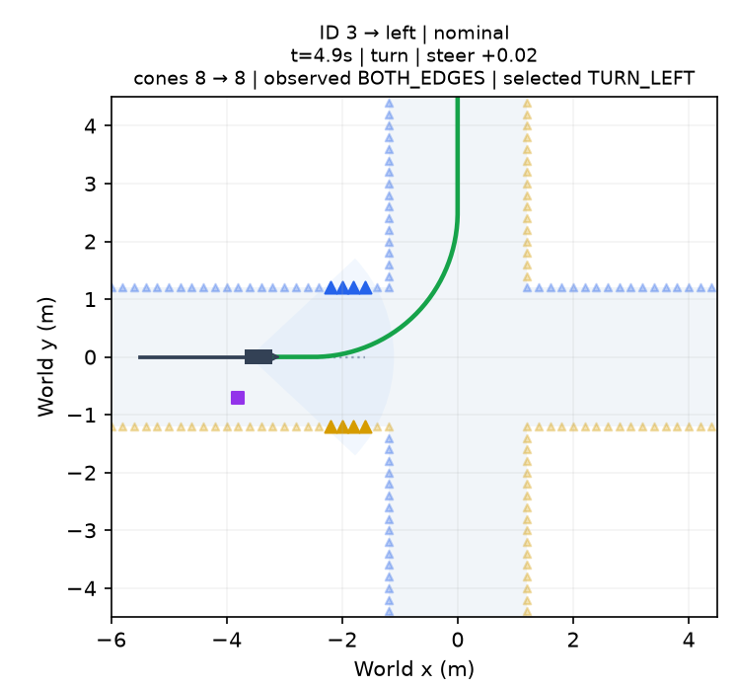
DISCUSSION BACKUP 6: EXPERIMENTAL JUNCTION NAVIGATOR
Experimental navigator: route selection
HISTORICAL 26 OCTOBER RESULTS
Junction scenario | Observed result
Four-way cross | 20/22 completed
Dense T, exit open | 22/24 completed
Dense T, exit blocked | 6/6 stopped
Sparse T approaches | 18/18 stopped
Queue command, verify exit, then hand off.
Green: selected MPC path. Grey: simulated approach.
Disabled by default. 2.4 m roads and earlier ID 3 = left mapping. Physical driving unverified.
07
Notes:
The Oct 26 experimental navigator uses a perpendicular, equal-width cross/T prior. The marker queues the desired exit. A finite approach path can form while the exit is unknown, but a closing row blocks commitment. The selected centre path drives MPC and the Foxglove lane display. Fresh outgoing cones and heading alignment admit normal lane following.
The historical cross matrix uses 0.2 and 0.4 m cone spacing. The two failed cross cases had noisy 0.4 m approaches and stopped before a route formed. Dense T cases use 0.2 m spacing. The 18 sparse T probes use 0.5 and 0.6 m spacing and stop on approach lane loss before exit admission. Counts are historical, before the later CI repairs. Decoded sensor simulation does not evaluate pixel recognition, physical stopping or frame accuracy.
https://github.com/CiaranGruber/robotic-car-ai/commit/d59e812
https://github.com/CiaranGruber/robotic-car-ai/blob/37b7b39/policy/action_policy/intersection_navigator.py
https://github.com/CiaranGruber/robotic-car-ai/blob/37b7b39/docs/acceptance.md#t-junction-exit-support-2026-10-26
Reused figure: build/intersection-turning-20261026/signal_selection.png, left panel, t=4.9 s. This illustrates selected path geometry before traversal, not completed handoff. Prior chat “Find Foxglove 2D map replay”, 01a151e5-51ef-7832-bcb9-2f8108d34883. The historical figure uses IDs 3/4/5 for left/right/straight. The later PR #35 grouped mapping shown on the preceding slide supersedes these IDs. Counts come from the historical cross and T report.json files. Two noisy 0.4 m cross cases stopped before route admission. Sparse T stops reflect approach lane loss, not successful blocked-exit recognition.
Discussion backup. Use for questions following the one-slide personal summary.
Historical cross/T conditions: equal-width2.4m roads,2.5m turn radius,0.4m/s turn speed,0.5m/s approach target. Decoded sensors and CAR_20 kinematics. The dark trajectory in this selection snapshot has not yet completed the turn. The20/22 and22/24 counts refer to this historical experimental navigator, not the fresh default-turner rerun on later slides. Source report hashes preserve exact code context.

Slide 8
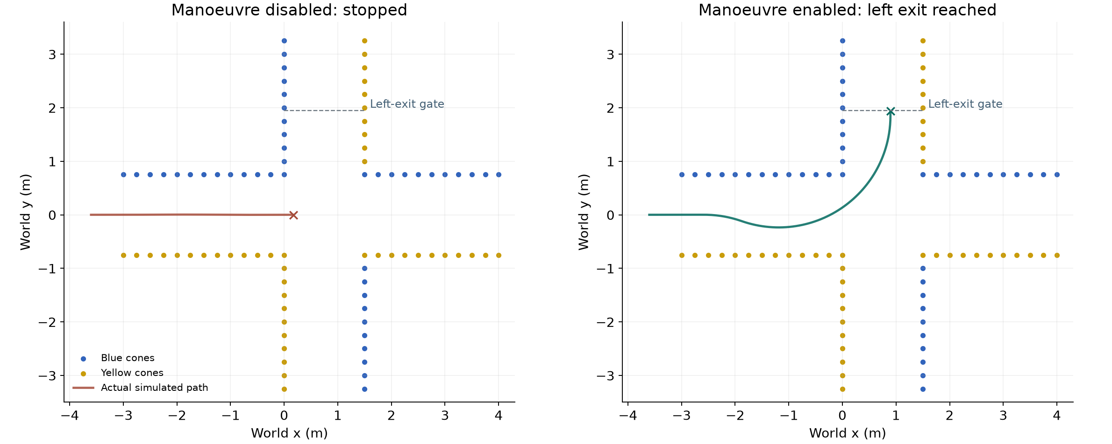
DISCUSSION BACKUP 7: FRESH CLOSED-LOOP COMPARISON
The marker-turn manoeuvre reaches the left exit
Same 1.5 m cross and seed 0. Only intersection.enabled changes.
One illustrative comparison. Synthetic decoded sensors and provisional vehicle kinematics.
08
Notes:
Fresh local comparison on 10 November2026 at source488ec30. cross_left_1.5m seed0. Baseline changes only intersection.enabled=False. Its outcome is stopped at12.83s, without reaching the requested exit. The enabled seed0 case reaches the left exit at18.44s. Lane fitting, MPC, memory and stopping remain enabled in the baseline. This is a comparison of the shared default marker-turn manoeuvre enabled versus disabled, not all control on/off and not an old/new comparison isolating Yuhao’s fixes. Same layout/settings/seed do not mean identical sensor input after the trajectories diverge.
Metric: centre reaches1.2m along the requested exit, with no recorded cone contact or positive corner-outside measure. It does not separately require heading alignment, a stopped goal or explicit handoff. Plant and body checks100Hz, policy10Hz. Synthetic cone/marker noise3cm, marker misses10%, camera delay0.2s, camera yaw0. Speed/steering lag1.5/0.1s. Provisional left plant capability1.0/m, configured policy commands capped0.48/m. CarController runs but the plant follows requested speed/curvature; negative drive primarily selects a provisional braking response. Physical turning/braking unverified.
Sources: https://github.com/CiaranGruber/robotic-car-ai/blob/488ec30/tests/policy/marker_simulation.py
https://github.com/CiaranGruber/robotic-car-ai/blob/488ec30/policy/action_policy/intersection.py
Data: /private/tmp/ai4r-slide-simulation-20261110/data/turn_disabled.json, marker_matrix.json and manifest.json. Reproduce matrix: .venv/bin/python tests/policy/marker_simulation.py --cases cross_left_1m t_left_1m cross_left_1.5m t_left_1.5m --seeds 3. Simulator/default turner by Toby; integration fixes by Yuhao; calibration/control inputs by Chris/team.

Slide 9
DISCUSSION BACKUP 8: CAR 20 · 30 OCTOBER
Car 20 exposed detector and turning limits
01 DETECTOR RANGE
02 TURN GEOMETRY
0 of 41
2.08 m
ID 1 poses within the 2.0 m gate.
Planned left radius at 0.48 m⁻¹.
The active detector used a 0.250 m
After reloading the detector, the policy
marker size for a 0.081 m print.
confirmed ID 1 and requested a stop
when the arc failed its clearance check.
The logs confirm recognition and a stop decision. A complete physical left turn remains unverified.
Source: detector runtime snapshot and policy logs
09
Notes:
Before the detector reload there were 14 + 27 posed ID 1 observations. The policy restart alone had left a stale 0.250 m detector snapshot active. After the operator authorised a detector-only restart, the effective parameter was verified at 0.081 m.
In the later run, ID 1 was confirmed at 3.025 s. The policy latched a geometry stop at 5.438 s. The 2.083 m radius came from the configured 0.48 m⁻¹ left curvature limit. At admission, the car was 4.61 degrees outward and about 26.5 mm beyond the model’s latest clear start. Recorded zero action is software evidence. It does not measure physical stopping distance. The failed run motivated earlier preparation and actual-heading tangent admission.
https://github.com/CiaranGruber/robotic-car-ai/blob/37b7b39/docs/acceptance.md#left-turn-retest-stale-aruco-size-snapshot-2026-10-30
https://github.com/CiaranGruber/robotic-car-ai/blob/37b7b39/docs/acceptance.md#left-turn-preparation-tangent-admission-and-exit-search-2026-10-30
https://github.com/CiaranGruber/robotic-car-ai/commit/bf5e08c
Discussion backup. Use for questions following the one-slide personal summary.

Slide 10
DISCUSSION BACKUP 9: STOP LOGIC · PR #36
A rejected turn keeps its stop latched
837
10 Nov rerun, seeds 0–2
Road width | Cross | T junction
1.5 m | 3/3 exits | 3/3 exits
1.0 m | 3/3 stops | 3/3 stops
2 Nov policy tests passed
5 skipped, 1 expected failure
Turn rejection or exit timeout keeps the
stop latched and requests bounded braking.
All 12: zero simulated contacts
and no sampled body-corner departure.
Only an explicit new run clears the latch.
Policy left limit 0.48 m⁻¹. Synthetic sensors and provisional kinematics. Physical stopping unverified.
10
Notes:
My 488ec30 commit addressed failures after PR #35: turn rejection and exit timeout keep their stop latch even after the manoeuvre object disappears. The code uses the existing bounded brake pulse. The experimental navigator reserves emergency stopping distance before budgeting approach speed. Camera command was restored to zero in line with the fixed camera transform, and Stage 1 assertions were updated for pytest 9.2 numeric and colour comparisons.
The 1.0 m and 1.5 m cases each use two junction types and seeds 0–2. Each run requires a recognised left command. The narrow-run outcomes are specific to delayed confirmation and sampled geometry, with no physical or comprehensive swept-body guarantee.
The 2 November macOS test record is 837 passed, 5 skipped, 1 expected failure and 6 subtests passed. The current checkout lacks the exact pinned dream_interfaces dependency, so there is no fresh installed ROS fast-gate result for this revision. A separate 23 October deployment record reports an earlier pinned ROS pass (186 pytest cases / 189 colcon checks) on a different source snapshot.
https://github.com/CiaranGruber/robotic-car-ai/pull/36
https://github.com/CiaranGruber/robotic-car-ai/commit/488ec30
https://github.com/CiaranGruber/robotic-car-ai/blob/37b7b39/docs/acceptance.md#pr-35-policy-test-repairs-2026-11-02
https://github.com/CiaranGruber/robotic-car-ai/blob/37b7b39/docs/acceptance.md#car-104325433-intersection-deployment-2026-10-23
https://github.com/CiaranGruber/robotic-car-ai/blob/37b7b39/ci/dependencies.repos
Discussion backup. Use for questions following the one-slide personal summary.
Fresh 10 November rerun at 488ec30: cross/T at1.5m each3/3 requested left exits; cross/T at1m each3/3 stopped before completing the turn. All 12 recognised TURN_LEFT, zero cone contacts, max_outside_m<0. These sampled narrow starts do not establish that every1m turn is impossible. The 837 test count remains historical2November evidence. The12-case simulation was rerun for this slide update. Data marker_matrix.json, manifest.json, source and settings hashes retained.

