Slide 1
AI4R System Project
A lane-following, obstacle-avoiding, marker-reading policy for a 1/10 car on DREAM
Ciaran Gruber, Thanh Long Nguyen, Zhenling Zhang, Peiyu Wang, Toby Lee, Yuhao Liu, Chris (Chuhan) Wang, Yifei Xia

Slide 2
Goals and what we achieved
Stage 1: follow a straight cone lane, hold speed, stop at the end and when the lane is lost. Stage 2: curves, obstacles, markers for lane side and turns
Behaviour | On a real car
Speed control at 0.5 m/s (feedforward + PI) | Car 20: 15% overshoot, 0.013 m/s error
MPC lane following within 20 ms | Car 20: 0.46 ms median solve
Lost-lane stop | Car 22: stopped 0.8 s after loss
Keep to the left / right of the lane | Car 20: kept left (by eye)
Obstacle stops | 5 stops, 0.21–0.33 m short every time
Pass obstacles left and right, stop when blocked | 26 Oct: passed 2 boxes, stopped 0.23 m short
Read ArUco markers and act on them | Car 13: 'Marker 14: KEEP_RIGHT'
Turn at an intersection from a marker | Not shown on a car; simulation only
MPC chosen over RL (milestone M1) | Sim: MPC passed every unseen case
Best video
26 Oct: the car passes a box on the right, a box on the left, then stops 0.23 m short of a box blocking the lane.
[play video here]
Process
Measure the car → simulate with the measured values → test on the car → explain each car result in simulation.
Notes:
About 1 minute. Goals of each stage, then the table: green is shown on a real car. Then play the 26 Oct obstacle video. The intersection turn is the one behaviour we only showed in simulation.

Slide 3
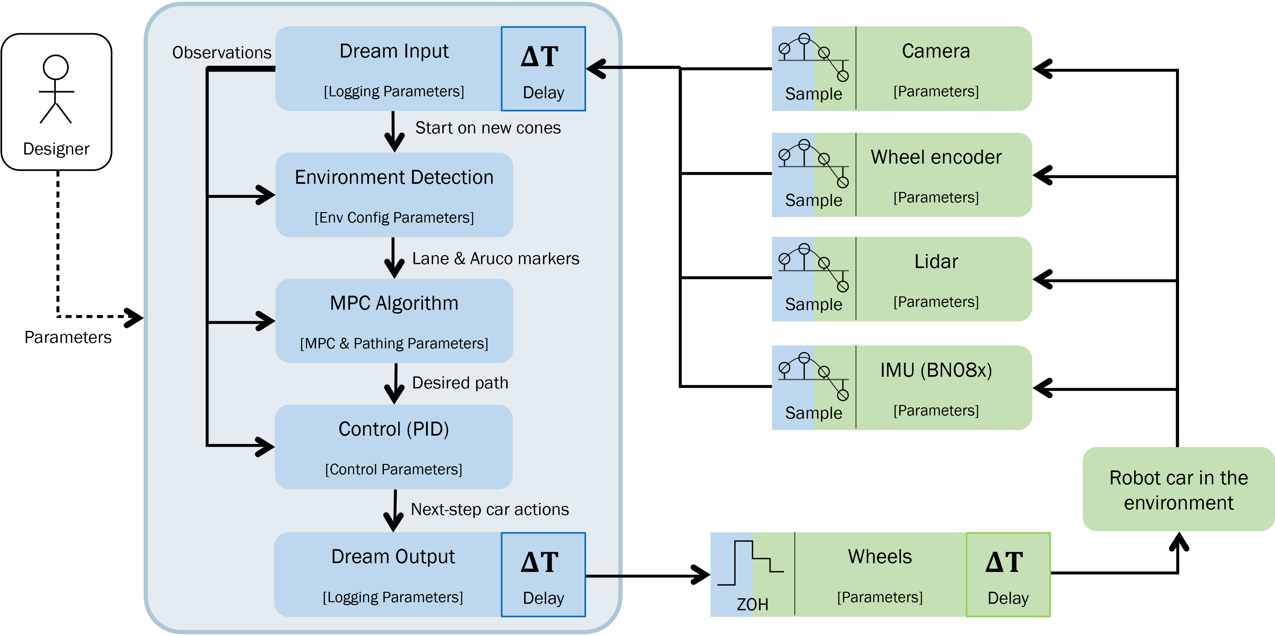
The system and who built it
Sub-team | Person | Main work
Interfaces | Ciaran | Data model, logging, CarMemory, repo, CI
Perception | Thanh Long | Lane estimation, camera pan, simulator
 | Zhenling | Cone filter, obstacles, avoidance, local map
Movement policy | Peiyu | MPC framework, Stage 1 design, lane end
(MPC) | Toby | Car 20 tuning, lane side, markers, turns
 | Yuhao | Measured-speed MPC, junctions, stops
Car control | Chris | System ID, speed and steering control
 | Yifei | Control tests, ArUco tests, camera pan
Notes:
About 1 minute. The policy runs once per cone batch, about 10 Hz. Data flows from the sensors through perception and the MPC to car control. Four sub-teams; each person's slide follows.

Slide 4
How the work was split over time
Weeks from 5 Oct; car access ended 2 Nov
Sub-team | Wk 0–1 (to 11 Oct) | Wk 2 (12–18 Oct) | Wk 3 (19–25 Oct) | Wk 4–5 (26 Oct – 2 Nov)
Interfaces | Repo, CI, upload, logging | Lidar scenarios, CarMemory | — | Curvy-road replay
Perception | Cone filter, lane estimation, pan hold | Obstacle detection, stop, brake | Planner, local map, sim retune | Final obstacle drive, car simulator
Movement policy | MPC framework, Stage 1 tests, M1: MPC vs RL | Car 20 MPC calibration, car models | Lane side, Foxglove, markers | Intersection turns, left-turn diagnosis
Car control | System ID cars 8 and 20, PI | CarController merged, two-box fix | Avoidance runs on car 20 | Speed fix, steering stand test
Integration: 29 PRs merged into dev, then dev merged to main on 7 Nov (#38). Car sessions on cars 8, 13, 14, 20, 21 and 22.
Notes:
About 1 minute. Read across each row: perception and control first, then the MPC on top, then Stage 2 features as the cars allowed. Hand over to Ciaran.

Slide 5
Ciaran Gruber
Slide to add
Notes:
Ciaran Gruber: slide not uploaded yet.

Slide 6
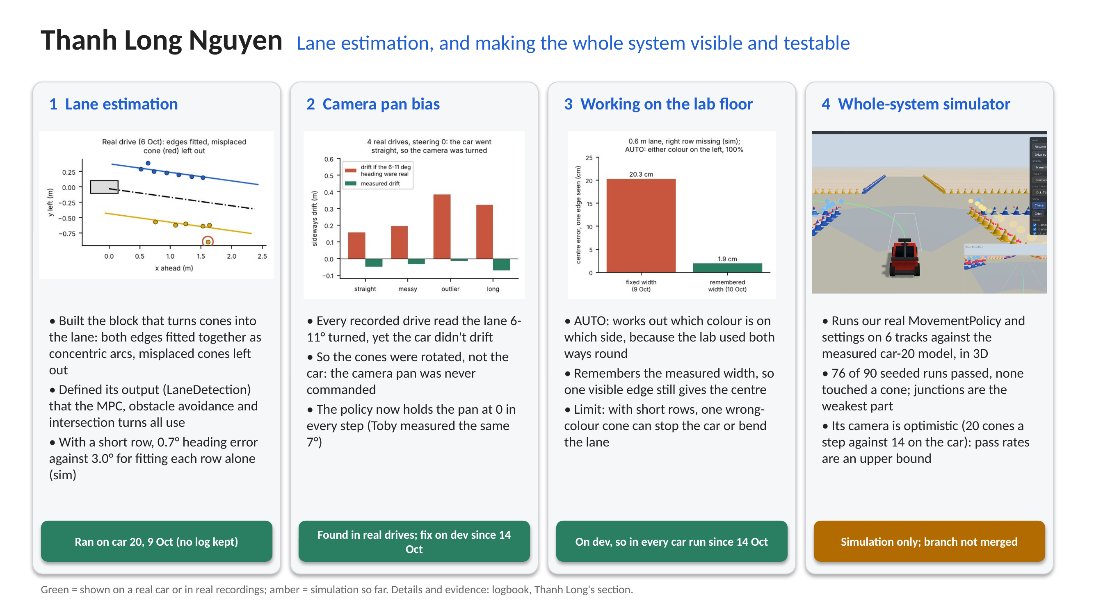
Notes:
About 1 minute 45 seconds (about 250 words). Point at each card as you reach it.
Hi, I'm Thanh Long. I owned lane estimation: the block that turns the cone detections into the lane, where the edges are, where the centre line is, and where the car sits in it. The MPC, the obstacle avoidance and the intersection turns all steer from its output.
[Card 1] I fit both edges together, as two arcs around one centre. That way a short row borrows the long row's direction: in simulation, with a three-cone row, the heading error fell from three degrees to under one compared with fitting each row alone. Misplaced cones are dropped and the fit is repeated.
[Card 2] On the real drives, every recording said the lane was turned six to eleven degrees, but the car drove straight. If that heading were real, the car would have drifted up to 38 centimetres; it moved less than seven. So the camera was turned, not the car: the pan servo was never commanded. The policy now holds it at zero, and in my simulator that much yaw would have failed every junction.
[Card 3] To work on the lab floor, it finds which colour is on which side and learns the lane width, so one edge is enough. A limit I measured: in a short row, one wrong-colour cone can stop the car.
[Card 4] Last, I built a whole-system simulator that runs our real policy on six tracks in 3D. It showed the junctions are our weakest part. Its camera is optimistic, so I treat its pass rates as an upper bound.

Slide 7
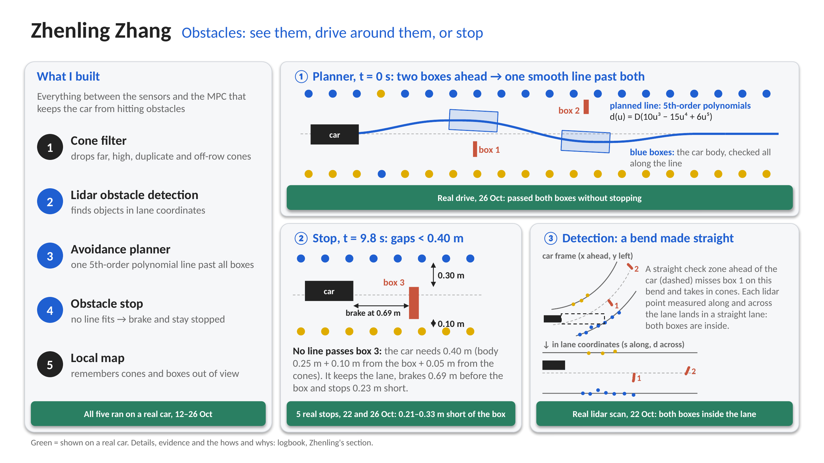
Notes:
Hi, I'm Zhenling. My part keeps the car from hitting anything.
One. A cone filter. It drops cone detections that can't be real: too far, too high, or counted twice.
Two. Lidar obstacle detection. The lidar also hits the cones, so I only count points inside the lane. I measure every lidar point along the lane and across it, so a bend looks straight. [Point to 3.] A straight check zone ahead of the car would miss this box on the bend; along the lane, it's clearly inside.
Three. The avoidance planner, in the same coordinates. [Point to 1.] It plans one smooth line past all the boxes, made of fifth-order polynomials, and checks the whole car body along it. On the real car, it drove past these two boxes.
Four. The obstacle stop. [Point to 2.] If no line fits (here both gaps are under the 40 centimetres the car needs), it brakes and stays stopped. In five real stops, the car ended 21 to 33 centimetres from the box.
Five. A local map that remembers cones and boxes the sensors can no longer see.
Thank you.

Slide 8
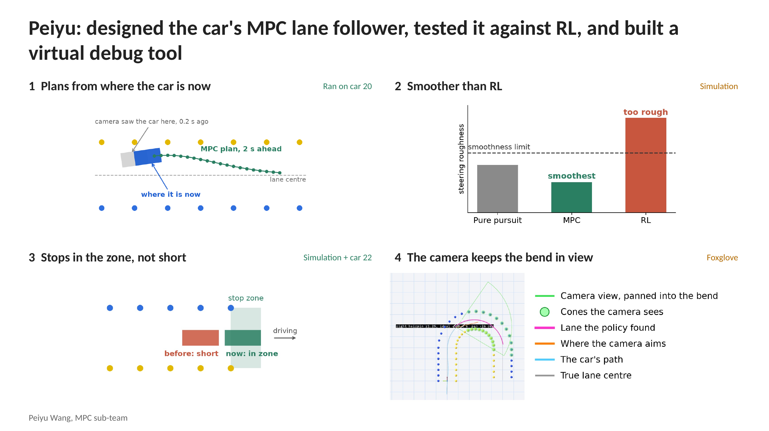
Notes:
I'm Peiyu, on the MPC sub-team. My part turns the lane into a speed and a curvature for Chris's controller, once per batch of cones, on camera data that's already a fifth of a second old.
I built the team's first MPC. It predicts where the car will be and picks curvatures that bring it back to the lane centre without jerky steering, starting from where the car is now, not where the camera saw it.
On the same simulated lanes, RL steered too roughly on the unseen ones, so we used the MPC. And the car now stops in the lane-end zone instead of short of it; car 22 also stopped by itself when it lost the lane.
Getting this onto the cars was its own job. They kept crashing: the cone detector died under OpenCV 5, the camera dropped off USB, and DREAM's own processes ate the CPU. I checked each one read-only first, then fixed or worked around it. Once the "bug" was a flat battery. I also resolved the merge conflicts when Chris's controller, Toby's calibration and my MPC all landed on the same day.
Last, the virtual debug tool in Foxglove. Here it's my camera-pan simulation: the green fan is the camera's view, turned into the bend, so the policy still finds the lane, in pink.

Slide 9
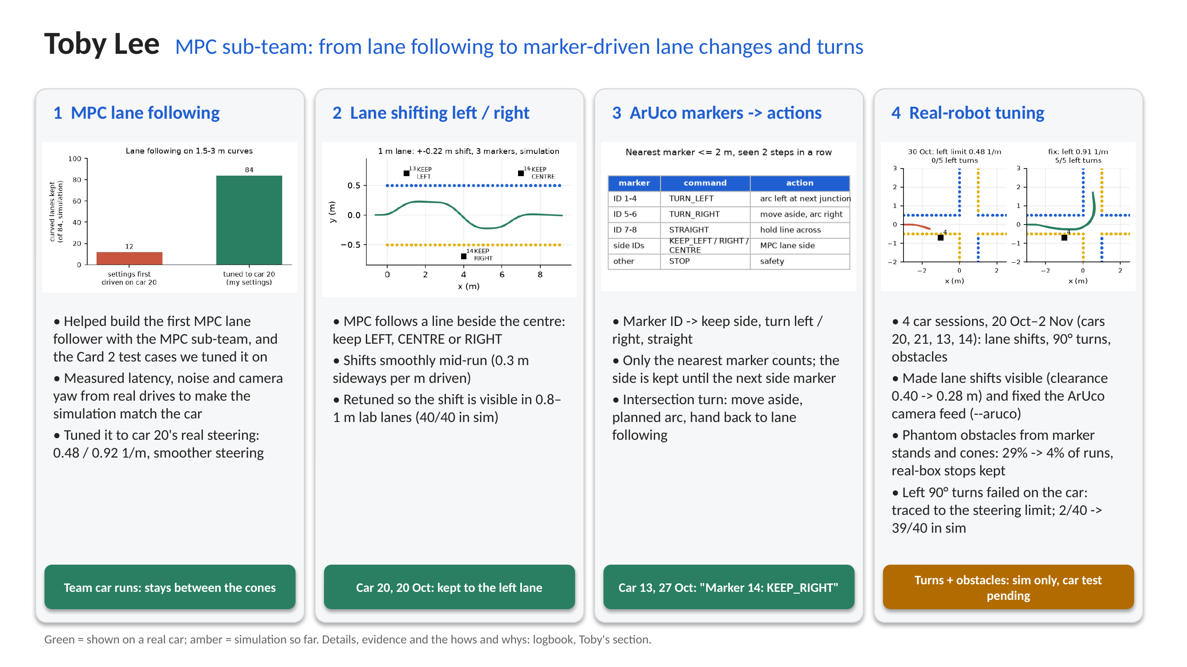
Notes:
About 90 seconds, whats only.
1. With the MPC sub-team I helped build the first MPC lane follower and the Card 2 test cases we tuned it on. I measured the real car's latency, noise and camera yaw from recordings and tuned the MPC to car 20's real steering limits.
2. Then I added lane shifting: the MPC can keep to the left, centre or right of the lane and move across mid-run. On car 20 on 20 Oct, setting it to left kept the car on the left.
3. Then I mapped ArUco markers to policy actions: keep a side, or turn left, right or go straight at the next junction, which uses a planned arc and hands back to lane following. Car 13 acted on a keep-right marker.
4. Finally, real-robot tuning and testing over four car sessions: I fixed the camera feed for the marker detector, filtered the phantom obstacles the marker stands caused, and traced the failing left turns to car 20's steering. The fix works in simulation; the full turn still needs a car test.

Slide 10
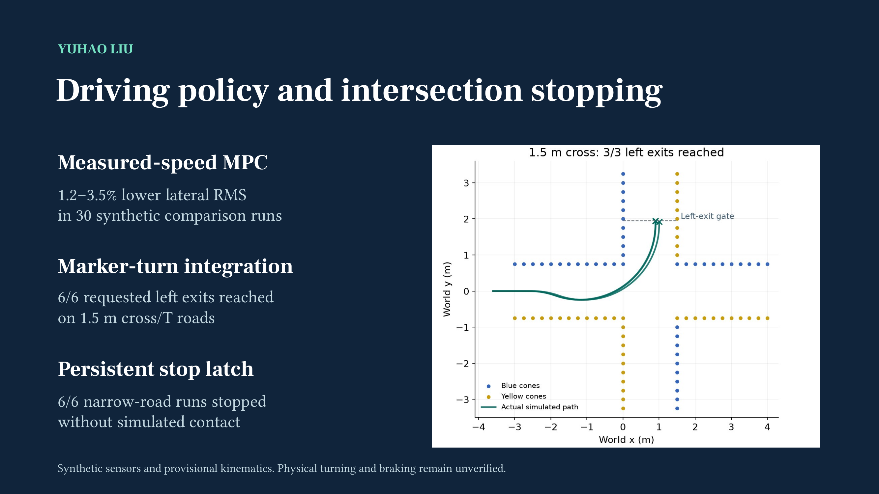
Notes:
Personal contribution summary for the assessed 1–2 minute slot. Remaining slides are discussion backups. Contribution period: 6 Oct–2 Nov 2026. Fresh simulation rerun prepared 10 Nov. I contributed measured-speed prediction, experimental route work, grouped direction IDs, earlier/tangent-aware turn preparation, and persistent stops. This is shared work: Peiyu built the MPC framework, Toby built the default marker turner and simulator, Chris/team supplied control/calibration inputs. The new 12-case rerun tests the integrated default marker manoeuvre at source 488ec30, not my individual changes in isolation. 1.5 m cross/T cases each reach the left-exit gate in seeds 0–2, 6/6 combined. The 1.0 m cases each stop in seeds 0–2. All 12 have zero recorded cone contacts and no sampled body-corner departure. The plant follows requested speed/curvature with lag, not a calibrated motor/servo model.
Sources: https://github.com/CiaranGruber/robotic-car-ai/blob/488ec30/tests/policy/marker_simulation.py
https://github.com/CiaranGruber/robotic-car-ai/pull/35
https://github.com/CiaranGruber/robotic-car-ai/pull/36
Fresh data and reproduction settings: /private/tmp/ai4r-slide-simulation-20261110/data/manifest.json and marker_matrix.json. Historical MPC experiment: docs/mpc-simulation-evaluation.md, f7052b2.

Slide 11
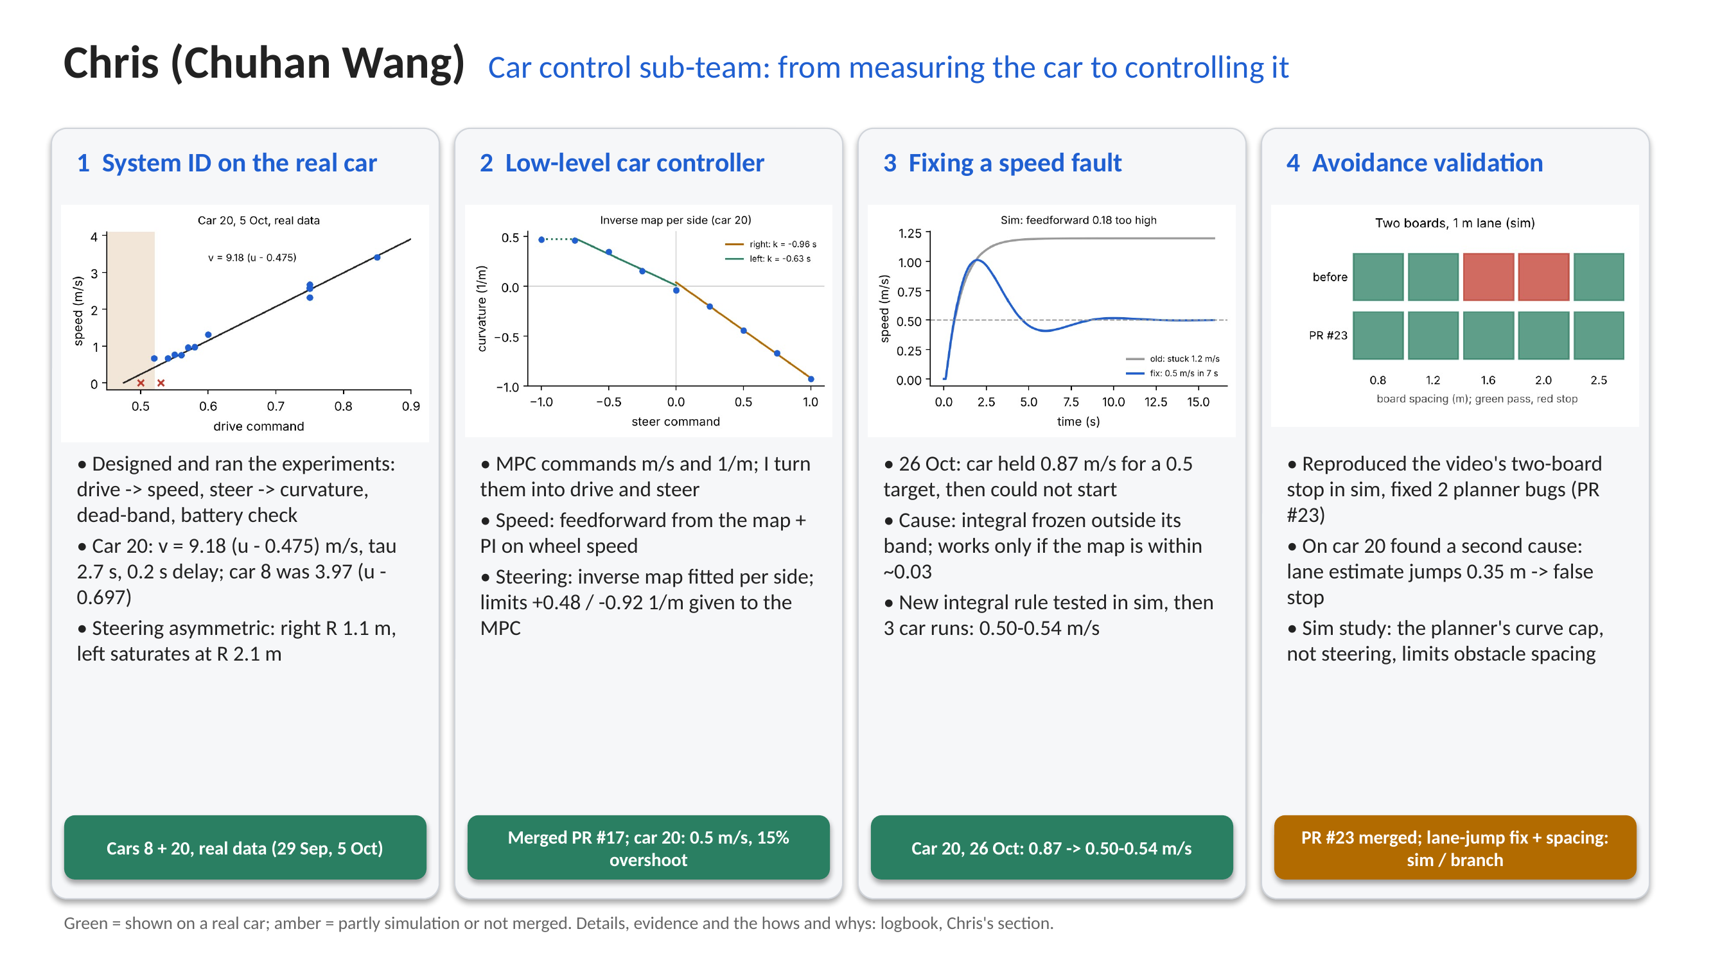
Notes:
About 90 seconds, whats only.
1. I designed and ran the system ID experiments on the real car: how drive maps to speed, how fast the car responds, and how steering maps to curvature. Every car was different, so I wrote a short recalibration.
2. From those maps I built the low-level controller: feedforward plus PI for speed, and a per-side inverse steering map, so the MPC can command metres per second and curvature. It is merged into the team code.
3. On 26 Oct the car ran far too fast, then could not start. I traced it to the integral rule, checked the fix in simulation and on car 20, where it settled at 0.5 m/s.
4. I validated obstacle avoidance: fixed two planner bugs found in simulation, found a lane-jump false stop on the car, and showed in simulation what limits how close two obstacles can be.

Slide 12
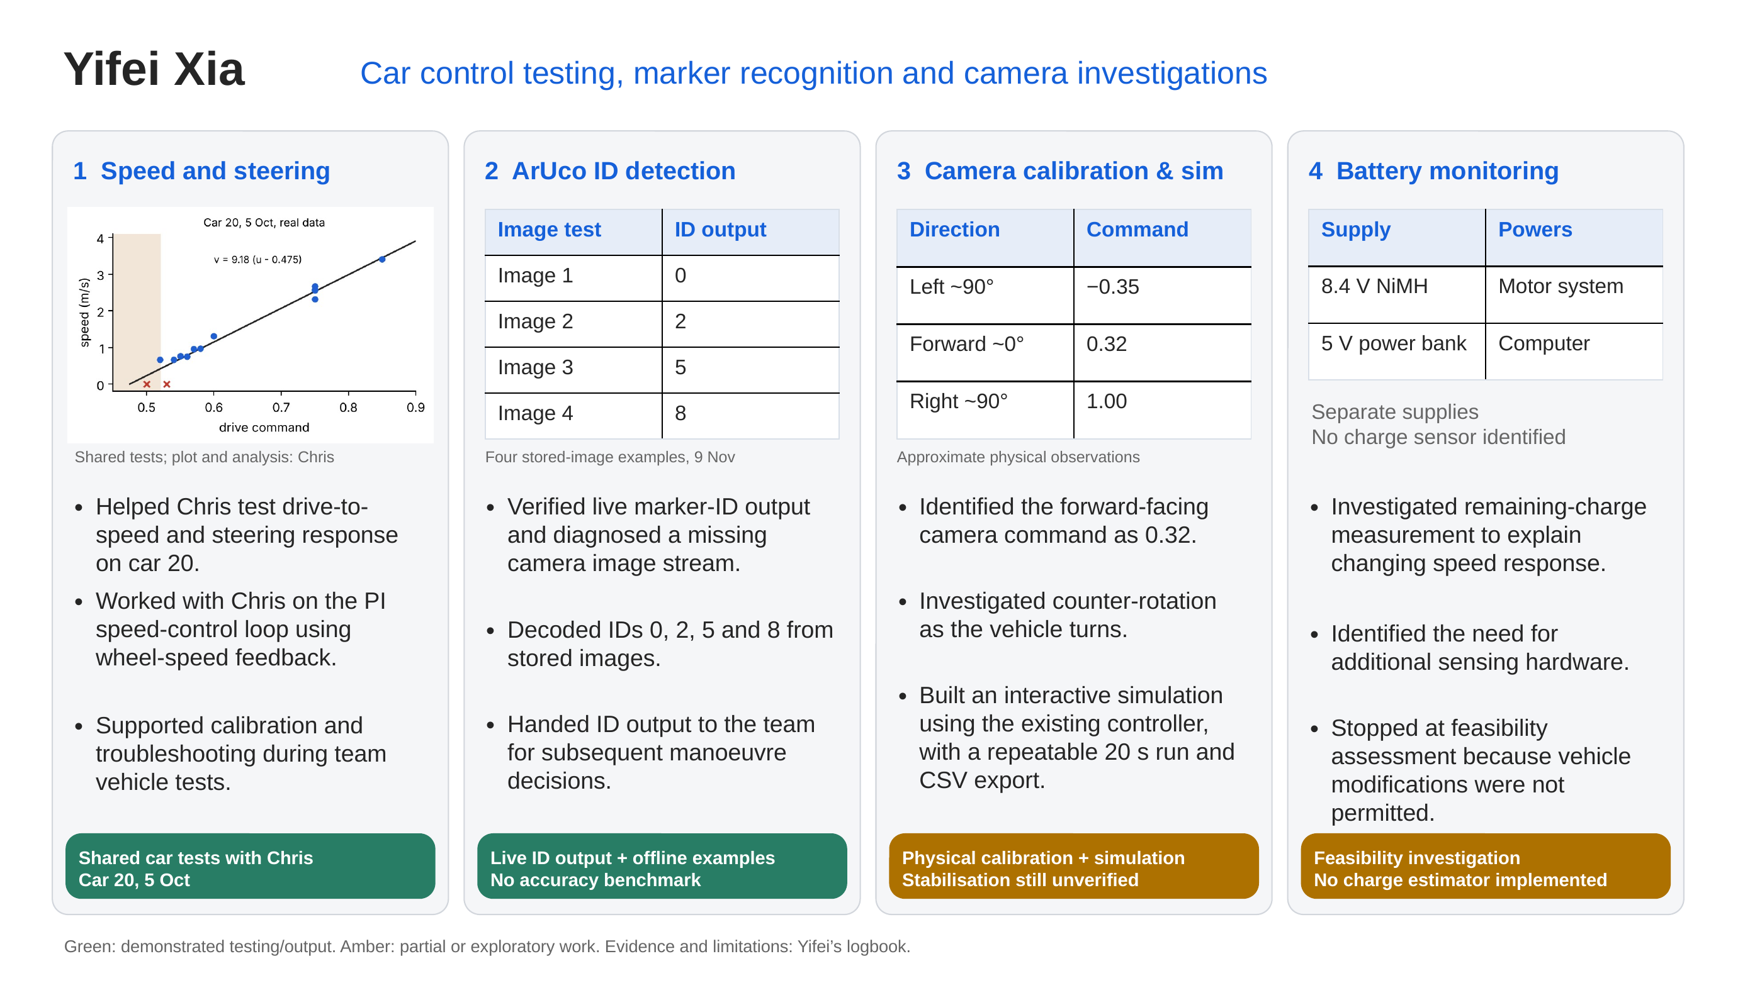
Notes:
Suggested 1–2 minute talk:
I worked with Chris on vehicle speed and steering tests, including the shared car 20 calibration session. We investigated how commands translate into physical motion and used wheel-speed feedback in a PI control loop. Chris documents the final controller implementation and numerical analysis.
I also tested ArUco marker IDs. On the car, I traced missing output to an image topic with no publisher. Later I used stored images to verify IDs 0, 2, 5 and 8. My contribution was ID output for the team's decision logic.
For the camera, I found that 0.32, rather than zero, pointed forwards. I investigated counter-rotation and developed a local simulation that reuses our controller. Physical stabilisation remains unverified.
Finally, I investigated battery monitoring. The motor and computer use separate supplies. Extra sensing hardware would be needed, but modifications were prohibited, so I documented feasibility rather than implementing a charge estimator.
Sources: docs/logbook/yifei-xia.md; docs/logbook/chris-wang.md (shared-test date and control evidence); chris/figures/slide_sysid.png (Chris's plot and analysis); Yifei/figure/camera-pan-calibration.png; Yifei/figure/aruco-photo-detection-results.png; Yifei/yifei/camera-game/README.md. Offline examples are not a recognition-accuracy benchmark. Pan points are approximate and have no uncertainty estimates. No comparative simulation performance improvement is claimed. AI assisted code, troubleshooting, and presentation preparation.

