Slide 1

Performance comparison between a distributed particle swarm algorithm and a centralised algorithm
Ciarán O’Loughlin - C13358011 -September 2021
Technical University Dublin
MSc in Advanced Software Development – TU060

Slide 2
Motivation & Research Question
Research Question:
“At what point are performance gains in running a particle swarm optimisation
algorithm in a distributed environment outweighed by the time lost in network communications between multiple swarms?”
Motivation for this Dissertation:
Discover the potential upper limit for PSO algorithms running on a singular machine.
Aim of the dissertation:
Generate results set of distributed and centralised PSO with increasing numbers of particles/Swarms
Cross compare the two, determine if there is an OTP(optimisation tipping point) where distributed is more time efficient than centralised.

Slide 3
Literature Review & Background
PSO is a population-based search
algorithm and is initialized with a population of random solutions, called particles.
Particles are then arranged into a ”swarm”.
PSO is commonly used in search and optimisation problems. Plenty of research utilizing it in robotics/ real world applications, not just simulations.
PSO update formula has 4 elements, social, cognitive, inertia and a random element
Literature has a focus on various off shoots of PSO, dPSO, AGLDPSO etc. to solve specific problems
Gap in Literature around distributed vs centralised.

Slide 4

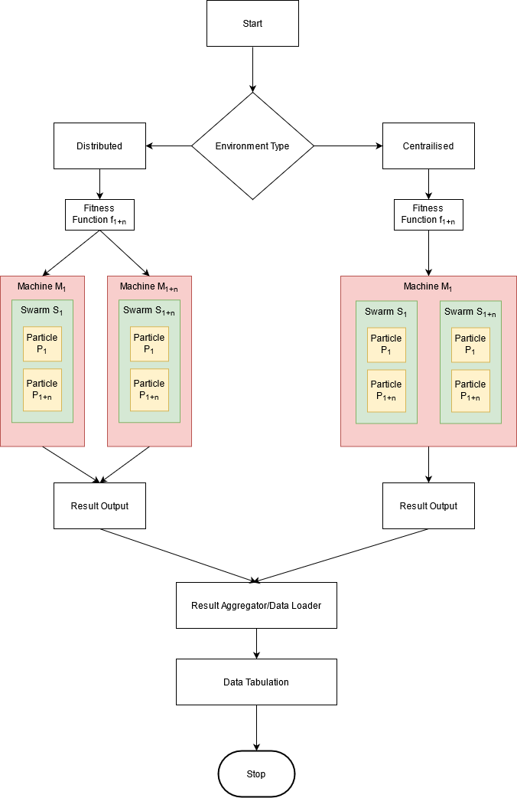
Design & Methodology
Build two algorithm implementations
Generate both results set
Benchmark results between two results sets.
Self build data aggregation/loader. Excel used to examine results.

Slide 5
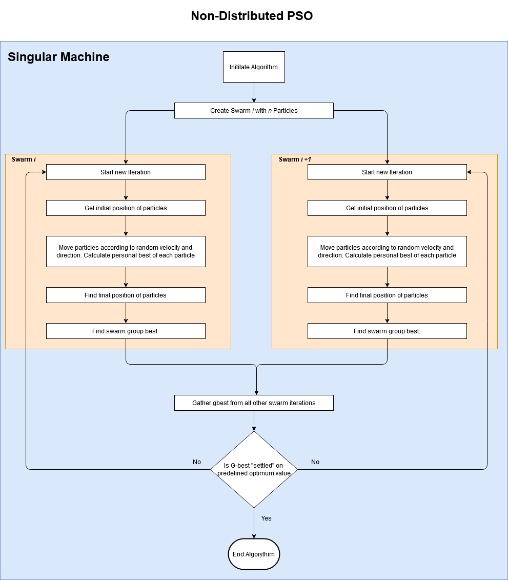
Implementation
Algorithm initializes x swarms with y particles.
Particles move according to PSO formula.
Current position is tested against specific fitness function.
If current position is better than last position, global best for that swarm is updated.
Iterations continue until Gbest value is “settled” across all swarms

Slide 6

Implementation
Java used for algorithm implementations.
Deployed to a container in the cloud. In centralised implementation all swarms run on a single container. In distributed each swarm runs on a separate container. Digital ocean used as the cloud provider.
Testing performed using postman/newman, with NodeJS used to aggregate results.
Fitness functions tested:
  Beales Function
  Booths Function
  Easoms Function

Slide 7
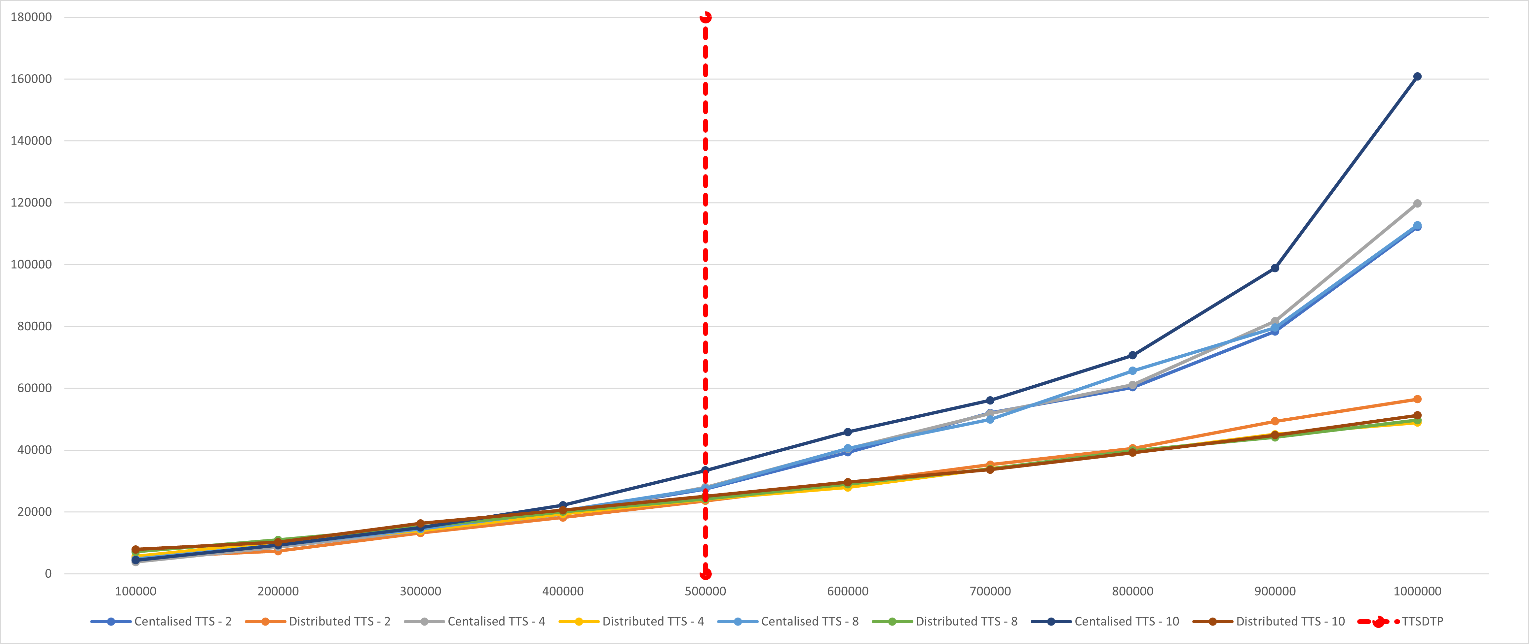
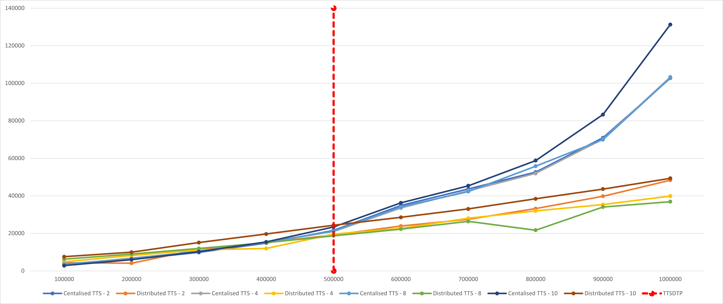
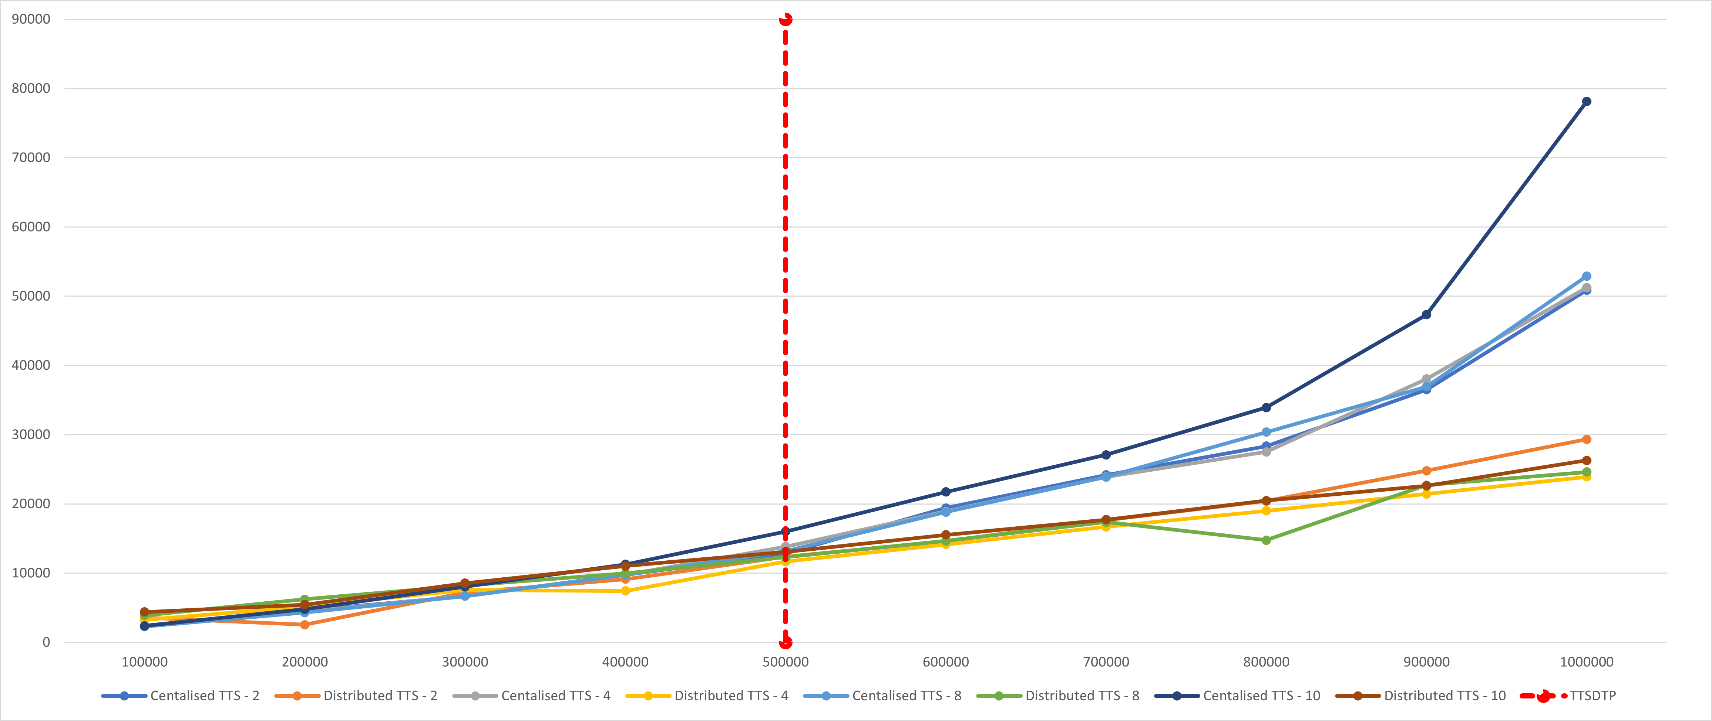
Results & analysis
Beale Results Chart
3 Fitness functions tested, with swarms ranging from 1-10, and particles ranging from 100,000-1,000,000
Distributed implementation has a better TTS across all FF’s at the 500,000 particle mark.
At 1,000,000 particles
  Beale’s function -145%.
  Booth’s function - 152%
  Easom’s function - 123%.
Booths Results Chart
Easom Results Chart

Slide 8
Beale TTS Comparison Chart

Slide 9
Results & analysis
100,000 Particles
 | TTS - 2 Swarms | TTS - 4 Swarms | TTS - 8 Swarms | TTS - 10 Swarms
Beale -Centralised | 4205 | 3842 | 4775 | 4417
Beale -Distribributed | 5291 | 5630 | 7153 | 7860
Booths -Centralised | 2910 | 3243 | 3634 | 2805
Booths -Distribributed | 4331 | 4846 | 6197 | 7541
Easom -Centralised | 2364 | 2297 | 2313 | 2388
Easom -Distribributed | 3551 | 3287 | 3925 | 4385
1,000,000 Particles
 | TTS - 2 Swarms | TTS - 4 Swarms | TTS - 8 Swarms | TTS - 10 Swarms
Beale -Centralised | 112258 | 119800 | 112751 | 160899
Beale -Distribributed | 56502 | 48906 | 49696 | 51248
Booths -Centralised | 102709 | 103364 | 102856 | 131270
Booths -Distribributed | 48322 | 39878 | 36861 | 49330
Easom -Centralised | 50887 | 51263 | 52918 | 78160
Easom -Distribributed | 29327 | 23923 | 24623 | 26300

Slide 10
Contributions and Impact
Validated Hypothesis and proved that there is a point where a distributed implementation is more time efficient than a centralised implementation.
OTP found to be around 500,000 particles for multiple optimisation functions.
Where this could have the most impact is for within a more practical experiment of a PSO, where very high levels of particles are required, possibly leaning towards more of a simulation problem than an optimisation problem.

Slide 11
Future work
Adapting
Adapting the implementation types to different languages/frameworks
Adding
Adding additional optimisation/search problems to test with.
Upgrading
Upgrading the container to have additional RAM/CPU power and retest to see changes in the OTP.
Utilising
Utilising different stopping criteria to test solution diversity between Centralised/Distributed.

Slide 12

Questions?

