Slide 1
Introduction to Embedded Systems using Arduino
Session 5: Temperature and Humidity Measurement on the Multifunction Shield
Programming using Methods, Functions or Subroutines
Dr Ciaran MacNamee

Slide 2
What we’ll do today:
We’ll use a device called DHT11 on the Multifunction Shield
It can be used to measure Temperature and Humidity
We’ll also have a look at a data type called float that allows computers to work with numbers like 3.92 and so on
We’ll see how programmers use functions (also called methods or subroutines) to make programs more modular and easier to design, maintain and reuse

Slide 3
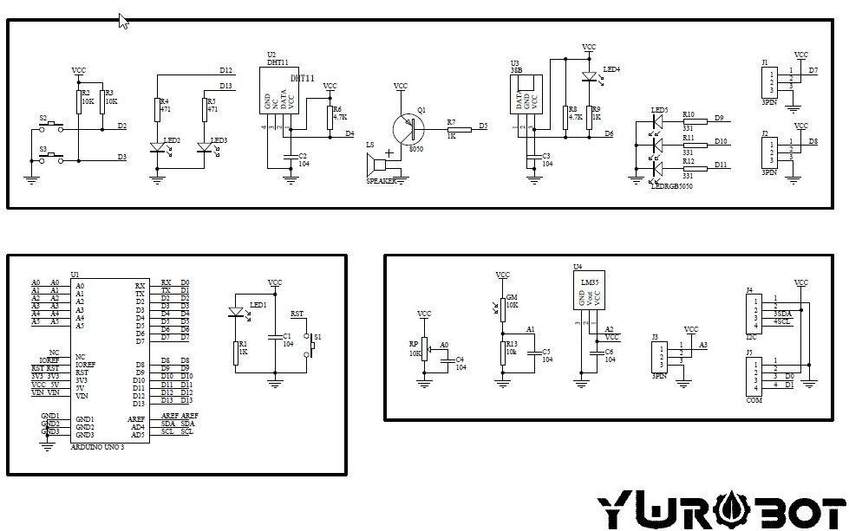
Multifunction Shield Diagram
This is the DHT11

Slide 4
DHT11 and its interfaces (1)
The DHT11 uses only one digital pin to communicate with a host computer
But this simple hardware interface means the software to interface to the DHT11 chip is quite complicated
So we will use a Library Function to allow us to work with this chip
This has some very important lessons common to all programming work

Slide 5
DHT11 Library Function
We use a DHT11 Library Function (from Adafruit) to allow us to use the DHT11 more easily
Idea of a Library Function:
Hide the low level details from the levels above it – interface by means of inputs and outputs and effects
Create a library function to allow this device to be used in many programs and applications, without forcing programmers to learn about the low level details
Hiding the details makes programs modular, so they’re easier to design debug and maintain

Slide 6
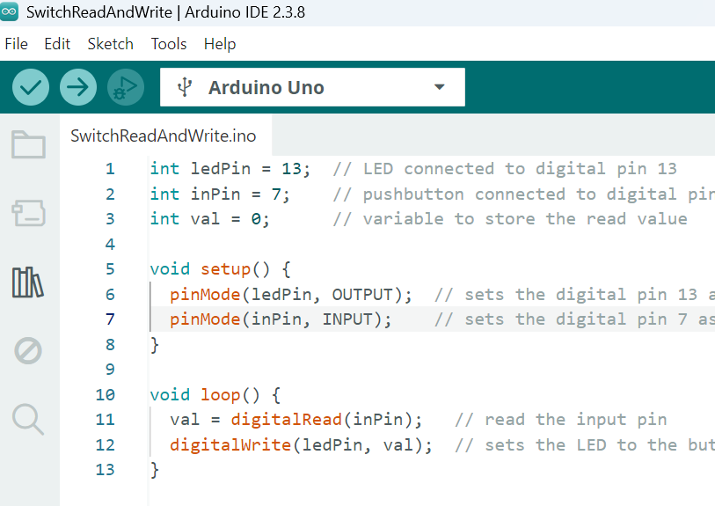
Arduino Library Manager (1)
First find the Library Manager
You could go Tools -> Manage Libraries
But it’s easier to use this icon

Slide 7
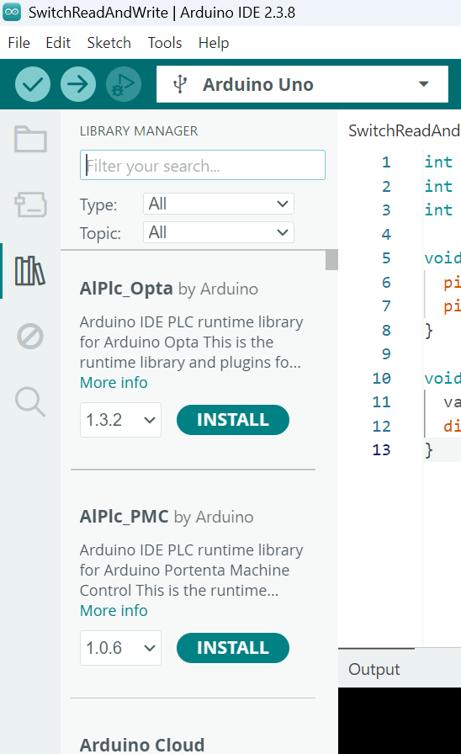
Arduino Library Manager (2)
We see a list of available libraries.
Some have already been installed
Others still need to be installed

Slide 8
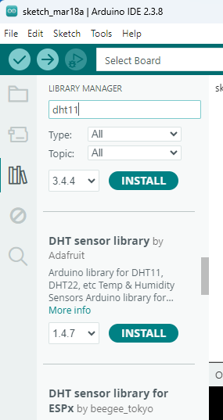
Arduino Library Manager (3)
Enter dht11 in the text box – a large number of libraries will appear
Scroll down until you find the DHT sensor library by Adafruit
Adafruit provide some of the best available library functions for Arduino
Select Install to add the library to your Arduino IDE
(If it has already been installed, you’ll see Remove instead of Install: DO NOT Remove it – it’s fine!)
If prompted, installed any supporting Adafruit libraries too)

Slide 9
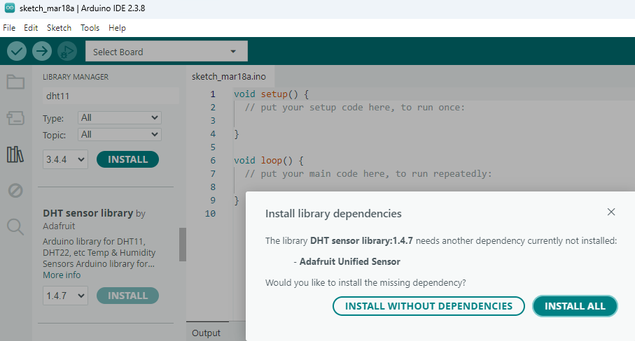
Arduino Library Manager (4)
Select the INSTALL ALL option

Slide 10
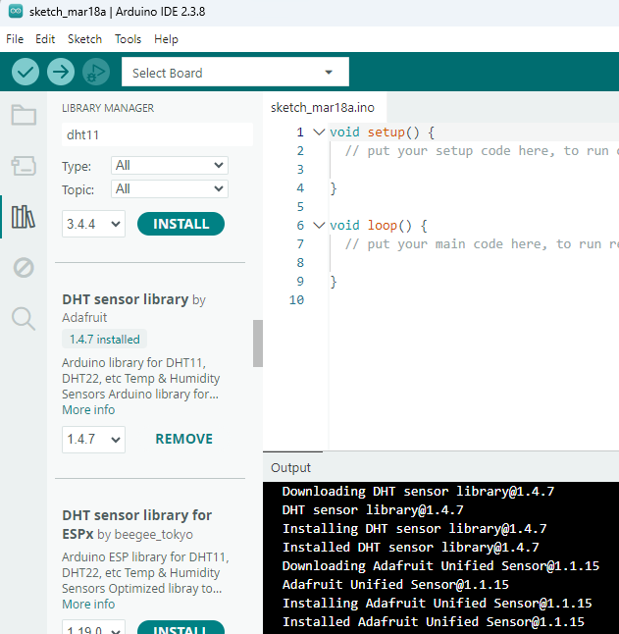
Arduino Library Manager (5)
When complete you will see a screen like this
Now we’re ready to go

Slide 11
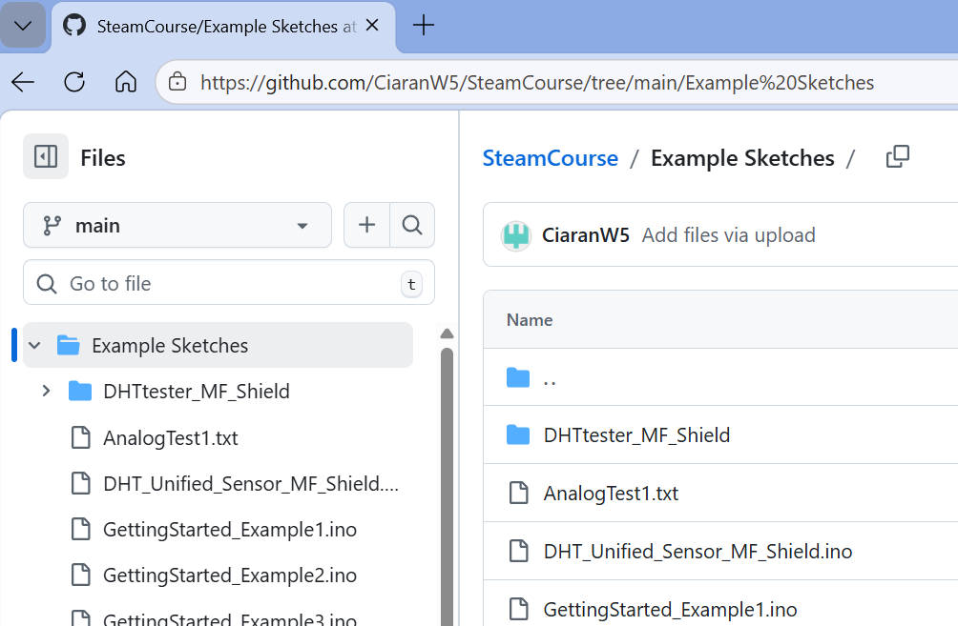
DHT Example (1)
Navigate to github.com/CiaranW5/SteamCourse
And select Example Sketches
Select DHT_Unified_Sensor_MF_Shield.ino

Slide 12
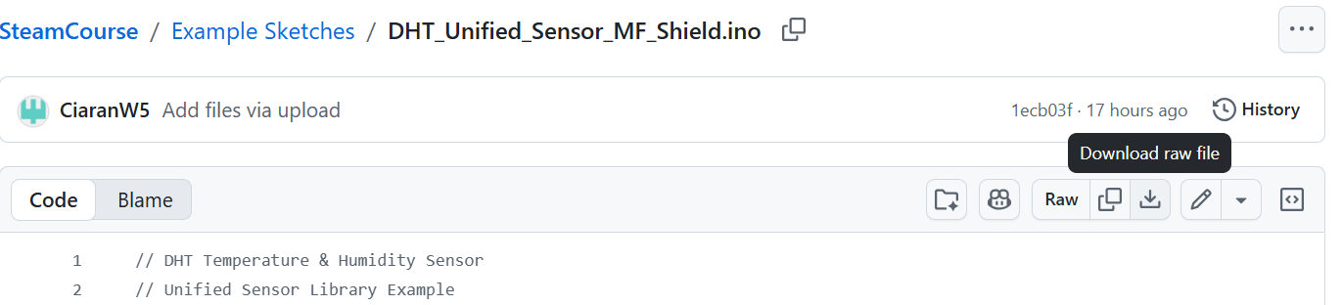
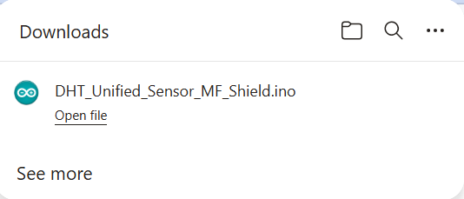
DHT Example (2)
Navigate to github.com/CiaranW5/SteamCourse
And select Example Sketches
Select Download raw file
When the file has downloaded, click on Open File

Slide 13
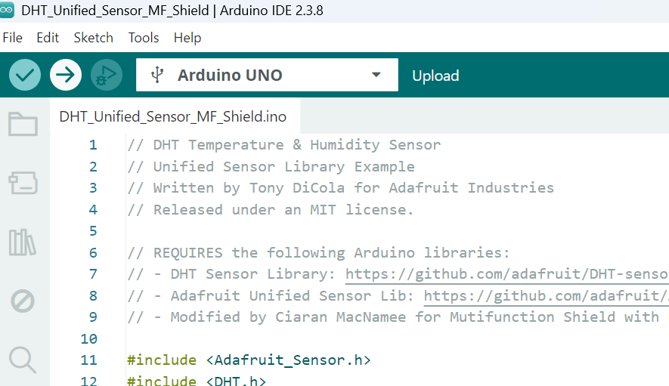
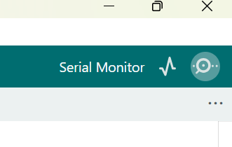
Using the example sketch
Connect up your Arduino and Shield, select the correct board and download the sketch to the board:
Then open the Serial Monitor
Use the Arrow icon

Slide 14
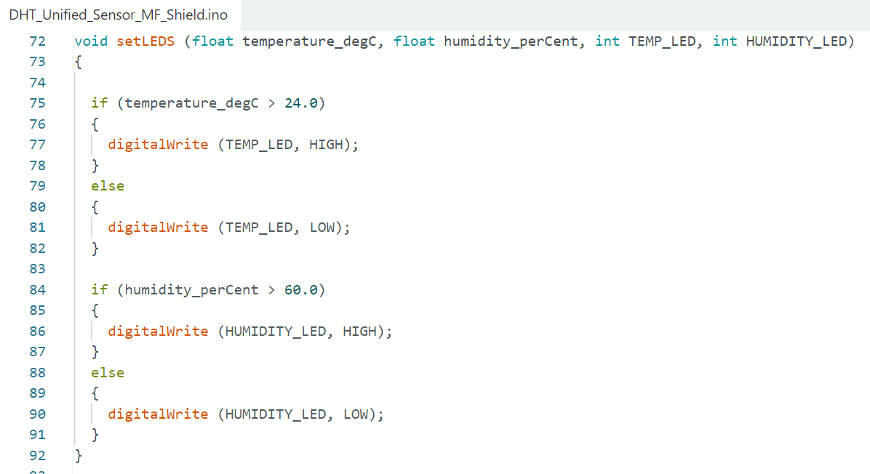
The setLEDS function (1)
The RED and BLUE LEDs are not named here
So other LEDS could be used without changing how this code runs

Slide 15
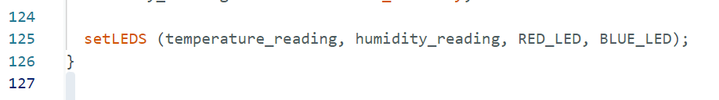
The setLEDS function (2)
This is how the setLEDS function is used: the parameter list passes parameters to the function which it can use
It’s the ORDER that the parameters appear in the lost that counts

Slide 16
The setLEDS function (3)
The setLEDS function allows us to put the operation of turning the LEDs on and off in its own function
setLEDS can be changed without affecting how the main program runs
It could be reused elsewhere if we wished
You can change the humidity and temperature with your breadth. Try it!
Change the LEDs used for temperature and humidity
Change the thresholds used for the leds to turn on and off

