Slide 1
Introduction to Embedded Systems using Arduino
Session 6: Ultrasonic Distance Measurement using HCSR04
Dr Ciaran MacNamee

Slide 2
What we’ll do today:
We’ll use an ultrasonic distance measurement device called HCSR04 to measure distance from the sensor to an object
Commonly used in cars and other vehicles
We can also use the Multifunction Shield for LED indication of distance
Possibly also the Buzzer as an alarm

Slide 3
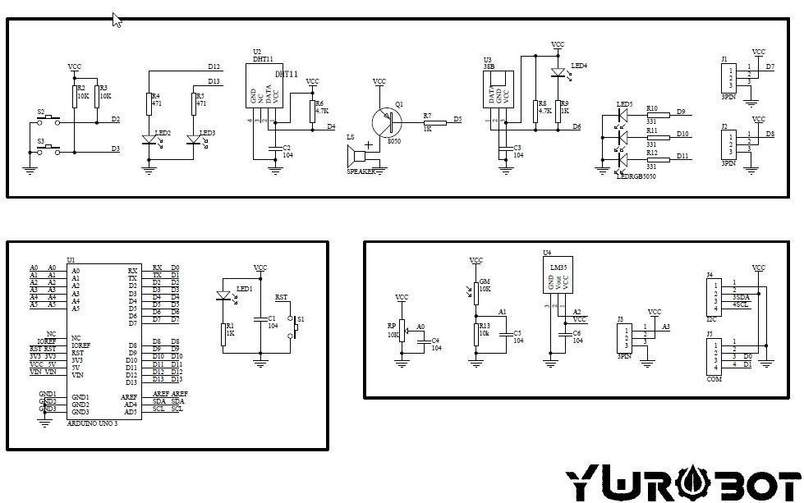
Multifunction Shield Diagram

Slide 4
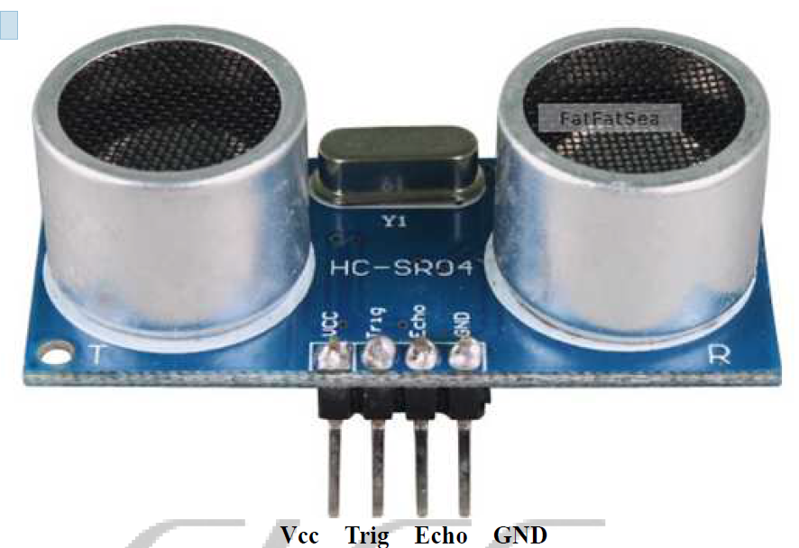
HCSR04 Ultrasonic Distance Measurement
Theory: Transmit an ultrasonic pulse and measure the time until its reflection is received
Distance = ((Time Taken) * Speed of Sound) /2
Arduino software sends out a short trigger pulse that triggers the US transmission
Then use the PulseIn() function to measure the time

Slide 5
Connections
Connect VCC to any VCC on the MF Shield
Connect GND to any GND on the MF Shield
Connect Trig to D7 on the MF Shield
Connect Echo to D8 on the MF Shield
Check with me before applying Power!

Slide 6
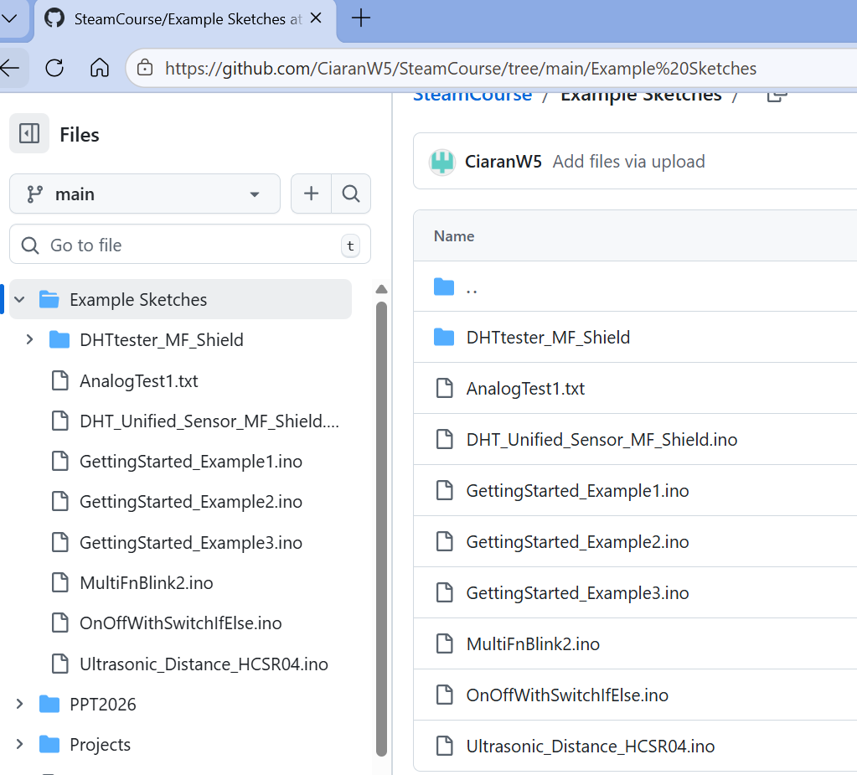
Ultrasonic Example Sketch
Navigate to github.com/CiaranW5/SteamCourse
And select Example Sketches
Select Ultrasonic_Distance_HCSR04.ino

Slide 7
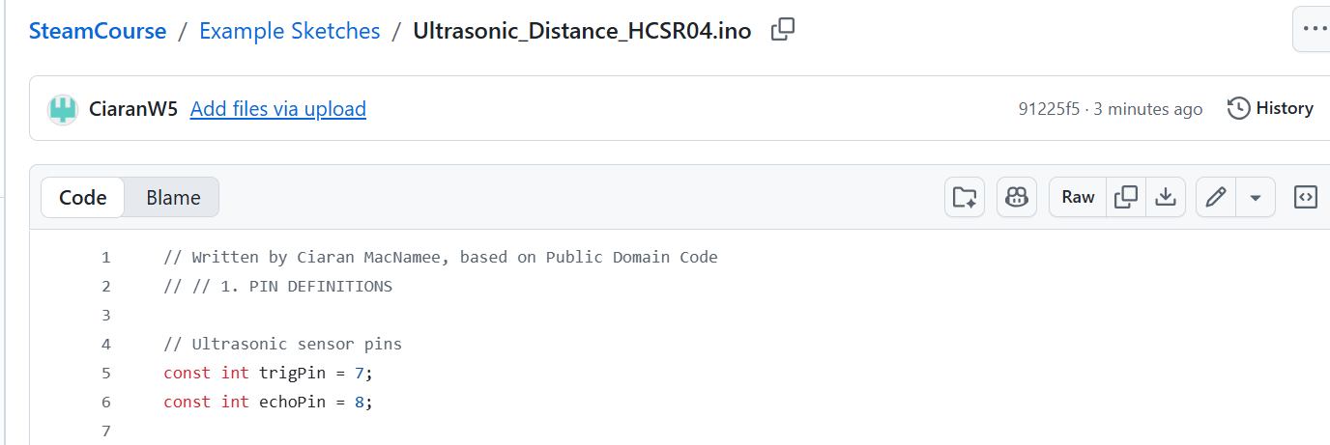
Ultrasonic Example Sketch (2)
Select Ultrasonic_Distance_HCSR04.ino
Select Download Raw File

Slide 8
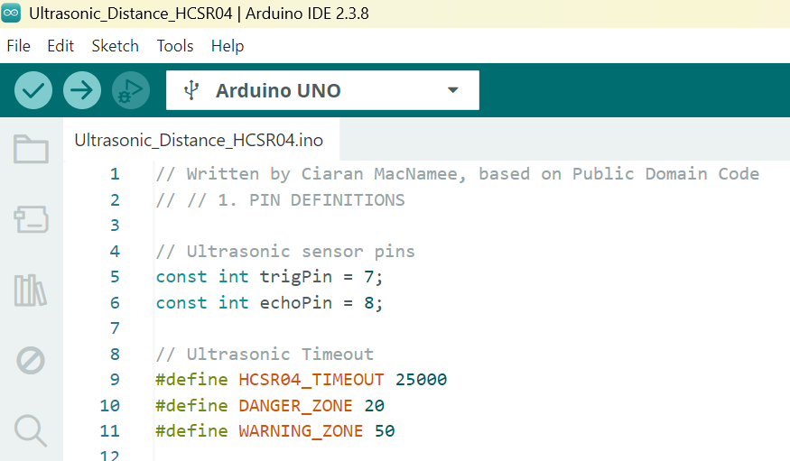
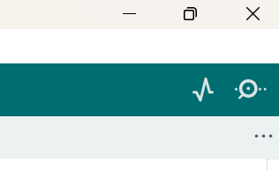
Using the Example sketch
Connect up your Arduino and Shield, select the correct board and download the sketch to the board:
Then open the Serial Monitor
Use the Arrow icon

