Slide 1
Introduction to Embedded Systems using Arduino
Session 4: Communicating using the Serial Port
Dr Ciaran MacNamee

Slide 2
Communicating with a user
Reading digital and analog inputs and driving LEDs is ok, but we want to do more
How do we report results to a user who has a PC?
Arduino uses a Serial Port for this type of communications

Slide 3
Communicating with Others
Arduino can use same USB cable for programming and to talk with computers
Talking to other devices uses the “Serial” commands
TX – sending to PC
RX – receiving from PC

Slide 4
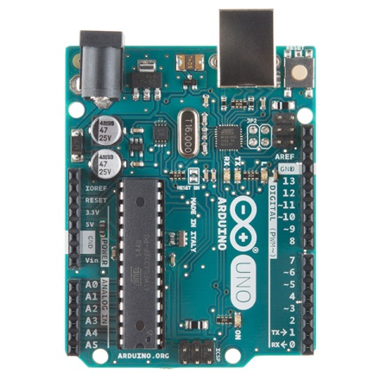
Arduino UNO R3 TX and RX
TXD and RXD are shared with PORTD bit 1 and bit 0
Arduino Digital Pins 1 & 0

Slide 5
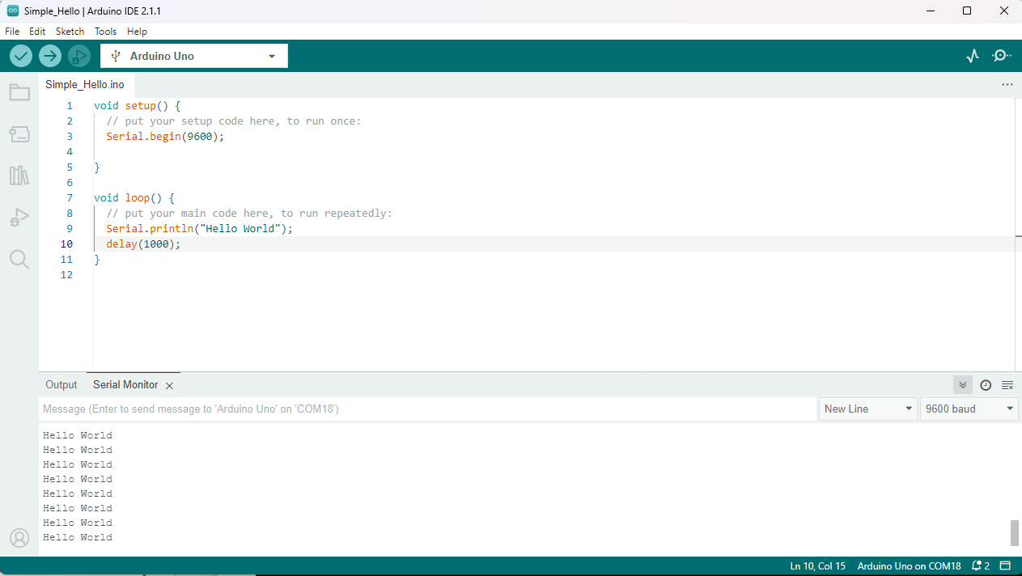
Serial Communications
Sends “Hello world!” to your computer
Click on “Serial Monitor” button to see output

Slide 6
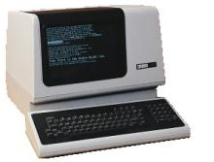
Arduino Serial Communications
Is just serial communications
Simple Arduino doesn’t really do USB
It really is “serial”, like old RS-232 serial
All microcontrollers can do serial
Not many can do USB
For the programmer:
Serial is easy, USB is hard
serial terminal from the old days

Slide 7
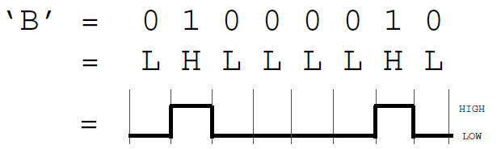
Serial Communications
“Serial” because data is broken down into bits, each sent one after the other down a single wire.
The single ASCII character ‘B’ is sent as:
ATmega328P has a USART module that does the Serial Port interfacing and timing for us
Toggle a pin to send data, just like blinking an LED
You could implement sending serial data with digitalWrite() and delay()
A single data wire needed to send data. One other to receive.

Slide 8
Arduino UNO R3 TX and RX
USB to Serial Interface
The USB to Serial Interface puts the serial data into USB packets
At the PC side, a Virtual COM port takes the serial data from USB packets
So end-to-end it looks like a simple serial interface but actually carried over the USB
Arduino Microcontroller

Slide 9
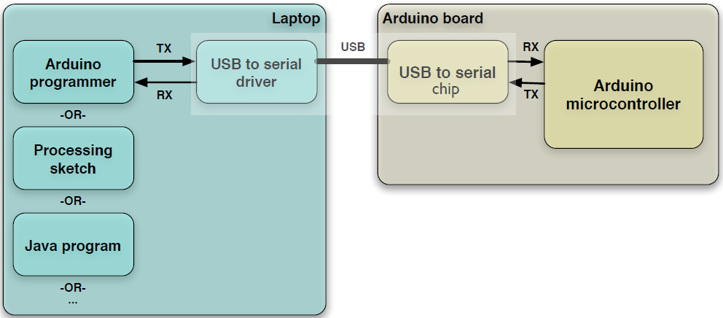
Arduino to Computer
Original Arduino boards were RS-232 serial, not USB
All programs that talk to Arduino (even the Arduino IDE) think that they’re talking via a serial port

Slide 10
Arduino & USB
Simple Arduino is all about serial, not USB
So interfacing to things like USB flash drives, USB hard disks, USB webcams, etc. is not possible
Also, USB is a host/peripheral protocol
Being a USB “host” needs a lot of processing power and software, not good for a small 32kB microcontroller
But Arduino can be a USB peripheral.

Slide 11
Sending Information from Arduino to Your Computer
This sketch prints sequential numbers on the Serial Monitor:
void setup(){
Serial.begin(9600); // send and receive at 9600 baud
}
int number = 0;
void loop(){
Serial.print("The number is ");
Serial.println(number); // print the number
delay(500); // delay half second between numbers
number++; // to the next number
}
Output is:
The number is 0
The number is 1
The number is 2

Slide 12
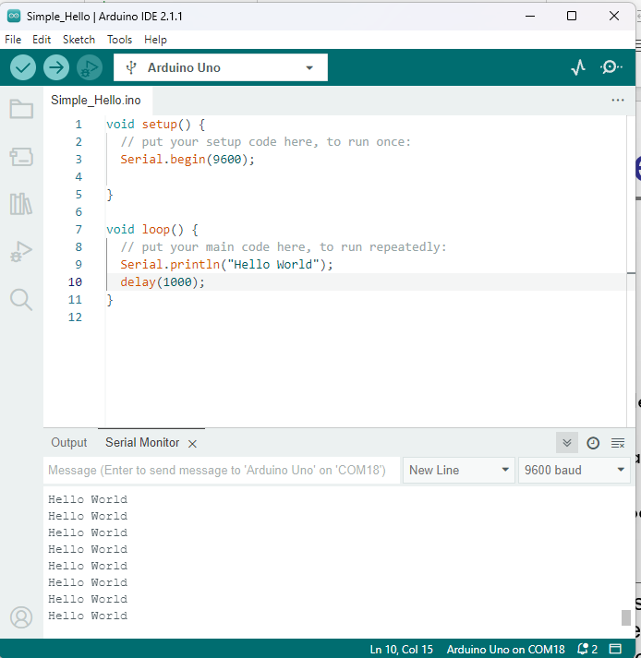
Baud rate
First call the
Serial.begin()
The function takes a single parameter: the desired communication speed (baud).
You must use the same speed for the sending side and the receiving side.

Slide 13
Sending information
You can display text using the Serial.print()or Serial.println() function
println() – prints the data followed by a carriage return character and a newline character
These commands can take many forms
Numbers are printed using an ASCII character for each digit
Floats are similarly printed as ASCII digits, defaulting to two decimal places
Bytes are sent as a single character
Characters and strings are sent as is

Slide 14
Strings
This is mostly for reference purposes here
String message = "This string"; //C++ type strings
  message.length()
  //provides thenumber of characters) in the string
  message.concat(anotherMessage)
  //appends the contents of anotheMessage to message (also + operator)
  message.substring(s, e);
  //returns a substring starting from s till e
  You can use the indexOf and lastIndexOf functions to find an instance of a particular character in a string
char message[8] = "Arduino"; //C type string
  int length = strlen(message);
  // return the number of characters in the string
  strcpy(destination, source);
  // copy string source to destination
  strcat(destination, source);
  // append source string to the end of the destination string
  if(strcmp(str, "Arduino") == 0)
  // do something if the variable str is equal to "Arduino"

Slide 15
Comparing C type Strings
This is mostly for reference purposes here
char str1[ ] = "left";
char str2[ ] = "right";
if(strcmp(str1, str2) == 0)
Serial.print("strings are equal)
strcmp("left", "leftcenter") == 0)
// this will evaluate to false
strncmp("left", "leftcenter", 4) == 0)
// this will evaluate to true

Slide 16
String Object
This is mostly for reference purposes here
charAt(n) or [n] - Access a particular character of the String
concat(parameter) or + - Appends the parameter to a String
endsWith(string2) - Tests whether or not a String ends with string2
equals(string2) or == - Compares two strings for equality (case sensitive)
indexOf(val, [strt]) – locates val in a String by searching forward starting from strt index. To search backward use lastIndexOf(val,[strt])
length() - Returns the length of the String, in characters
remove(index,[count]) – remove all characters (or count caracters if given) from a String starting from index
replace(substring1, substring2) – Replace all instances of substring1 in a String to substring2
setCharAt(index, c) - Sets a character to c at index of the String
startsWith(string2) - Tests whether or not a String starts with the string2
substring(from, [to]) - Get a substring of a String, from - inclusive, to – exclusive
toInt() or toFloat() - Converts a valid String to an integer or float
toLowerCase() or toUpperCase() - Get a lower-case or upper-case version of a String
trim() - Get a version of the String with any leading and trailing whitespace removed

Slide 17
Mathematical Operators
This is mostly for reference purposes here

Slide 18
Compare Character and Numeric Values
This is mostly for reference purposes here

Slide 19
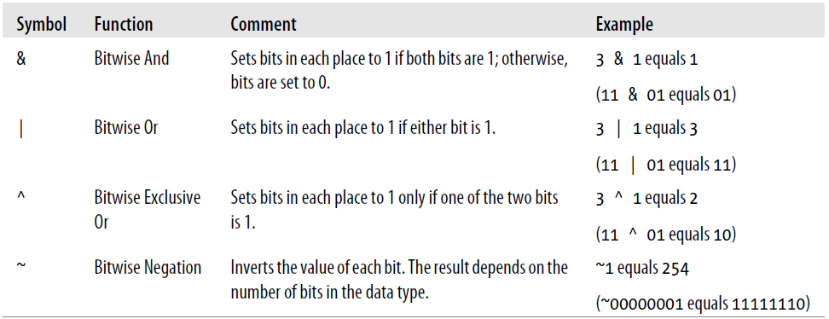
Logical and Bitwise operators
This is mostly for reference purposes here
Logical operators
Bitwise operators

Slide 20
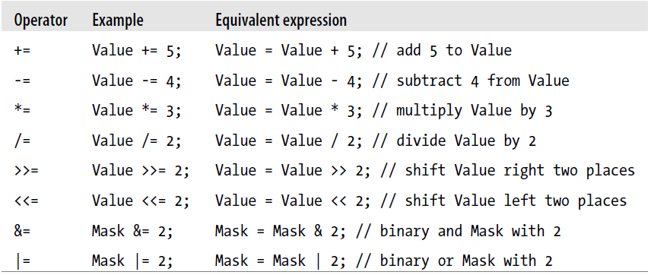
Combine Operations and Assignment
This is mostly for reference purposes here

Slide 21

Advanced Mathematical Operators
This is mostly for reference purposes here

Slide 22
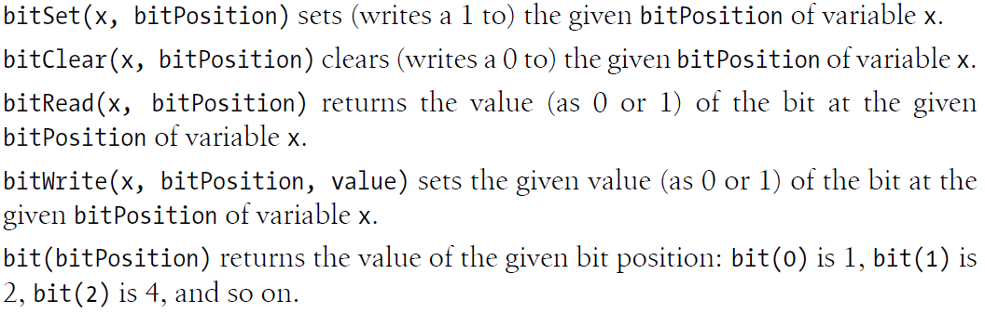
Other Useful Operators
This is mostly for reference purposes here

Slide 23
Functions
type functionName(parameters)
{
statements;
}
Functions are declared by first declaring the function type. This is the type of value to be returned by the function such as 'int' for an integer type function. If no value is to be returned the function type would be void. After type, declare the name given to the function and in parenthesis any parameters being passed to the function.
int delayVal()
{
int v; // create temporary variable 'v'
v = analogRead(pot); // read potentiometer value
v /= 4; // converts 0-1023 to 0-255
return v; // return final value
}

Slide 24
Receiving Serial Data in Arduino
Serial.available() - Get the number of bytes (characters) available for reading from the serial port. If > 0, we have data
This is data that's already arrived and stored in the serial receive buffer (which holds 64 bytes)
Serial.read() - Reads incoming serial data
Serial.readBytes(buffer, length) - reads characters from the serial port into a buffer. The function terminates if the determined length has been read, or it times out

Slide 25
Controlling Arduino
int ledPin = 12; // choose a pin for LED
int val = 0; // variable to store the data received via Serial port
void setup() {
pinMode(ledPin,OUTPUT); // make ledPin an output
Serial.begin(9600); // initialize the Serial port
}
void loop () {
// Serial.available() – is a method to see whether something is
// received or not via Serial port without pausing the main program
if( Serial.available() ) {
val = Serial.read(); // read the value received via Serial port
if( val == 'H' ) { // if ‘H’, then blink
digitalWrite(ledPin, HIGH);
delay(1000);
digitalWrite(ledPin, LOW);
}
}
}

Slide 26
Tasks with Serial communications (1)
Read the number N from Serial port and make LED blink N times
  You may need Serial.parseInt() for this
Ask the user to input a delay time, greater than 100 and less than 5000 and use this delay time in our RGB LED program
Read a value from the Analog Input Pin 0, convert it to a voltage, and report the voltage value to the user using the serial port, every second
Repeat the task using a Baud Rate of 115200 Baud

Slide 27
Tasks with Serial communications (2)
Read a value from Analog Input Pin 1, convert it to a voltage, report the voltage to the user using the serial port
  Analog Input Pin 1 is connected to a Light Dependent Resistor (LDR)
  Modify your program to tell the user (every 5 seconds) if it is bright or dark
Read a value from Analog Input Pin 2, convert it to temperature, report the temperature to the user using the serial port
  Analog Input 2 is connected to temperature sensor, where 0.1V corresponds to 1 degree C

Slide 28
Tasks with Serial communications (3)
Read a value from the DHT11 Temperature and Humidity Sensor and report your results to the user on the serial port at a rate set by the user
You will need to use an Arduino Sensor Library for this task, which we’ll describe in the lab session
(I recommend using the Adafruit DHT Sensor Library)

Slide 29
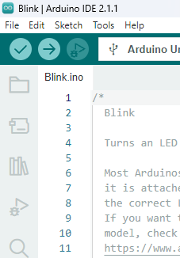
Adding an Arduino Library for your sketch (1)
Arduino gives you libraries to make it easy to interface to and use many sensors
This example uses the DHT11 one wire Temperature and Humidity sensor
  The interface to this device is complicated but the library hides the difficult parts
Begin by opening the Library Manager
Library Manager

Slide 30
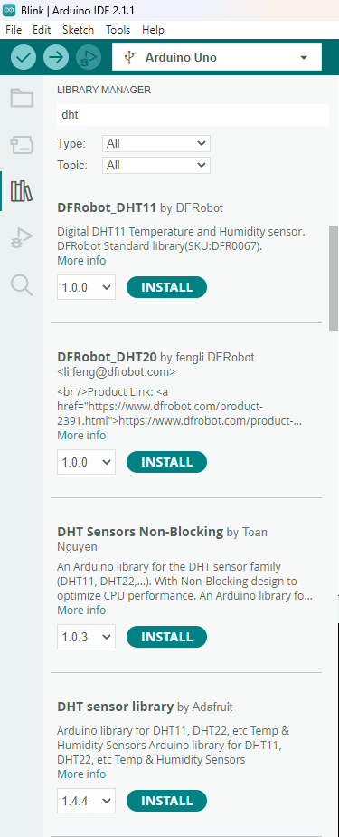
Adding an Arduino Library for your sketch (2)
In the Library Manager, enter dht in the search box
You’ll see that Arduino has several DHT11 and DHT22 libraries
I recommend using the Adafruit library
It is very reliable
I recommend this one
Press INSTALL

Slide 31
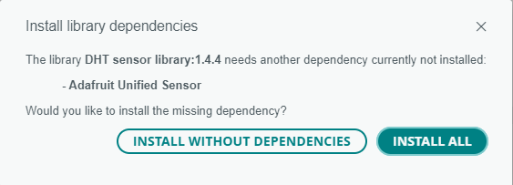
Adding an Arduino Library for your sketch (3)
Arduino DHT sensor library needs another library
Select INSTALL ALL

Slide 32
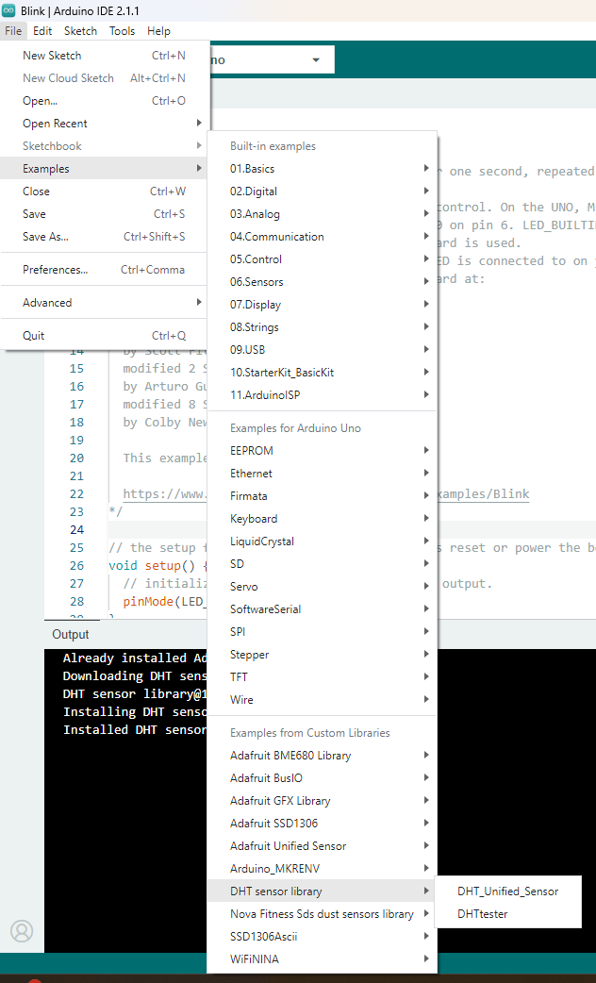
Adding an Arduino Library for your sketch (4)
When you install a library, it usually gives you some examples sketches to help you use the library and the sensor
This example shows how to find the examples for the Adafruit DHT Library
Select the DHTtester example sketch

Slide 33
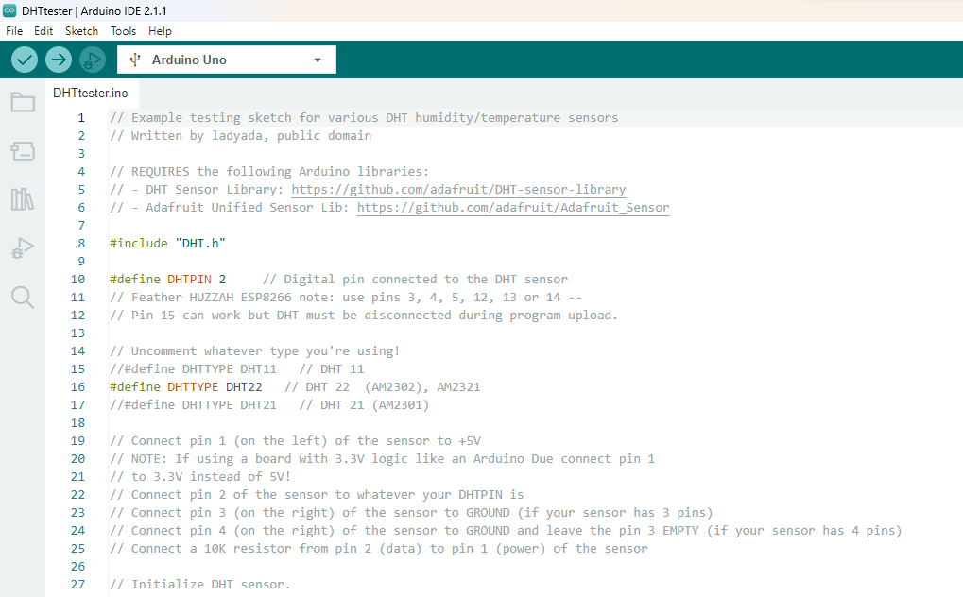
Adding an Arduino Library for your sketch (5)
The example defaults to support for DHT22 on Arduino Digital Pin2
Change DHTPIN to 4
Comment out #define DHTTYPE DHT22
Uncomment #define DHTTYPE DHT11

Slide 34
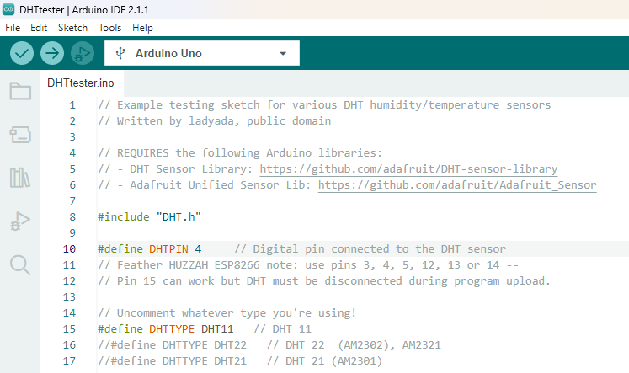
Adding an Arduino Library for your sketch (6)
Also try out the DHT_Unified_Sensor example
The example defaults to support for DHT22 on Arduino Digital Pin2
Change DHTPIN to 4
Comment out #define DHTTYPE DHT22
Uncomment #define DHTTYPE DHT11
Save your sketch, then compile and load it to your Arduino
Open the Serial Monitor to see the output

Slide 35
DHT11 Exercises
Try out the DHT_Unified_Sensor example
How is this different from the DHT_Tester example?
Vary the temperature and humidity measured by the DHT11 sensor
  You could use your breath for this!
What outputs to you see?

