Slide 1
Introduction to Embedded Systems using Arduino
Session 2: Getting Started 2
Dr Ciaran MacNamee

Slide 2
Getting Started
Arduino Software should be installed on Lab PCs
If not – install it from www.arduino.cc – Downloads
Start Arduino in Windows
And connect your Arduino

Slide 3
Next Arduino Exercise
We can blink the LED on the Arduino Board
This time, we’d like to read a switch and use that to turn ON or turn OFF a LED
This simple exercise is the basis for many real world actions
We use a construction called IF … ELSE
If a switch is not pressed, turn the LED OFF
ELSE (i.e. if it is pressed), turn the LED ON
First a quick look at some program structures, then a look at our Shield

Slide 4
Flow control
Similar to other programming languages
1. if
if(expression){ //if expression is true
doSomething;
}
2. if… else
if(inputPin == HIGH){
doThingA;
} else{
doThingB;
}
3. for
for (initialization; condition; expression){
doSomething;
}
4. while
while (expression){
doSomething;
}
5. do… while
do {
doSomething;
} while (expression);
if (inputPin < 500){
doThingA;
}
else if (inputPin >= 1000){
doThingB;
}
else{
doThingC;
}
for(j=0; j < 4; j++ ){
Serial.println(j);
}
while (someVariable < 200){ //if less than 200
doSomething; // executes enclosed statements
someVariable++; // increments variable by 1
}
do{ // assign readSensors value to x
x = readSensors();
delay (50); // pauses 50 milliseconds
} while (x < 100); // loops if x is less than 100

Slide 5
Shield Connections
RGB Package:
Digital 9: Red
Digital 10: Green
Digital 11: Blue
Separate LEDs:
Digital 12: Red
Digital 13: Blue
Digital 5: Buzzer
Analog 0: Potentiometer
Analog 1: Light Dependant Resistor
Analog 2: LM35 Temperature Sensors

Slide 6
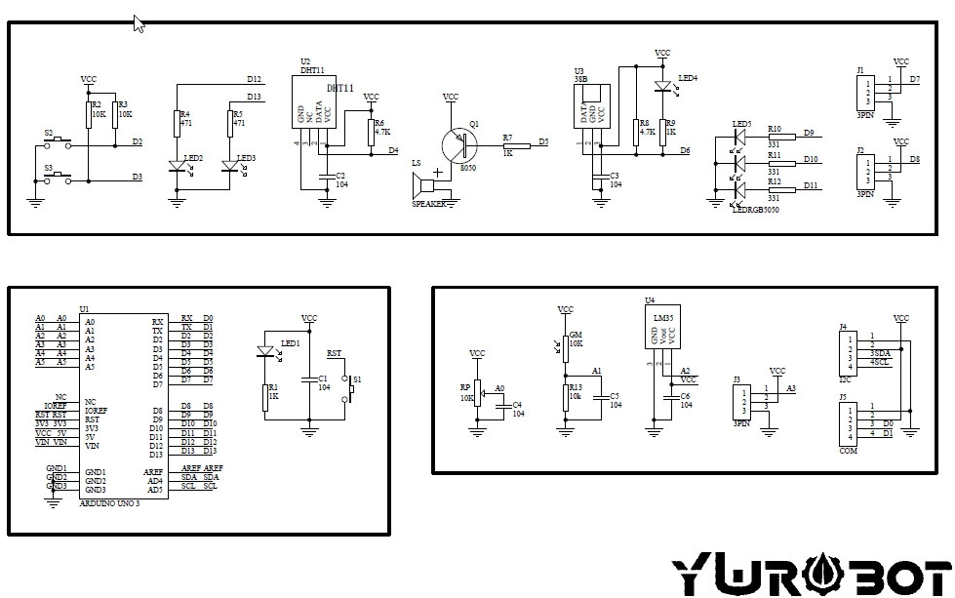
Shield Schematic

Slide 7
Digital Inputs and Outputs
Computers understand 1s and 0s ONLY
  Just as in arithmetic we can combine groups of 1s and 0s to form binary numbers
Usually when we read a digital input we read a ‘1’ (HIGH) or a ‘0’ (LOW), and in our case ‘1’ means close to 5V and ‘0’ means close to 0V
  In other cases ‘1’ could be 3.3V or 1.8V depending on the chips used in the computer
When we write a ‘1’ we will output 5V (approx.) and when we output a ‘0’ we output 0V (approximately)

Slide 8
Analog Inputs and Outputs (1)
Computers understand 1s and 0s ONLY
But the real world is not like that
Temperature, voltage, distance etc all vary continuously
These are called analog quantities
To work with these quantities in a computer we have to convert the analog values into a digital representation – a number
Arduino UNO has an analog to digital converter (ADC) on-chip to do this

Slide 9
Analog Inputs and Outputs (2)
We can access the ADC in Arduino using a library function called analogRead();
We’ll see this again soon
Arduino UNO has no Analog Output because it has no Digital to Analog Converter (DAC)
Its Analog Write function uses Pulse Width Modulation
Too complicated for now

Slide 10
How to read a Digital Input
We read the switch state using the digital Read library
This function returns a value of ‘1’ or ‘0’
To use the value, we have to store it in a variable
In this case an ‘int’ variable
See: digitalRead() | Arduino Documentation
This has an example:

Slide 11
Digital Read and Write Example (1)
Exercise: Modify this sketch to work on our Shield using SW1 (Digital Pin 2) and the RED LED (Digital Pin 12)
int ledPin = 13; // LED connected to digital pin 13
int inPin = 7; // pushbutton connected to digital pin 7
int val = 0; // variable to store the read value
void setup() {
pinMode(ledPin, OUTPUT); // sets the digital pin 13 as output
pinMode(inPin, INPUT); // sets the digital pin 7 as input
}
void loop() {
val = digitalRead(inPin); // read the input pin
digitalWrite(ledPin, val); // sets the LED to the button's value
}

Slide 12
Digital Read and Write Example (2)
#define MM_SWITCH 2
#define BB_LED 13
void setup() {
// initialize digital pin BB_LED as an output, and MM_SWITCH as an INPUT
pinMode(BB_LED, OUTPUT);
pinMode(MM_SWITCH, INPUT);
}
void loop() {
int SwitchState = 0;
SwitchState = digitalRead(MM_SWITCH);
if (SwitchState == HIGH)
{
digitalWrite(BB_LED, HIGH); // turn the LED on (HIGH is the voltage level)
}
else
{
digitalWrite(BB_LED, LOW); // turn the LED off by making the voltage LOW
}
}
See OnOffWithSwitchIfElse
This is overkill but it shows how if … else works

Slide 13
Reading an Analog Input (1)
The Arduino UNO’s AtMega328P (and any microcontroller) samples an input voltage and converts it to a digital representation of the input voltage
The ADC has 10 bits, and defaults to converting voltages between 0V and 5V to a number
If the input is 0V, the ADC returns a value of 0
If the input is 1V, the ADC returns a value of 1023
Why do you think this is the case?
If Vin = 2V, the ADC result will be 409 (only integer values are returned)

Slide 14
Reading an Analog Input (2)
You can convert the input reading to a voltage reading using the equation
Vin = ((ADC_Reading) * 5.0)/1023
But you need to use floating point variables because the result is not an integer (we’ll see these later)
Reference: analogRead() | Arduino Documentation
In the link above you’ll find an example sketch. Modify it for use on our shields which have a potentiometer on A0.
Also see Built In Examples AnalogReadSerial and ReadAnalogVoltage

Slide 15
Analog Input with if … else and a LED
Try writing a sketch using the Analog Input to turn on or off the RED LED
  If the analog in value is less than 512, turn OFF the LED
  Else turn it ON
Try writing a sketch using the Analog Input to Blink the Blue LED at different rates
  If the analog in value is less than 256 blink the Blue LED with 2 seconds on/off time (delay(2000))
  Else blink the Blue LED with one quarter of a second on/off time (delay(250))

Slide 16
Printing output to a terminal
The library functions Serial.print and Serial.println allows us to send data to a terminal in Arduino
Using the Arduino serial port
Serial.print writes some data and Serial.println writes the data and moves to the start of a newline
Serial.println() | Arduino Documentation
See the example file ‘DigitalReadSerial
Note that before using Serial.print or Serial.println we must first initialise the serial port and specify the number of bits per second being used

Slide 17
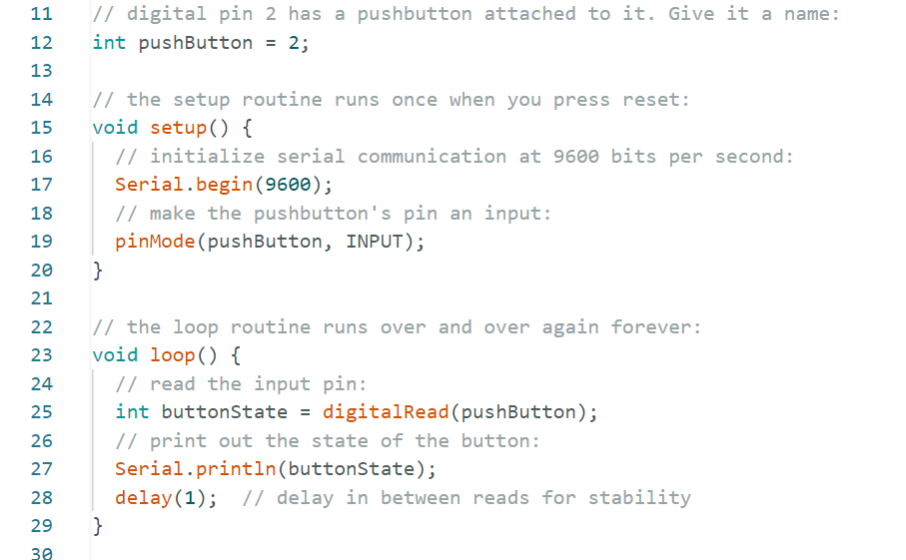
Try modifying this for our Shield
This initialises the Serial Port
This line writes out to the Arduino Terminal Window

Slide 18
Your turn
Try combining the programs we have:
If the PB switch is not pressed (HIGH) blink the Blue LED once per second (delay(1000)
Else blink the Blue LED every quarter second (delay(200))
Make a new sketch for this or modify an old one

Slide 19
Next Arduino Exercise
We can blink the LED on the Arduino Board
Let’s go further
This time, we’re going to blink several LEDs on a Shield board that has a 5 LEDs
Three LEDS (Red, Green and Blue) are placed together in one packages
We’re going to turn on one LED at a time across the package

Slide 20
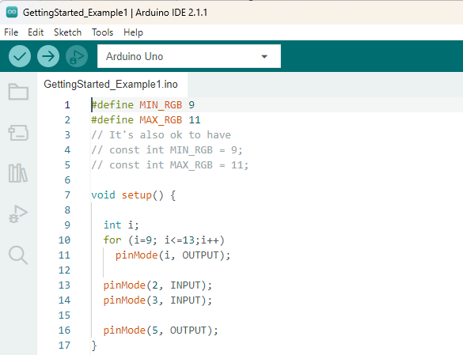
Getting started (1)
This is the file we’re going to use
First look at setup();
We set the pins we want to use to be outputs

Slide 21
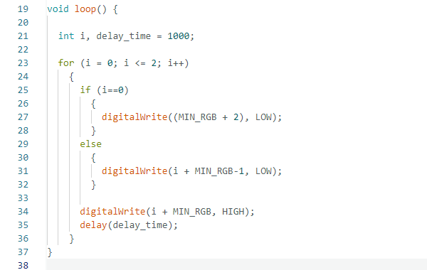
Getting started (2)
Flashes Red -> Green -> Blue

Slide 22
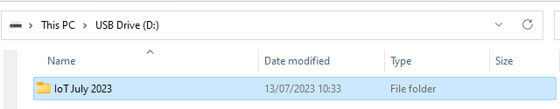
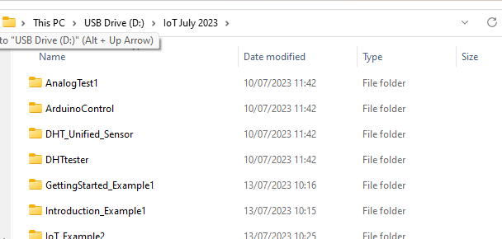
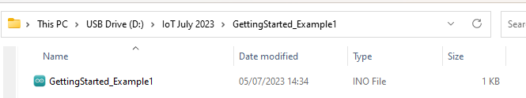
Getting started 3
You can find these files on the supplied USB for this module
Arduino sketches end in the suffix .ino
Copy this file to a folder on your computer called Documents\Arduino

Slide 23
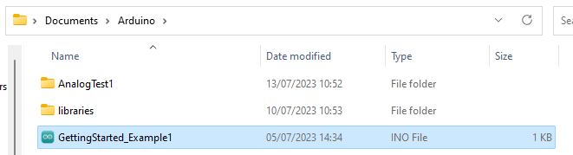
Getting started 4
Now open up Arduino and select File … Open
Select the file you have just downloaded (GettingStarted_Example1.ino)
Your folder might look a bit different here
This is the file you want

Slide 24
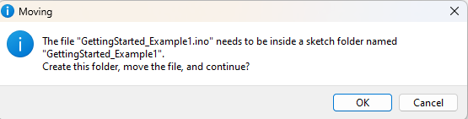
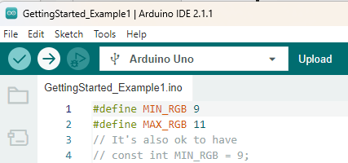
Getting started 5
Select the .ino file and you’ll get the following prompt:
Press ‘OK’ to load the file into the Arduino environment
Now Compile and Upload your sketch to the Arduino Board – just like we did with Blink
This time, after you have done this, attach a Shield with LEDs to the Arduino and note what is happening
Select this option to compile your sketch and also program your Arduino UNO

Slide 25
Modify the program:
In class we’ll look at how this program works
Then try the following exercises:
Change the LED sequence from R-G-B to
All OFF-R-G-B
The sketch uses an on/off time of 1 second (1000 milliseconds)
Try to change the delay time to 0.5 seconds
Try to change the delay time to 2 seconds

Slide 26
Other Examples and Solutions
GettingStarted_Example2 implements the sequence: All OFF-R-G-B
GettingStarted_Example3 uses the SW2 (D2) button to select between two ways of using the RGB LEDs: only one on at a time or combinations of LEDs.
All LEDs on together gives a white light – but depends on how close and how bright the LEDs are

Slide 27
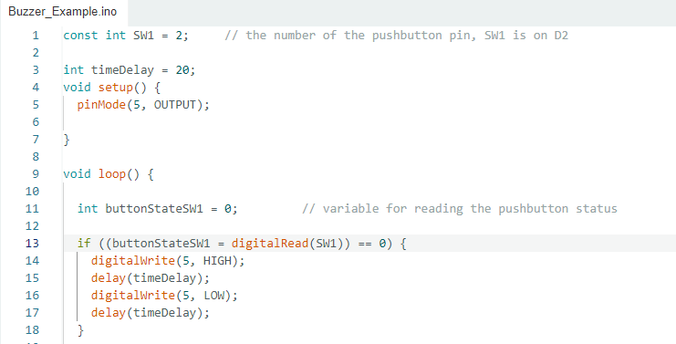
Buzzer_Example
Buzzer_Example.ino is a sketch that uses the Buzzer attached to Digital Pin 5 on the Shield
The sketch reads the state of the Switch and sounds the buzzer if the Switch is pressed
What do you notice about the way that the push button switch, SW1, is used?

Slide 28
Modify the Buzzer_Example
Modify the Buzzer_Example sketch to change the buzzer tone
  What is the effect of changing the delay time?
Modify the Buzzer_Example sketch to change the buzzer tone, based on the state of SW2
  If SW1 is pressed, select a lower tone, else select a higher tone

