Slide 1
Introduction to Embedded Systems using Arduino
Session 7: OLED display using I2C Synchronous Serial Interface
Dr Ciaran MacNamee

Slide 2
Synchronous Serial Interfaces
As well as the (asynchronous) serial interface we have been using, many microcontrollers, including Arduino, also use two synchronous serial interfaces: I²C and SPI
We’ll look at them briefly and then move onto using I²C as an interface to an OLED display

Slide 3
Synchronous Serial Interfaces
SPI (Serial Peripheral Interface) and I²C (Inter-Integrated Circuit) interfaces are synchronous serial communications interfaces
Synchronous means that a common clock signal is used to interface between devices
In comparison the UART used for Serial in Arduino does not use a common clock - it is asynchronous
SPI and I²C are used for short-distance communications - often on the same board or in the same system

Slide 4
I2C – Two Wire Interface
Inter-Integrated Circuit (I²C) Bus is a 2-wire synchronous serial bus originally developed by Philips that is widely used for communications with many devices
Smaller number of wires is an advantage but comes at a cost
You cannot get data to go in both directions simultaneously
Half-Duplex only – one at a time
Master transmits, then if needed slave transmits
Also means that I²C needs a ‘protocol’ to sort out the order of transmit/receive

Slide 5
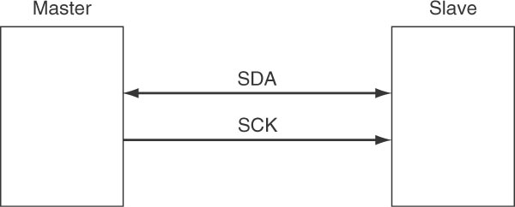
I2C Data Flow
SCK goes from Controller to Peripheral
SDA is bi-directional
I2C devices each have an address, which is detected
Only the addressed device takes part in the transmission
This is a true 2-wire bus

Slide 6
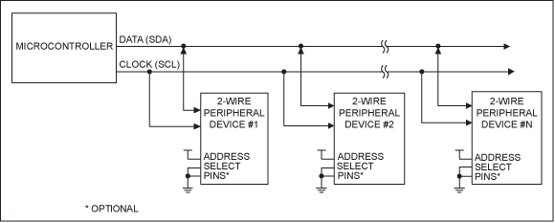
I2C Operation
SCL and SDA are open-drain lines
Their Idle state is high
Open drain signals need a pull-up resistor to work
When a 3V supply is used, use a 1kΩ or greater pullup resistor on SCL and SDA
When using a 5V supply, use a 1.6k Ω or greater pullup resistor

Slide 7
I2C in Arduino
The I2C protocol is quite complicated and Arduino makes your life easier by providing a library called ‘wire’ that handles the low-level details of an I2C interface
Use it by including the following lines at the start of your sketch:
This gives you access to a lot of useful functions
// include the library code:
#include <Wire.h>

Slide 8
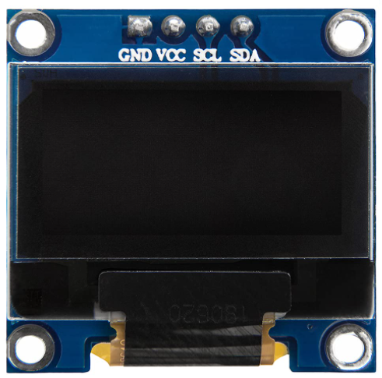
OLED SSD1306 display using I2C
SSD1306 is an OLED display that you can use for graphics and/or text
It is small but very useful and powerful and some versions have colour displays
We’ll use it for simple text, but you might like to try a few different options yourselves
Note the I2C interface pins and the VCC and Ground Connections
You’ll need to connect these pins to the Arduino using jumper wires
The OLED SSD1306 driver has an I2C address = 0x3c

Slide 9
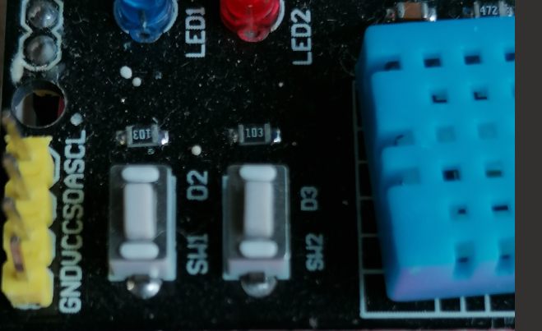
Shield I2C pins
Connect these pins to the SSD1306 OLED display using jumper wires
Be careful of the order of the pins:
They are not exactly in the same places on the SSD1306 display

Slide 10
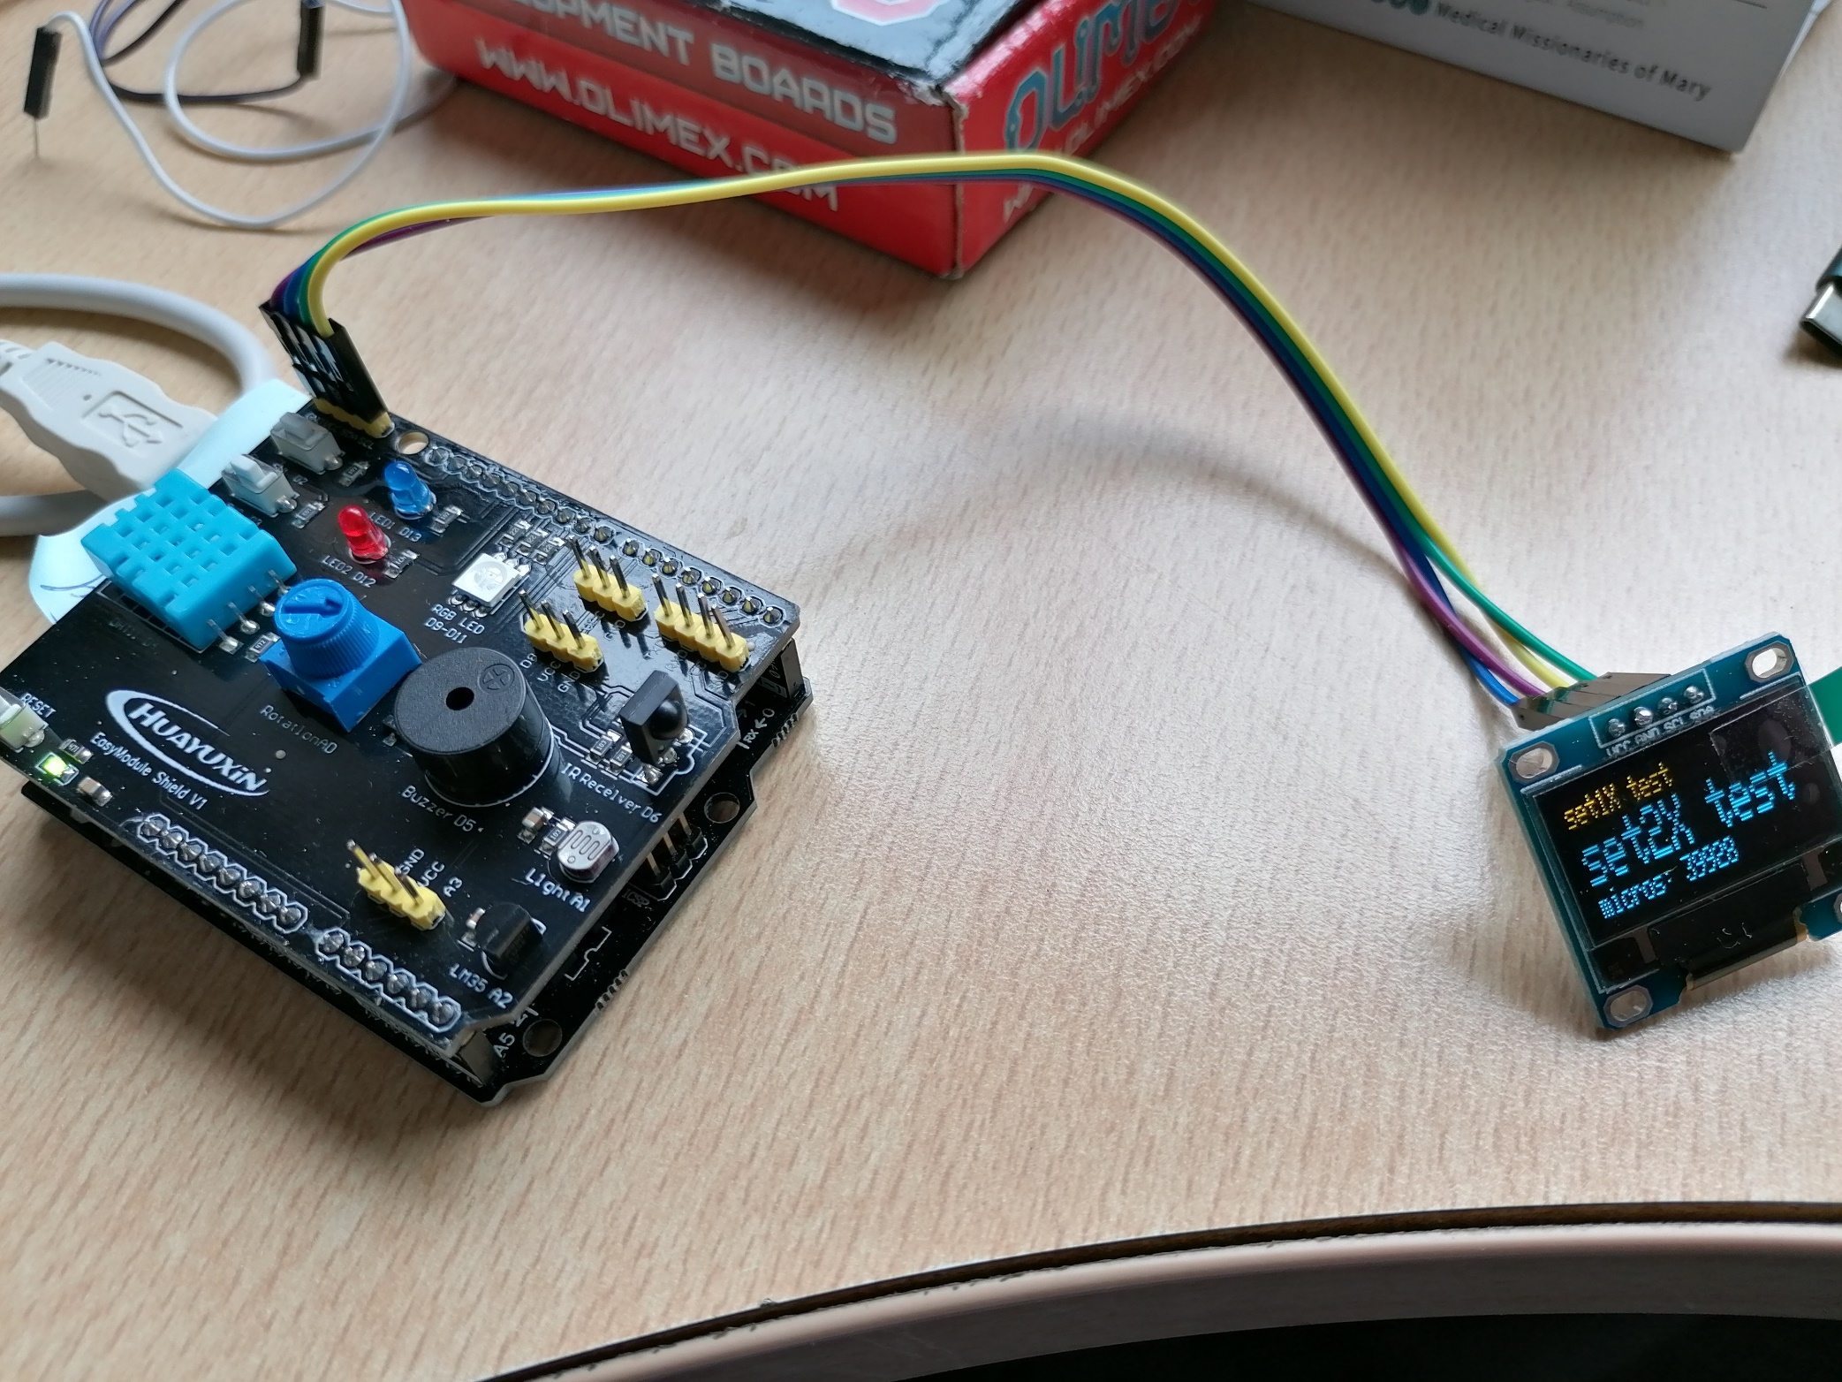
Final Connection

Slide 11
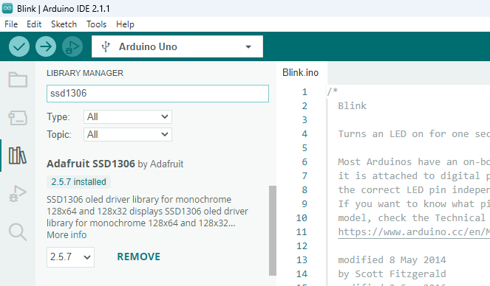
SSD1306 OLED Display Library
Before using this display, we need to include a library for it.
First, we try the Adafruit library, which supports graphics
Here the library has already been installed

Slide 12
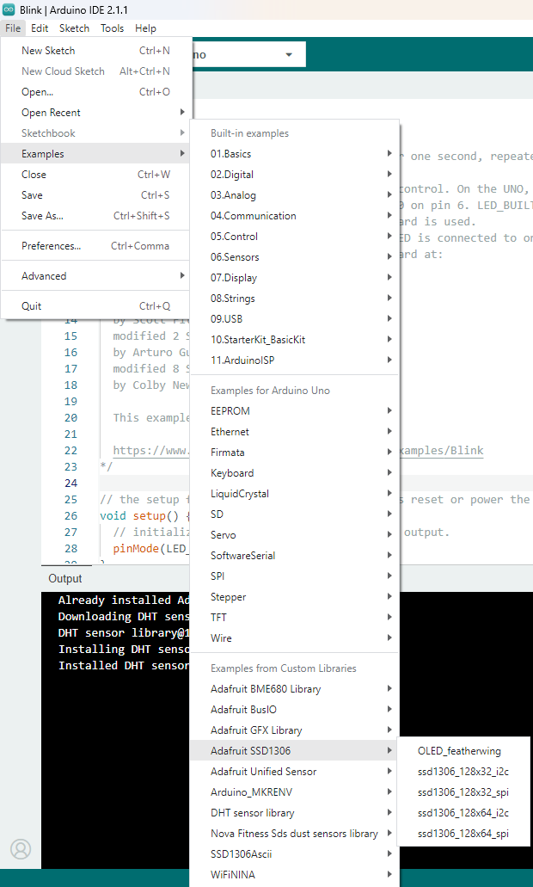
Adafruit OLED Graphics (1)
This example shows the graphics capability of the Adafruit Library and OLED display
We’re using the I2C interface and the 128x32 example

Slide 13
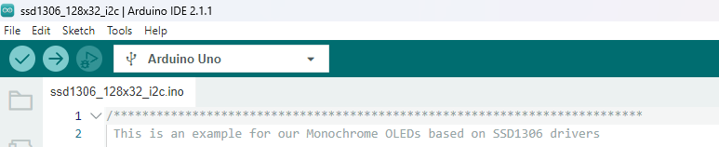
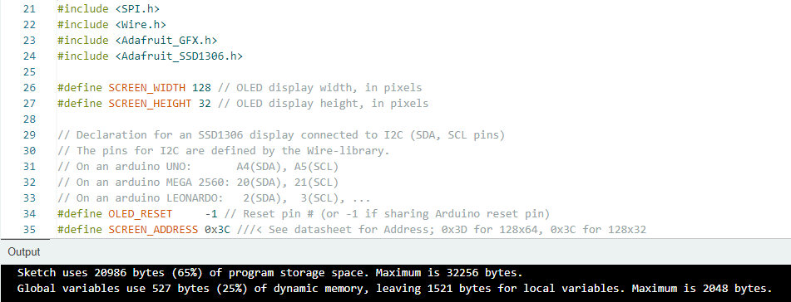
Adafruit OLED Graphics (2)
This sketch has a great display, but…
The sketch uses a lot of code and data memory
Remember: The SSD1306 driver has an I2C address = 0x3c

Slide 14
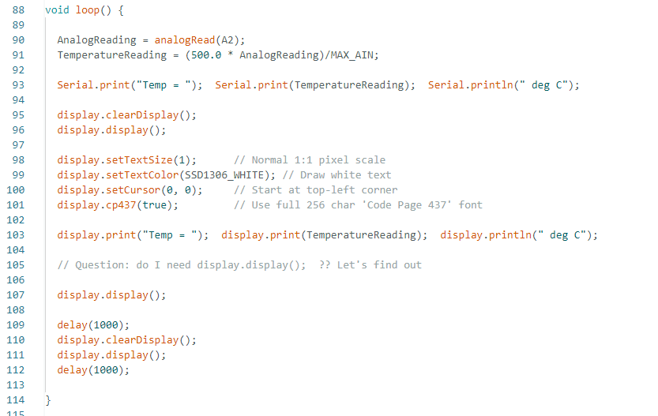
Adafruit Library for text (print and println)
The Adafruit library can support simple text and print operations
Just like Serial.print etc – but with a smaller display and some points to remember
Uses of display.print and display.println
Note that you must include display.display();
if you want anything to appear on the display
See ssd_1306_i2c_128x32_text.ino

Slide 15
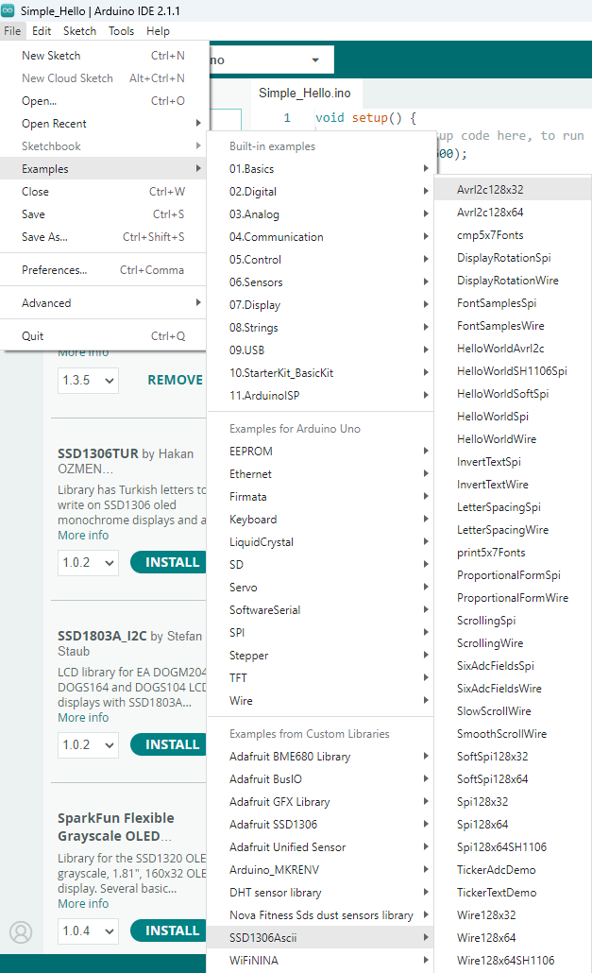
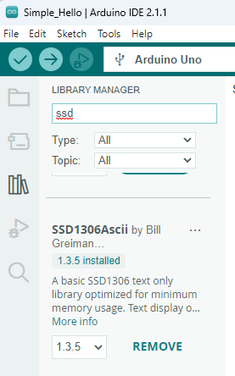
A smaller but less powerful library
This is smaller ssd1306 library, which only works for text
Try AvrI2c128x32 and modify it to display DHT11 readings on the OLED display instead of the Serial port

Slide 16
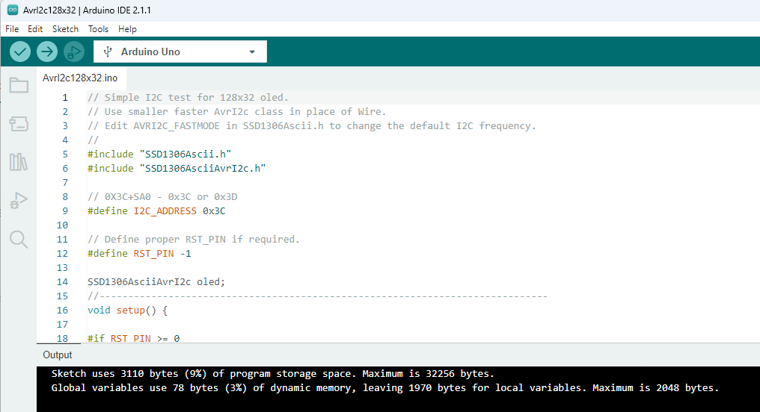
AvrI2c_128x32 Compiled
Modify this sketch to display DHT11 and Analog In 0 data on the OLED display
This time use oled.print() and oled.println();
Notice that the memory used is much less

Slide 17
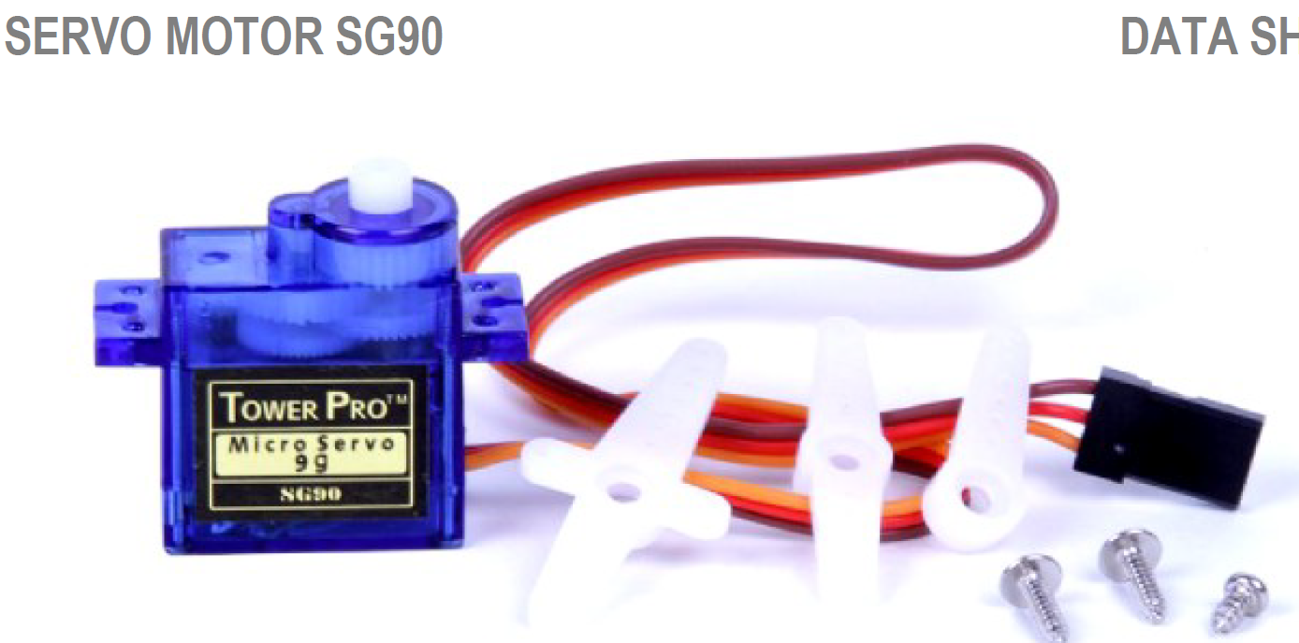
Control a Servo Motor (1)
Servo motors use a PWM input signal to control the servo motor position
They come in a range of sizes
We use a small one, SG90
Servo can rotate approximately 180 degrees (90 in each direction)

Slide 18
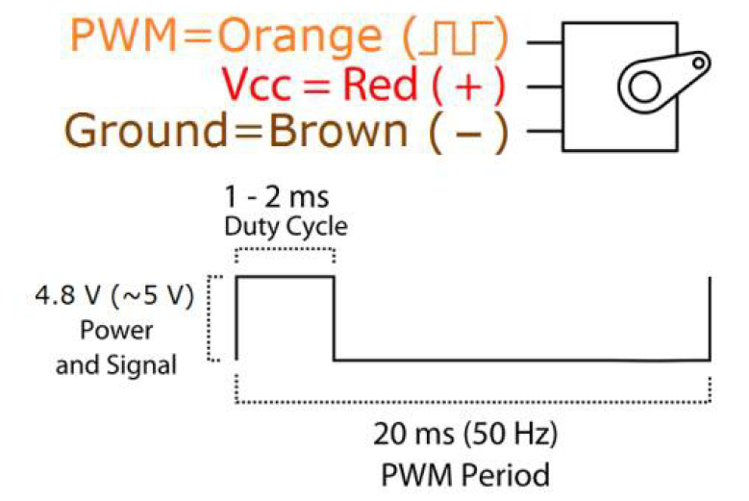
Control a Servo Motor (2)
Servo motors should have a PWM signal of approximate period 20ms
Then the width of the high pulse sets the angle that the servo moves to
Pulse Widths should be between 1ms and 2ms

Slide 19
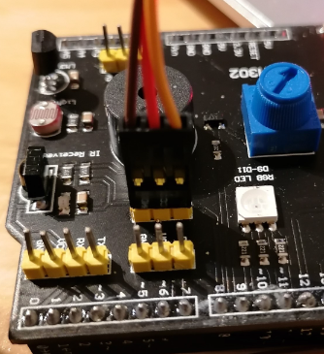
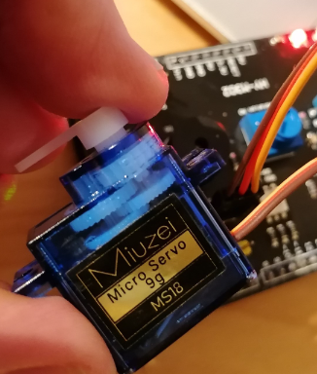
Control a Servo Motor (3)
We can connect the servo motor directly onto the Multifunction shield
Connect Red – VCC
Connect Brown – GND
Connect Orange - D8

Slide 20
Servo example program
We could modify AVR/Arduino Timer initialisation and use AnalogWrite() to position the servo
But Arduino has a library called Servo that makes the servomotor very easy to use
See servo.ino and ModifiedServo.ino
Exercise: try out these programs
Modify the sketch (ModifiedServo) so that the user inputs an angle to set the servo position

Slide 21
Servo Motor, Multifunction Shield and OLED
Start with the servo.ino example
Modify the program so that it displays the angles when
i == 10
i == 45
i == 90
First on the Serial port
Then on the OLED display

Slide 22
Motor Speed, OLED, Multifunction Shield (1)
Disconnect the USB cable before proceeding
Disconnect the Multifunction Shield and replace with the Motor Shield
Place the Multifunction Shield above the Motor Shied
(Be sure to connect the Power Supply)

Slide 23
Motor Speed, OLED, Multifunction Shield (2)
Write a program (sketch) that shows the temperature, humidity and Motor Speed on the OLED display
Motor Speed should be controlled by the state of the SW1 switch
SW1=1, Motor at 20%
SW1=0, Motor at 50%

Slide 24
Motor Speed, OLED, Multifunction Shield (3)
Write a program (sketch) that shows the temperature, humidity and Motor Speed on the OLED display
Motor Speed should be controlled by the state of the LDR value
Bright: Motor Speed = 50%
Dark: Motor Speed = 25%

