Slide 1
Introduction to Embedded Systems using Arduino
Session 3:
(1) Building a circuit with an LED and a resistor
(2) Arduino: Analog Inputs and starting a new sketch
Dr Ciaran MacNamee

Slide 2
Steam Course Session 3
Today we do two things:
Build a circuit on breadboard with an LED and a current-limiting resistor
Start a new sketch (we can use previous examples if necessary)

Slide 3
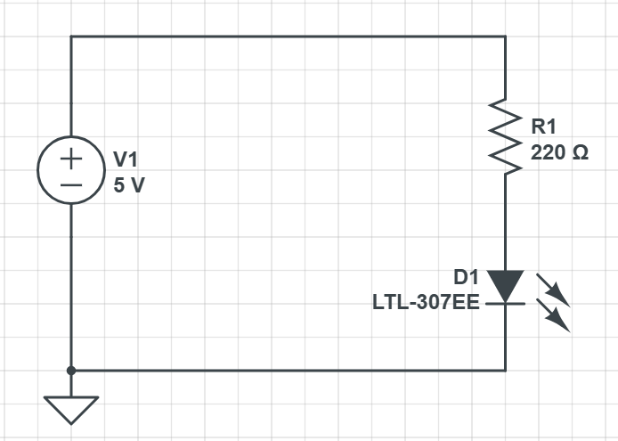
Simple LED Circuit
We’re going to build this circuit
This is the schematic diagram of an electrical circuit
It shows how the components are connected
In our case the 5V Voltage source will be provided by the Arduino 5V and Ground (GND) connections
Voltage Source (5V)
Resistor
Light Emitting Diode
LED
Ground Point

Slide 4
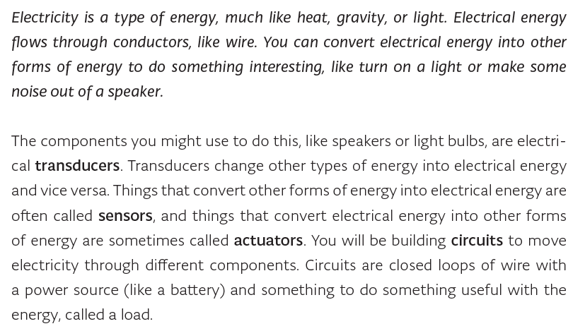
Some background (1)

Slide 5
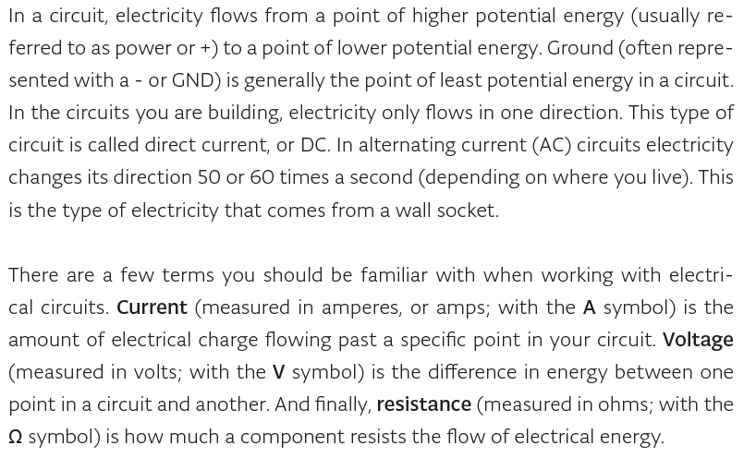
Some background (2)

Slide 6
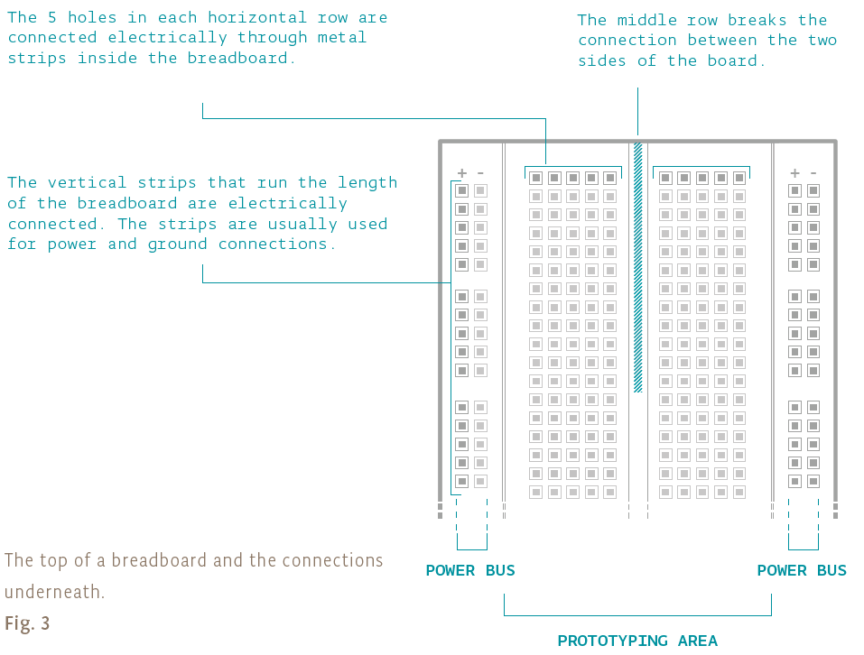
Breadboard

Slide 7
Simple LED Circuit
We’re going to build this circuit
This is the schematic diagram of an electrical circuit
It shows how the components are connected
In our case the 5V Voltage source will be provided by the Arduino 5V and Ground (GND) connections
Voltage Source (5V)
Resistor
Light Emitting Diode
LED
Ground Point

Slide 8
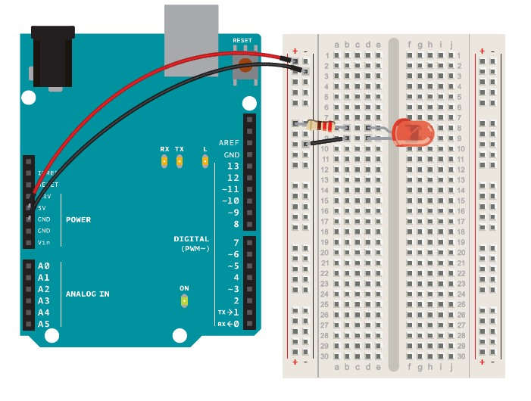
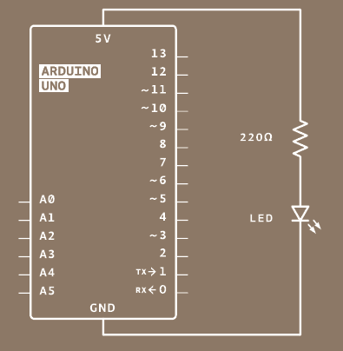
Circuit with breadboard and Arduino

Slide 9
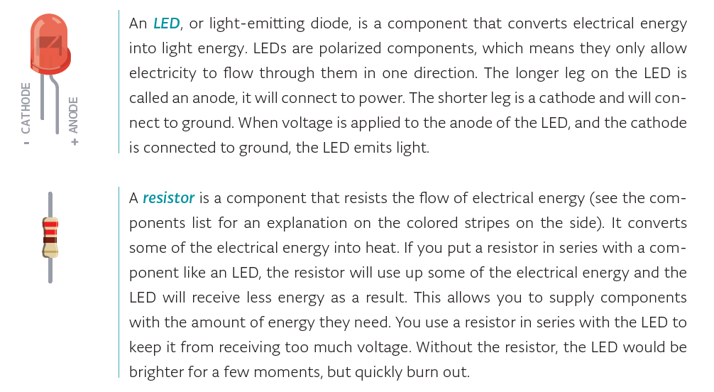
Circuit Components

Slide 10
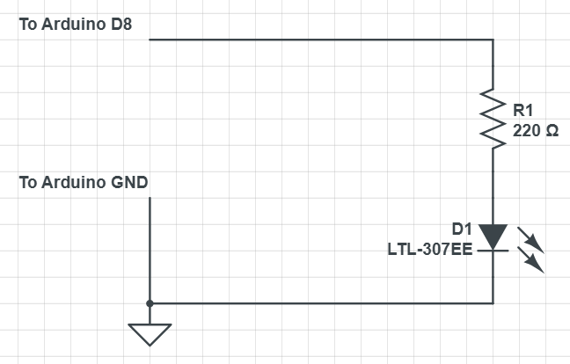
Modify the circuit to turn on/off the LED
Modify your Blink Program to blink the LED

Slide 11
Next steps
We have loaded a demonstration sketch and loaded a pre-written one
In the next lab session we’ll write a new sketch
This time, we will use the Analog input as an example
The Analog Inputs on Arduino use the ATMega328P Analog to Digital Converter

Slide 12
Analog to Digital Converter (1)
Most microcontrollers have at least one analog to digital converter (ADC)
  Note that for very high performance (very high resolution or very high data rates) a dedicated ADC may be required
  We will not go into detailed ADC design here
Arduino uses a library called AnalogRead(pin); to get the result of the Analog to Digital Conversion
But note that the result is not in volts or millivolts (yet!)

Slide 13
Analog to Digital Converter (2)
Most ADCs convert over a voltage range
Starting at 0V up to a maximum input Voltage
The maximum voltage should convert to the maximum number that the ADC can have
Suppose that the maximum input voltage is 5V and we have an 8-bit ADC
An input of 5V should be read as a value of 255
An input of 0V should be read as a value of 0
An input of 2V should be read as 255*(2/5)
  This applies to a linear ADC – other types, eg logarithmic ADCs are also available

Slide 14
ADC Resolution (1)
For the programmer, the ADC resolution is determined by the number of bits that the ADC has
Typical values are 8 or 10 bits
  8 bits: 0 – 255 for full-scale
  10 bits: 0 -1023 for full scale
We have: Vin/Vfs = x/(2^{n} -1), where n is the number of ADC bits
  If n = 10, 2^{n} -1 = 1023
  It’s important to note that getting 10-bit or higher resolution also requires good circuit design, from the analog signal to the input pin of the ADC
Note that the biggest voltage you can measure will be 5V – the voltage for one bit (one LSB in ADC terms)

Slide 15
ADC Resolution (2)
So: Vin/Vfs = x/(2^{n}-1)
  The number of bits and the full-scale voltage fix the best resolution we can get
E.g. Vfs = 5V, n = 10
For resolution put x =1 (ie getting the voltage that will change the ADC output by 1 bit)
Vin (1-bit) = Vresolution = 5.0/1023 = 0.00489V = 4.9mV (approx)
You can’t resolve the input voltage more precisely than 4.9mV
  If you need to measure with better resolution, then some other approach will be required

Slide 16
ADC Resolution (3): Full-scale
Full-scale voltage may be set by the power-supply, but is more often fixed by a reference Voltage, VREF, sometimes called AREF
In the Arduino circuit, VREF = 5V, and usually we have 10-bits of resolution

Slide 17
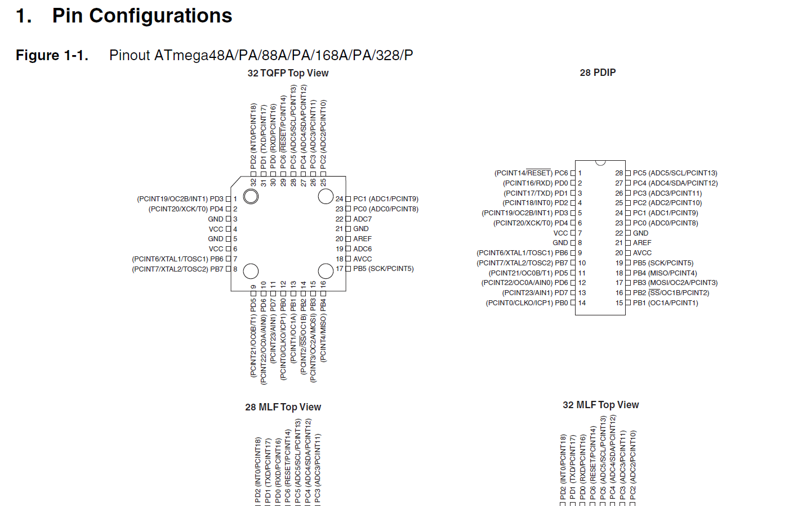
The ADC inputs are shared with the PORTC pins
Notice that the 32 pin TQFP has two extra ADC pins
The ADC pins are kept away from the noisy digital signals when possible
In microcontrollers, it’s very common to share digital port pins and analog input pins
Microcontroller pins are valuable – they add to the chip cost
Q: There are 6 ADC pins (8 on 32 pin package): does this mean 6 ADCs on-chip?

Slide 18
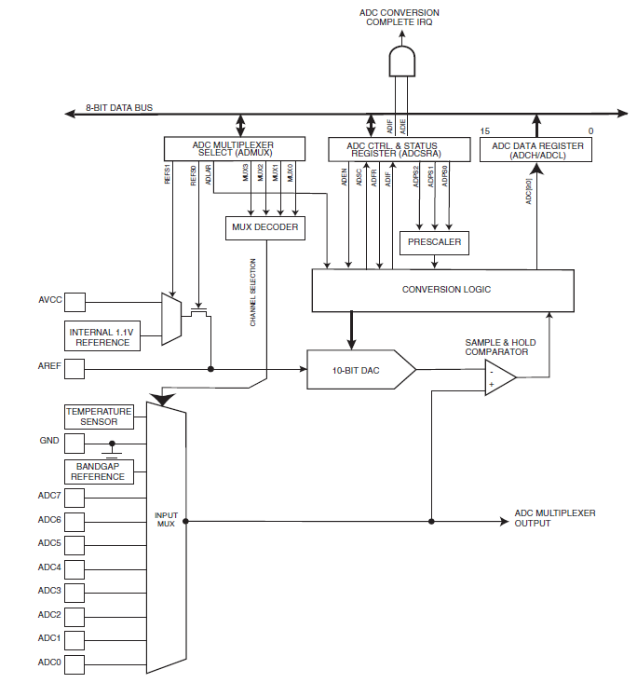
ADC Diagram
Just for reference purposes, here’s what the ATMega328P ADC looks like:
Sample and Hold is to keep Ain steady during conversion

Slide 19
Next example sketch
In this example, we’re going to write a sketch (Arduino program) that reads Analog input pin 0 and turns on one LED on the Shield depending on the input voltage we read (we’ll use the Red LED, Output Pin 12)
The Shield also has a potentiometer connected to Analog Input pin 0 so we can vary the analog input voltage

Slide 20
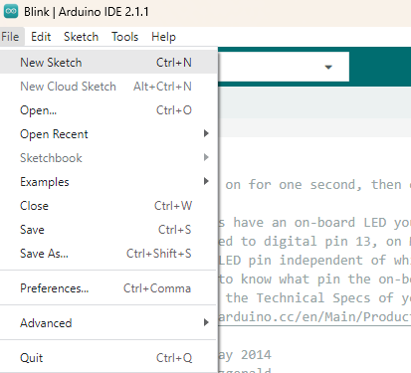
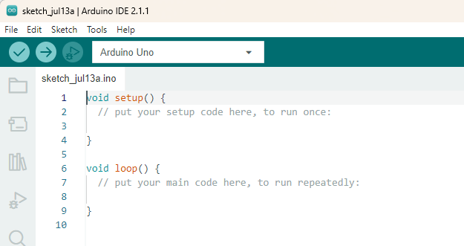
Create a new sketch (1)
This time we start a new sketch
  Don’t worry we will copy some text into it to reduce the typing!
From the drop-down menu, select New Sketch
This starts a new empty sketch with the Arduino template

Slide 21
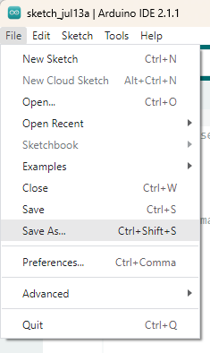
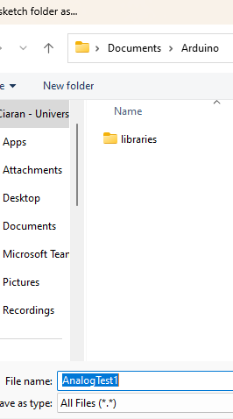
Create a new sketch (2)
By default, Arduino sketches have today’s date
Use File Save As to change the name of the sketch
The default location is Documents\Arduino
This is fine
But you may change the folder if you wish

Slide 22
Saving on the typing, use a text file (1)
You could simply copy the code on the following slides into your sketch
Or you could browse to github and locate a file called AnalogTest1.txt
CiaranW5/SteamCourse: Course Material for Steam Course
Open it in a text editor (e.g. NotePad)
Copy all the text and paste it into your new sketch (next slide)

Slide 23
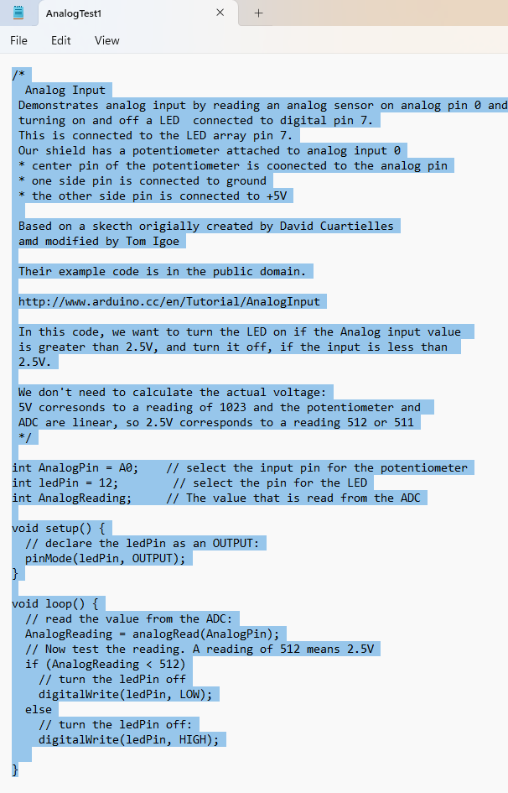
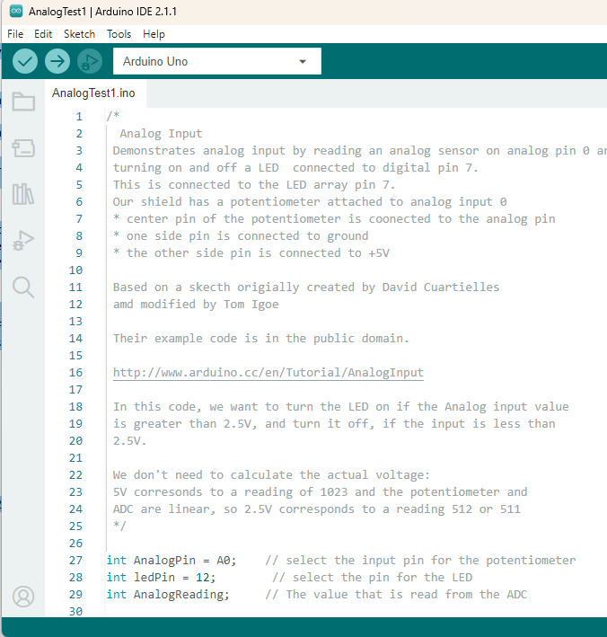
Use a text file
Now compile and load your code

Slide 24
/* In this code, we want to turn the LED on if the Analog input value
is greater than 2.5V, and turn it off, if the input is less than
2.5V.
We don't need to calculate the actual voltage:
5V corresonds to a reading of 1023 and the potentiometer and
ADC are linear, so 2.5V corresponds to a reading 512 or 511
*/
Or you could just copy this text and the following slide text into your sketch

Slide 25
const int AnalogPin = A0; // select the input pin for the potentiometer
const int ledPin = 12; // select the pin for the LED
int AnalogReading; // The value that is read from the ADC
void setup() {
// declare the ledPin as an OUTPUT:
pinMode(ledPin, OUTPUT);
}
void loop() {
// read the value from the ADC:
AnalogReading = analogRead(AnalogPin);
// Now test the reading. A reading of 512 means 2.5V
if (AnalogReading < 512)
digitalWrite(ledPin, LOW); // turn the ledPin off
else
digitalWrite(ledPin, HIGH); // turn the ledPin on
}
Here’s the code to run

Slide 26
Let’s look at the ADC result again
We’ve used the Analog Inputs the ATMega328P Analog to Digital Converter
We worked out in advance what reading corresponded to 5V and 2.5V
We have a simple processor not a powerful laptop so we often try to reduce the number of calculations
But we often need the voltage input

Slide 27
Data types again
We’ve been using integer variables up to now
Sometimes we need numbers like 2.15 and so on
We need a new variable type for these numbers: float
Floating point numbers are the way a computer represents numbers like 1.23 or 2.9 * 10⁻²

Slide 28
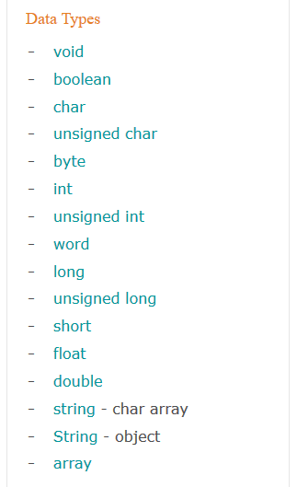
Arduino Data types
From Arduino’s Reference Section:
We’ve used int variable up now:
These are float variables:

Slide 29
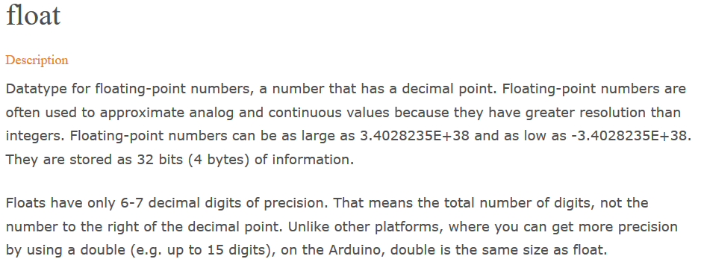
Arduino Reference on float
Eg
float refVoltage;
refVoltage = 2.5;

Slide 30
Another exercise …
Rewrite the Analog Input sketch program so that
If the Analog Input voltage is < 4.0V turn the BLUE LED (Digital Pin 13) ON and turn the RED LED (Digital Pin 12) OFF
Otherwise (>=4.0V) turn the BLUE LED (Digital Pin 13) OFF and turn the RED LED (Digital Pin 12) ON
But this time calculate the voltage at the pin and compare with 4.0

Slide 31
Analog In 1 and Analog In 2 (1)
On the shield, AIN1 is connected to a circuit with a Light Dependent Resistor and AIN2 is connected to a simple temperature sensor, LM35
LM35 has the following output: 10mV per degree Centigrade
Write a program (Arduino Sketch) that uses the RGB LEDs to indicate temperature:
Temp < 20deg RGB OFF
20deg <= Temp < 22deg, Blue ON, others OFF
21deg <= Temp < 24deg, Green ON, others OFF
Temp >= 24deg, Red ON, others OFF
Sometimes the LM35 doesn’t work, so don’t worry if you cannot do this!

Slide 32
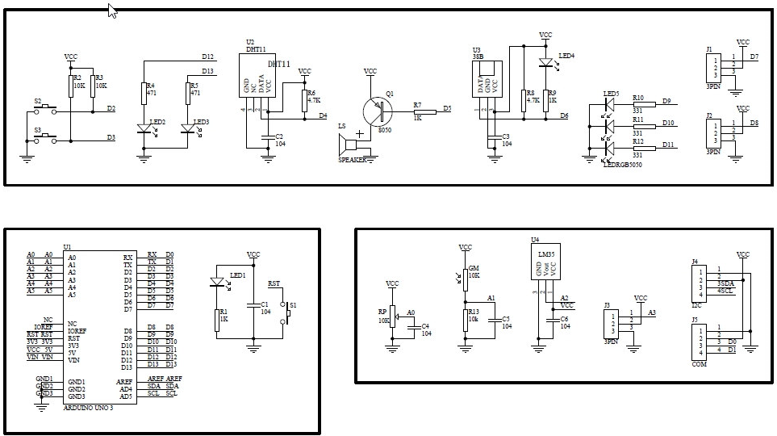
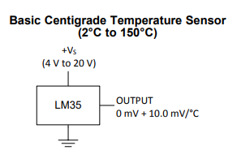
Analog In 1 and Analog In 2 (2)
LDR Circuit

Slide 33
Analog In 1 and Analog In 2 (3)
Write a program (Arduino Sketch) that uses the RGB LEDs to check darkness:
If it is dark, turn on all the RGB LEDs together (White light)
Otherwise turn off all the RGB LEDs
Remember AIN1 is on the LDR circuit
You will have to work out the readings that indicate light and dark
If you like buzzers, you could sound the buzzer also if it is dark!

Slide 34
Communicating with a user
Reading digital and analog inputs and driving LEDs is ok, but we want to do more
How do we report results to a user who has a PC?
Arduino uses a Serial Port for this type of communications
See Examples - AnalogReadSerial

