Slide 1
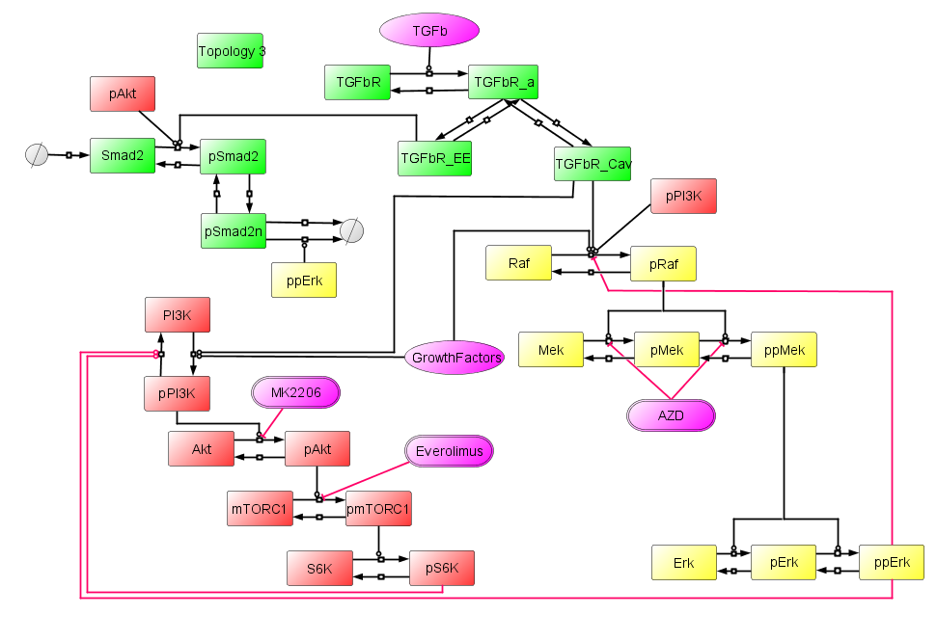
Topology 3
Idea
Spatial segregation of Smad2 phosphorylation by pAkt and dephos by ppErk as part of the mechanism for Smad2 regulation.
This did not work as the amount of Smad2 phosphorylation was not limited to a maximum value (as we are hypothesising)

Slide 2
Experimental Design – and similarly for MK2206
 |  | Time (h)
Condition Code | Condition | 0.00 | 24.00 | 48.00 | 70.25 | 70.75 | 71.25 | 72.00
D | DMSO | Add DMSO | - | - | Starve | - | - | Lysis
T | TGFb | Add DMSO | - | - | Starve | - | TGFb Treatment | Lysis
E | TGFb + EV | Add DMSO and EV | - | - | Starve | - | TGFb Treatment | Lysis
E_A_72 | TGFB + Everolimus+ AZD 3 | Add EV and AZD | - | - | Starve | - | TGFb Treatment | Lysis
E_A_48 | TGFB + Everolimus+ AZD | Add EV | Add AZD | - | Starve | - | TGFb Treatment | Lysis
E_A_24 | TGFB + Everolimus+ AZD 1 | Add EV | - | Add AZD | Starve | - | TGFb Treatment | Lysis
E_1.25 | TGFB + Everolimus+ AZD30 mins | Add EV | - | - | Starve | Add AZD | TGFb Treatment | Lysis
72 | TGFB + AZD 3 | Add DMSO and AZD | - | - | Starve | - | TGFb Treatment | Lysis
48 | TGFB + AZD 2 | Add DMSO | Add AZD | - | Starve | - | TGFb Treatment | Lysis
48 | TGFB + AZD 1 | Add DMSO | - | Add AZD | Starve | - | TGFb Treatment | Lysis
A_1.25 | TGFB + AZD 30mins | Add DMSO | - | - | Starve | Add AZD | TGFb Treatment | Lysis

Slide 3
Reminder
Last time we spoke we:
Suggested restricting total Smad2 levels available in the system for reproducing the saturation effect observed in the Smad2 data.
This did not have the desired effect since reducing the amount of total Smad2 only scaled the simulation, not affect its behaviour
Adding TSC complex to try and get S6K simulating according to the data.
Unfortunately, neither of these hypotheses worked in reproducing the behaviour.

Slide 4
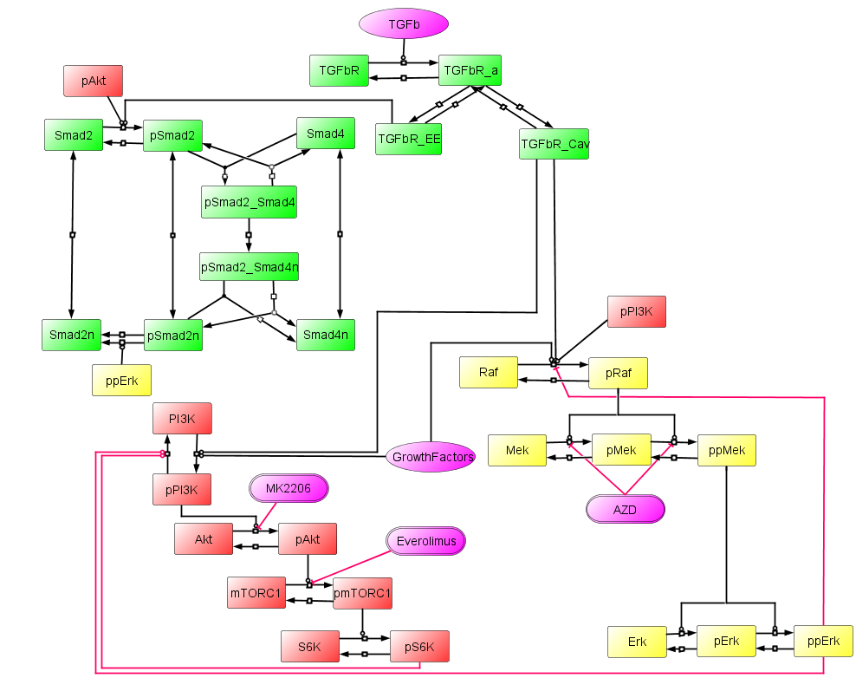
Topology 4

Slide 5
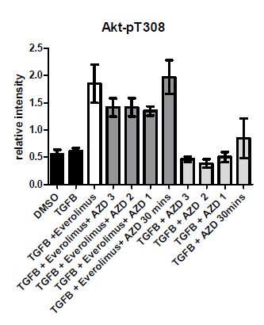
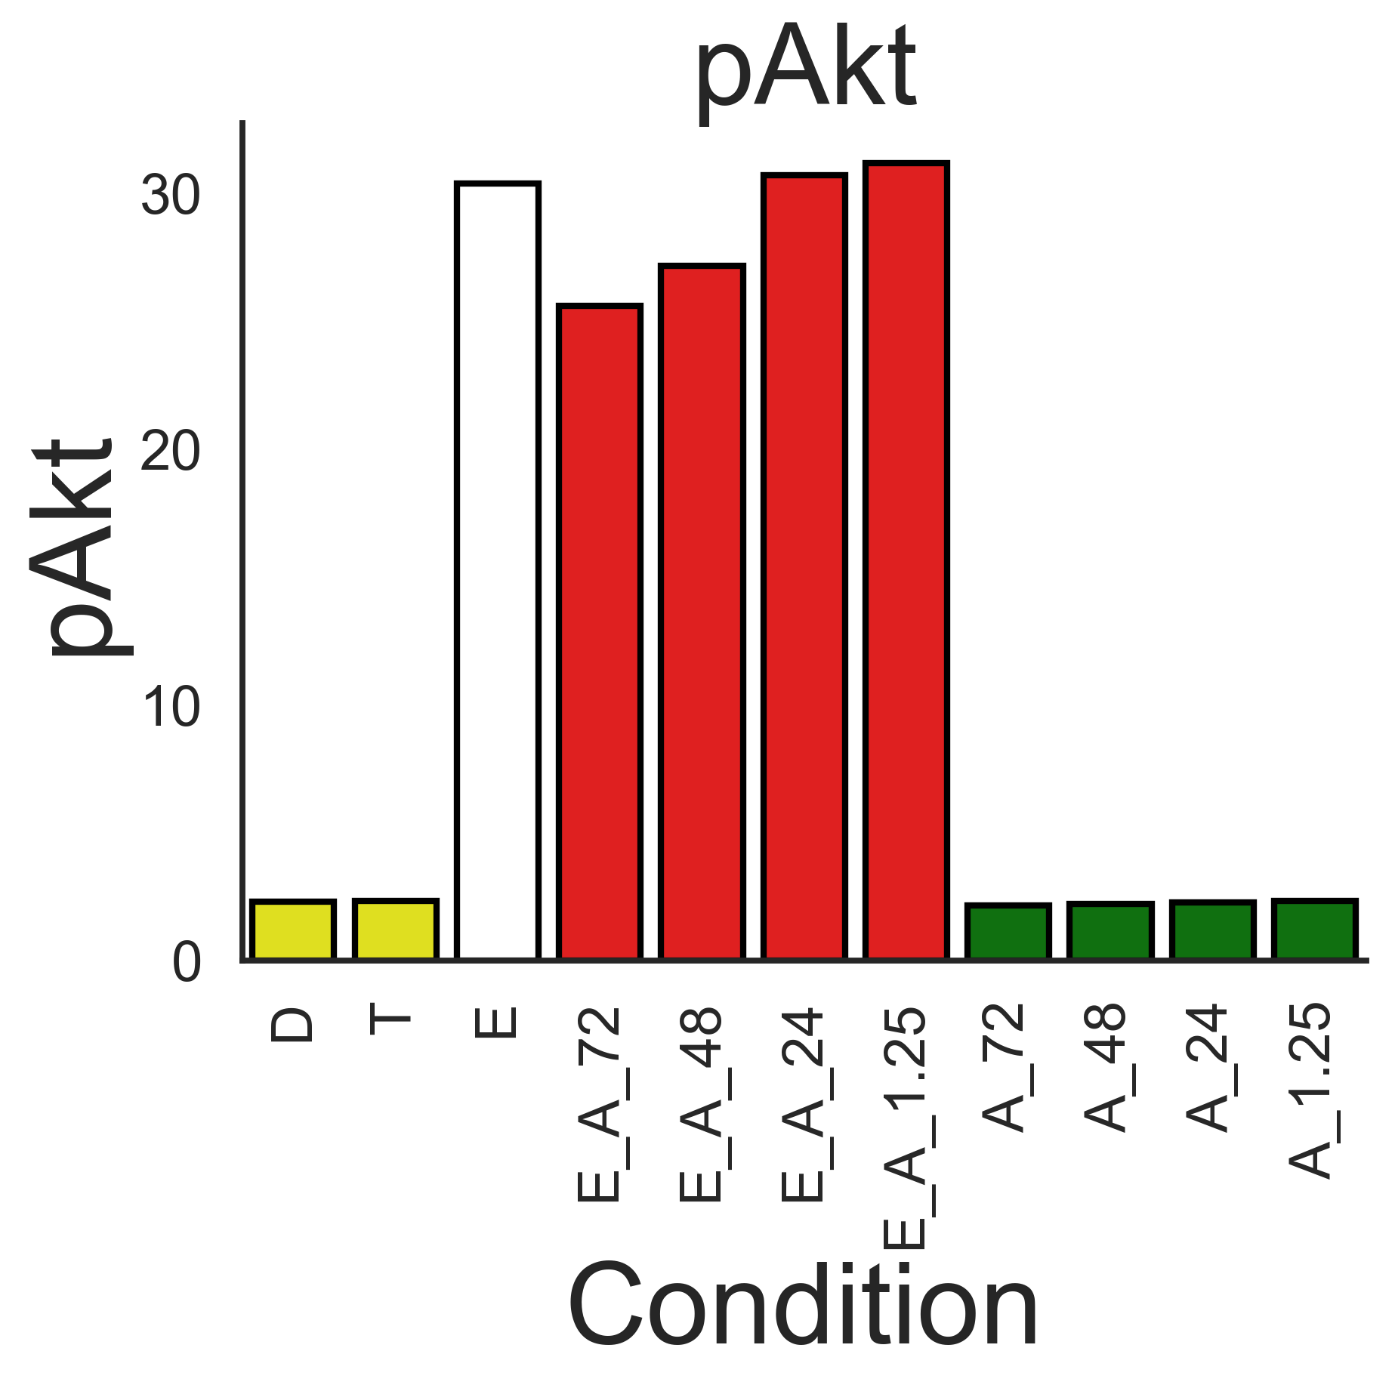
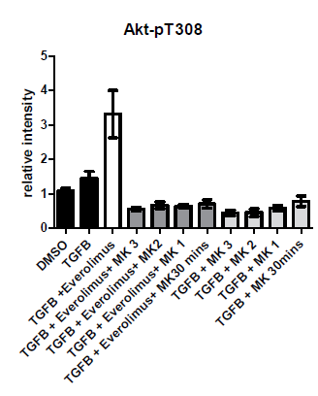
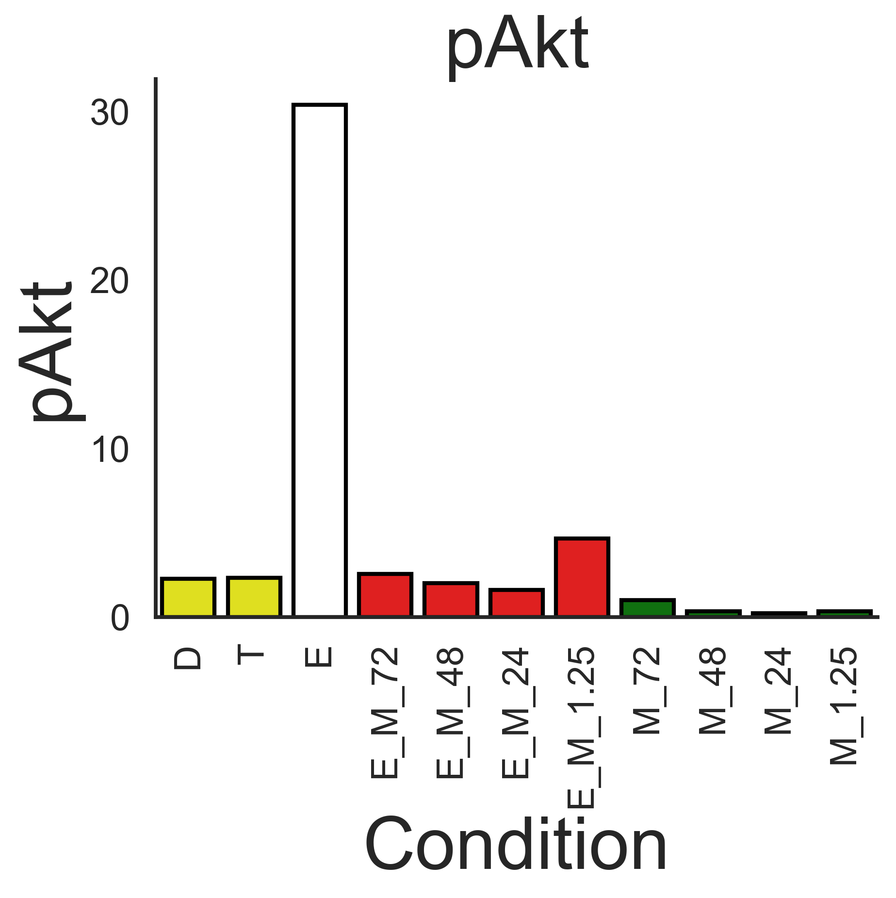
pAkt
Experimental
Simulation
AZD
MK2206

Slide 6
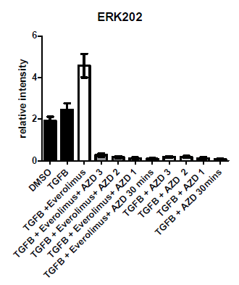
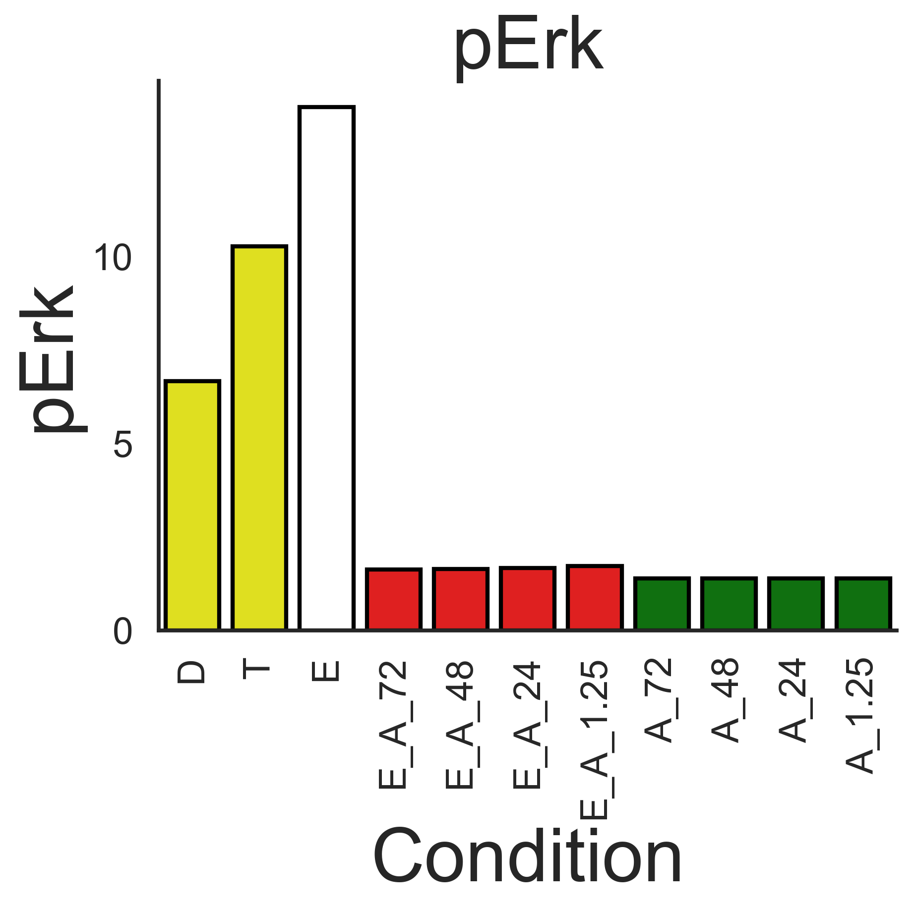
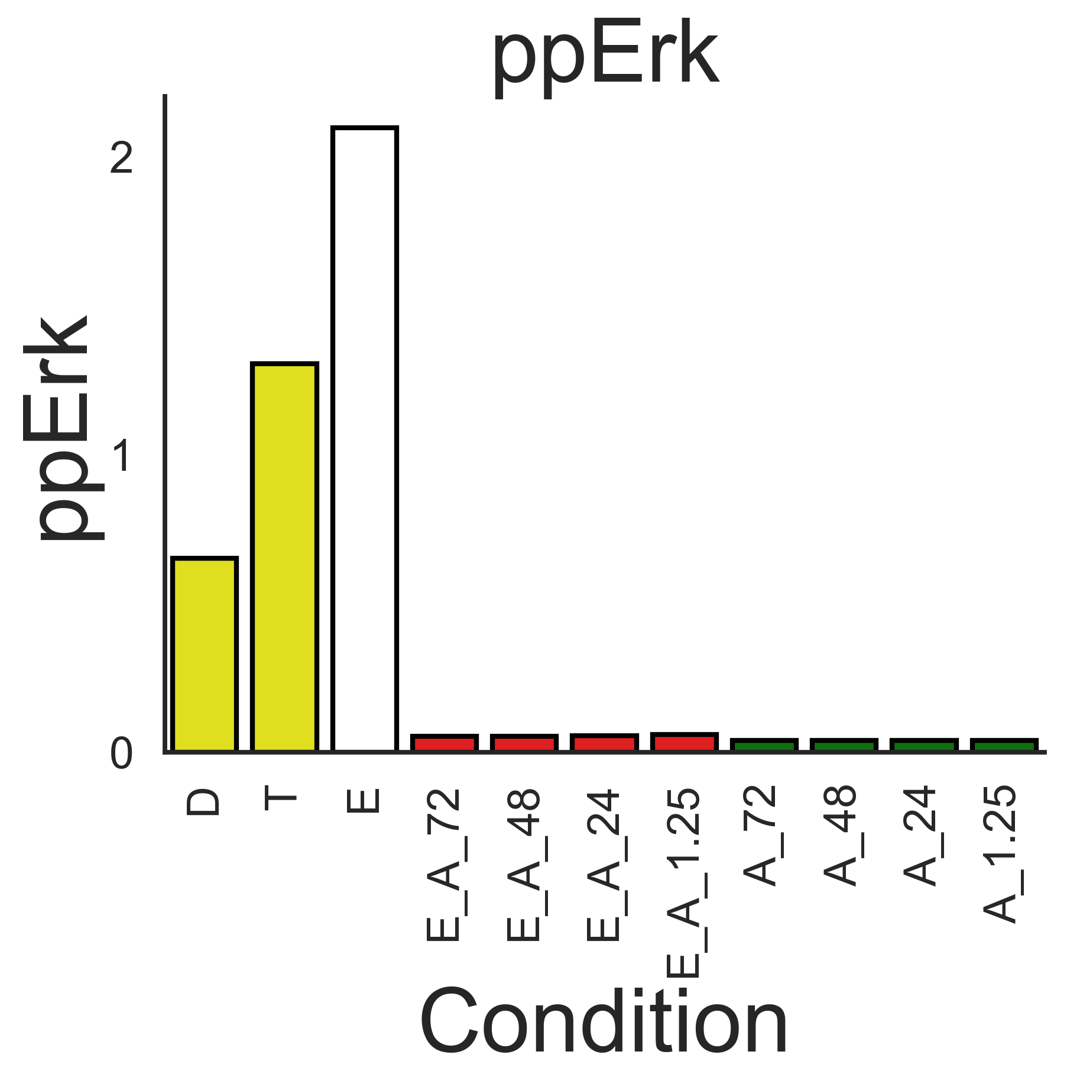
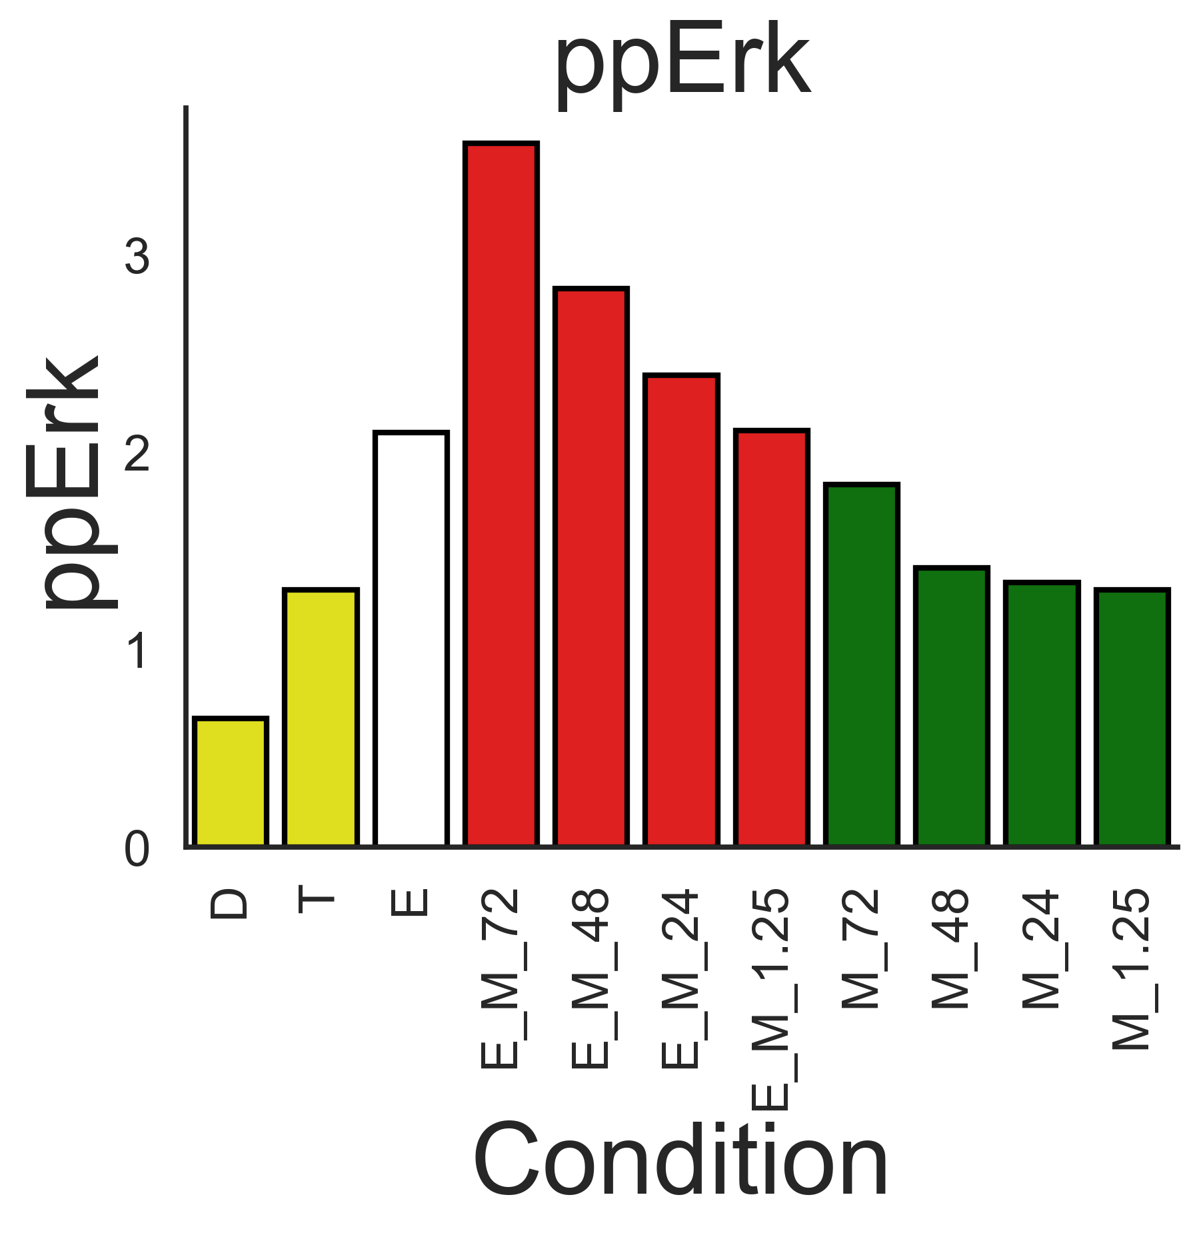
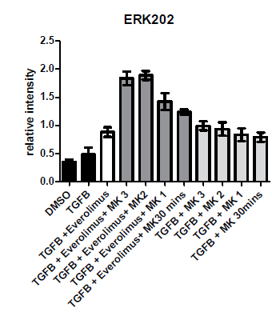
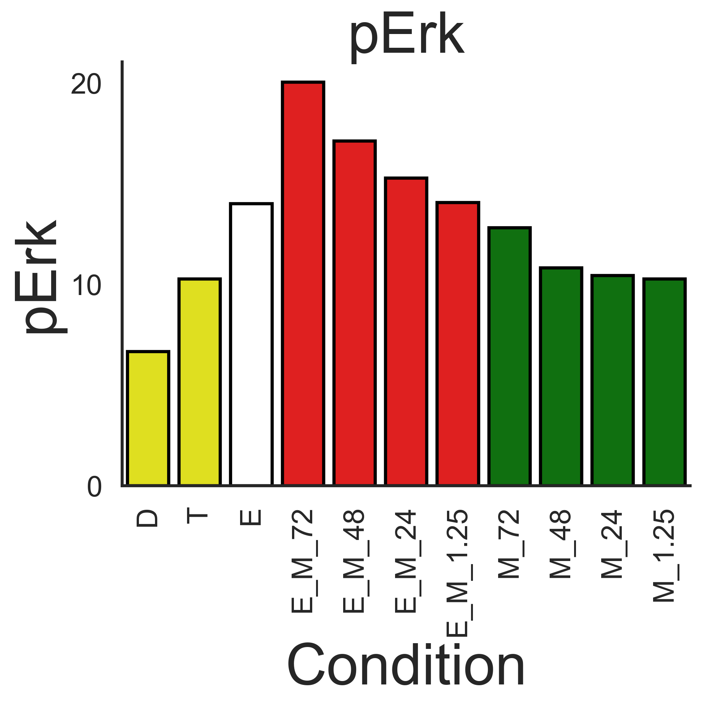
pErk / ppErk
Experimental
Simulation
AZD
MK2206

Slide 7
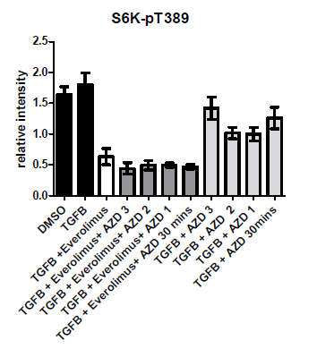
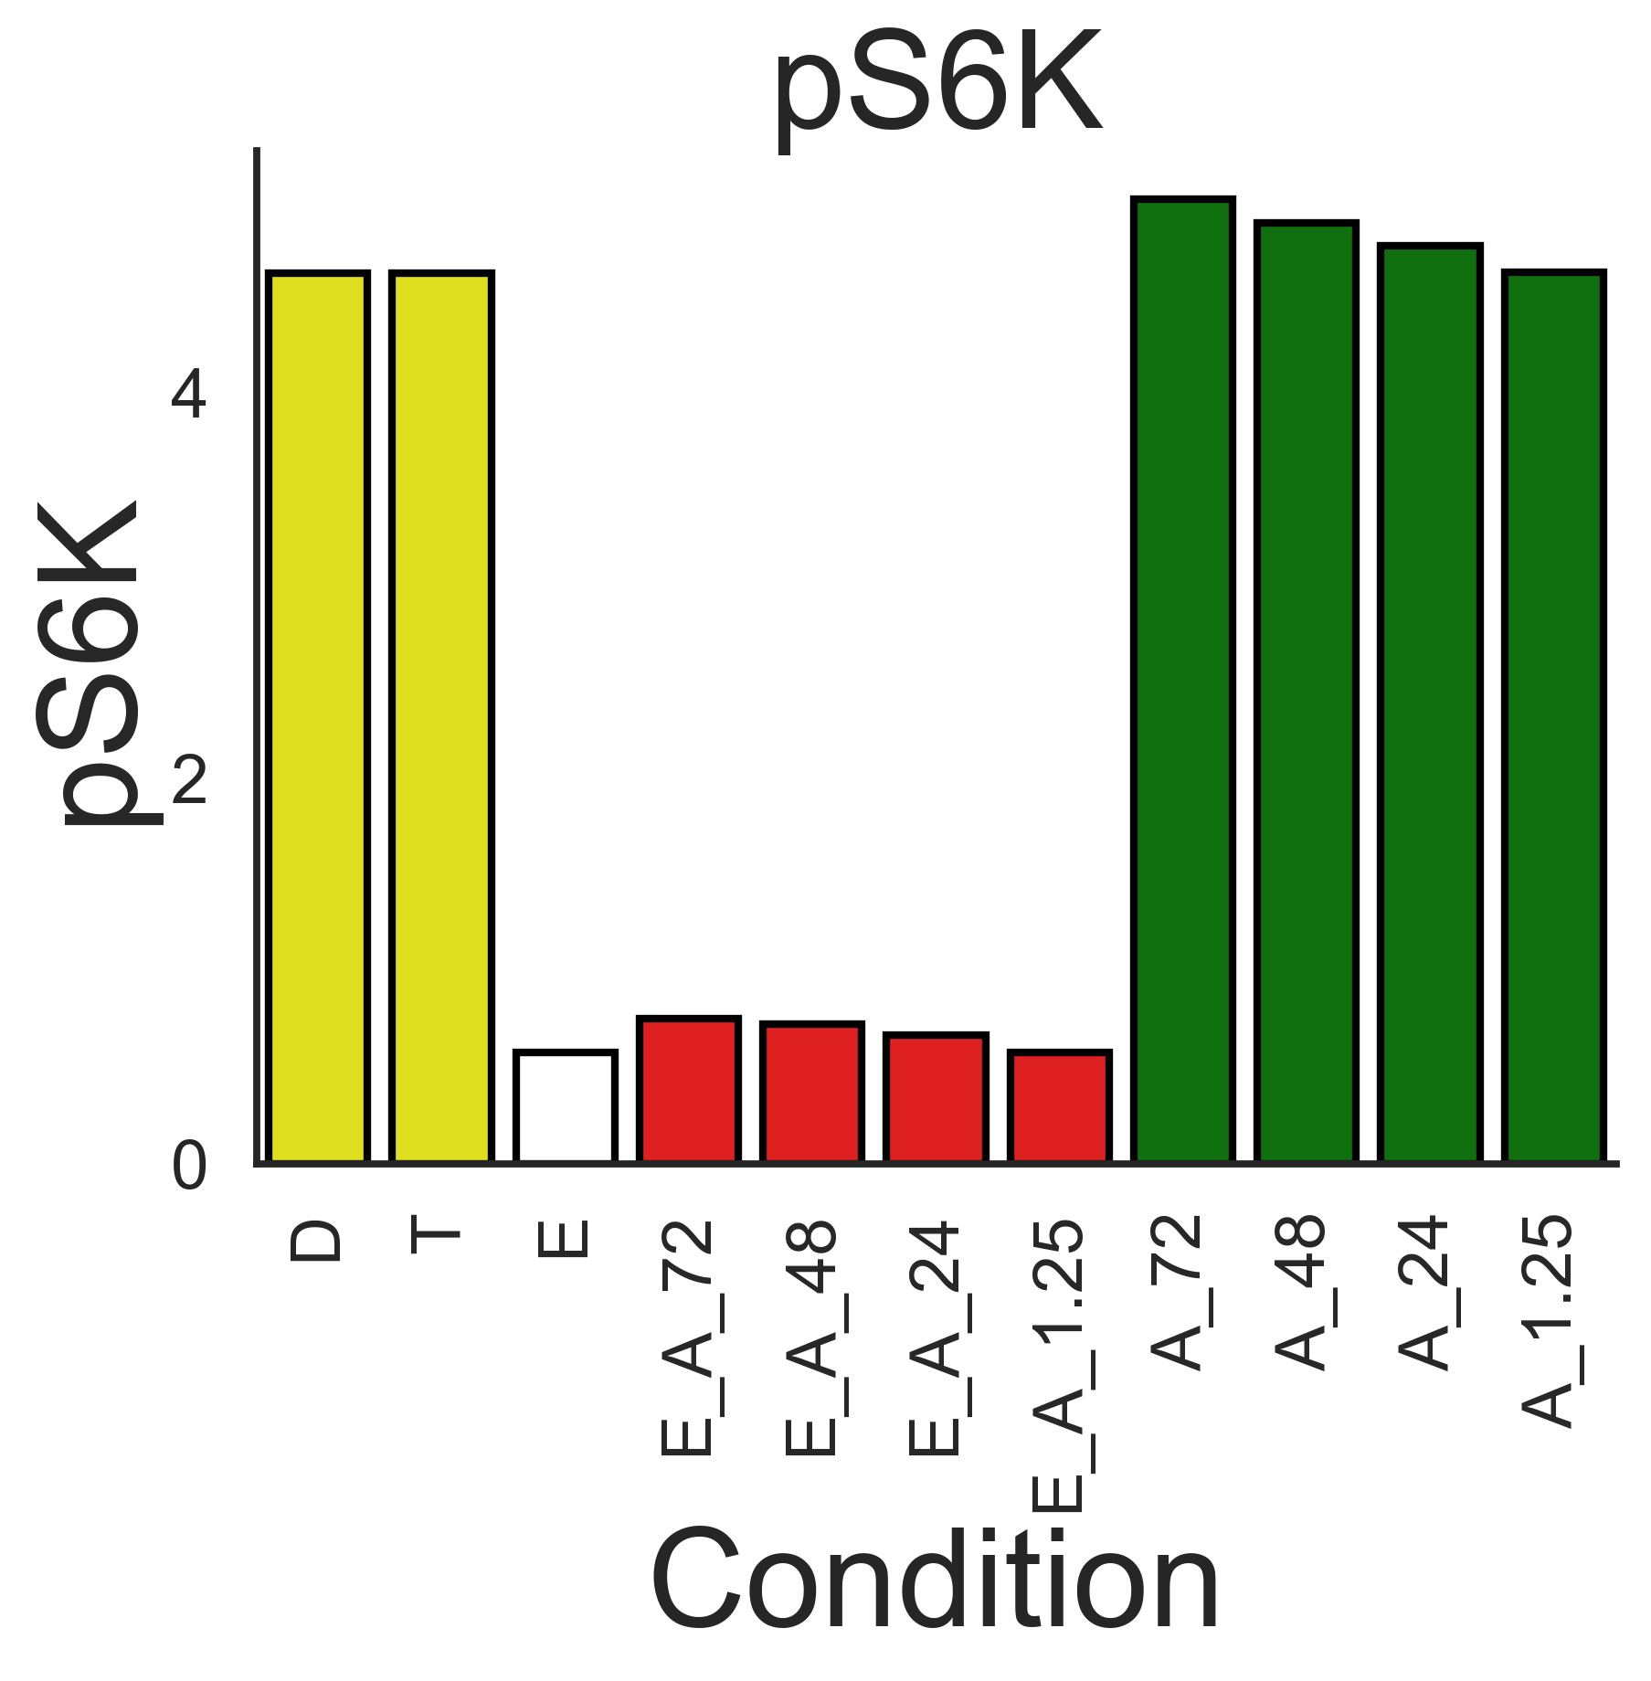
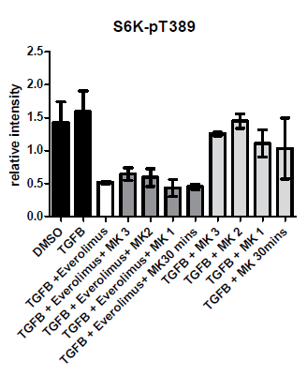
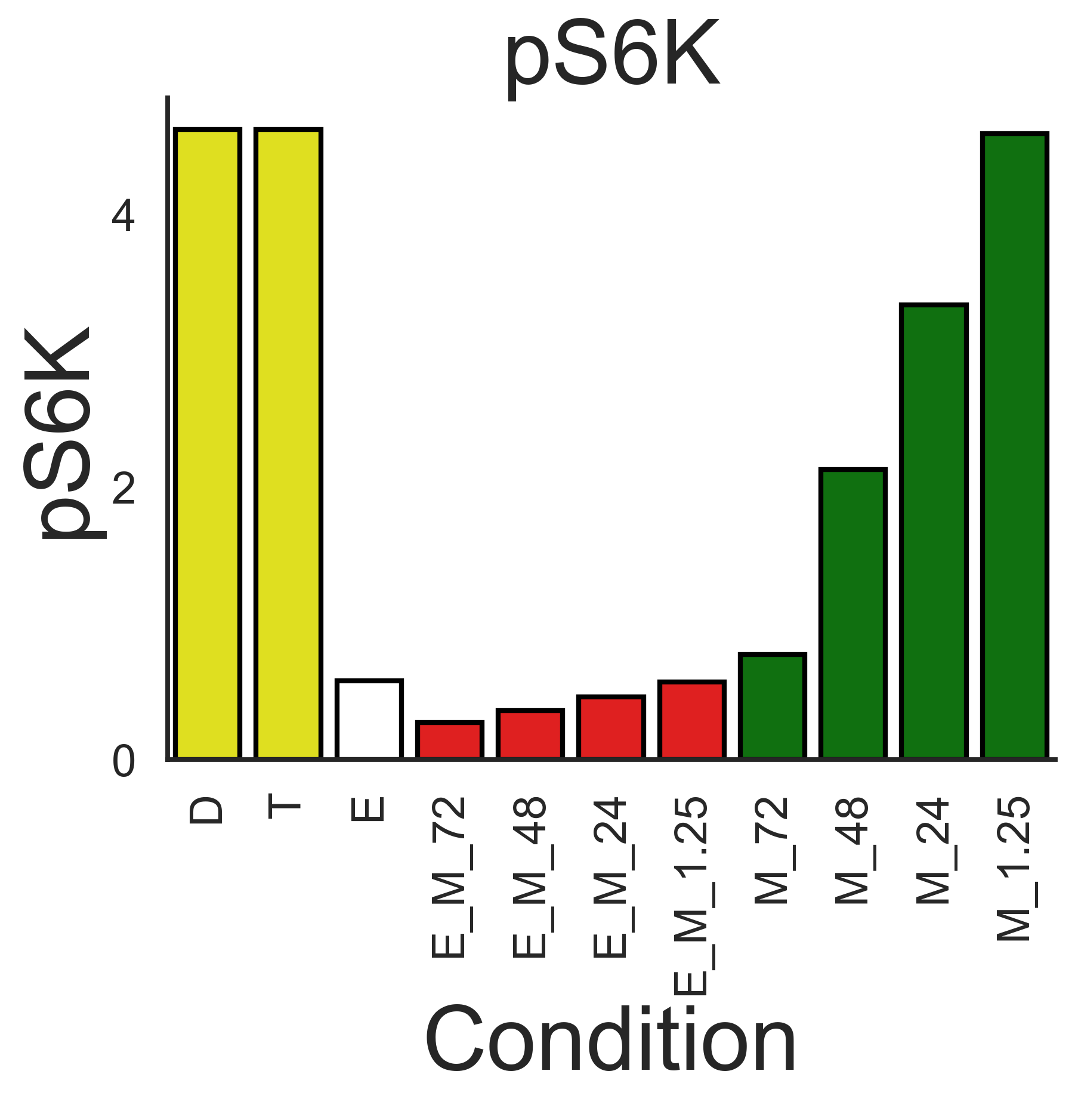
pS6K
Experimental
Simulation
AZD
MK2206

Slide 8
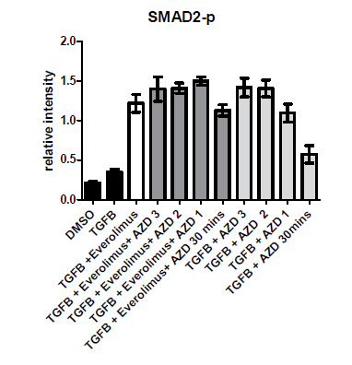
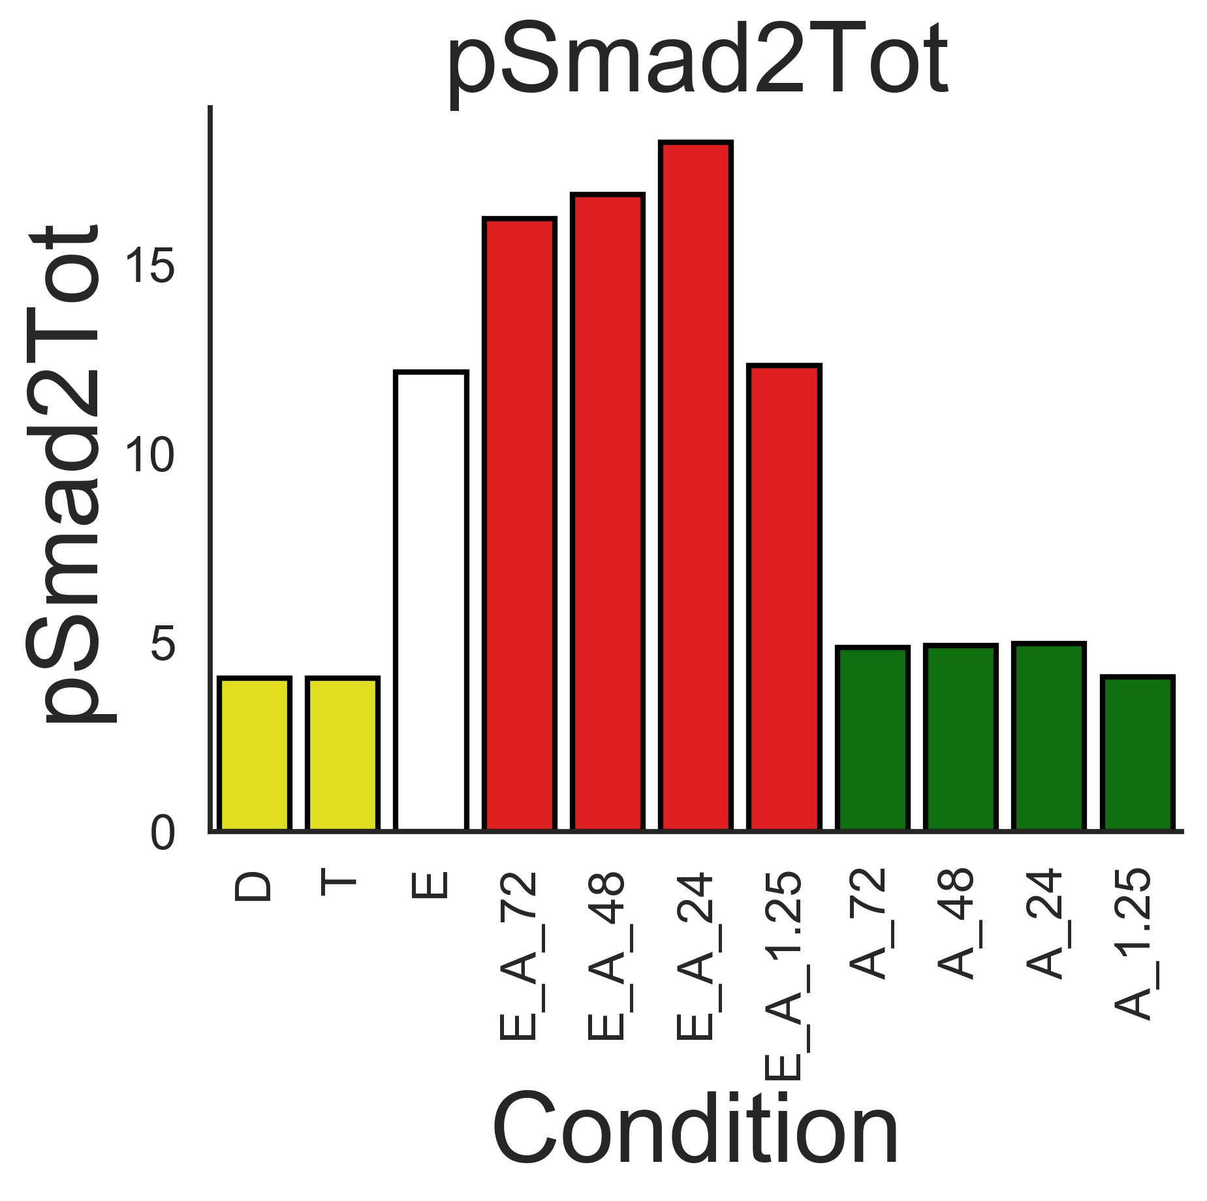
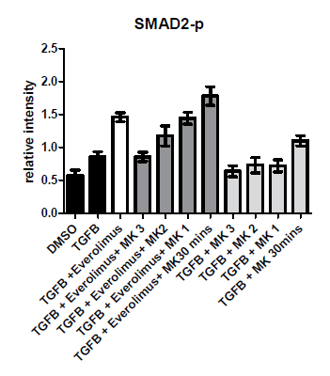
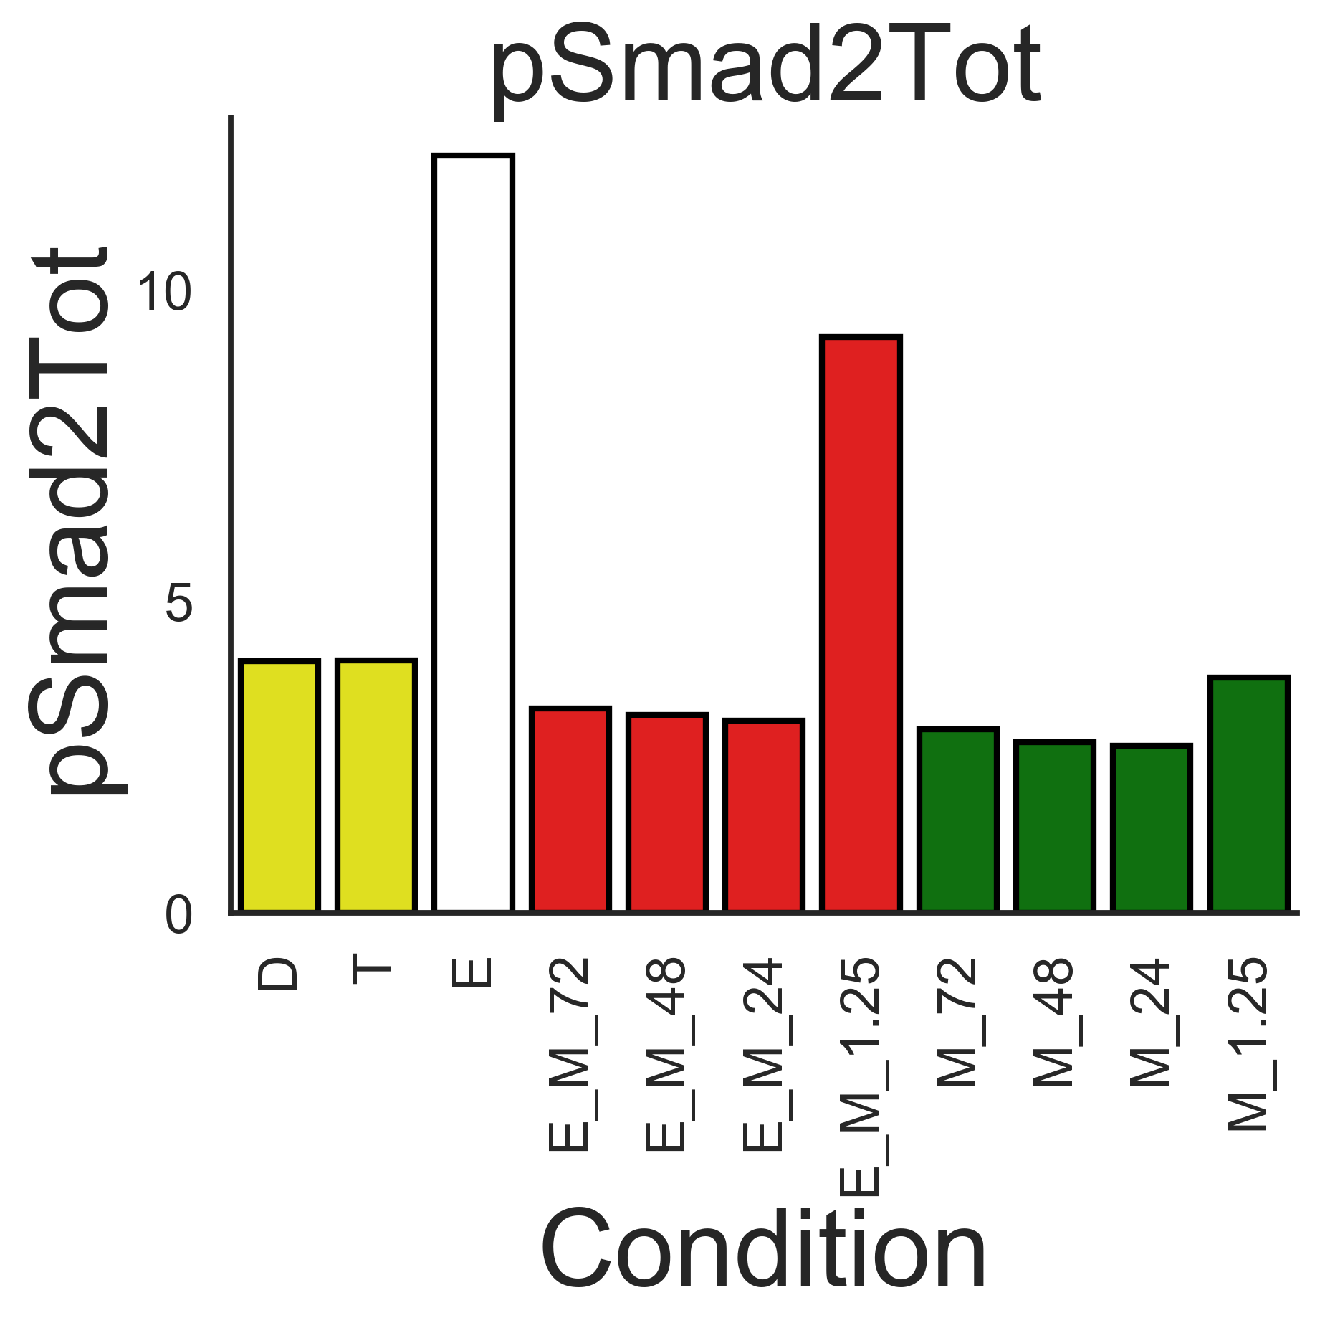
Smad2 simulations
pSmad2Tot is the sum of all pSmad2 species
AZD
MK2206

Slide 9
What needs doing to drive the model forwards.
S6K simulations do not resemble the experimental data. Solution: topology changes
Smad2 simulations do not resemble the experimental data. Again, the solution requires topology changes.

Slide 10
Version Control
Date Committed | Branch | Comments | Git ref
18-12-2018 | Akt | This is the model version that simulated the graphs in slides 4 – 8. | e08c385cd54d24f0c1944f6dc6f1ed78be6de0cd

