Slide 1
Experimental Design – and similarly for MK2206
 |  | Time (h)
Condition Code | Condition | 0.00 | 24.00 | 48.00 | 70.25 | 70.75 | 71.25 | 72.00
D | DMSO | Add DMSO | - | - | Starve | - | - | Lysis
T | TGFb | Add DMSO | - | - | Starve | - | TGFb Treatment | Lysis
E | TGFb + EV | Add DMSO and EV | - | - | Starve | - | TGFb Treatment | Lysis
E_A_72 | TGFB + Everolimus+ AZD 3 | Add EV and AZD | - | - | Starve | - | TGFb Treatment | Lysis
E_A_48 | TGFB + Everolimus+ AZD | Add EV | Add AZD | - | Starve | - | TGFb Treatment | Lysis
E_A_24 | TGFB + Everolimus+ AZD 1 | Add EV | - | Add AZD | Starve | - | TGFb Treatment | Lysis
E_1.25 | TGFB + Everolimus+ AZD30 mins | Add EV | - | - | Starve | Add AZD | TGFb Treatment | Lysis
72 | TGFB + AZD 3 | Add DMSO and AZD | - | - | Starve | - | TGFb Treatment | Lysis
48 | TGFB + AZD 2 | Add DMSO | Add AZD | - | Starve | - | TGFb Treatment | Lysis
48 | TGFB + AZD 1 | Add DMSO | - | Add AZD | Starve | - | TGFb Treatment | Lysis
A_1.25 | TGFB + AZD 30mins | Add DMSO | - | - | Starve | Add AZD | TGFb Treatment | Lysis

Slide 2
Event based modelling
Will hopefully allow us to map the experimental protocol directly onto model
I don’t think the previous strategy of starting the simulation with the various initial conditions mapped the simulation variables correctly onto the experimental variables
Previously (as I recall), the simulation started with TGFb in all conditions whereas in reality, TGFb is only used at 71.25h after the first pretreatment.
Previously, we set the initial conditions and allowed the simulation to progress, using the 24, 48 and 72h as read out times. This neglects the stimulation part of the protocol (i.e. TGFb stimulation at t=71.25h = -45min)
An alternative strategy is to use events to reproduce the experimental protocol exactly

Slide 3
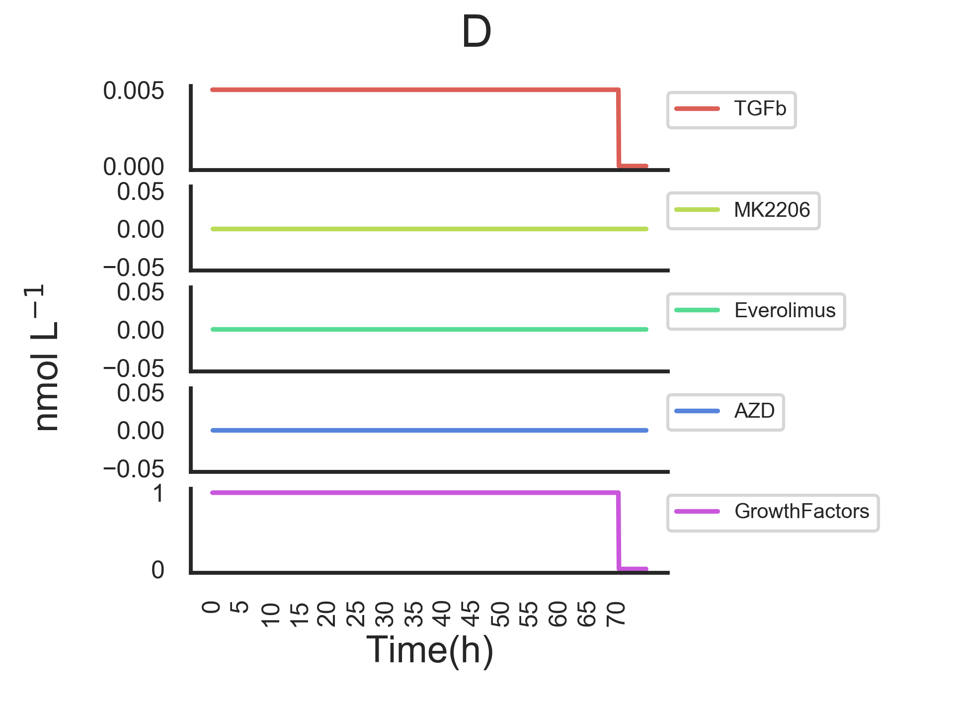
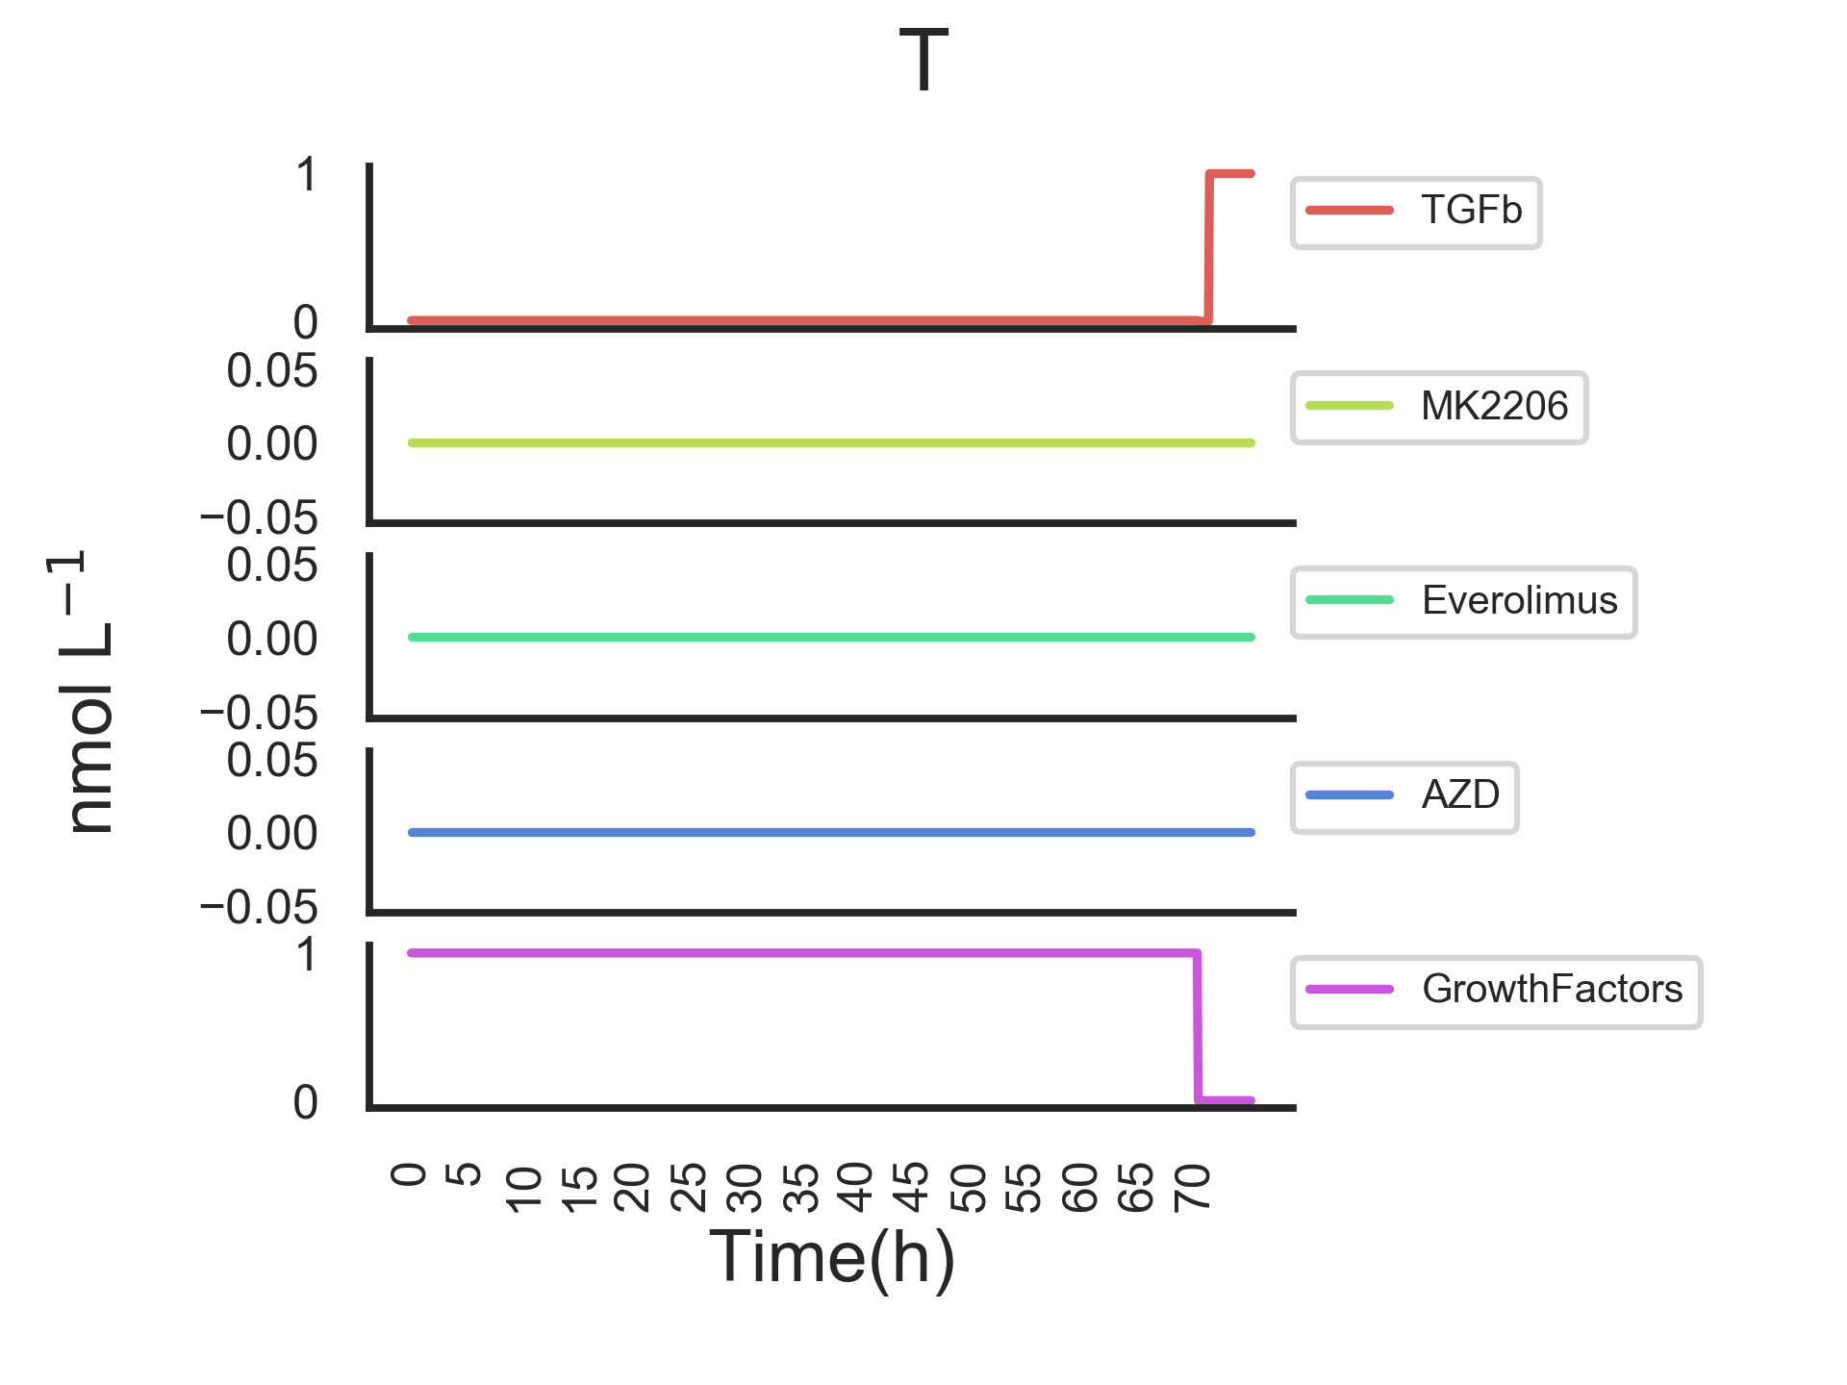
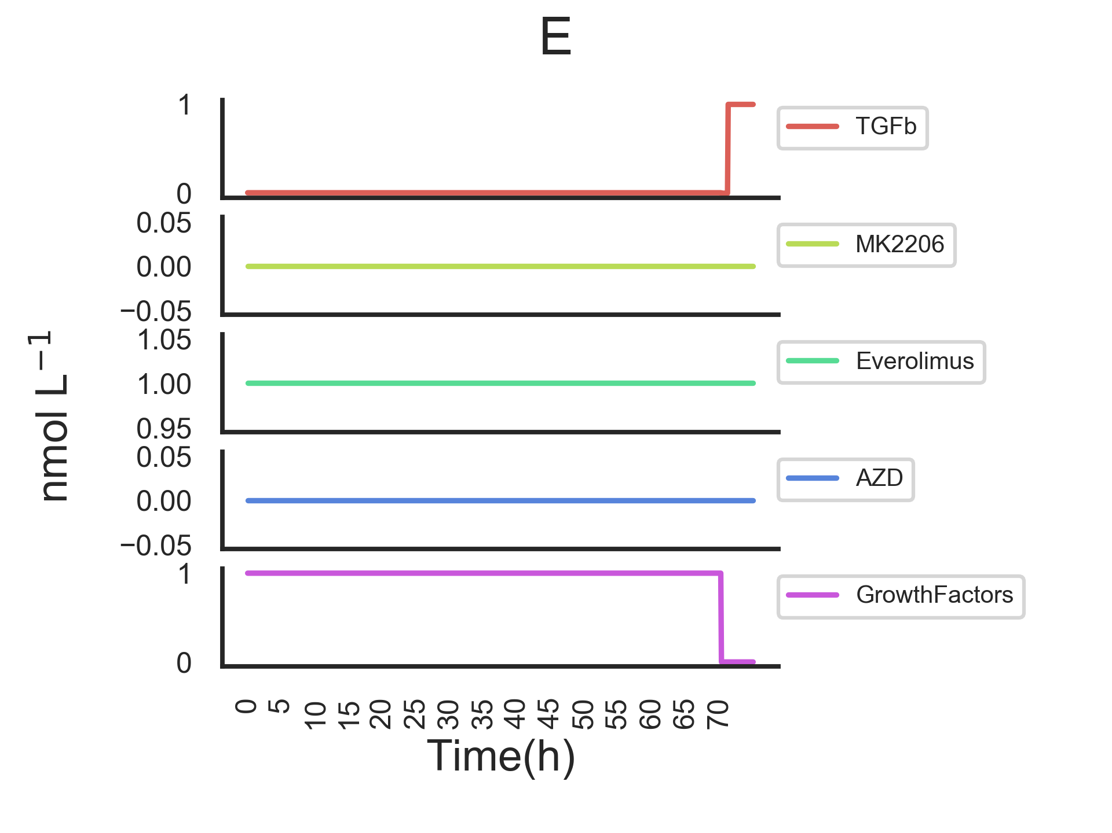
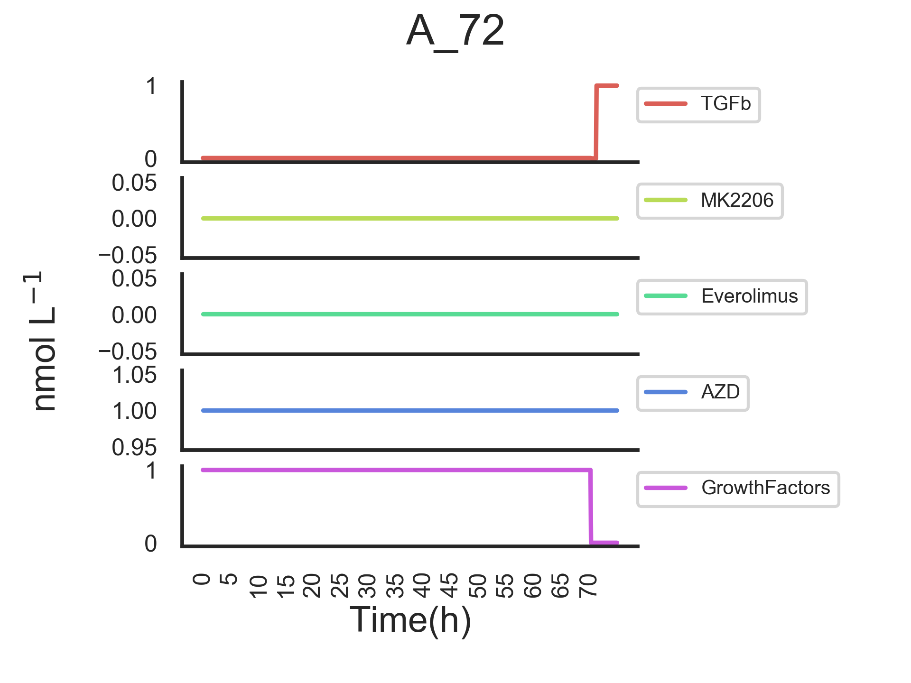
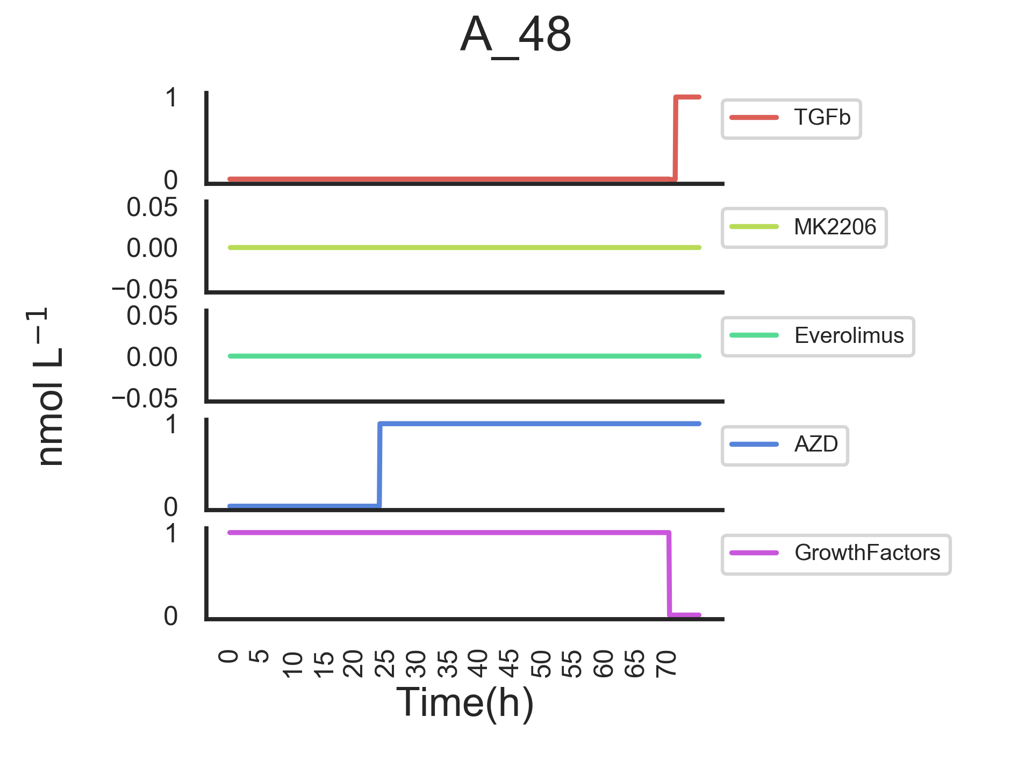
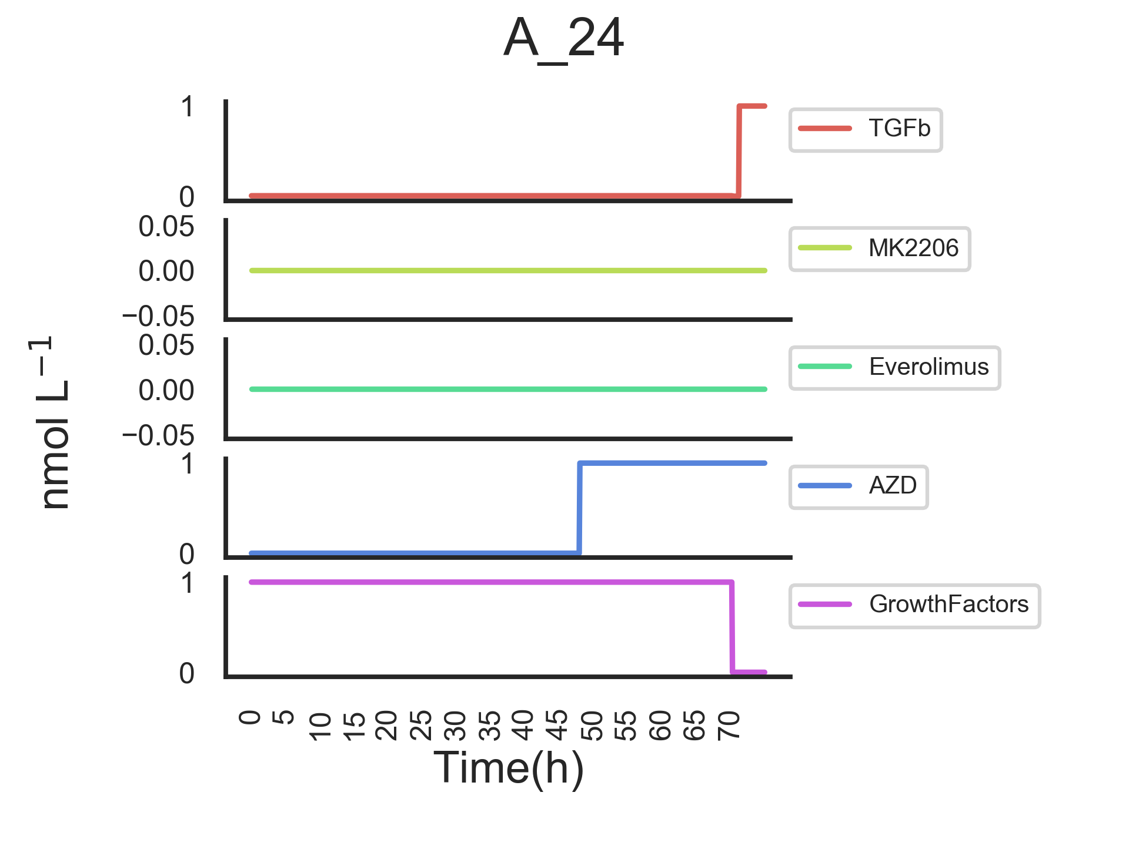
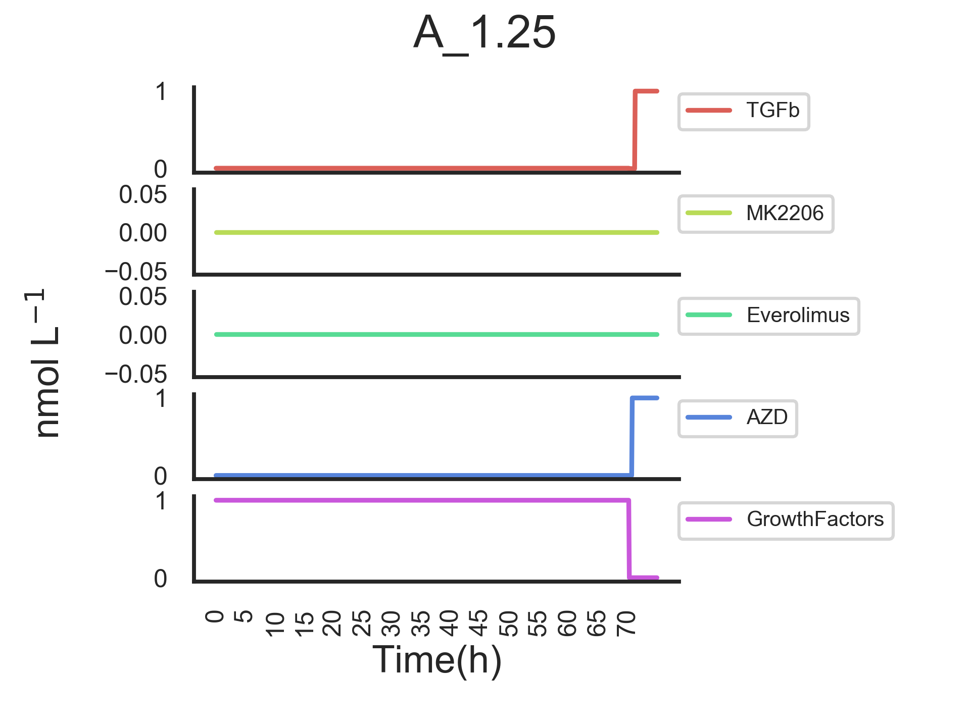

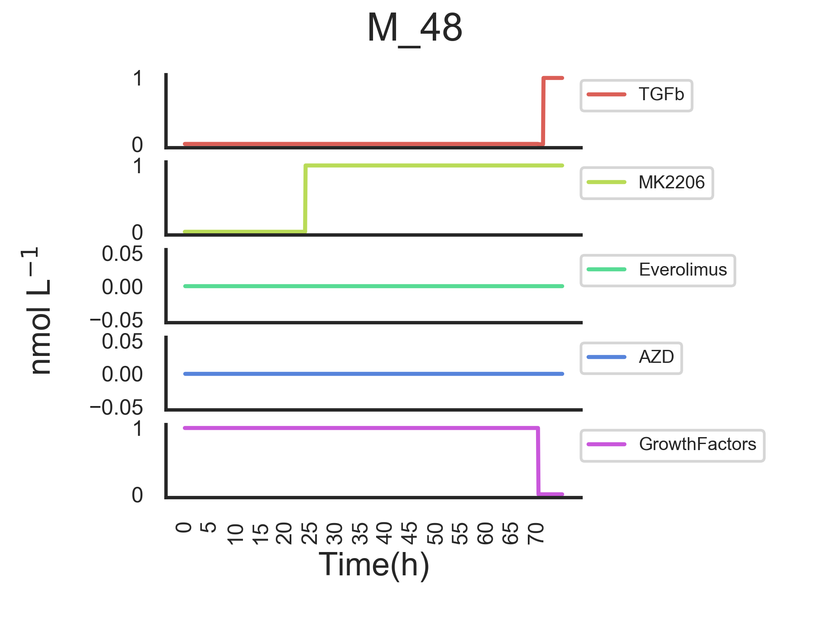
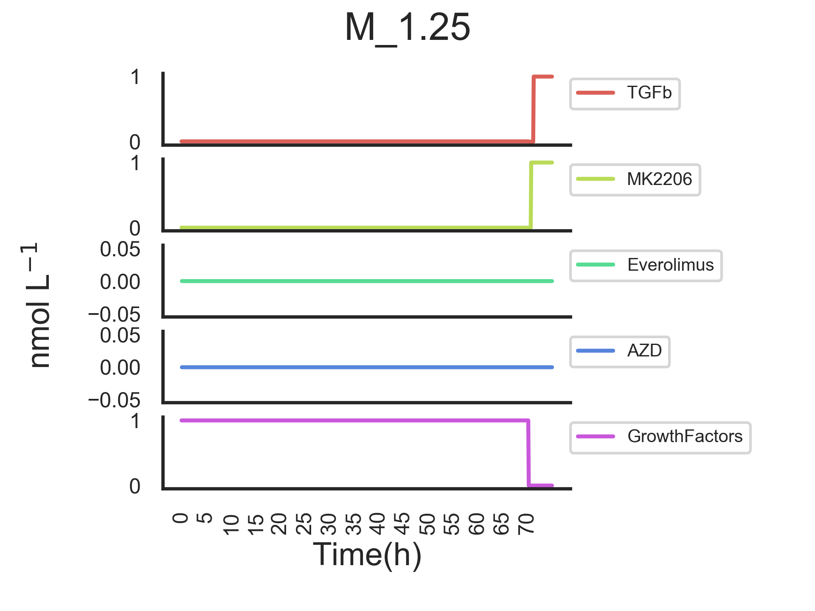
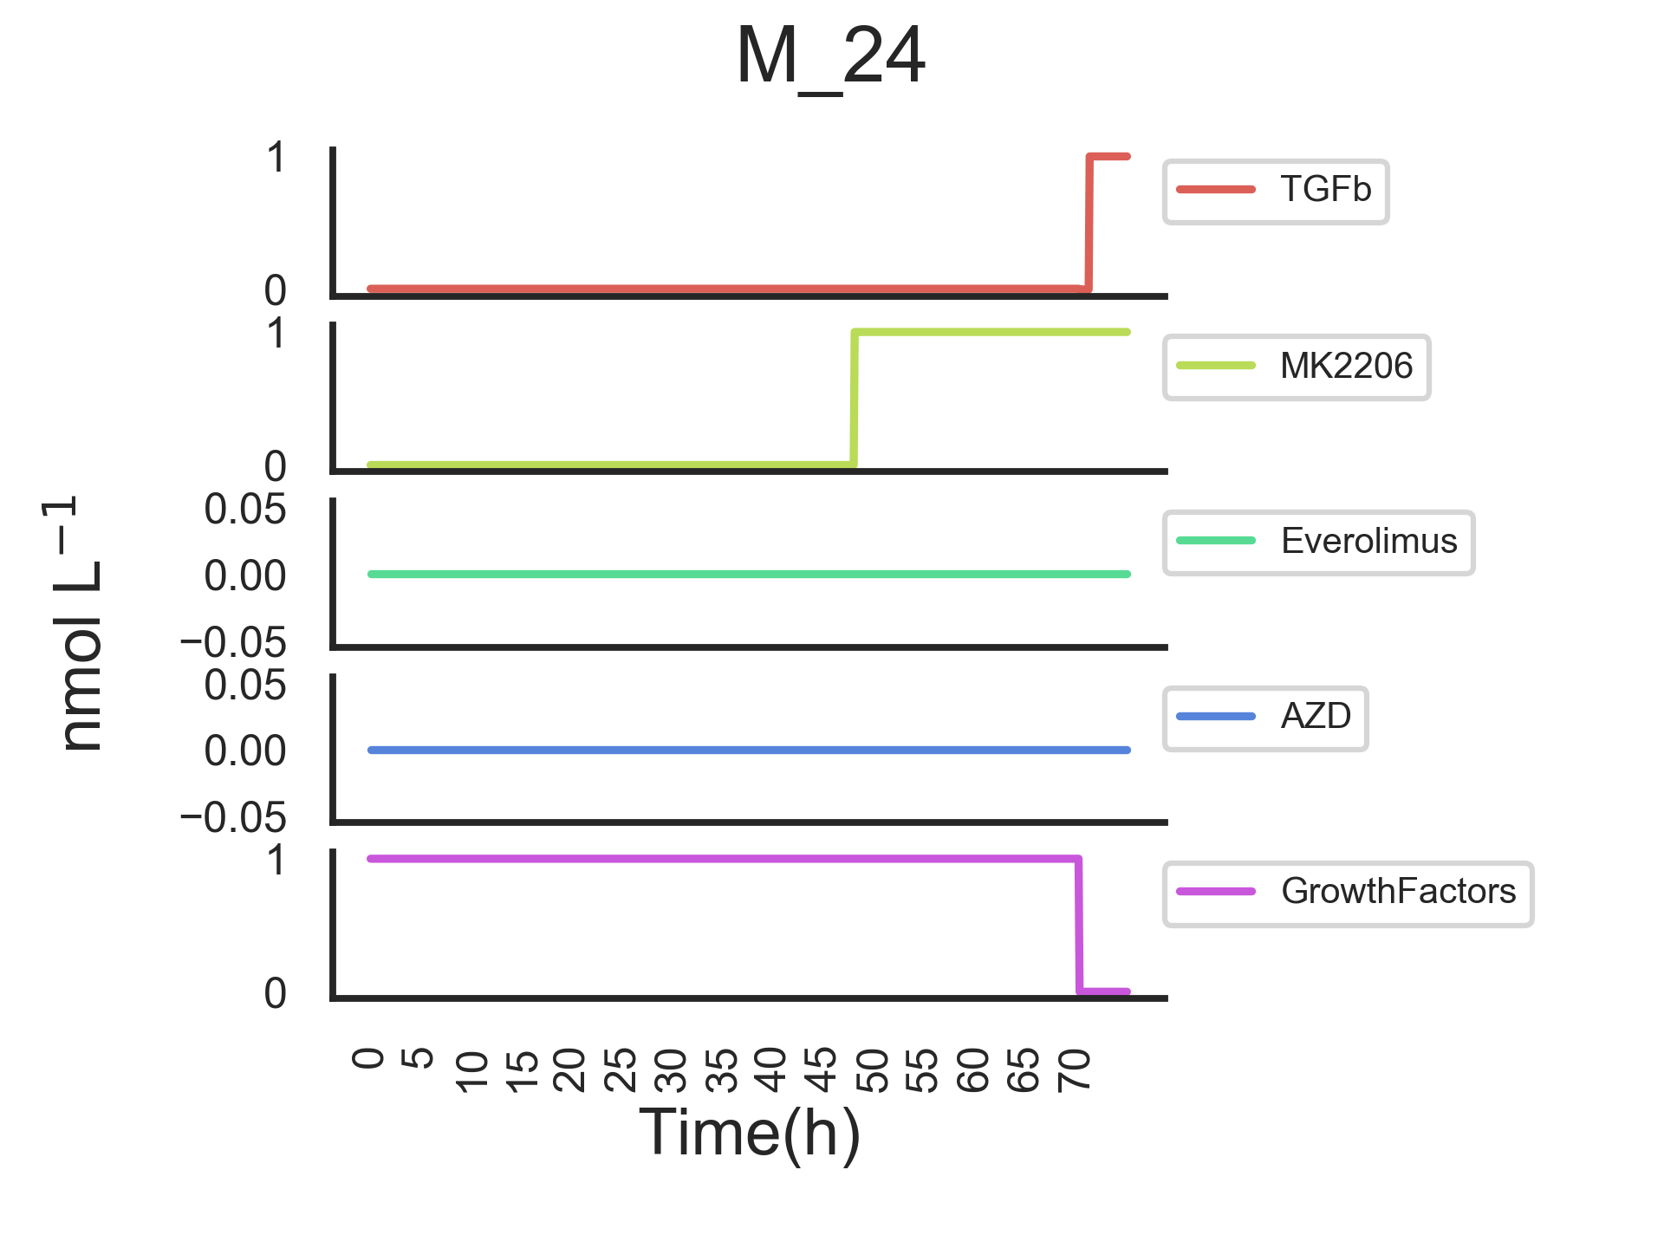
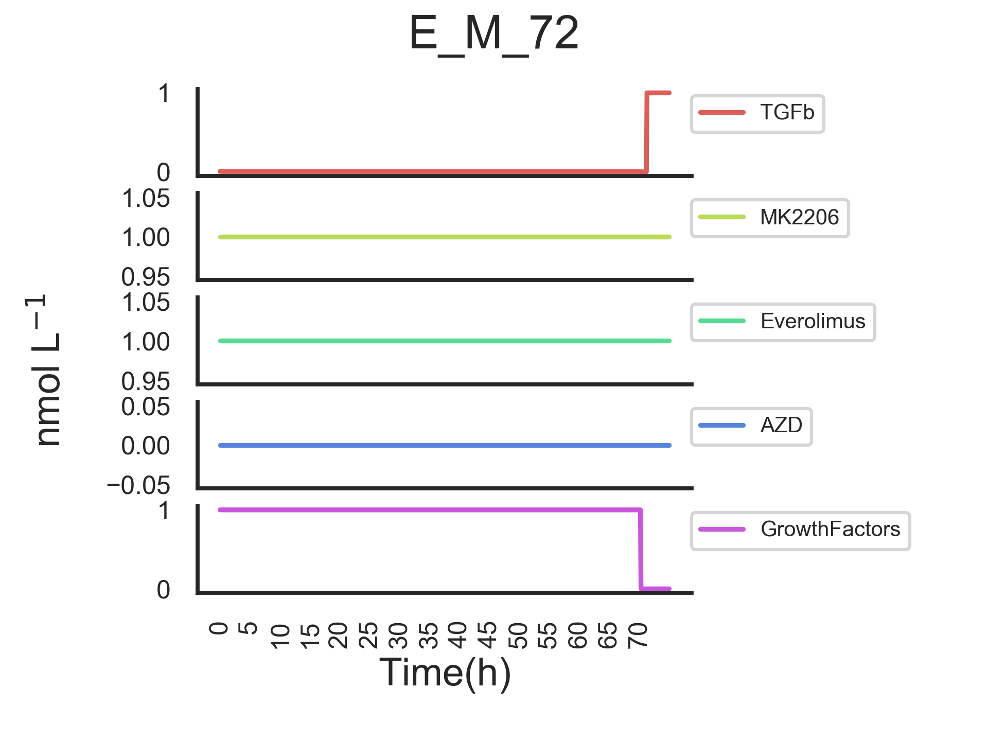




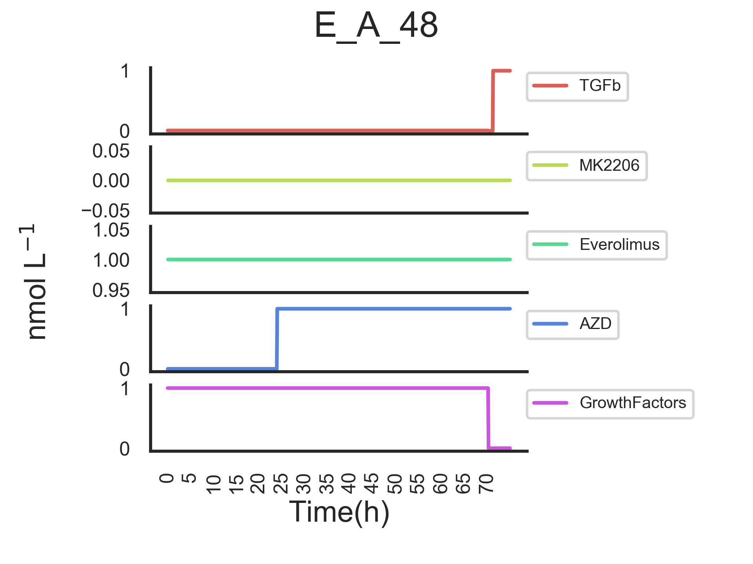
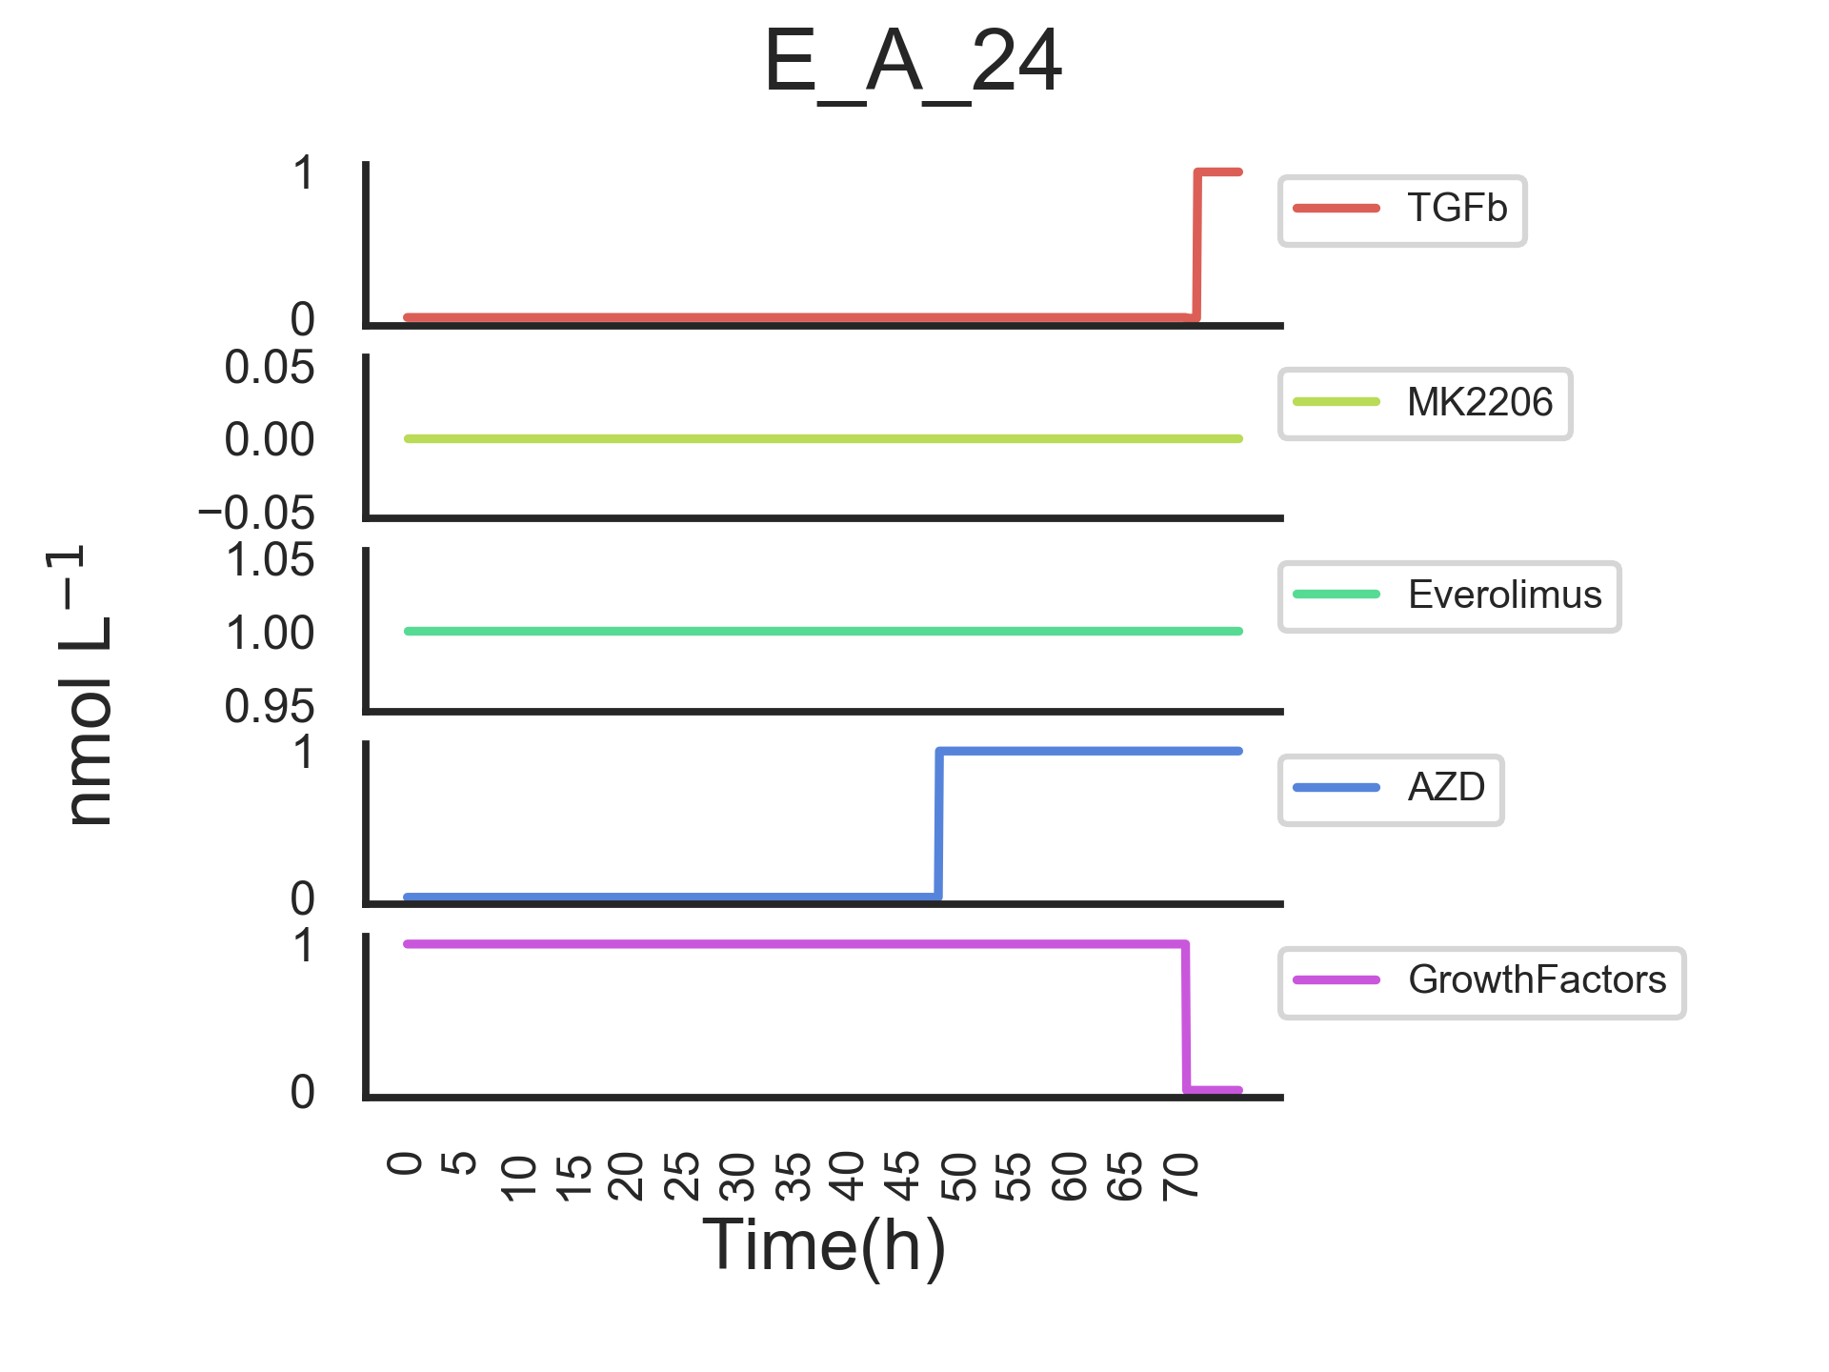
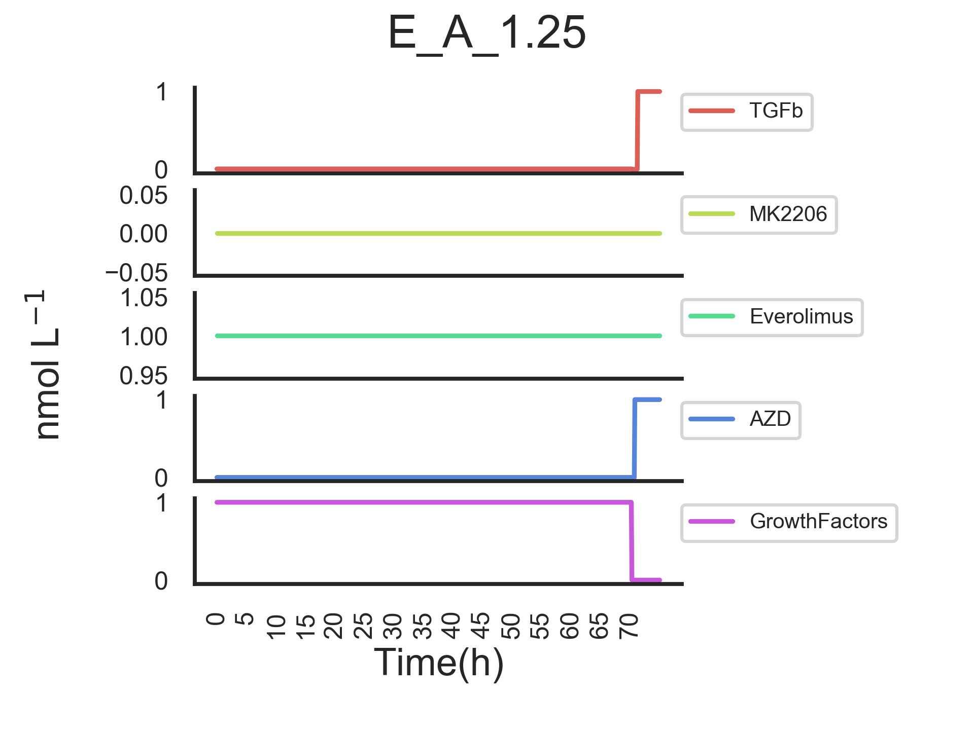
Modelling inputs

Slide 4
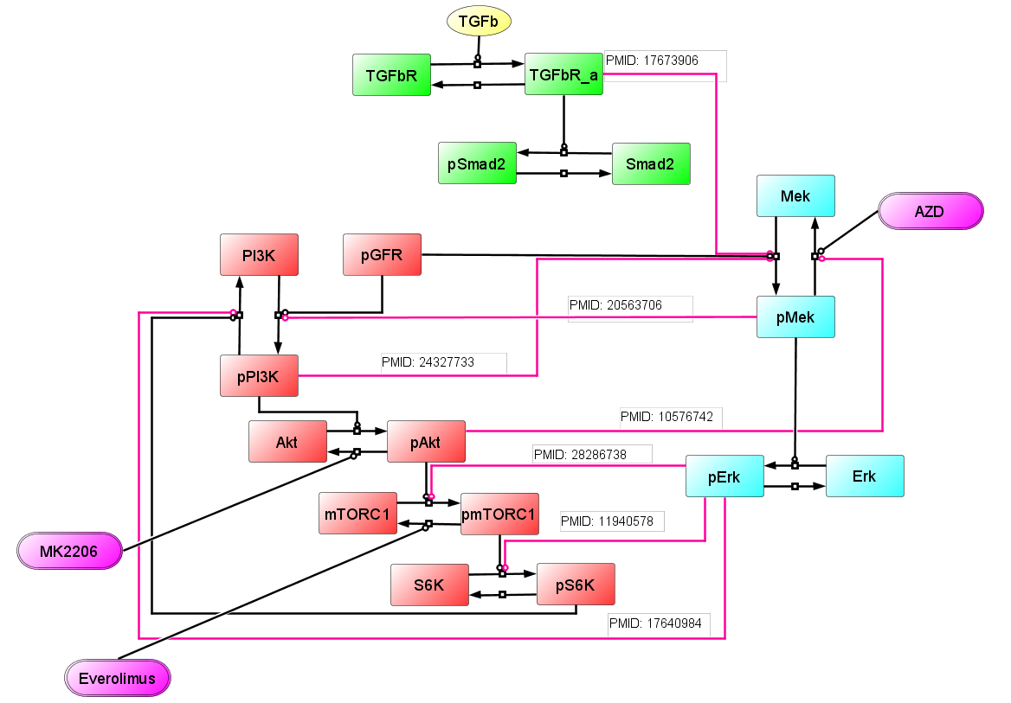
These two feedbacks counteract the effect of Everolimus
The parameter: kmTORCDephosByEv
controls the increase in pAkt between the T and T_E conditions
pErk phosphorylating mTORC1 and S6K negates the effect of Everolimus in the model. When these two phosphorylations are high they compensate for the activation mTOR and S6K when mTORc1 is inhibited by Everolimus.
Thus we can achieve the same behaviour by tuning kmTORCDephosByEv, kS6KPhosByErk and kmTORPhosByErk appropriately, i.e. its a non-identifiability.
Moreover, these two feedbacks actually achieve the same job in the model and are therefore superfluous
The rates of these two reactions are set to 0 for a ‘deprecation period’ after which they will be removed.
Git id for this model version is “eaa83d2c798cb39755189f04c05adf76692fb6e6” on master branch

Slide 5
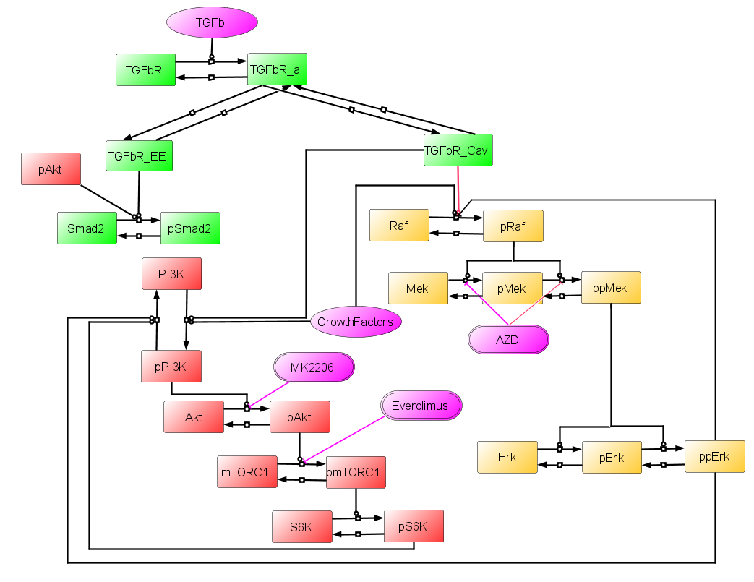
New Topology

Slide 6
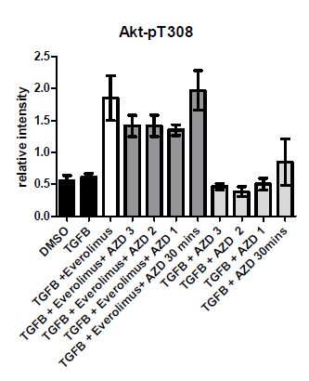
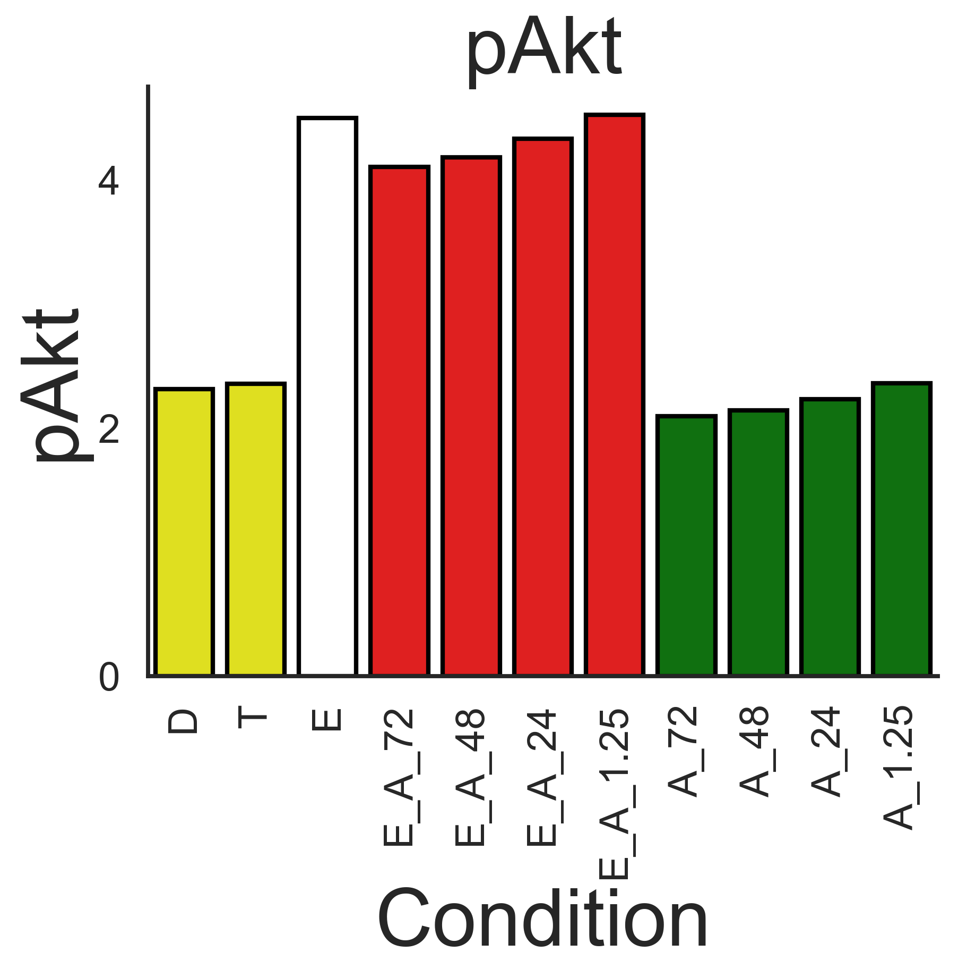
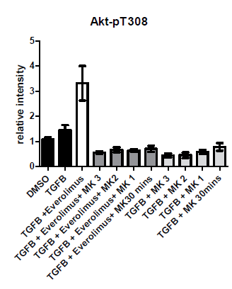
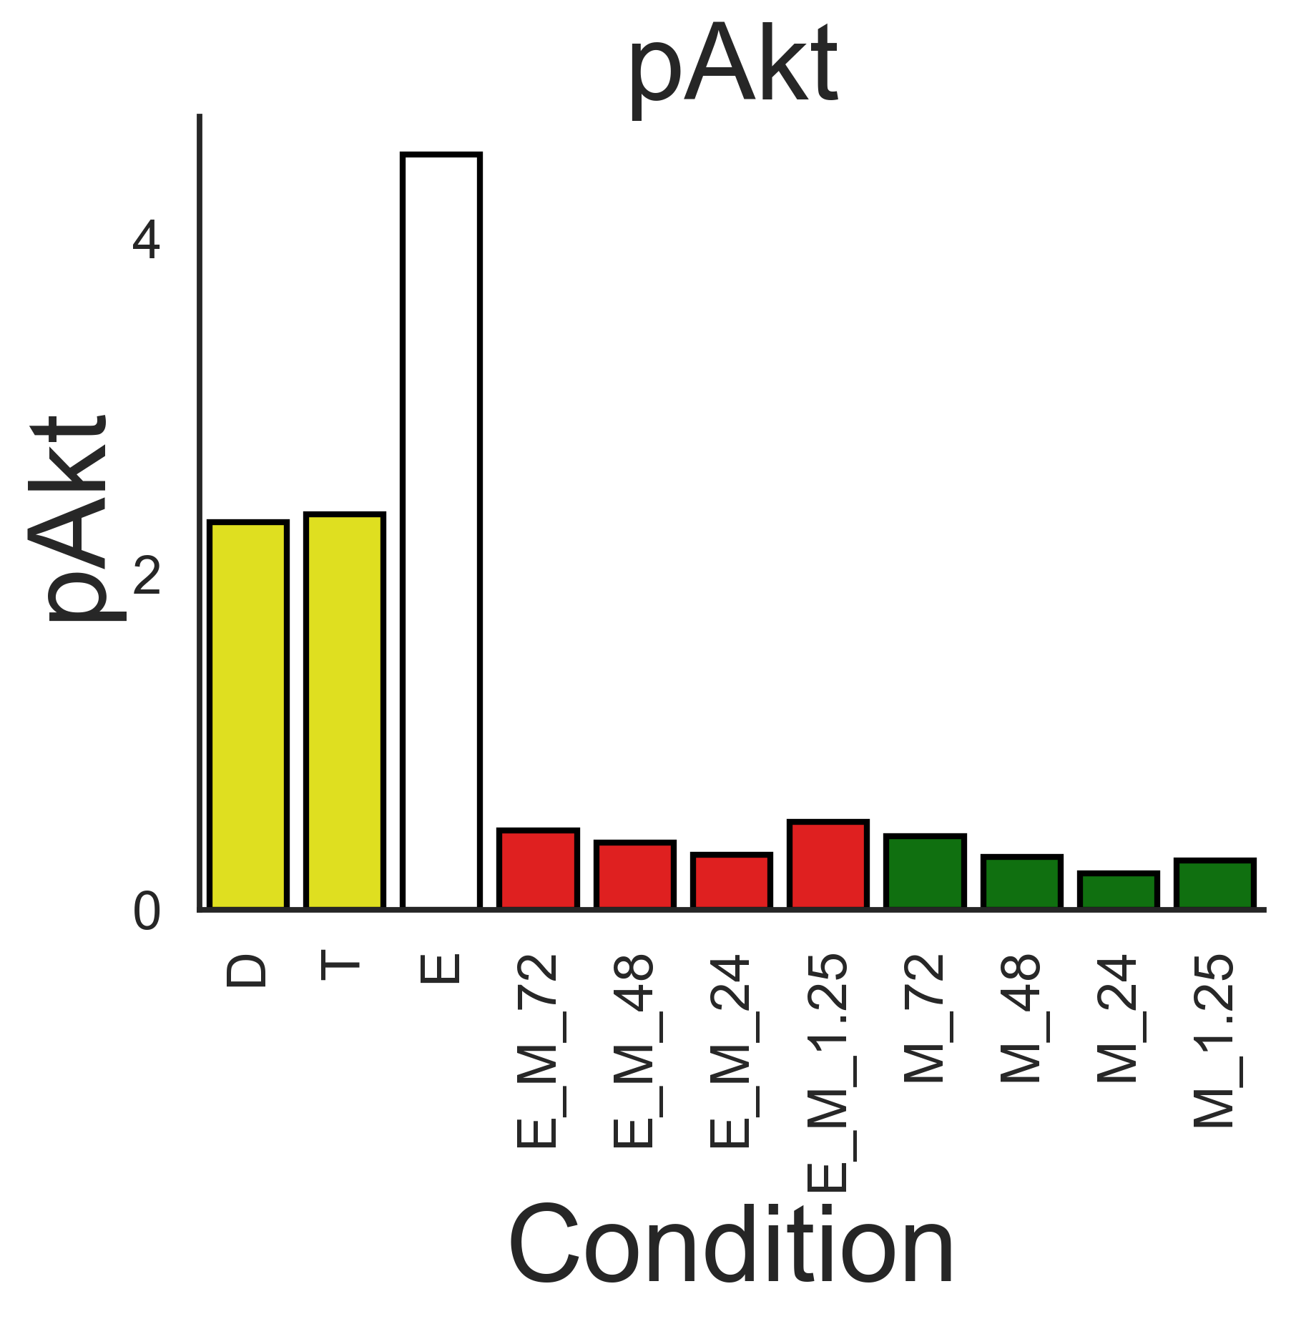
pAkt
Experimental
Simulation
AZD
MK2206

Slide 7
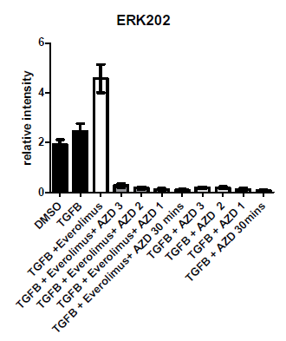
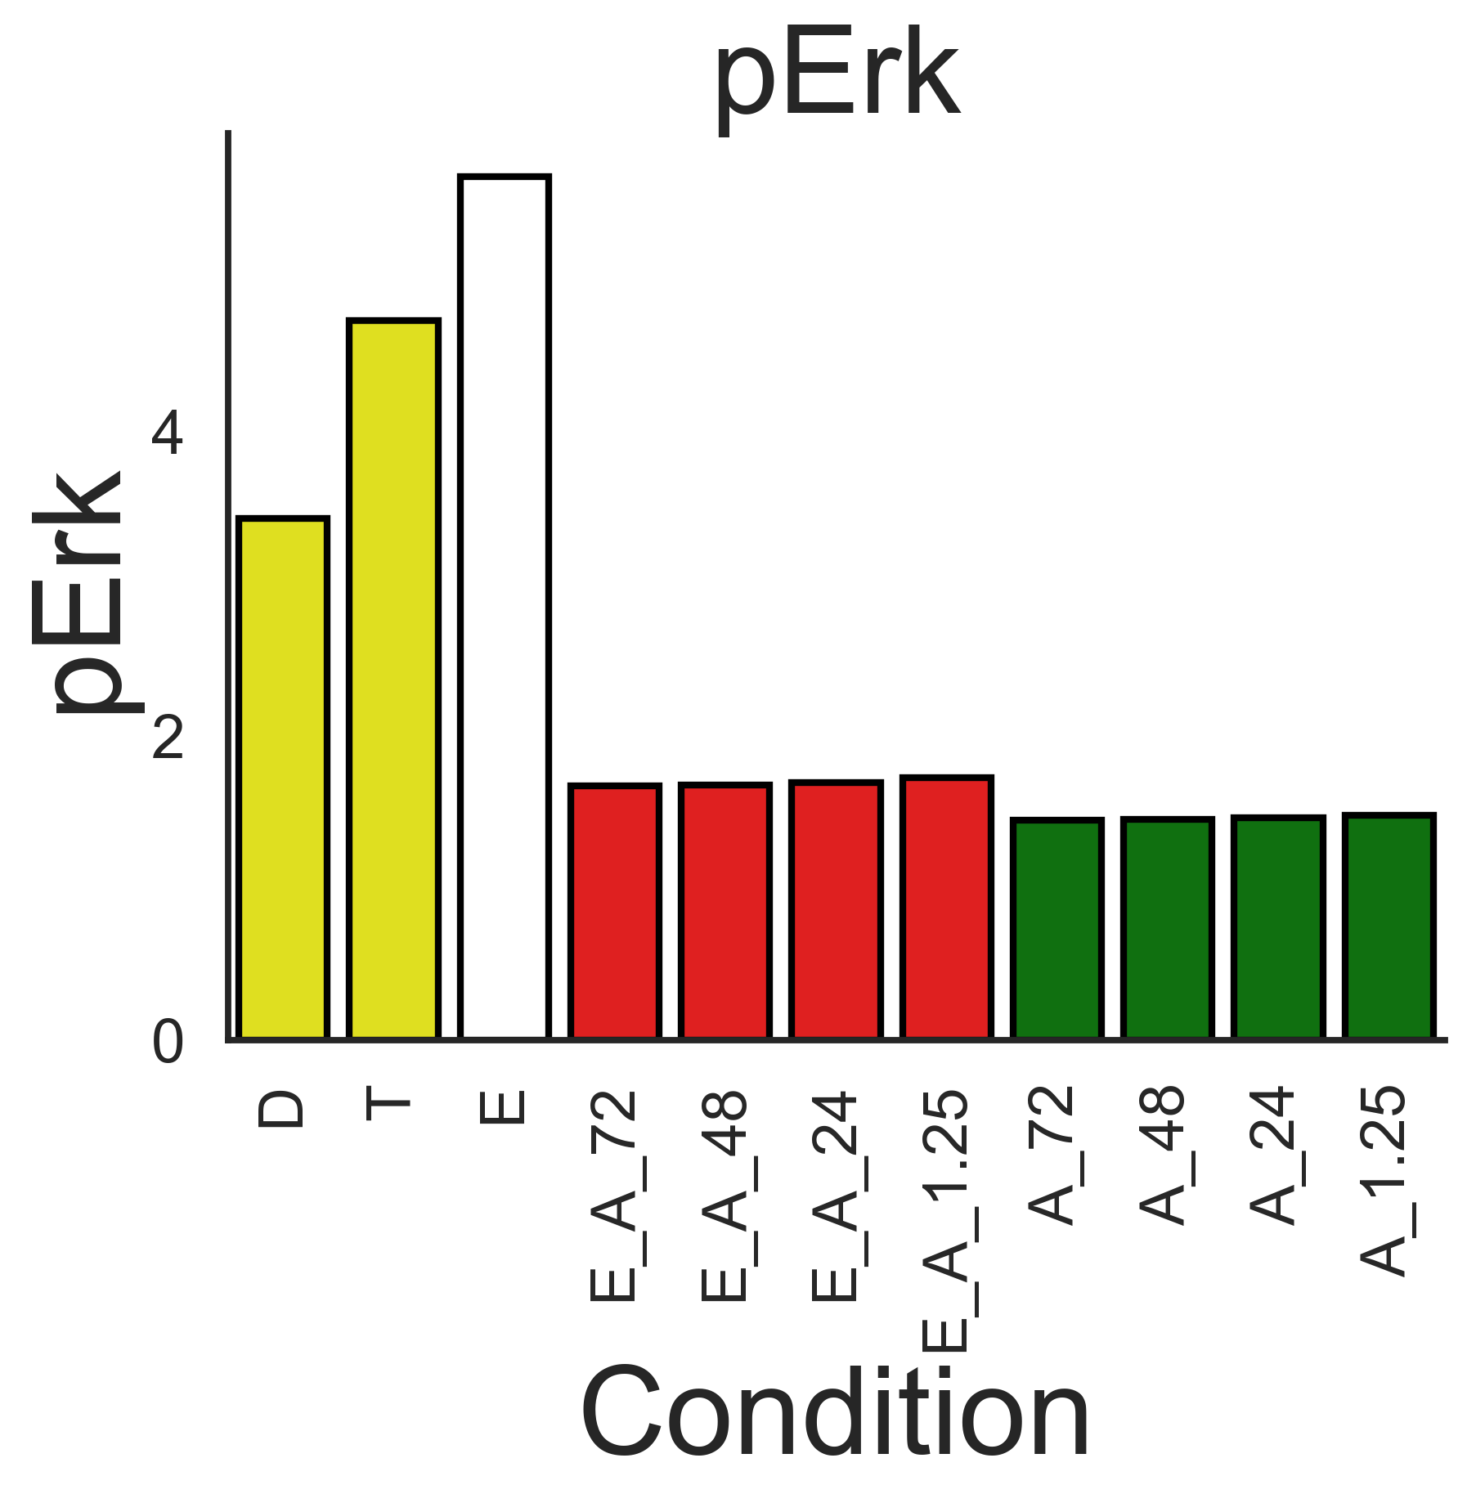
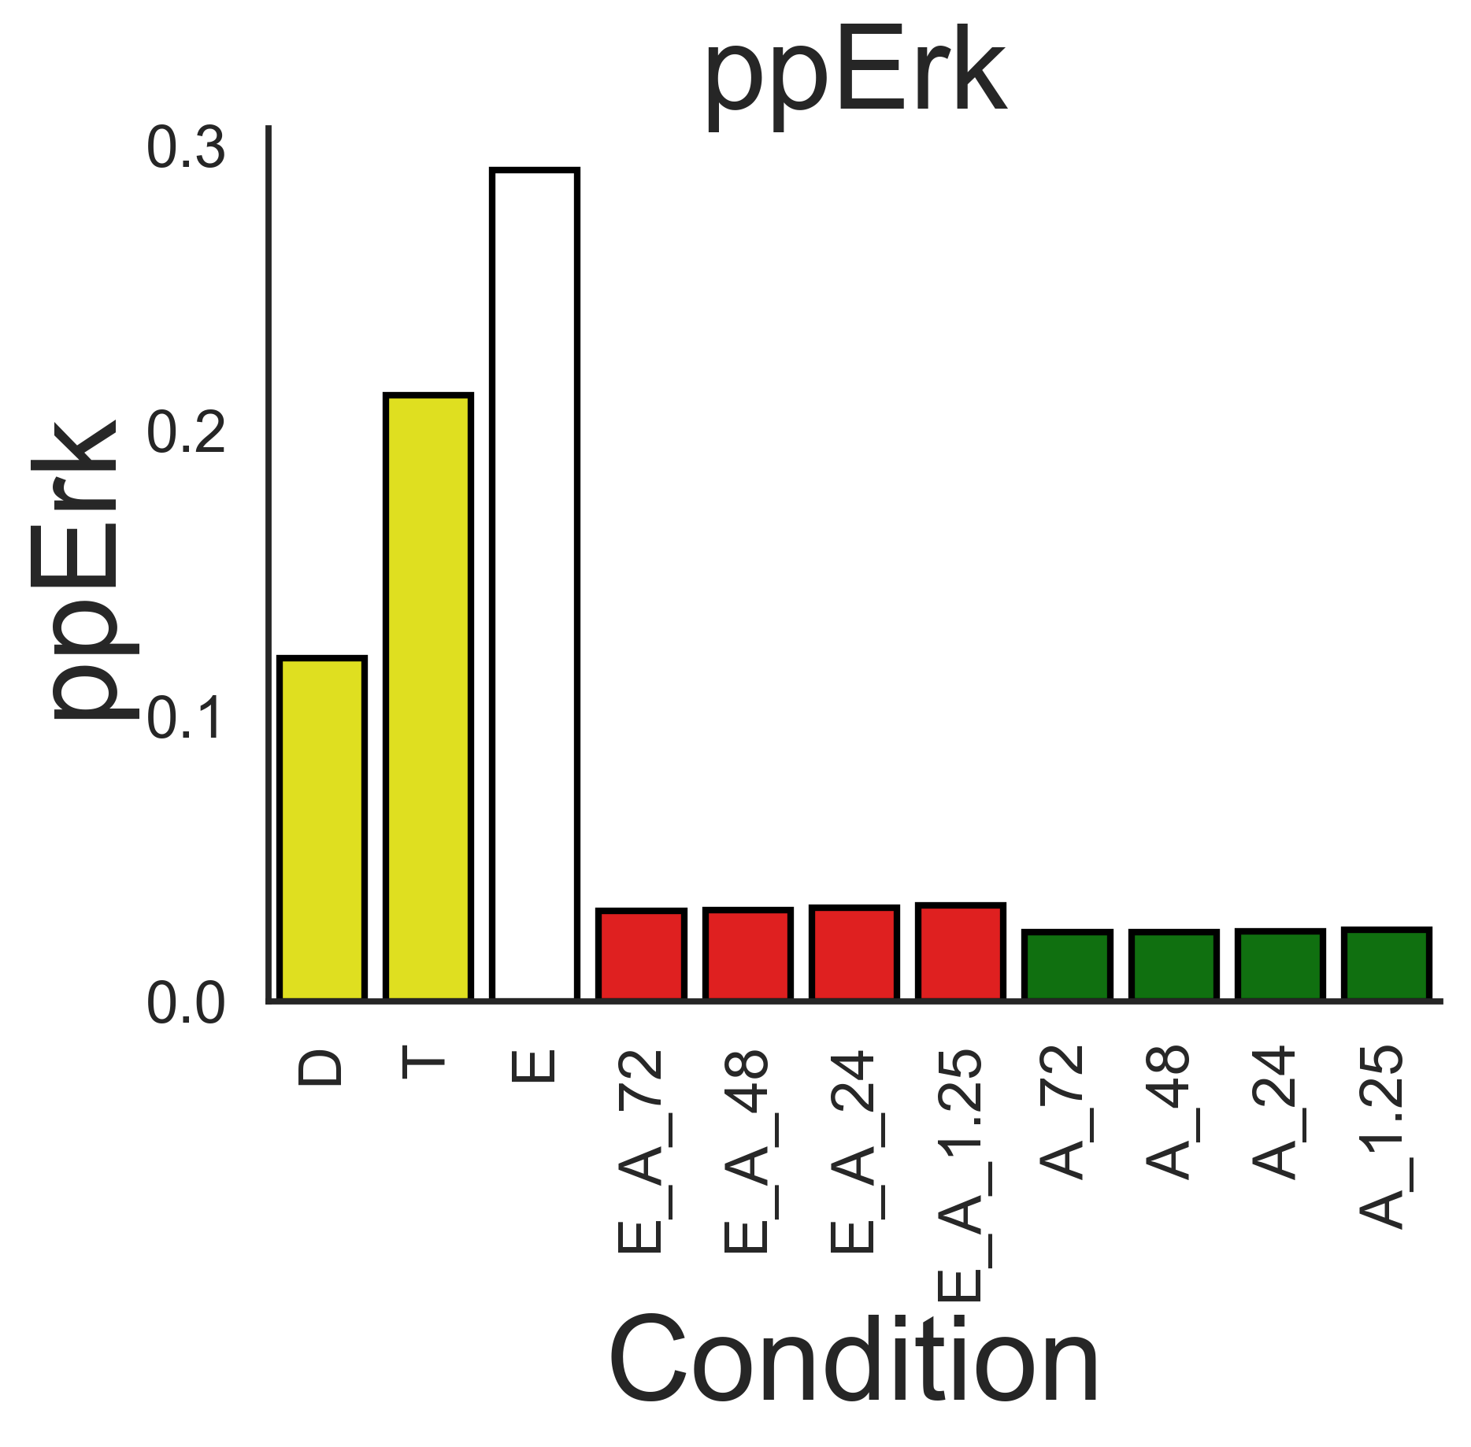
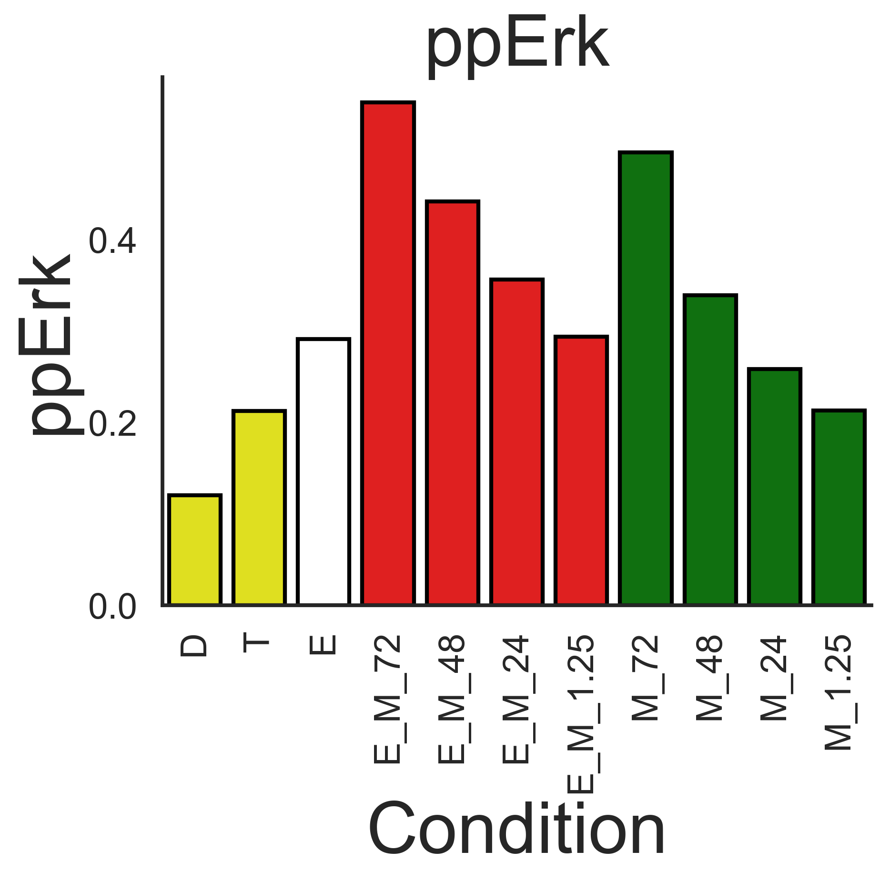
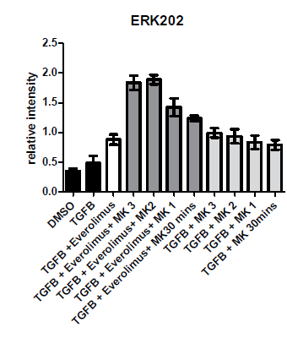
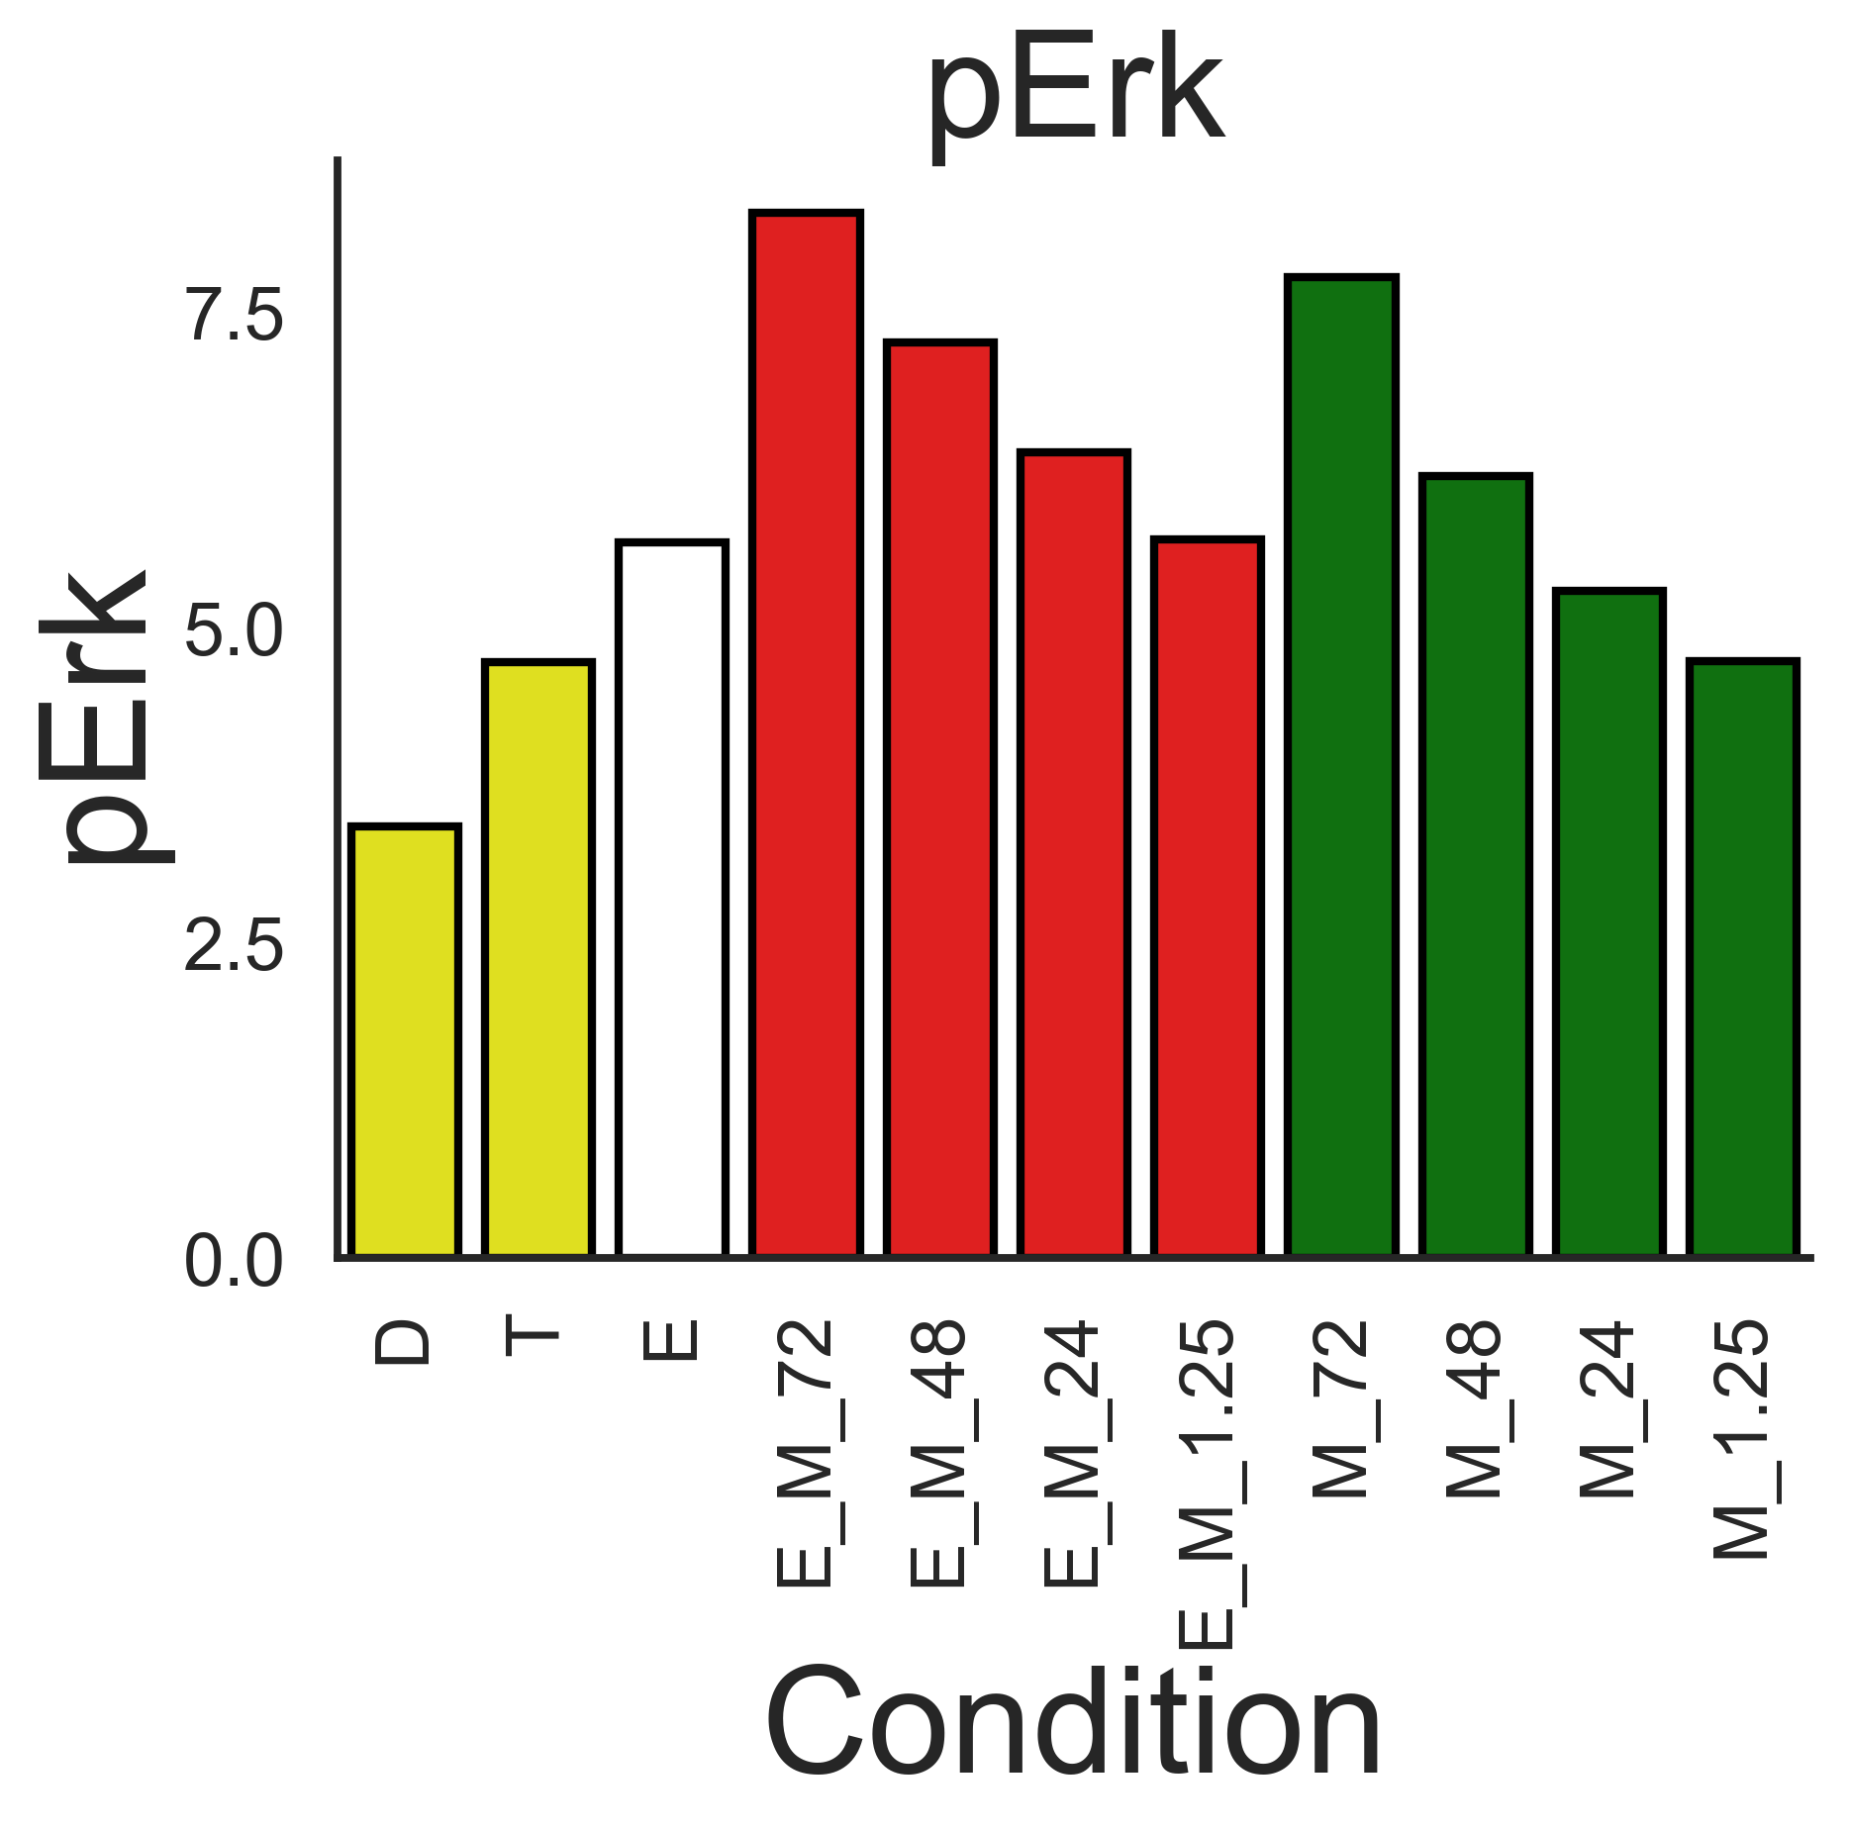
pErk / ppErk
Experimental
Simulation
AZD
MK2206

Slide 8
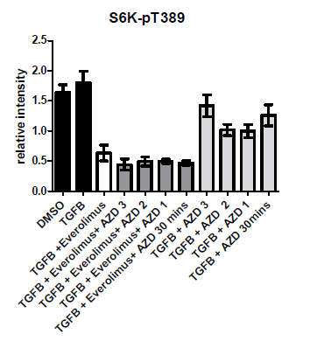
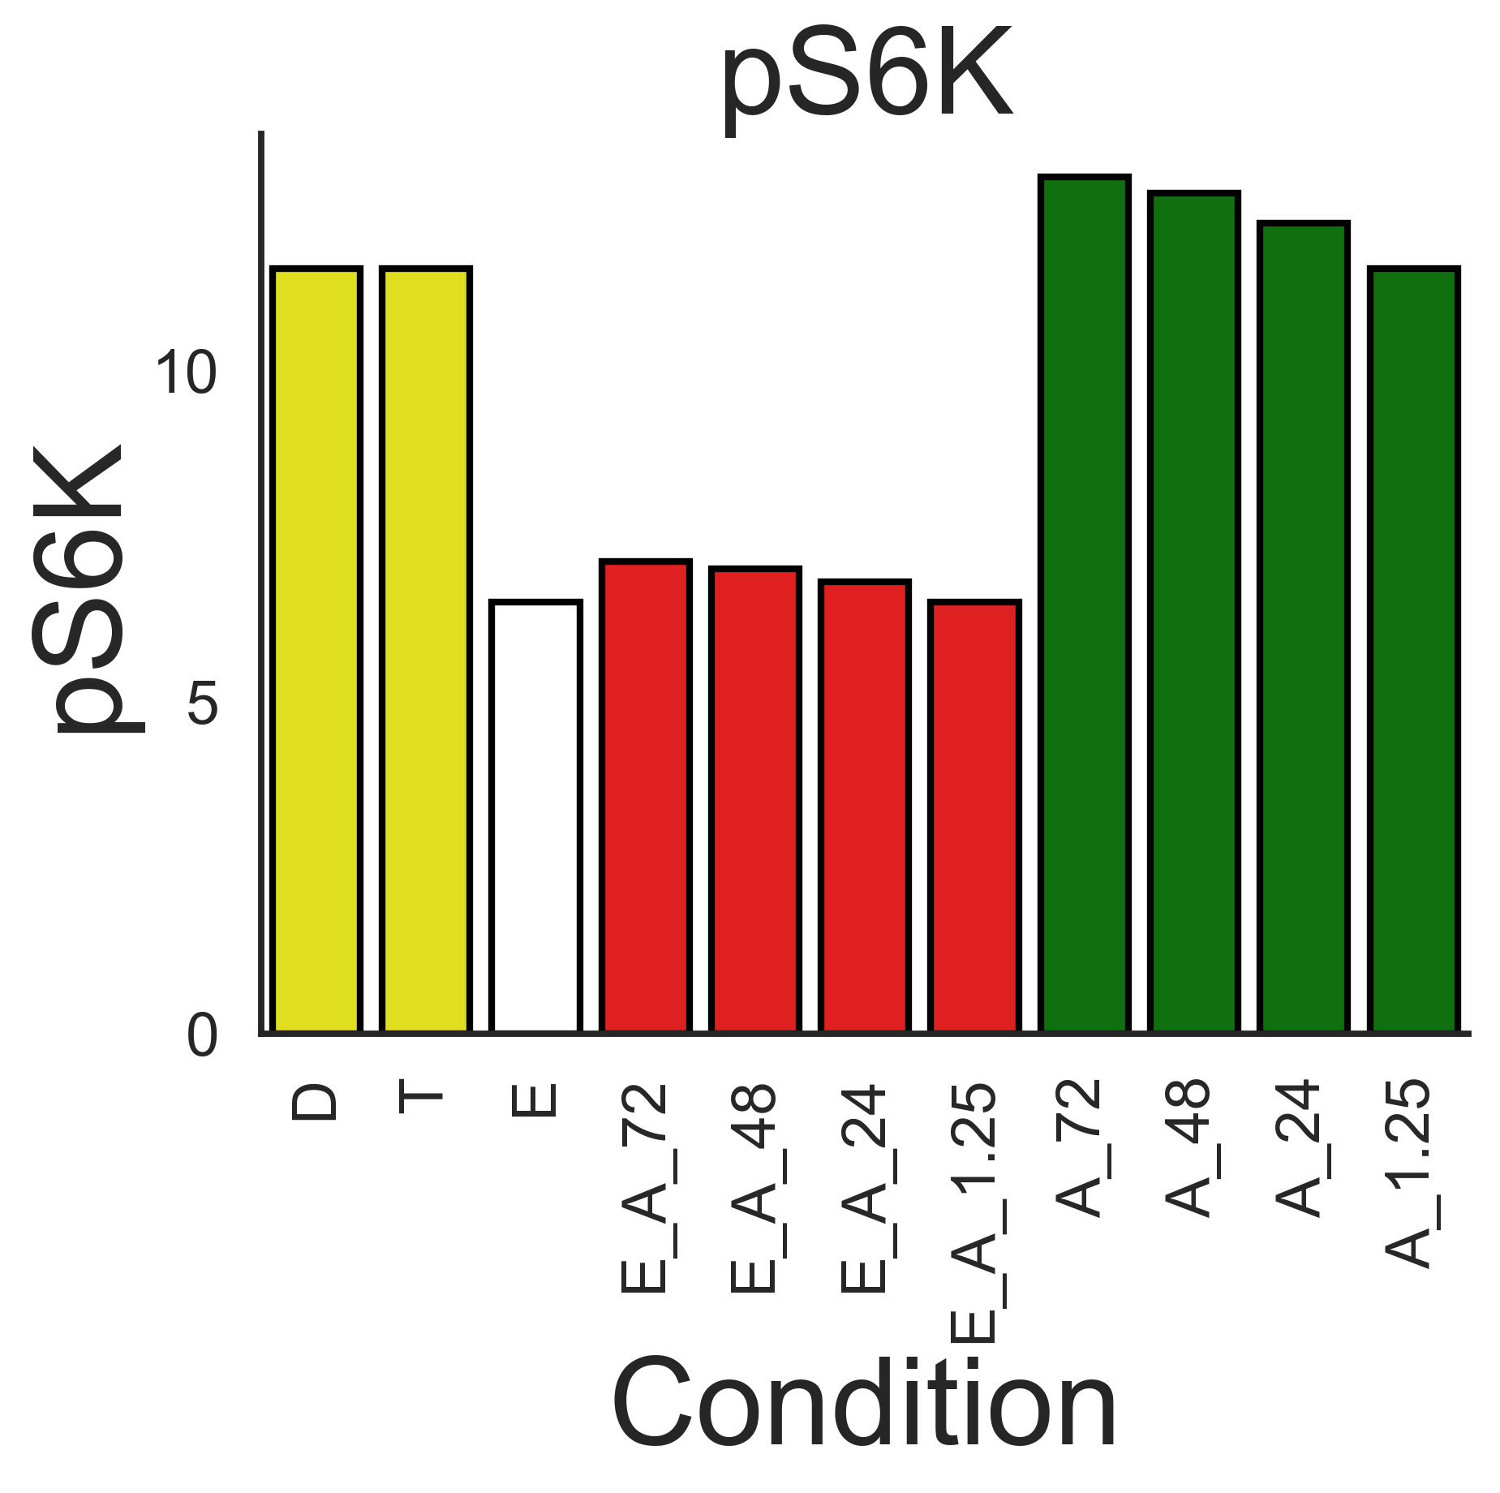
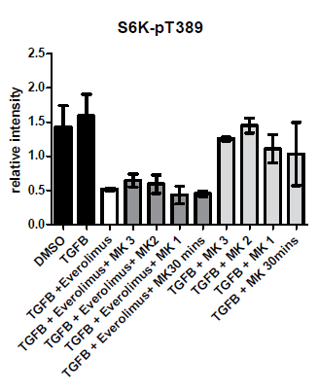
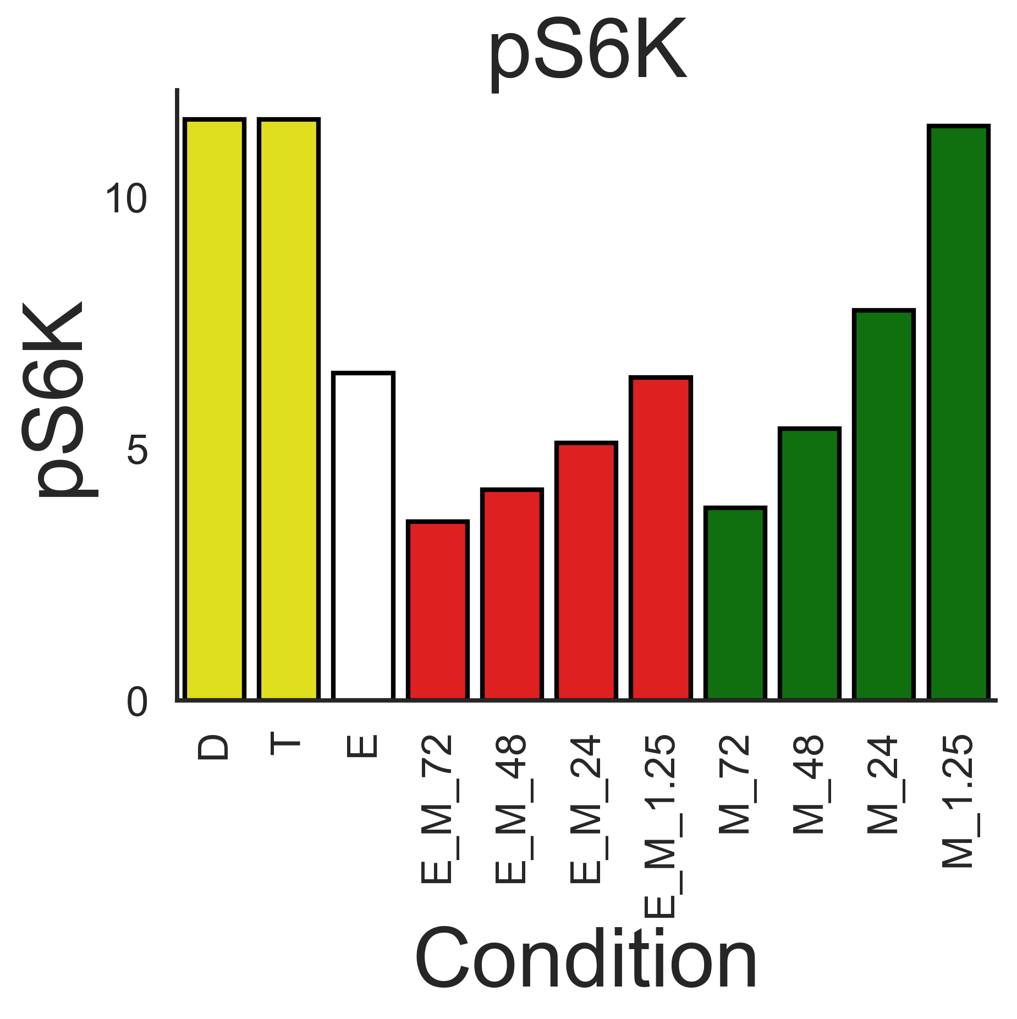
pS6K
Experimental
Simulation
AZD
MK2206

Slide 9
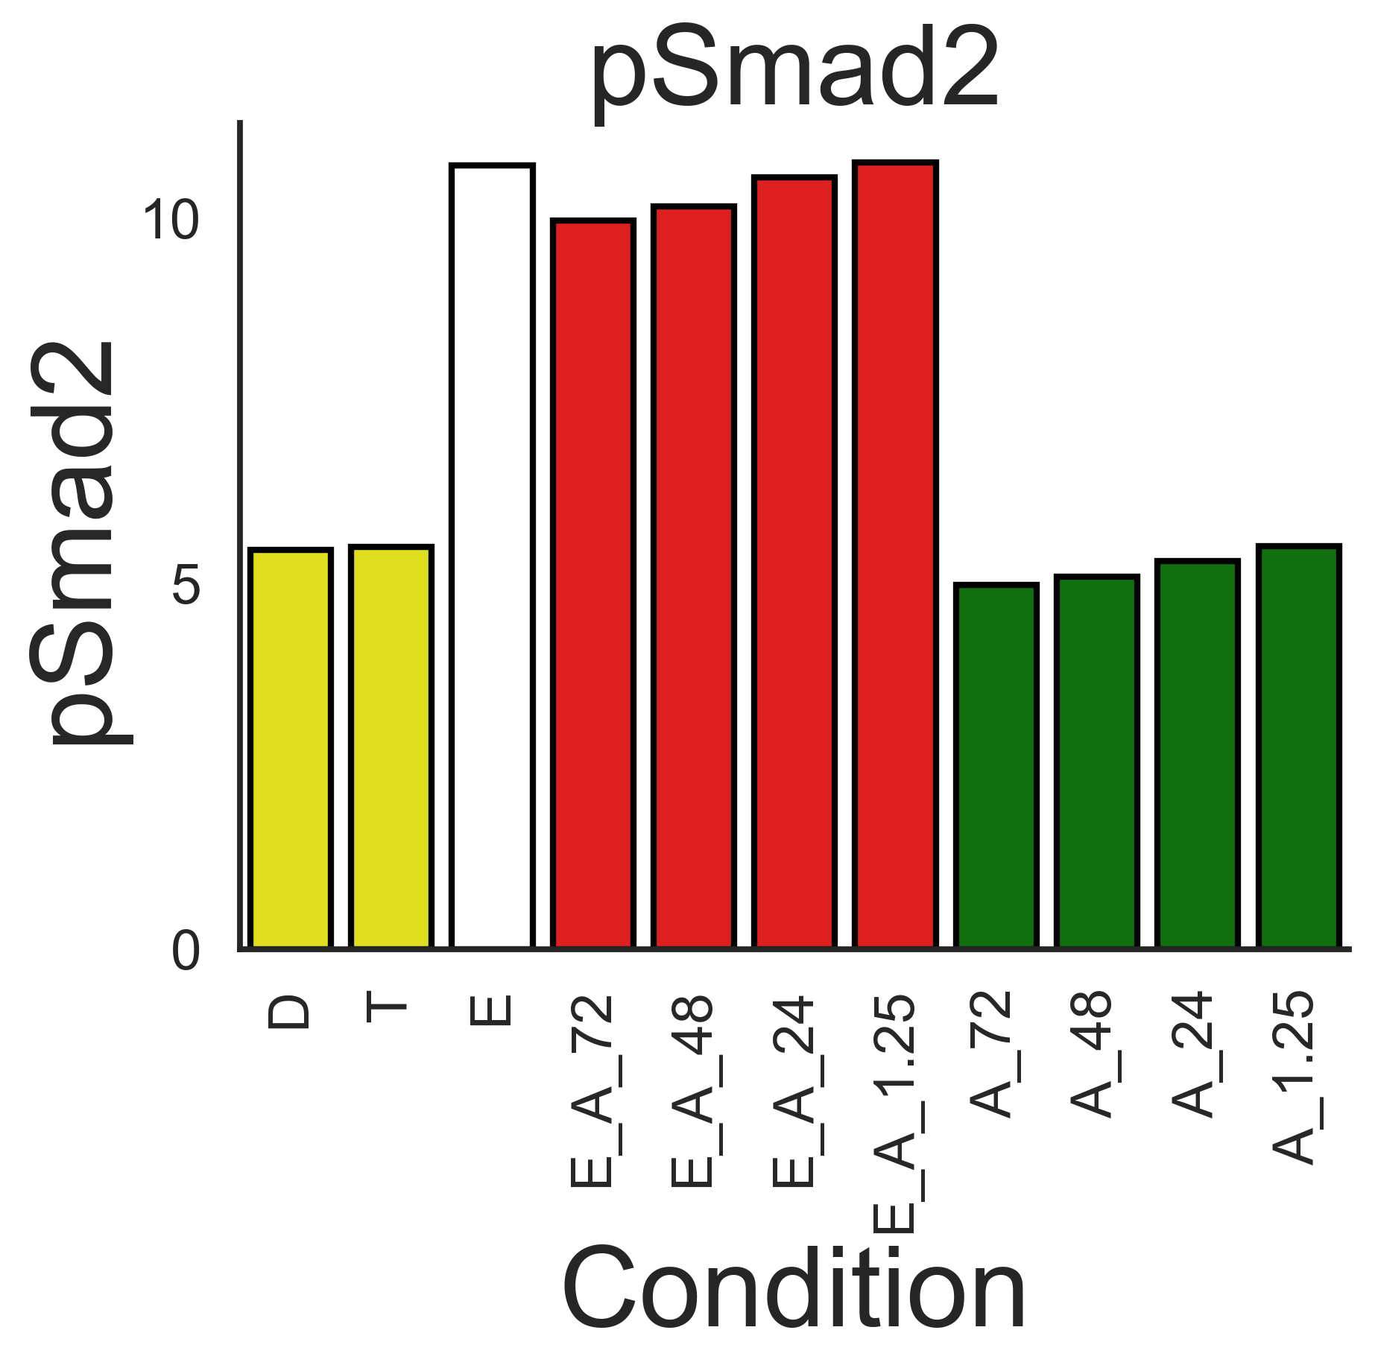
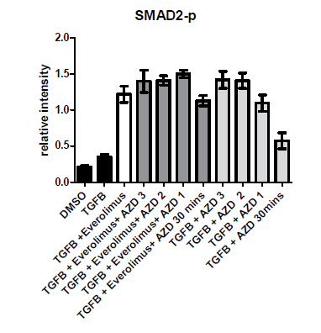
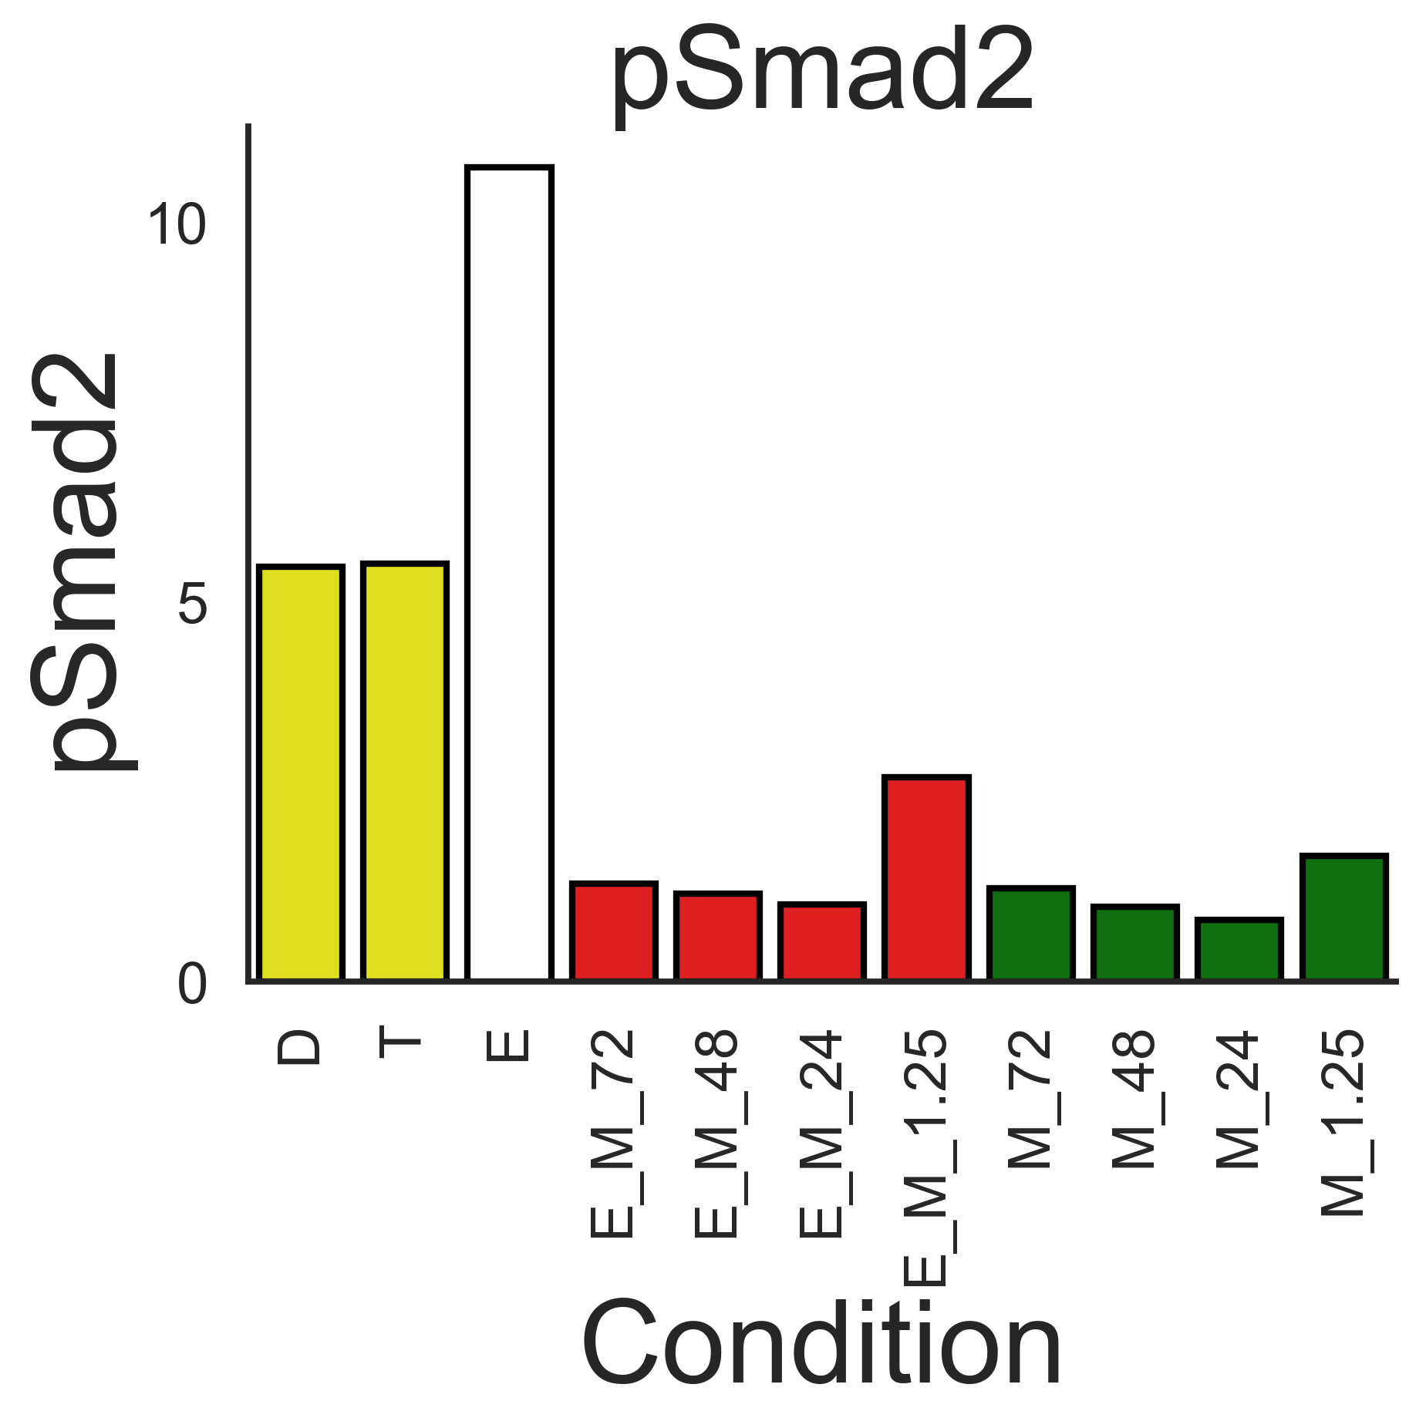
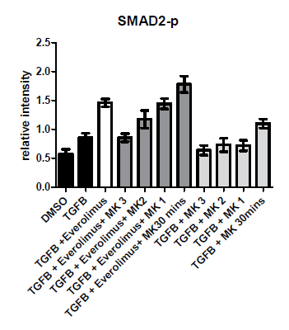
pSmad2
Experimental
Simulation
AZD
MK2206

Slide 10
I’ve had a think about what might be required – in addition to your existing experiments - in order to distinguish Erk and Akt interactions with Smad2.
At present you are using 45 minutes of TGFb stimulation as a read out and a proxy for how a variety of pretreatment conditions affect Smad2 signaling. It may be that pAkt, pErk or indeed both are capable of interacting with Smad2, so how do we distinguish between these scenarios?
Well perhaps if we were to measure more than just the 45min time point after TGF exposure in one or two of these conditions we may be able to distinguish the shape of the pSmad2 profile.
To be clear, This means varying the lysis time after TGF stimulation, rather than varying the pretreatment time, which would be left fixed at +/- TGFb, +/- Everolimus

Slide 11
Some notes
The connection from ppErk to PI3K dephosphorylation may be incorrect.
AZD inhibits Mek which inhibits Erk and lowers Erk dephos to PI3K.
In other words, under this regime, AZD increases PI3K and Akt.
However, the data suggests that AZD has only a minimal effect on Akt phosphorylation, suggesting that the connection between Erk and PI3K is incorrect.

