Slide 1











Modelling methods in the MESI-STRAT project
Metabolic Signalling Stratification
Dr Ciaran Welsh
Newcastle University

Slide 2
Overview
Introduction to the MESI-STRAT project from a high level biological perspective
An introduction to our use of mathematical modelling to better understand biological systems
A brief formal description of the mathematical framework I’m using
A brief look at one of my models in active development
A discussion of the limitations of my current methodologies
A discussion of some new software that implements a new way of working that also addresses some of these limitations (non-published)

Slide 3
MESI-STRAT: Metabolic Signalling Stratification of Breast Cancer Patients
Breast cancer is a complex disease with mortality rates at approx. 100K per year in the EU alone
The majority of BC patients (~75-80% ) are oestrogen receptor positive (ER+) and are treated with endocrine therapies (ET), which essentially block ER related tumour growth
ET works, but ~30% of patients eventually relapse with metastatic breast cancer (MBC)
The mechanisms contributing towards ET resistance broadly include:
Loss of ER
Mutations in ER
Changes in the expression of ER coregulators
Since the mechanisms leading to ET resistance are still not well understood, many BC patients may be receiving inadequate or inappropriate treatment
The MESI-STRAT project is a large EU funded consortium of researchers collectively aimed at understanding ET resistance from a mechanistic perspective.
An emphasis on understanding the complex interactions between metabolism and signalling aspects of the disease
With this better understanding, we aim to stratify BC patients to improve clinical decision making and treatment strategies

Slide 4
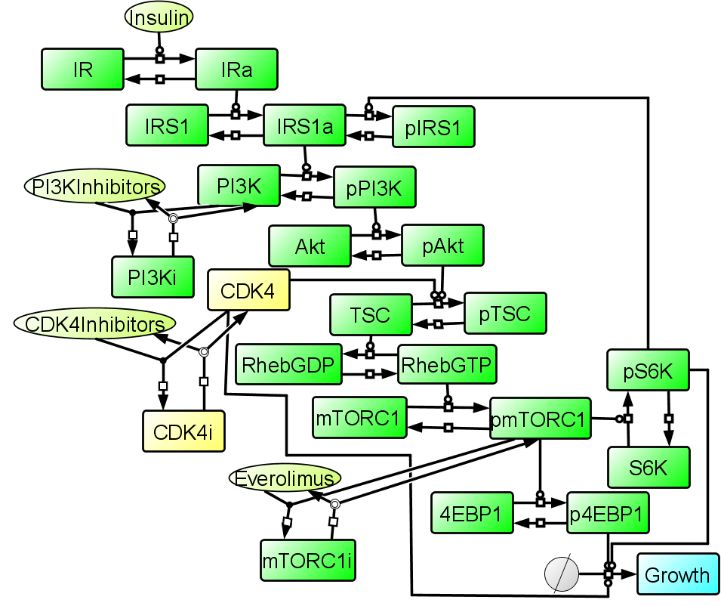
MESI-STRAT: Importance of cell signalling
Given that ER is a signalling molecule, much of the work in understanding ET resistance has focused on cross-talk with other oncogenic signalling pathways
mTOR and MAPK pathways are two such examples and are thought to be among the drivers of ET resistance
Activation of mTOR or MAPK leads to enhanced ER activity, both by PTMs and de novo synthesis of the ER
PI3K inhibitors are among the treatment strategies for ER+ BC, aimed at lowering mTOR activity
One example of combinatorial therapy is the combination of CDK4 and PI3K inhibitors.
CDK4 is a driver of cell cycle but also inhibits TSC2 activity and therefore converges with the PI3K/Akt pathway in mTORC1 activation.
Therefore, inhibition of CDK4 leads to sensitisation of BC to PI3K inhibitors.
An issue in treating ER+ BC is that the contribution of MAPK to ET resistance is not therapeutically explored
Not considering MAPK may lead to serious consequences because some drugs (i.e. everolimus, a mTORC1 inhibitor) result in enhanced MAPK activity which may actually exacerbate the disease (perhaps explaining why everolimus has had limited sucess)
CDK4 inhibition can sensitise cells to PI3K inhibition

Slide 5
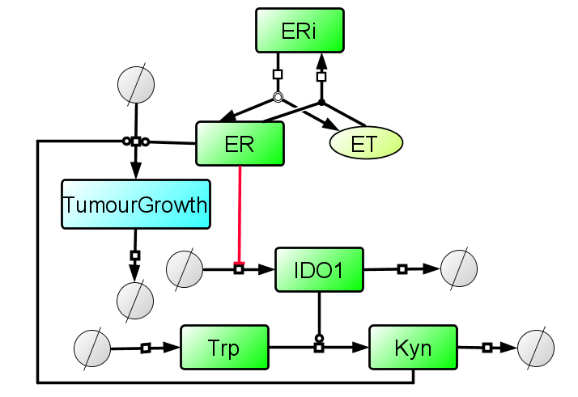
MESI-STRAT: Importance of metabolism
Tumour metabolism is also an important (but often neglected) player in ET resistance
Kyurenine (Kyn) is the metabolic product of Tryptophan (Trp), a reaction catalysed by an enzyme called IDO1
IDO1 is under the regulation of the ER which is blocked by ET
High Kyn levels have been associated with increased tumour immune evasion and aggression and inhibition of IDO1 have as been positively associated with BC treatment
Hence, one mechanism of ET resistance may involve the unintended enhancement of Kyn along with inhibition of the ER

Slide 6
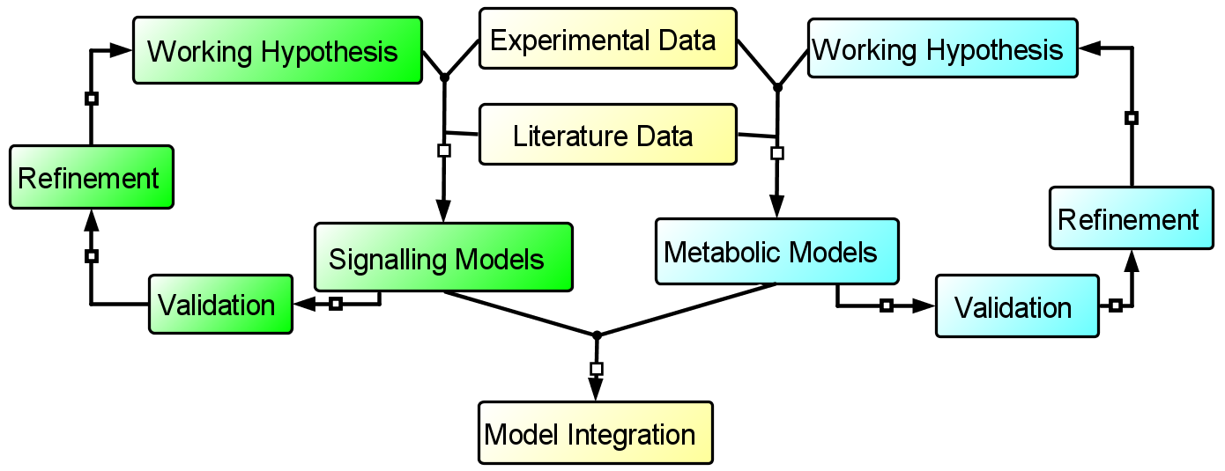
The MESI-STRAT project: An integrative systems biology project
The regulatory mechanisms that govern cell signalling, metabolism and the interactions between the two are particularly complex
To help comprehend this complexity, the essential biology is abstracted into mathematical frameworks so that we can simulate biological processes
This is the systems modelling approach which sits on the interface between molecular biology, mathematics and computer science
These models depict our working hypothesis of a biological process and are refined when invalidated, either with our own experiments or by literature findings
Using these models, we predict the dynamics of key network components in order to understand their behaviour in different biological contexts

Slide 7
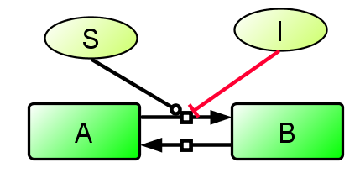
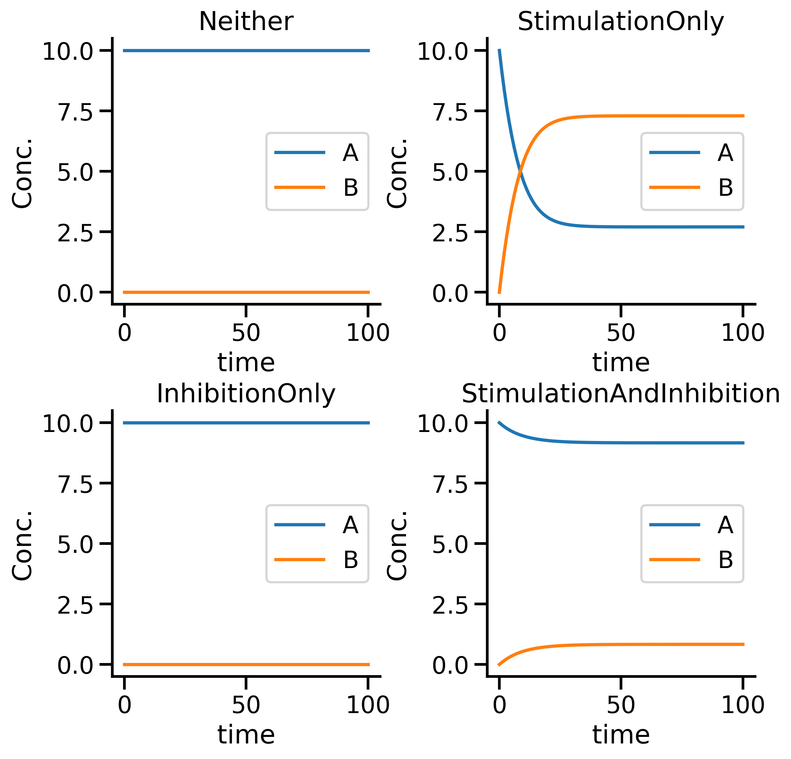

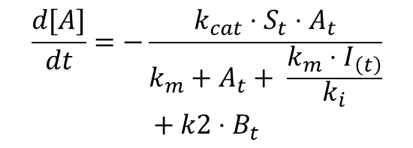
Systems modelling methods
A concrete example
$${\vec{x}}_{\left(t\right)}= f\left(\vec{x}, \vec{u},\vec{p}\right)$$
The goal of a systems modeller in biology is to abstract the essential biology into a mathematical frameworks so that dynamic processes can be simulated
We aim to recapitulate experimental findings to predict how a system might behave in other biological contexts
Many simulation frameworks exist including:,
ODEs, PDEs, Gillespie, spatial Gillespie, agent based models, cellular automata
The choice of model is dependent on your research question
ODE’s are particularly well suited for predicting the dynamics of biological systems because
They are quick and easy to built and simulate (i.e. numerical integration)
Well developed mathematical methods for parameter optimization and model selection
Once calibrated, a dynamic model can be perturbed in silico to predict the outcome of an intervention
$$\frac{d[A]}{dt}=−\frac{k_{cat}⋅S_{t}⋅A_{t}}{k_{m}+A_{t}+ \frac{k_{m}⋅I_{\left(t\right)}}{k_{i}}}$$
$$+ k2⋅B_{t}$$

Slide 8
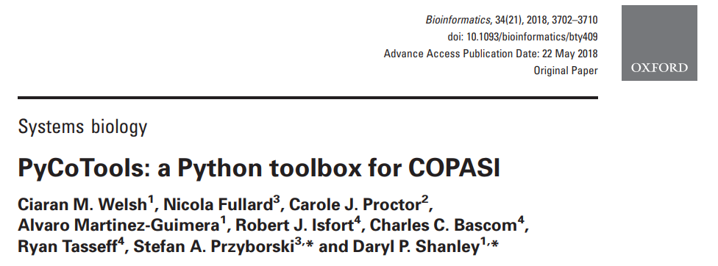
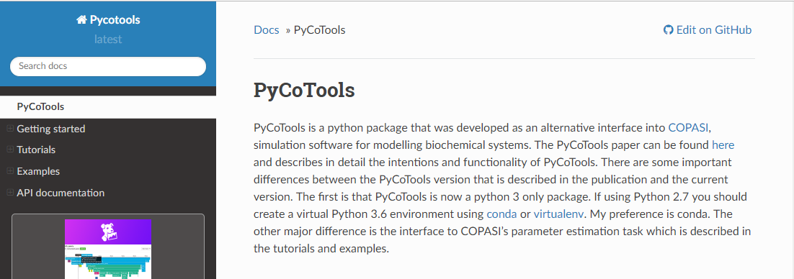
PyCoTools is a 3rd party API for a modelling toolbox called COPASI for
PyCoTools enhances productivity by automating repetitive tasks such as
Parameter estimation configuration
Plus multiple models for model selection
Parallel execution of parameter estimations (local or HPC)
Identifiability analysis
EDA on parameter estimation data

Slide 9
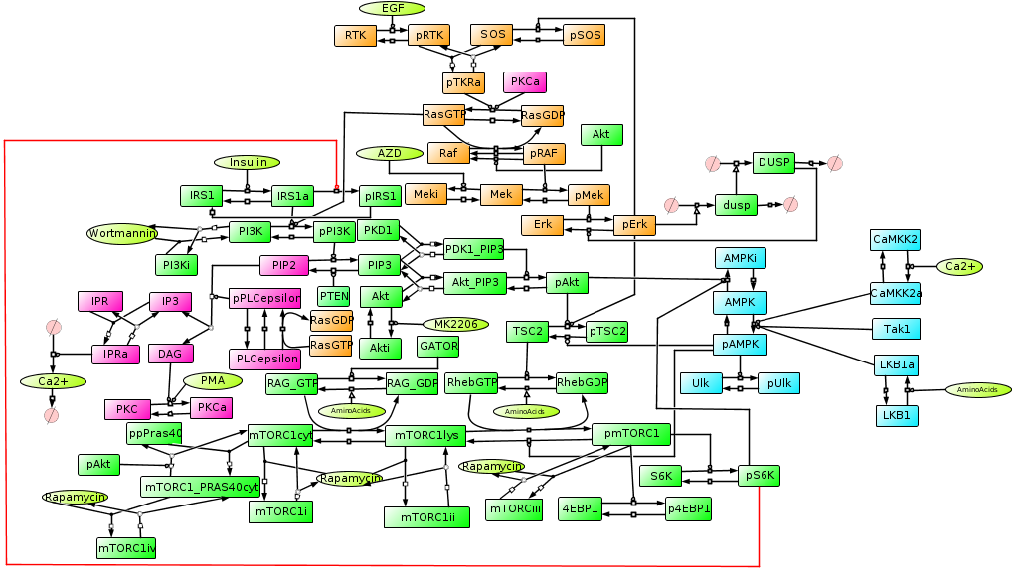
Modelling the interplay between PI3K and MAPK
This model has 9 inputs
If I can produce dynamic behaviour consistent with as many of the potential combinatorial conditions as possible then we may be able to predict the unobserved combinations

Slide 10
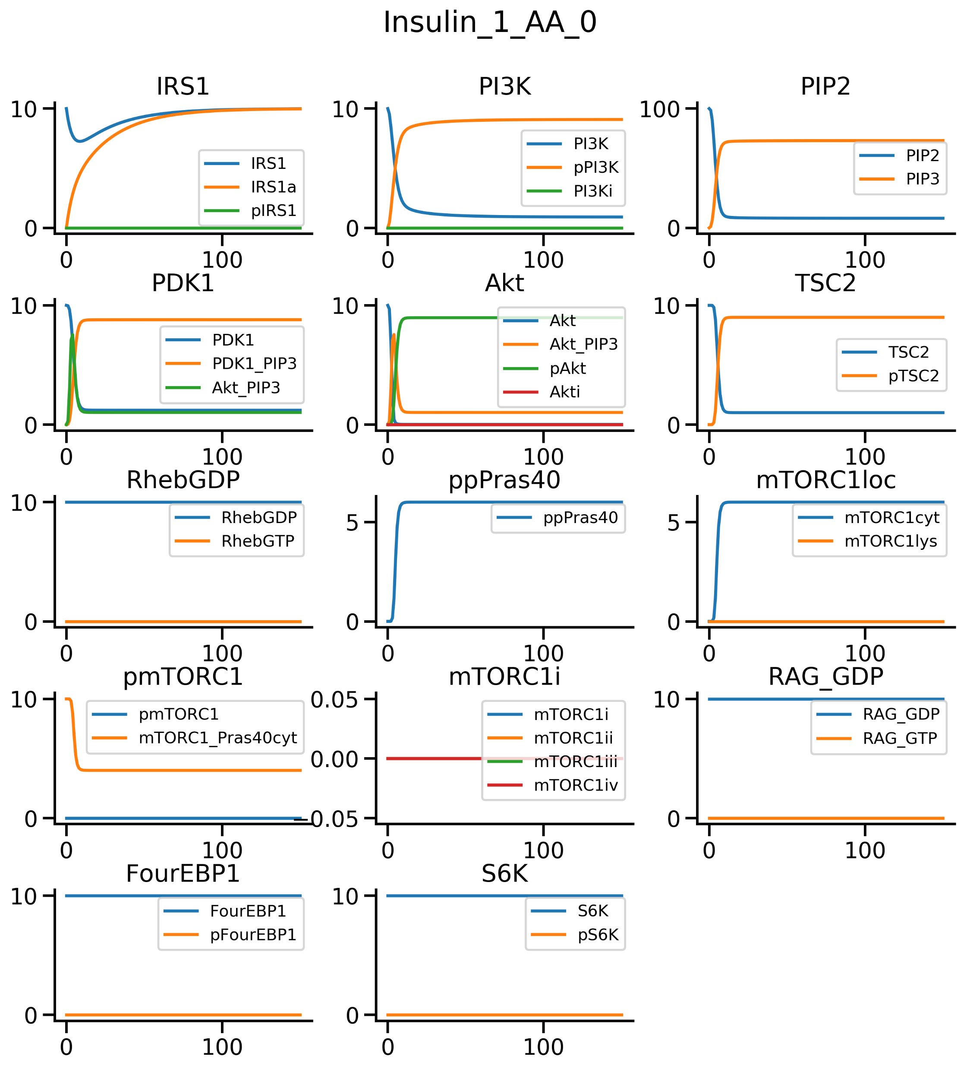
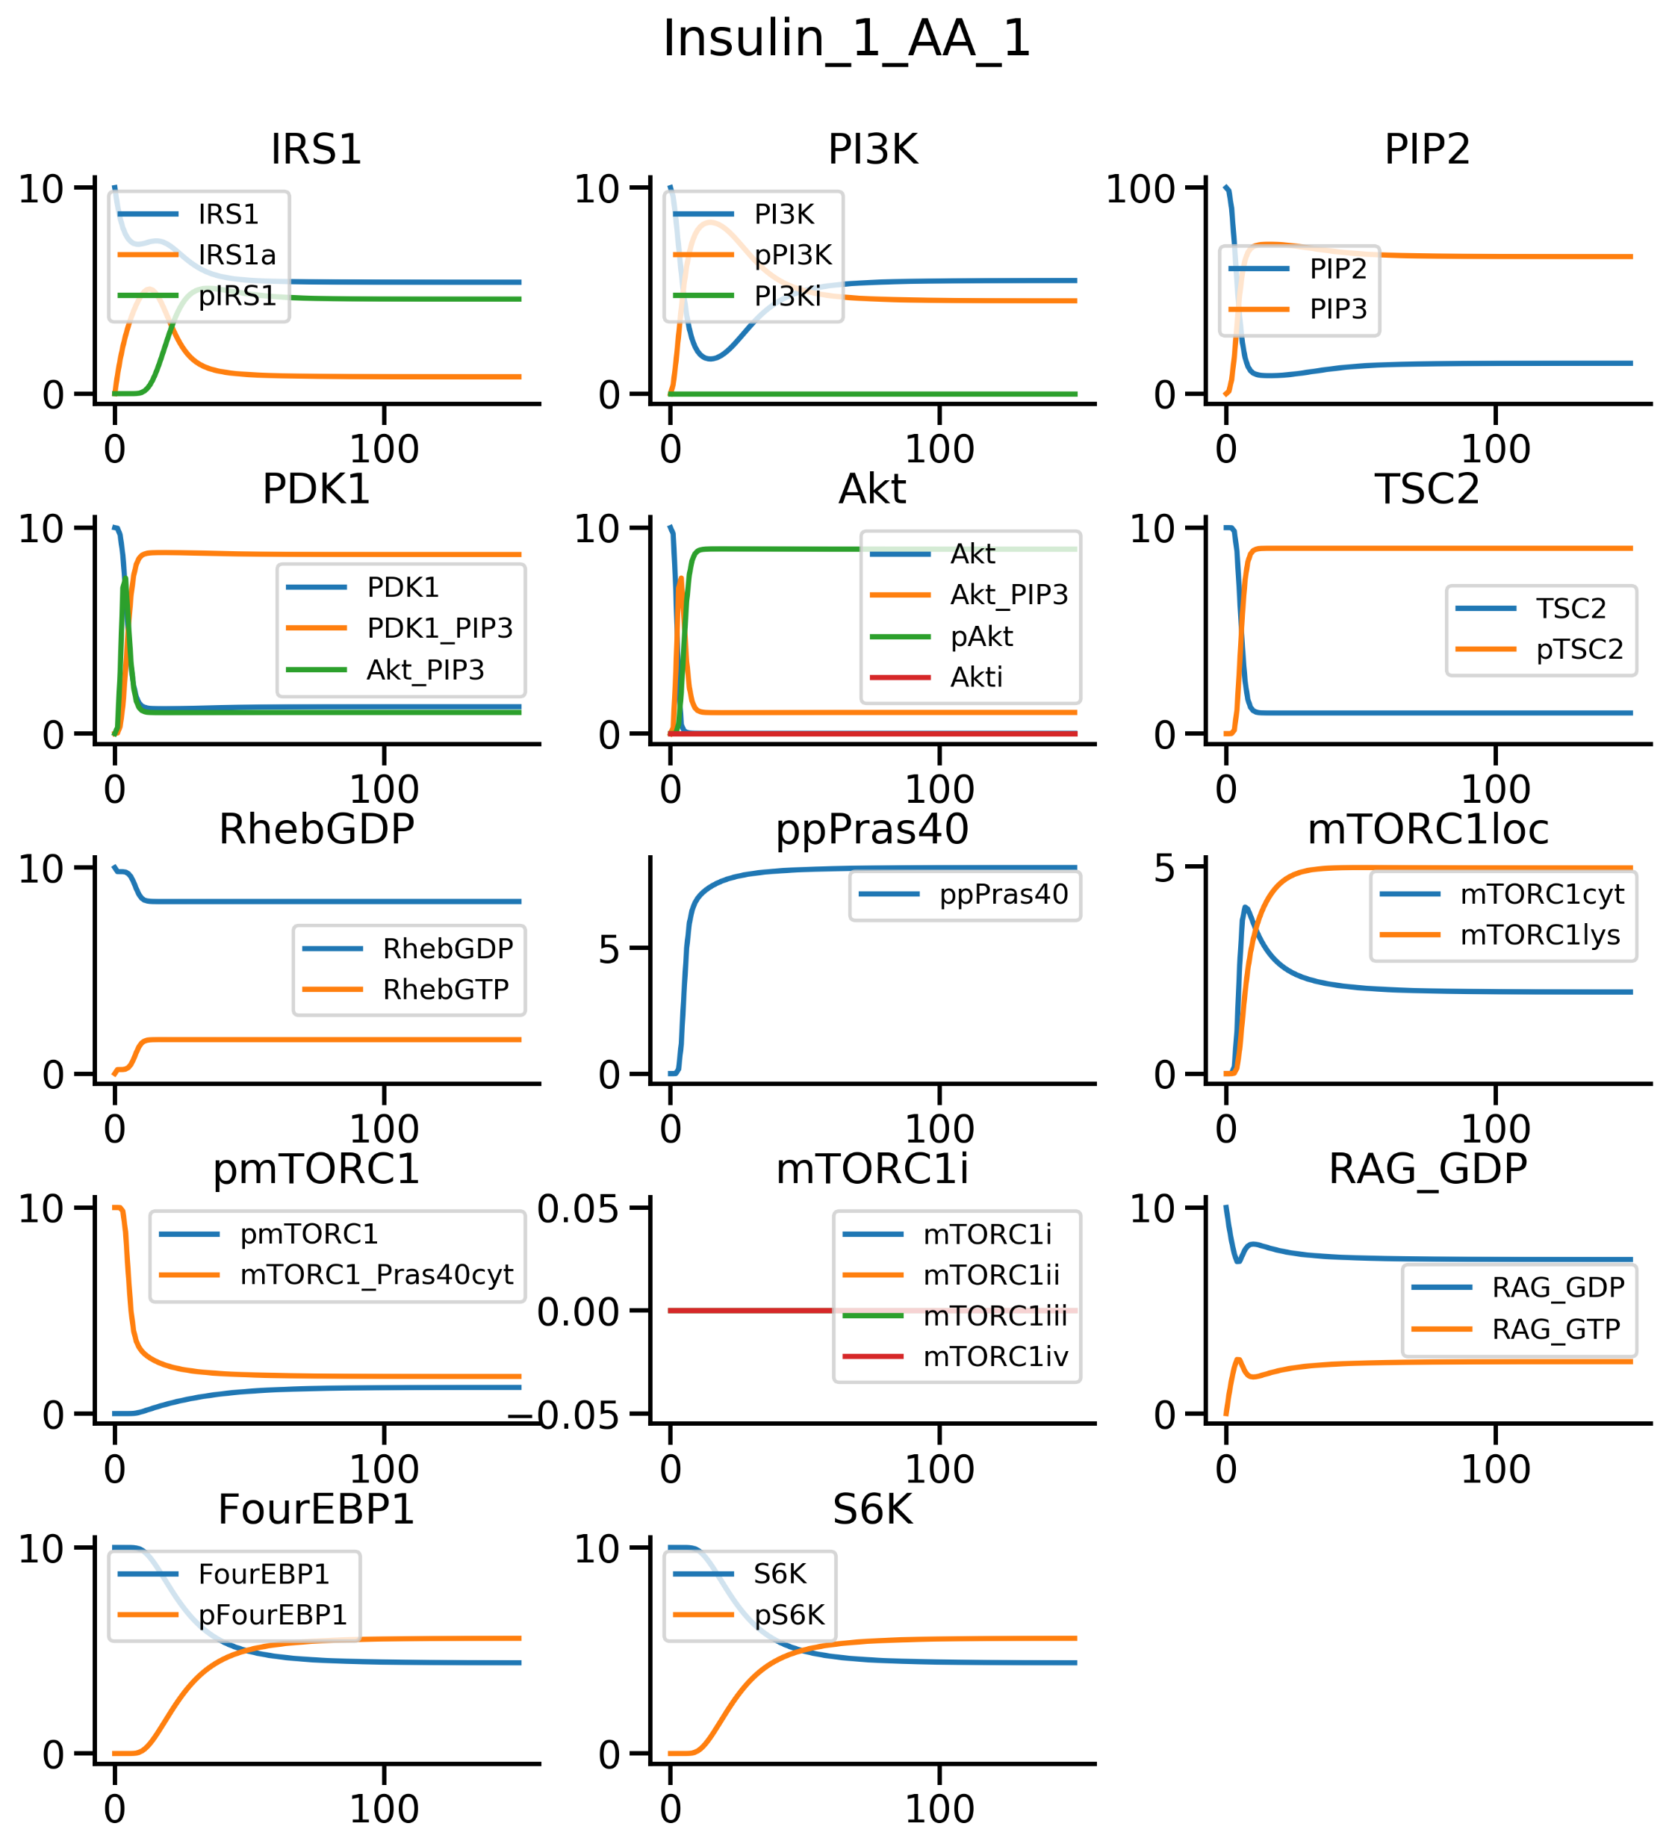
Simulation of Insulin +/- Amino acids
The model reflects the biology in that insulin only stimulates mTORC1 activation in the presence of ample amino acids

Slide 11
Some limitations and difficulties often encountered in systems modelling
A serious limitation of the ODE framework is that a properly informed model requires a lot of good quality data which often isn’t available
The result is that of non-identifiability: a situation where some combinations of the parameters cannot uniquely be determined with the defined optimization problem
Some techniques to mitigate the non-identifiability problem include bootstrapping or interpolating the data, reducing the complexity of the model and the gold standard - go get more data
Some other difficulties with ODE modelling:
Requirement for normalisation of relative data from different sources before use in parameter estimation
Whether to use individual repeats or averages of time points
Use of nuisance parameters such as scale and offset parameters
What to use for initial conditions?
How to deal with non-observed network components?
Which optimisation methods to use?
How to weight your objective function
Tuning algorithm settings to strike a balance between speed and convergence
EDA on parameter estimation data for understanding the landscape of the optimization problem (PyCoTools)
Effective use of HPC for parameter identification and model selection
Whether to use validation data for early stopping criteria (to prevent overfitting)

Slide 12
Qualitative Model Fitting: A focus on qualitative model behaviour
A normal systems modelling cycle includes a literature review, network design, wet lab experiments, parameter optimisation, identifiability analysis, model refinement and model selection.
However, by focusing on model behaviour, rather than finding the parameters, we can omit the mathematical rigour of optimization and identifiability analysis in favour of ensuring the behaves well in accordance with data and literature (i.e. the model is well validated)
This is the focus of a software package I’m currently developing (called QualitativeModelFitting (qmf) on my github)
Qmf is essentially a unit testing framework for validation of ODE models in systems biology.
Qualitative observations (i.e. from data or literature) are encoded the syntax of a (yet unnamed) language I invented
The language is interpreted by a pure Python lexer and parser. TestCase classes and methods are dynamically generated at run time to test the observation
Hence, an arbitrary number of qualitative observations can be validated simultaneously and highlight important discrepancies with literature findings.
The package has two font ends:
A manual interface for testing observations and manually tweaking the model
An automatic interface that locates ensembles of parameter sets that are consistent with the observations
In active development. Involves designing an objective function that will be
Minimized using standard optimization algorithms (such as hill climbers or evolutionary strategies)
Maximized by a reinforcement learning algorithm (Q-learning based)

Slide 13
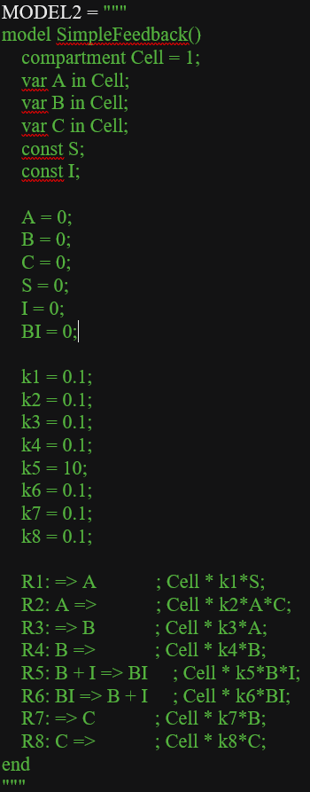
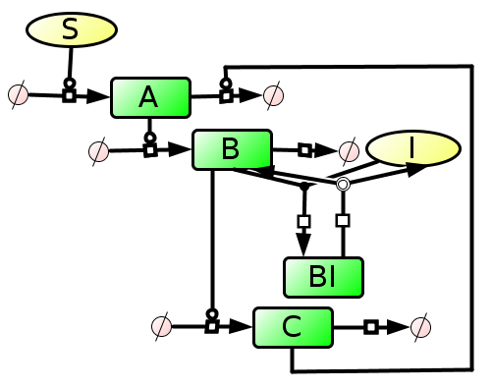
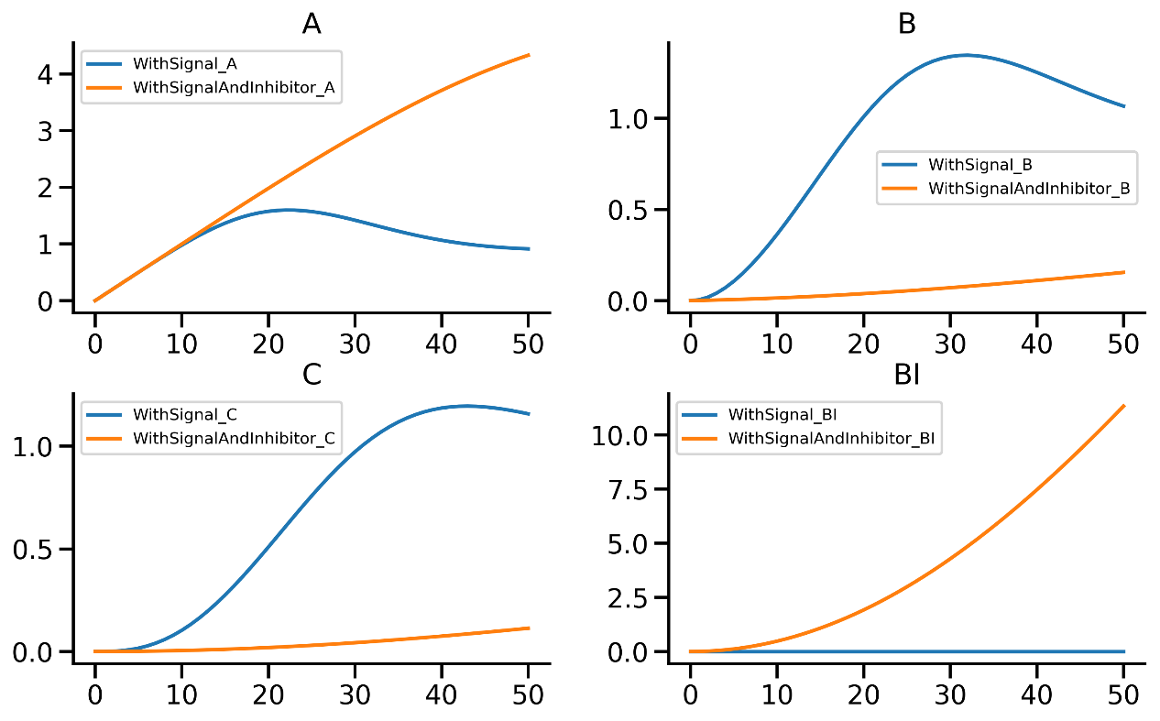
Qualitative Model Fitting: A toy model
This string defines a set of ODEs representing this network and produces these predictions for the two conditions

Slide 14
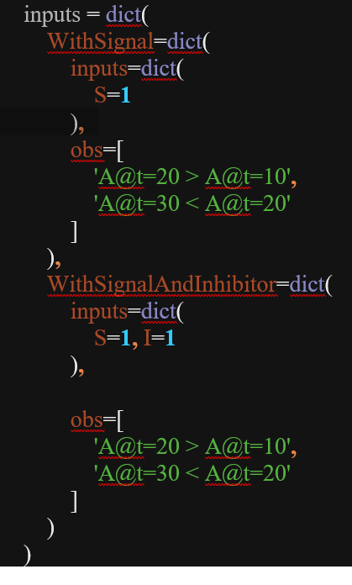
Qualitative Model Fitting: specifying model conditions and some observations
Conditions
definition
Observations
Condition names
(arbitrary)
Interpretation of observations :
With stimulation by S, A should be increasing between t=10 and t=20 and decrease again at t=30
With stimulation by A and inhibition by I, the same conditions should hold.

Slide 15
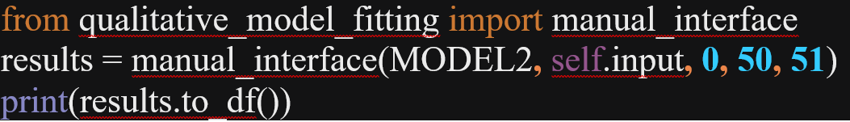
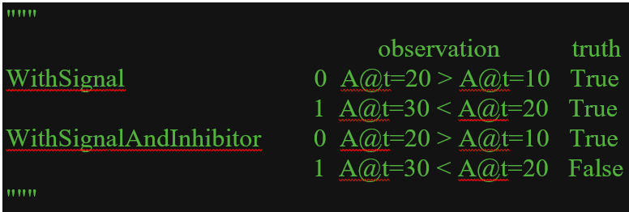
Qualitative Model Fitting: A simple front end
Antimony string
Import the manual API
Input:
Start, stop and step integration parameters
Returns a dict like results object
Output:
Inputs and observations
The ‘to_df()` method
Turns the results into a standard pandas dataframe.
Key point: we now know that the last condition doesn’t hold without the need for looking at the simulations. For simultaneous model validation of hundreds of observations, this is particularly valuable

Slide 16
To summarise
The MESI-STRAT project is dealing with some very complicated biology
My role in this project is to piece together the relevant biological interactions in a mechanistic model, using in-house and literature sourced data
I have developed a new unit testing framework for validating model predictions that addresses a bottleneck in the development of mechanistic models
Therefore, this software has the potential to potently enhance productivity within the systems biology community

Slide 17
Thank you for listening
Ciaran Welsh

