Slide 1
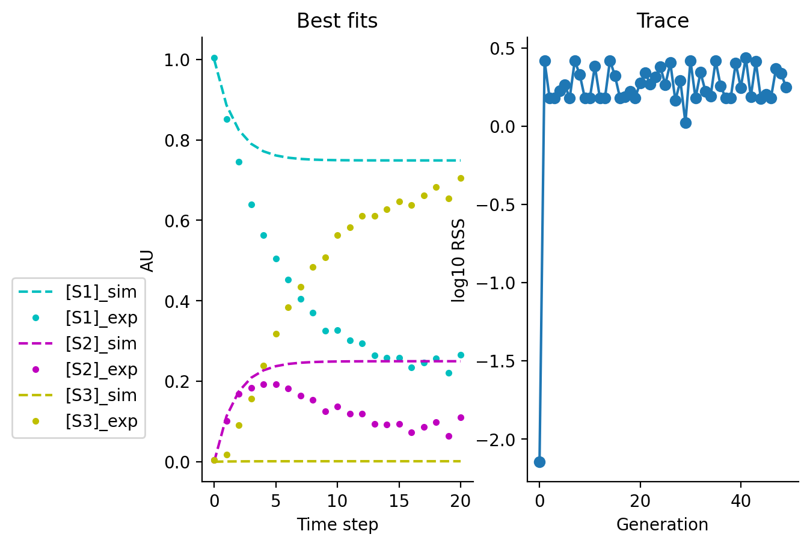
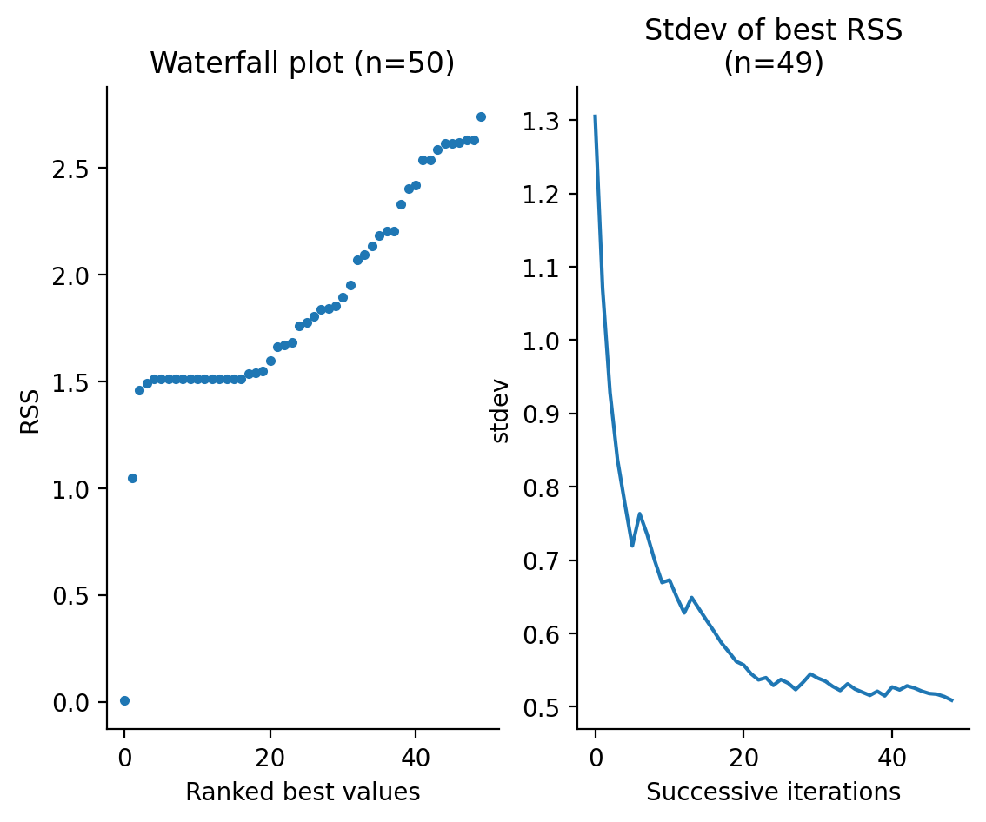
Estimating all three parameters with all three datasets using SRES
k1
Original values:
k1=0.15
k2=0.45
k3=0.05
S1
S2
k3
k2
S3
Number of generations: 50; number of parameter estimations: 50; lower bounds: all 0.001; upper bounds: all 100
Parent popsize (mu): 50; child popsize: 100; gamma=0.5; all other hyperparameters are defaults from sres.SRES.

Slide 2
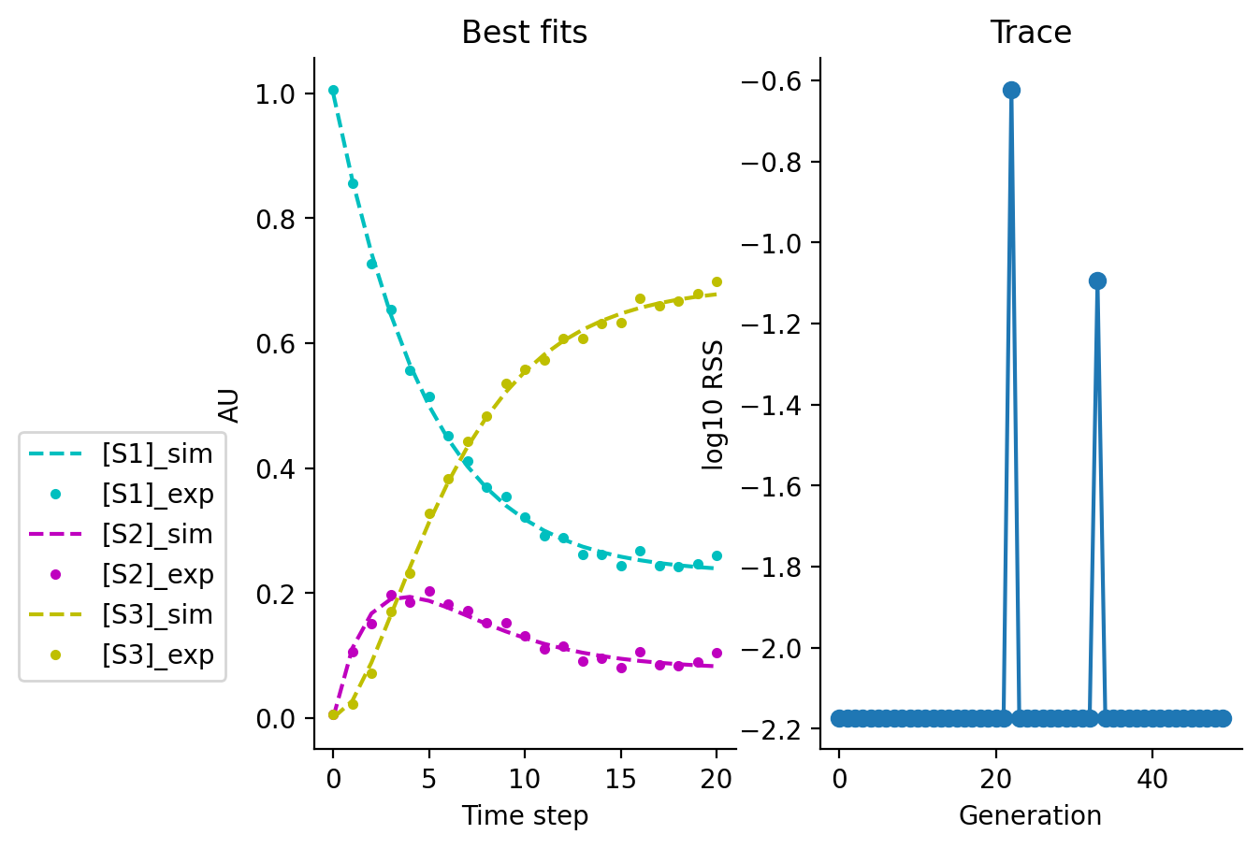
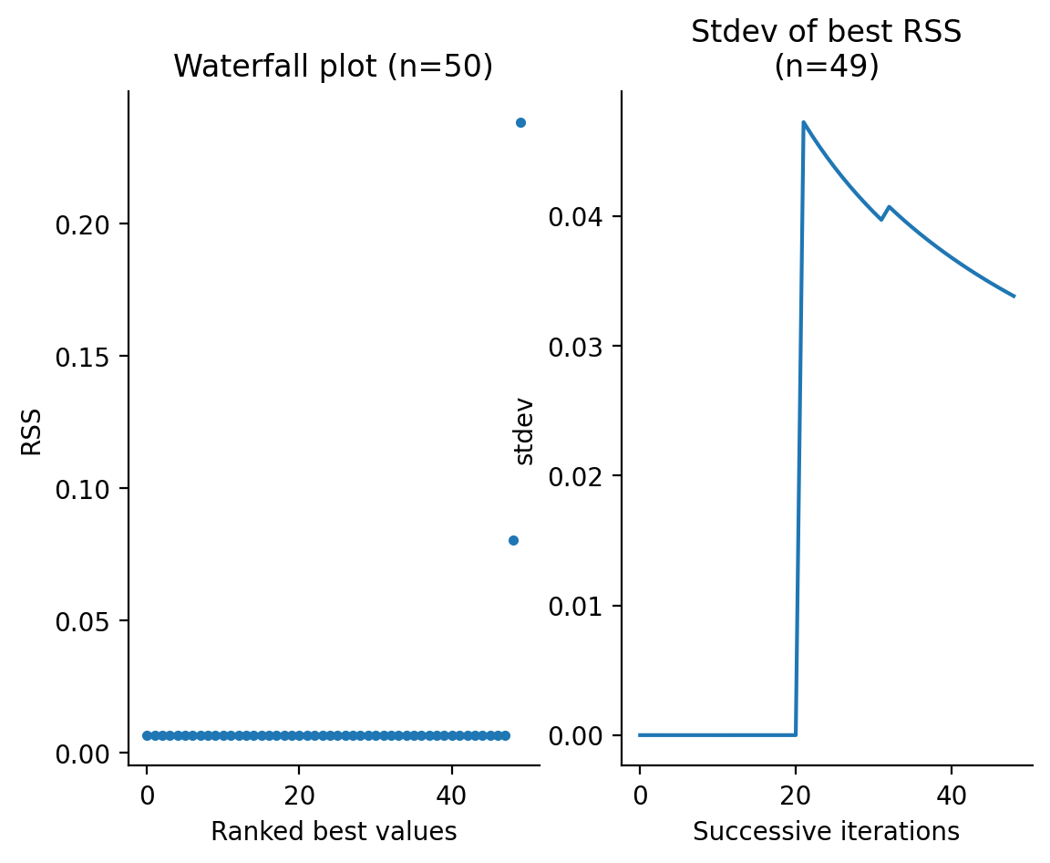
Estimating only k2 and k3 with all variables, and fixing k1 to proper values.
Fixed to 0.15
k1
Original values:
k1=0.15
k2=0.45
k3=0.05
S1
S2
k3
k2
S3
Number of generations: 50; number of parameter estimations: 50; lower bounds: all 0.001; upper bounds: all 100
Parent popsize (mu): 50; child popsize: 100; gamma=0.5; all other hyperparameters are defaults from sres.SRES.

