Slide 1


M.Tech
Advanced Industry Integrated Programs
Jointly offered by University and LTIMindTree
Review III
CASETAG: RAG-Based Legal Provision and Precedent Retrieval with LLM-Based Explanation from Case Filings
Cibiksha V
MTech AI&DS | BSA Crescent Institute Of Science and Technology | T9960
Knowledge partner | Implementation partner

Slide 2
CASETAG: RAG-Based Legal Provision and Precedent Retrieval with LLM-Based Explanation from Case Filings
Introduction
Legal case filings contain complex and extensive information that requires careful analysis.
Identifying the relevant Acts and Sections manually can be time-consuming.
Finding previous judgments related to similar legal issues also requires extensive legal research.
CASETAG uses Retrieval-Augmented Generation (RAG) to retrieve relevant legal provisions and previous criminal judgments.
The retrieved information is processed by an LLM to generate clear and relevant legal explanations.
The system aims to make legal research faster, structured, and easier to understand.

Slide 3
CASETAG: RAG-Based Legal Provision and Precedent Retrieval with LLM-Based Explanation from Case Filings
Objective
To develop an LLM-based RAG system for analyzing legal case filings.
To retrieve relevant Acts and Sections based on the facts and legal issues in a case.
To retrieve relevant previous criminal judgments related to the given case.
To use semantic search and FAISS for efficient retrieval of legal information.
To generate clear explanations of why the retrieved legal provisions and judgments are relevant.
To provide a structured and user-friendly platform for assisting legal research and case analysis.

Slide 4
CASETAG: RAG-Based Legal Provision and Precedent Retrieval with LLM-Based Explanation from Case Filings
Module name
S. No. | Module Name | Description
1 | Case Filing Input | Accepts case details or legal case filings from the user.
2 | Legal Document Processing | Processes, cleans, and chunks legal documents for retrieval.
3 | Legal Provision Retrieval | Retrieves relevant Acts and Sections using semantic search and FAISS.
4 | Previous Judgment Retrieval | Retrieves relevant previous criminal judgments related to the case.
5 | LLM-Based Explanation | Uses the Groq LLM to explain the relevance of retrieved legal information.
6 | Case Analysis | Presents relevant provisions, punishment details, and judgment-based insights.
7 | User Interface | Provides a user-friendly React interface for case analysis and legal queries.

Slide 5
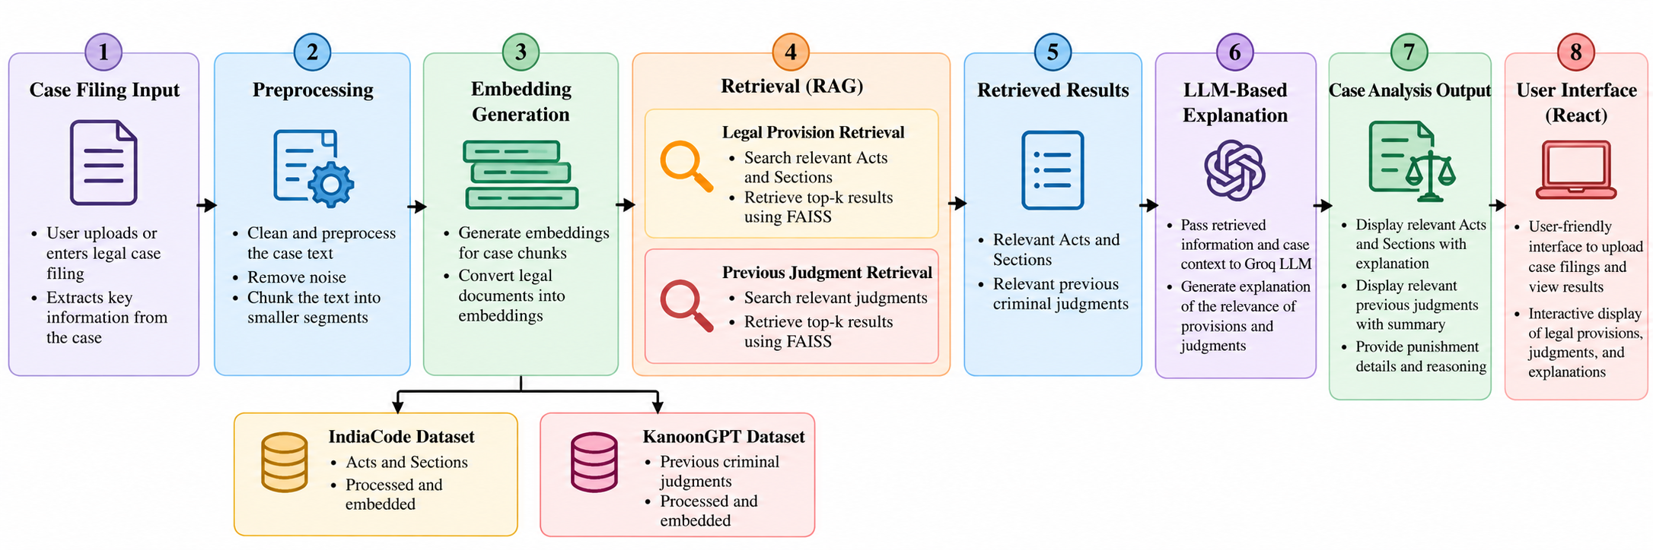
CASETAG: RAG-Based Legal Provision and Precedent Retrieval with LLM-Based Explanation from Case Filings
Methodology

Slide 6
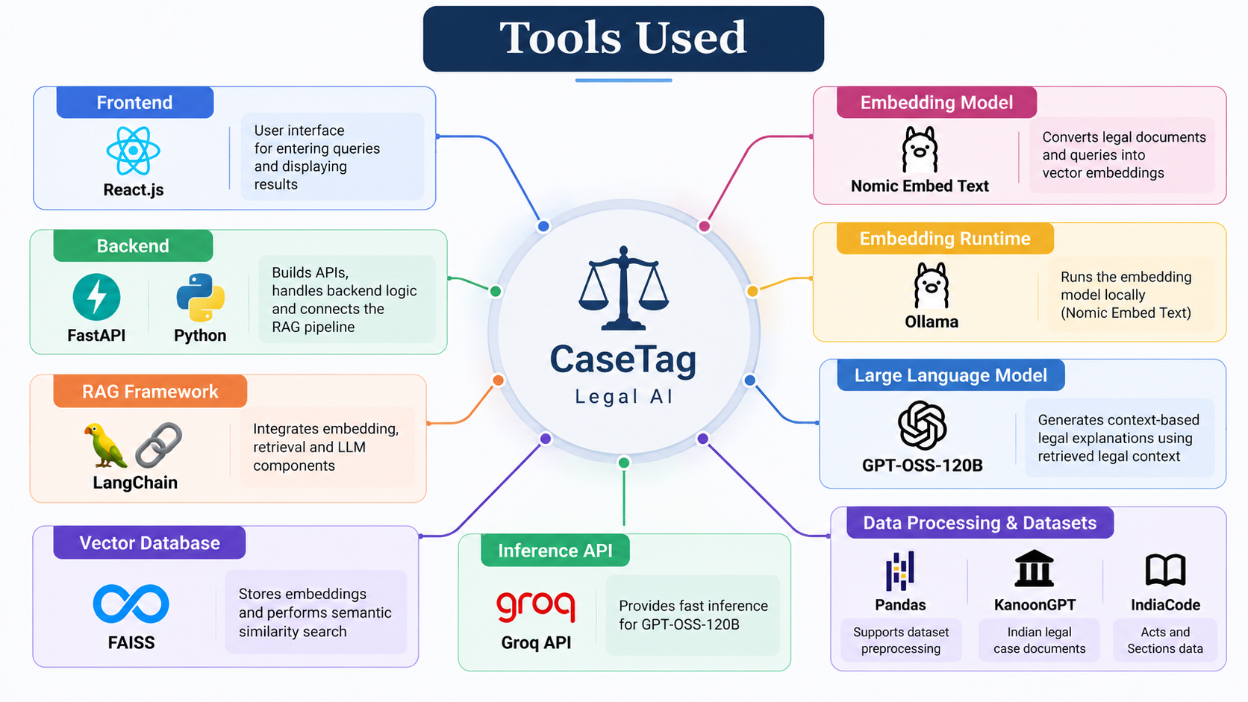
CASETAG: RAG-Based Legal Provision and Precedent Retrieval with LLM-Based Explanation from Case Filings
Tools

Slide 7
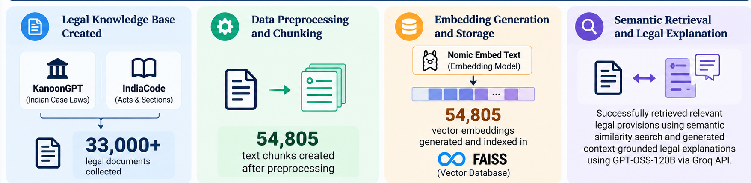
CASETAG: RAG-Based Legal Provision and Precedent Retrieval with LLM-Based Explanation from Case Filings
Findings and Results

Slide 8
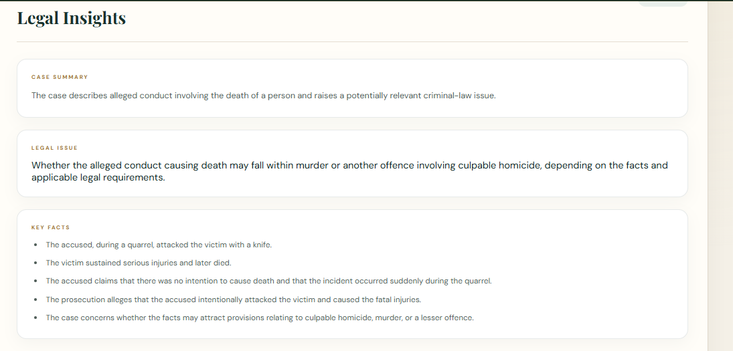
CASETAG: RAG-Based Legal Provision and Precedent Retrieval with LLM-Based Explanation from Case Filings
Findings and Results

Slide 9
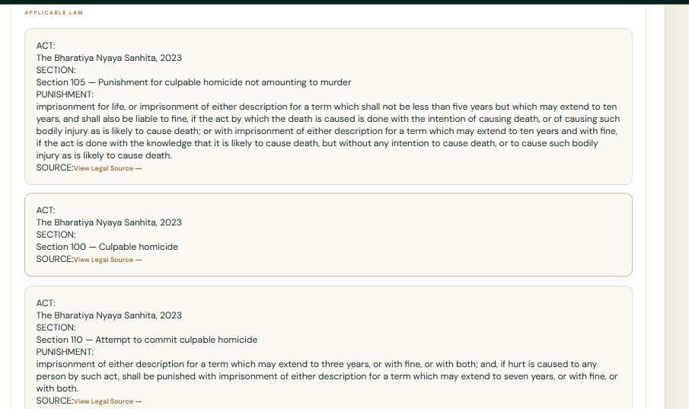
CASETAG: RAG-Based Legal Provision and Precedent Retrieval with LLM-Based Explanation from Case Filings
Findings and Results

Slide 10
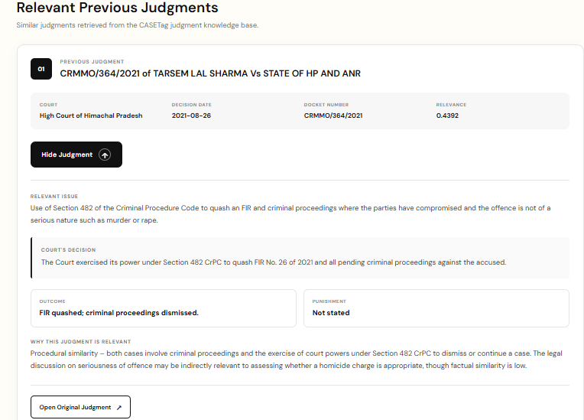
CASETAG: RAG-Based Legal Provision and Precedent Retrieval with LLM-Based Explanation from Case Filings
Findings and Results

Slide 11
CASETAG: RAG-Based Legal Provision and Precedent Retrieval with LLM-Based Explanation from Case Filings
Conclusion
CASETAG integrates RAG and LLM technologies to assist in legal case analysis by retrieving relevant Acts, Sections, and previous criminal judgments. The retrieved information is processed by the Groq LLM to generate structured legal explanations based on the case facts. The system provides a user-friendly platform for faster, structured, and evidence-grounded legal research.

Slide 12
CASETAG: RAG-Based Legal Provision and Precedent Retrieval with LLM-Based Explanation from Case Filings
Future Work
Multilingual Support for Tamil, Hindi, and other Indian languages.
Continuous Knowledge-Base Updates with new judgments, Acts, and amendments.

Slide 13
CASETAG: RAG-Based Legal Provision and Precedent Retrieval with LLM-Based Explanation from Case Filings
Acknowledgement
I sincerely thank LTM and L&T EduTech for providing the infrastructure, laptop, training room, ID card, and a valuable 2-month opportunity to enhance my technical skills through practical project development.
I express my special gratitude to Dr. Ganesh for his continuous guidance, valuable suggestions, and support in improving my project. I also thank the Classroom Managers for their daily monitoring, coordination, and assistance in resolving issues. Finally, my special thanks to Mr. Jayakanthan, Manager – Delivery Operations, L&T EduTech, for his encouragement, support, and for providing this valuable opportunity.

Slide 14
CASETAG: RAG-Based Legal Provision and Precedent Retrieval with LLM-Based Explanation from Case Filings
Reference
[1] Government of India, “India Code: The Bharatiya Nyaya Sanhita, 2023,” India Code, 2023.
[2] KanoonGPT, “Indian Legal Documents Dataset,” Hugging Face.
[3] J. Johnson, M. Douze, and H. Jégou, “Billion-scale similarity search with GPUs,” IEEE Transactions on Big Data, vol. 7, no. 3, pp. 535–547, 2021.
[4] P. Lewis et al., “Retrieval-augmented generation for knowledge-intensive NLP tasks,” Advances in Neural Information Processing Systems (NeurIPS), vol. 33, pp. 9459–9474, 2020.
[5] Ollama, “nomic-embed-text: Text Embedding Model,” Ollama Documentation.
[6] Groq, “Groq API Documentation,” Groq Documentation.

