Slide 1


M.Tech Program
Advanced Industry Integrated Programs
Jointly offered by University and LTIMindTree
CaseTag: LLM-Based Legal Act & Section Identification with Explanation from Case Filings
Cibiksha V
Knowledge partner | Implementation partner

Slide 2
Project Title - Calibri body 18
Introduction
Legal case analysis involves examining large volumes of legal documents, Acts, and sections.
Finding relevant legal provisions manually is time-consuming and difficult.
CASETag Legal AI uses RAG and LLM technology to retrieve relevant Indian legal provisions.
It provides relevant sections, explanations, and source references for legal queries and case documents.

Slide 3
Project Title - Calibri body 18
Objective
To develop an AI-powered legal information retrieval system for Indian laws.
To retrieve relevant Acts and sections using semantic search with RAG and FAISS.
To generate contextual legal explanations using Llama 3.2.
To provide source-backed legal information for natural-language queries and case documents.

Slide 4
Project Title - Calibri body 18
Scope
To provide AI-assisted retrieval of relevant Indian Acts and legal sections from legal documents.
To support natural-language legal queries and case document analysis.
To use RAG and semantic search for retrieving contextually relevant legal provisions.
To generate clear explanations with source references using an LLM.

Slide 5
Project Title - Calibri body 18
Literature Review
Calibri body 28
No. | Paper & Year | Method / Focus | Key Findings | Relevance to CASETag
1 | Legal Query RAG – Wahidur et al. (2025) | Retrieval-Augmented Generation with recursive feedback for legal queries | Improved retrieval quality and response relevance; addresses hallucination and legal-context challenges. | Supports CASETag's use of RAG for retrieving relevant legal provisions before LLM generation.
2 | NyayaRAG: Realistic Legal Judgment Prediction with RAG under the Indian Common Law System – Nigam et al. (2025) | RAG using case facts, relevant statutes, and semantically retrieved prior cases | Found that adding structured legal knowledge improved prediction accuracy and explanation quality. | Highly relevant to CASETag's Indian legal documents + RAG-based retrieval and explanation.
3 | AILQA: Evaluating AI-driven Legal Question Answering Systems for the Indian Legal System – Nigam et al. (2026) | Indian legal QA using embeddings, LLMs and RAG | Evaluated AI legal QA using lexical, semantic and expert-based evaluation; showed the effectiveness of RAG for complex Indian legal questions. | Closely related to CASETag's Indian legal question answering using embeddings, retrieval and Llama 3.2.

Slide 6
Project Title - Calibri body 18
Summary of Literature
2025 studies show that RAG, legal embeddings, and LLMs can improve legal information retrieval and response generation.
NyayaRAG demonstrates the use of RAG with Indian statutes and case laws for better legal reasoning and explanations.
The 2026 AILQA study evaluates RAG-based legal question answering for the Indian legal system, highlighting the importance of retrieval quality.
These studies support the development of CASETag, which uses LangChain, FAISS, Ollama embeddings, and Llama 3.2 to retrieve relevant Indian Acts and sections.

Slide 7
Project Title - Calibri body 18
Additional Information
Input: Natural-language legal questions or uploaded case documents in PDF format.
Legal Data Sources: IndiaCode and KanoonGPT Indian Legal Documents.
Knowledge Base: Approximately 33,000 legal sections converted into 54,805 searchable chunks.
Embedding: nomic-embed-text converts legal text into vector representations.
Retrieval: FAISS initially retrieves 15 candidates, removes duplicates, and selects the top 5 unique provisions.

Slide 8
Additional Information
Generation: Llama 3.2 generates the final legal analysis using the retrieved context.
Framework: LangChain connects the retrieval and LLM components.
Output: Legal issue, applicable Act, relevant section, explanation, related provisions, and source references.
Interface: Streamlit provides the user-facing web application.
Purpose: Supports preliminary legal information retrieval and is not a substitute for professional legal advice.

Slide 9
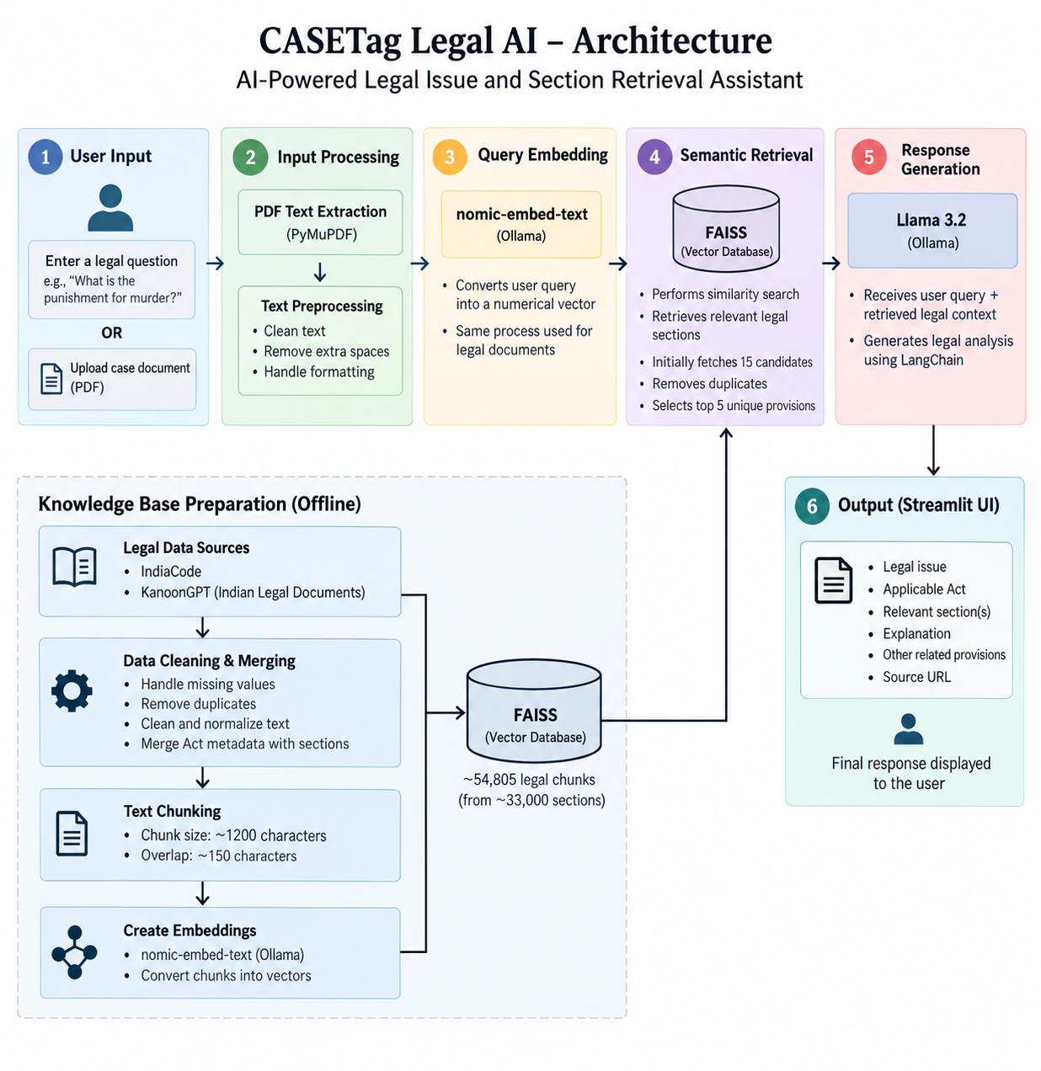
Project Title - Calibri body 18
System Design
Subtopic - Calibri body -28
Content Calibri body -28
Calibri body -28

Slide 10
Project Title - Calibri body 18
Modules to cover
Module | Description
1. User Input Module | Accepts a natural-language legal query or an uploaded case document (PDF) from the user.
2. PDF Processing Module | Extracts and preprocesses text from uploaded legal case documents using PyMuPDF.
3. Data Preprocessing Module | Cleans legal data, removes duplicates, combines Act and section information, and prepares the knowledge base.
4. Embedding Module | Converts legal text and user queries into numerical vectors using nomic-embed-text.
5. FAISS Retrieval Module | Performs semantic similarity search and retrieves the top relevant legal provisions from the vector database.
6. RAG & LLM Module | Uses LangChain to pass retrieved legal context to Llama 3.2 and generate a contextual response.
7. Legal Analysis Module | Presents the identified legal issue, applicable Act, relevant section, explanation, and other provisions.
8. Source & Output Module | Displays retrieved provisions along with their source references through the Streamlit interface.
Module 1 calibri 28

