Slide 1


M.Tech Program
Advanced Industry Integrated Programs
Jointly offered by University and LTIMindTree
Leftover Ingredient-Based Recipe Recommendation using Agentic AI
CIBIKSHA V
Knowledge partner | Implementation partner

Slide 2
Project Title - Calibri body 18
Introduction
An AI-based recipe recommendation system is developed to utilize available and leftover kitchen ingredients.
Retrieval-Augmented Generation (RAG) is used to retrieve relevant recipes from a recipe knowledge base.
FAISS performs vector similarity search using nomic-embed-text embeddings, while Llama 3.2 generates the recommendation through Ollama.
The system identifies matched/missing ingredients and ranks the retrieved recipes to provide suitable recommendations through a Streamlit interface.

Slide 3
Project Title - Calibri body 18
Objective
Accept available kitchen ingredients as input.
Retrieve relevant recipes from the recipe knowledge base.
Identify matched and missing ingredients.
Recommend recipes that make better use of available ingredients.
Generate an understandable recommendation using RAG.
Help reduce avoidable kitchen food waste.

Slide 4
Project Title - Calibri body 18
Scope
Develop an AI-based recipe recommendation system using available and leftover kitchen ingredients.
Use RAG with FAISS to retrieve relevant recipes from the recipe knowledge base.
Perform ingredient matching and missing-ingredient identification to rank suitable recipes.
Provide AI-generated recipe recommendations and cooking instructions through a Streamlit interface using Llama 3.2 and Ollama.

Slide 5
Project Title - Calibri body 18
Literature Review
Calibri body 28
Year | Paper | Technique / Method Used | Key Findings | Relevance to Your Project
2025 | Ingredient-Only Recipe Recommendation via Self-Supervised Contrastive Learning for Sustainable Cooking – Mariyam Mohammed Ashraf & M.W. Maduranga | Self-supervised contrastive learning; ingredient-based semantic representation; 64-dimensional semantic space | Recommends recipes using only available ingredients and addresses cold-start and semantic-matching problems. (Faith Future Tech Sci) | Supports your ingredient-based recipe recommendation approach and motivates semantic retrieval rather than simple keyword matching.
2025 | KERL: Knowledge-Enhanced Personalized Recipe Recommendation using Large Language Models – Fnu Mohbat & Mohammed J. Zaki | Knowledge Graph + LLM; entity extraction; subgraph retrieval; LLM-based recipe selection and generation | Retrieves relevant food knowledge and provides personalized recommendations and recipe generation using LLMs. (ACL Anthology) | Closely relates to your RAG architecture, where external recipe knowledge is retrieved before Llama generates the recommendation.
2026 | Ontology-enhanced RAG for a personalised and sustainable food advisory system | RAG + FoCOSA ontology + LLM; knowledge-enhanced retrieval and reasoning | Reports improved retrieval effectiveness, response accuracy and fewer hallucinations for sustainable food advice. (ScienceDirect) | Highly relevant to your RAG-based food recommendation and food-waste reduction objective. It also supports your decision to ground LLM responses in retrieved recipe information.

Slide 6
Project Title - Calibri body 18
Summary of Literature
Existing systems focus mainly on semantic recommendation, personalization, or structured food knowledge.
Limited focus on directly combining available-ingredient matching with RAG-based recipe retrieval for kitchen-waste reduction.
Our project combines nomic-embed-text + FAISS + LangChain + Llama 3.2 to recommend recipes based on available ingredients.

Slide 7
Project Title - Calibri body 18
Additional Information
Data Preprocessing: Clean and normalize recipe data and prepare structured recipe documents.
Embedding & Retrieval: Generate embeddings using nomic-embed-text and retrieve relevant recipes using FAISS.
Ingredient Matching & Ranking: Identify matched/missing ingredients and rank recipes based on ingredient matches.
AI Generation: Use LangChain + Llama 3.2 through Ollama to generate grounded recipe recommendations.

Slide 8
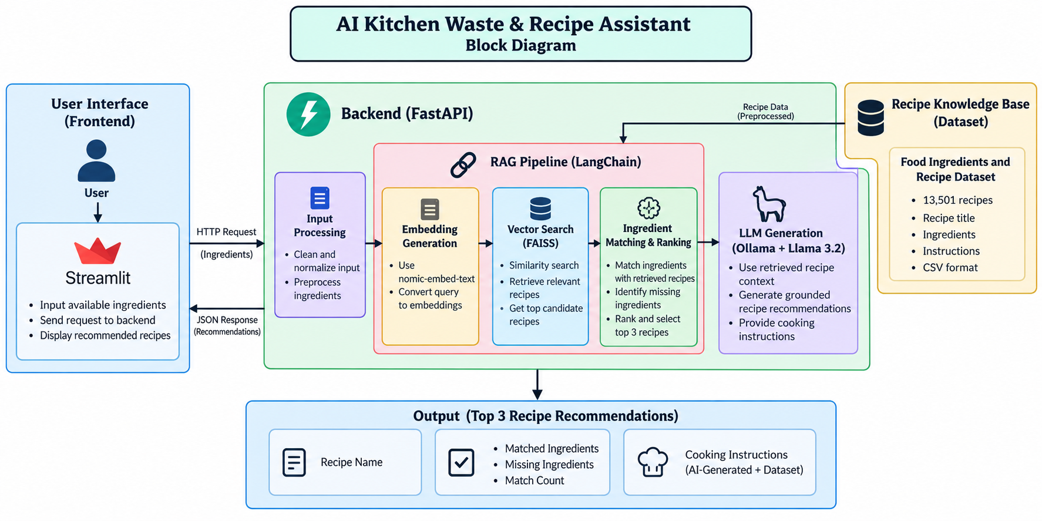
System Diagram

Slide 9
Project Title - Calibri body 18
Module Description
Module | Description
Data Preprocessing Module | Loads the recipe dataset, cleans and normalizes ingredient data, and prepares structured recipe documents.
Embedding & Vector Store Module | Converts recipe information into embeddings using nomic-embed-text and stores them in FAISS for similarity-based retrieval.
Recipe Retrieval & Ranking Module | Retrieves relevant recipes from FAISS, identifies matched and missing ingredients, and ranks recipes based on ingredient matches.
RAG & AI Recommendation Module | Uses LangChain to provide retrieved recipe context to Llama 3.2 via Ollama and generates the final recipe recommendation.

