Slide 1


M.Tech/MCA Program
Advanced Industry Integrated Programs
Jointly offered by University and LTIMindTree
Review II
CaseTag: LLM-Based Legal Act & Section Identification with Explanation from Case Filings
CIBIKSHA V
Calibri body -24
Knowledge partner | Implementation partner

Slide 2
Project Title - Calibri body 18
Introduction
Legal case analysis involves examining large volumes of legal documents, Acts, and sections.
Finding relevant legal provisions manually is time-consuming and difficult.
CASETag Legal AI uses RAG and LLM technology to retrieve relevant Indian legal provisions.
It provides relevant sections, explanations, and source references for legal queries and case documents.

Slide 3
Project Title - Calibri body 18
Objective
To develop an AI-powered legal information retrieval system for Indian laws.
To retrieve relevant Acts and sections using semantic search with RAG and FAISS.
To generate contextual legal explanations using Llama 3.2.
To provide source-backed legal information for natural-language queries and case documents.

Slide 4
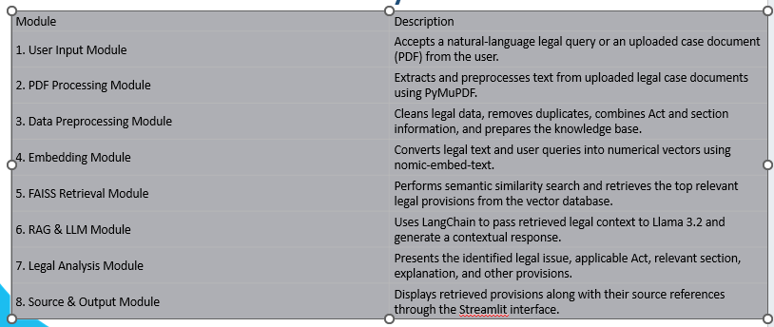
Project Title - Calibri body 18
Module name

Slide 5
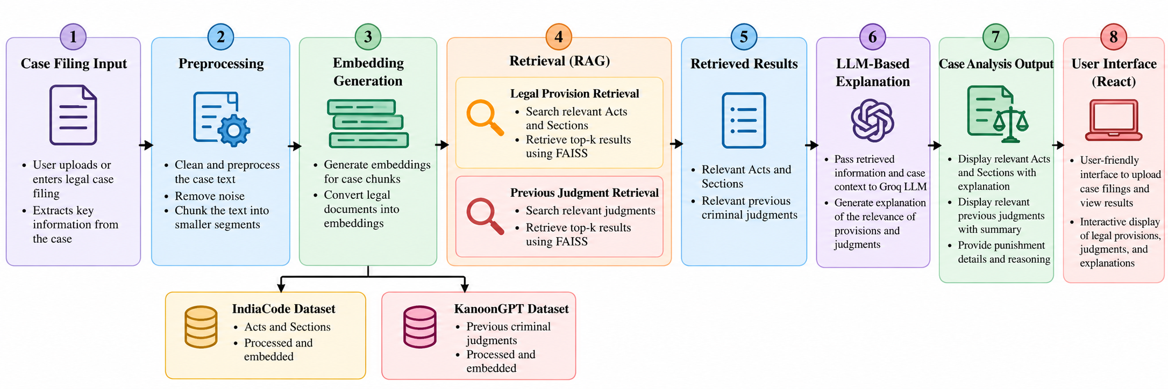
Project Title - Calibri body 18
Methodology

Slide 6
Project Title - Calibri body 18
Data preprocessing & EDA
Data Cleaning – Remove missing and irrelevant data
Text Preprocessing – Clean and normalize legal text
Data Structuring – Organize Acts, Sections, Headings and Legal Text
Chunking – Split lengthy legal documents into meaningful chunks
Data Validation – Check completeness and consistency of the legal dataset

Slide 7
Project Title - Calibri body 18
Algorithms
FAISS Vector Search – Semantic retrieval of relevant legal sections
Cosine Similarity – Measures query–document relevance
Legal Relevance Reranking – Ranks retrieved provisions based on legal relevance
RAG (Retrieval-Augmented Generation) – Grounds LLM responses in retrieved legal content
Llama 3.2 – Generates the structured legal analysis

Slide 8
Project Title - Calibri body 18
Project plan
Calibri body 28
Milestone | Status
Problem Identification & Literature Study | Completed
Dataset Collection & Preprocessing | Completed
Knowledge Base Creation | Completed
Embedding & FAISS Vector Store | Completed
RAG Pipeline Development | Completed
Legal Query Module | Completed
Case Analysis Module | Completed
UI & Backend Integration | Completed
Retrieval & Reranking Optimization | In Progress
Testing & Performance Evaluation | In Progress
Final Documentation & Deployment | Planned

Slide 9
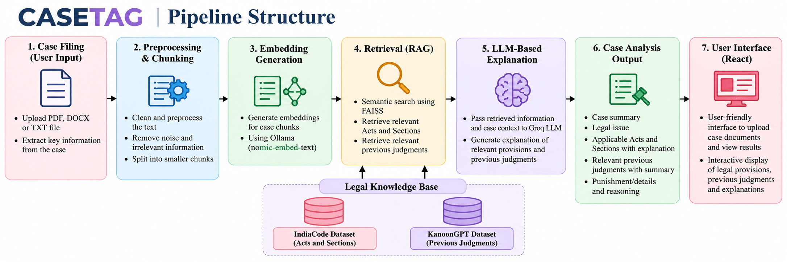
Project Title - Calibri body 18
Pipeline Structure

