Slide 1


M.Tech/MCA Program
Advanced Industry Integrated Programs
Jointly offered by University and LTIMindTree
Review II
Leftover Ingredient-Based Recipe Recommendation using Agentic AI
CIBIKSHA V
Knowledge partner | Implementation partner

Slide 2
Project Title - Calibri body 18
Introduction
An AI-based recipe recommendation system is developed to utilize available and leftover kitchen ingredients.
Retrieval-Augmented Generation (RAG) is used to retrieve relevant recipes from a recipe knowledge base.
FAISS performs vector similarity search using nomic-embed-text embeddings, while Llama 3.2 generates the recommendation through Ollama.
The system identifies matched/missing ingredients and ranks the retrieved recipes to provide suitable recommendations through a React interface.

Slide 3
Project Title - Calibri body 18
Objective
Accept available kitchen ingredients as input.
Retrieve relevant recipes from the recipe knowledge base.
Identify matched and missing ingredients.
Recommend recipes that make better use of available ingredients.
Generate an understandable recommendation using RAG.
Help reduce avoidable kitchen food waste.

Slide 4
Project Title - Calibri body 18
Project Title - Calibri body 18
Project Title - Calibri body 18
Module Description
Module | Description
Data Preprocessing Module | Loads the recipe dataset, cleans and normalizes ingredient data, and prepares structured recipe documents.
Embedding & Vector Store Module | Converts recipe information into embeddings using nomic-embed-text and stores them in FAISS for similarity-based retrieval.
Recipe Retrieval & Ranking Module | Retrieves relevant recipes from FAISS, identifies matched and missing ingredients, and ranks recipes based on ingredient matches.
RAG & AI Recommendation Module | Uses LangChain to provide retrieved recipe context to Llama 3.2 via Ollama and generates the final recipe recommendation.
Module | Description
Data Preprocessing Module | Loads the recipe dataset, cleans and normalizes ingredient data, and prepares structured recipe documents.
Embedding & Vector Store Module | Converts recipe information into embeddings using nomic-embed-text and stores them in FAISS for similarity-based retrieval.
Recipe Retrieval & Ranking Module | Retrieves relevant recipes from FAISS, identifies matched and missing ingredients, and ranks recipes based on ingredient matches.
RAG & AI Recommendation Module | Uses LangChain to provide retrieved recipe context to Llama 3.2 via Ollama and generates the final recipe recommendation.

Slide 5
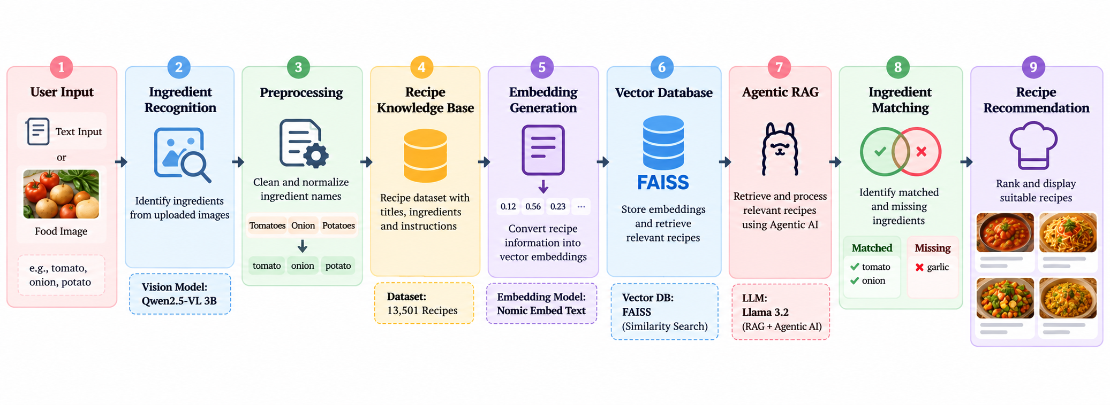
Project Title - Calibri body 18
Methodology

Slide 6
Project Title - Calibri body 18
Data preprocessing & EDA
Data Cleaning: Remove missing and unnecessary values from the recipe dataset.
Text Cleaning: Convert ingredient text to lowercase and remove quantities, units, and preparation terms.
Ingredient Normalization: Standardize ingredient names and handle singular/plural variations.
Data Structuring: Organize recipe titles, ingredients, instructions, and image information.
Embedding Preparation: Prepare the cleaned recipe text for Nomic Embed Text to generate embeddings for FAISS retrieval.

Slide 7
Project Title - Calibri body 18
Algorithm
Data Cleaning: Remove missing and unnecessary values from the recipe dataset.
Text Cleaning: Convert ingredient text to lowercase and remove quantities, units, and preparation terms.
Ingredient Normalization: Standardize ingredient names and handle singular/plural variations.
Data Structuring: Organize recipe titles, ingredients, instructions, and image information.
Embedding Preparation: Prepare the cleaned recipe text for Nomic Embed Text to generate embeddings for FAISS retrieval.

Slide 8
Project Title - Calibri body 18
Project plan
Dataset Collection & Preprocessing — Completed
EDA & Ingredient Analysis — Completed
RAG + FAISS Retrieval — Completed
Agentic AI Integration — Completed
Recipe Matching & Ranking — Completed
React + FastAPI Integration — Completed
Image Integration & UI Testing — Completed
Final Testing & Evaluation — In Progress
Documentation & Final Presentation — In Progress

Slide 9
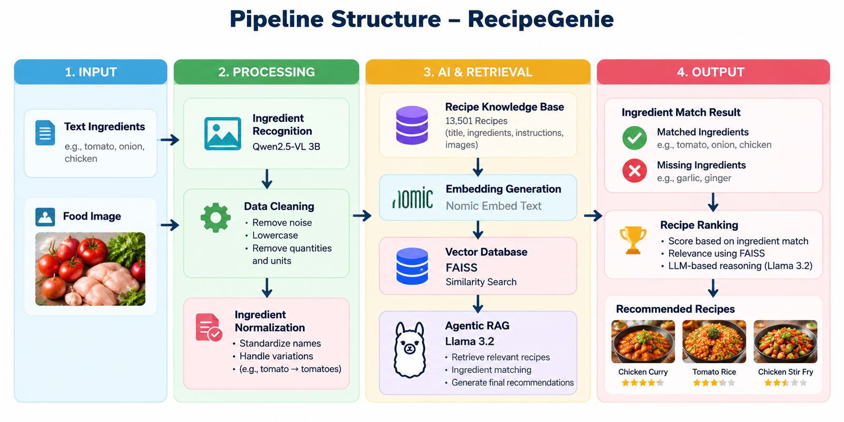
Project Title - Calibri body 18
Pipeline structure

