Slide 1


M.Tech/MCA Program
Advanced Industry Integrated Programs
Jointly offered by University and LTIMindTree
Review III
CASETAG: RAG-Based Legal Provision and Precedent Retrieval with LLM-Based Explanation from Case Filings
Cibiksha V
Knowledge partner | Implementation partner

Slide 2
Project Title - Calibri body 18
Introduction
Legal case filings contain complex and extensive information that requires careful analysis.
Identifying the relevant Acts and Sections manually can be time-consuming.
Finding previous judgments related to similar legal issues also requires extensive legal research.
CASETAG uses Retrieval-Augmented Generation (RAG) to retrieve relevant legal provisions and previous criminal judgments.
The retrieved information is processed by an LLM to generate clear and relevant legal explanations.
The system aims to make legal research faster, structured, and easier to understand.

Slide 3
Project Title - Calibri body 18
Objective
To develop an LLM-based RAG system for analyzing legal case filings.
To retrieve relevant Acts and Sections based on the facts and legal issues in a case.
To retrieve relevant previous criminal judgments related to the given case.
To use semantic search and FAISS for efficient retrieval of legal information.
To generate clear explanations of why the retrieved legal provisions and judgments are relevant.
To provide a structured and user-friendly platform for assisting legal research and case analysis.

Slide 4
Project Title - Calibri body 18
Module name
S. No. | Module Name | Description
1 | User Authentication | Handles user registration, login, and secure access to CASETag.
2 | Case Filing Input | Accepts case details or legal case filings from the user.
3 | Legal Document Processing | Processes, cleans, and chunks legal documents for retrieval.
4 | Legal Provision Retrieval | Retrieves relevant Acts and Sections using semantic search and FAISS.
5 | Previous Judgment Retrieval | Retrieves relevant previous criminal judgments related to the case.
6 | LLM-Based Explanation | Uses the Groq LLM to explain the relevance of retrieved legal information.
7 | Case Analysis | Presents relevant provisions, punishment details, and judgment-based insights.
8 | User Interface | Provides a user-friendly React interface for case analysis and legal queries.

Slide 5
Project Title - Calibri body 18
Problem Statement
Legal case filings contain large and complex information, making manual analysis time-consuming.
Identifying the relevant Acts and Sections for a given case requires extensive legal knowledge and research.
Finding similar previous criminal judgments from large collections of legal documents is difficult and inefficient.
Traditional keyword-based search may fail to identify semantically related legal provisions and cases.
There is a need for a system that can retrieve relevant legal information and provide understandable explanations based on the given case.
Therefore, CASETag aims to develop an LLM-based RAG system for efficient legal provision and previous judgment retrieval and explanation.

Slide 6
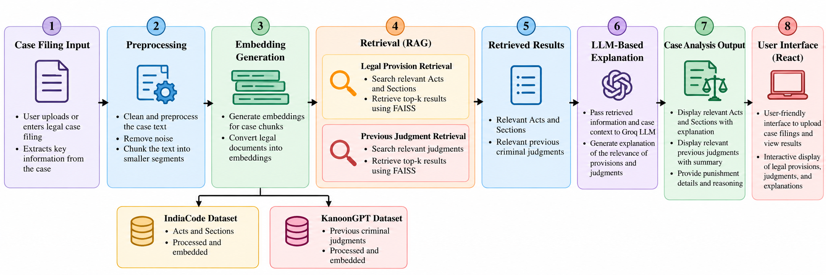
Project Title - Calibri body 18
Methodology

Slide 7
Project Title - Calibri body 18
Algorithms
Step | Stage | Process
1 | Case Filing Input | Accept the legal case description or case filing.
2 | Preprocessing | Clean, normalize, and divide the case text into meaningful chunks.
3 | Embedding Generation | Generate semantic embeddings using Ollama – nomic-embed-text.
4 | Legal Provision Retrieval | Search the Acts & Sections FAISS database for relevant legal provisions.
5 | Judgment Retrieval | Search the Criminal Judgments FAISS database for relevant previous judgments.

Slide 8
Project Title - Calibri body 18
Algorithms
Step | Stage | Process
6 | Context Formation | Combine the case details with retrieved Acts, Sections, and judgments.
7 | LLM Processing | Send the retrieved context to Groq – openai/gpt-oss-120b.
8 | Explanation Generation | Generate an explanation of the relevance of the retrieved legal information.
9 | Case Analysis Output | Display relevant provisions, punishment details, previous judgments, and legal reasoning.

Slide 9
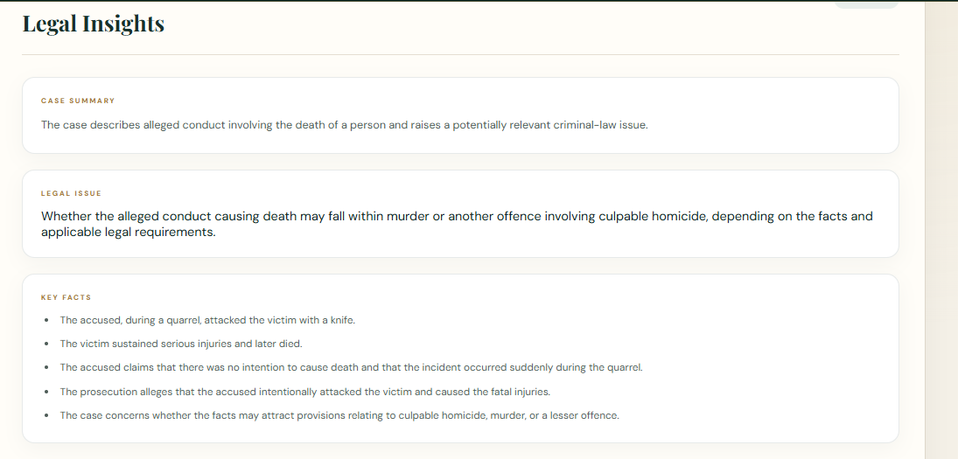
Project Title - Calibri body 18
Findings and Results

Slide 10
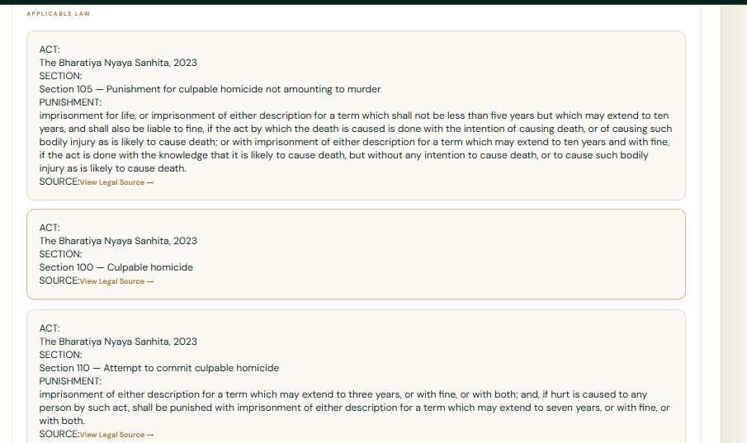
Project Title - Calibri body 18
Findings and Results

Slide 11
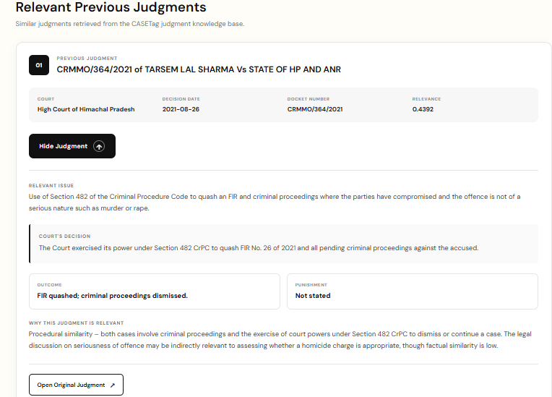
Project Title - Calibri body 18
Findings and Results

Slide 12
Project Title - Calibri body 18
Conclusion
CASETAG integrates RAG and LLM technologies to assist in legal case analysis by retrieving relevant Acts, Sections, and previous criminal judgments. The retrieved information is processed by the Groq LLM to generate structured legal explanations based on the case facts. The system provides a user-friendly platform for faster, structured, and evidence-grounded legal research.

Slide 13
Project Title - Calibri body 18
Acknowledgement
I sincerely thank LTM and L&T EduTech for providing the infrastructure, laptop, training room, ID card, and a valuable 2-month opportunity to enhance my technical skills through practical project development.
I express my special gratitude to Dr. Ganesh for his continuous guidance, valuable suggestions, and support in improving my project. I also thank the Classroom Managers for their daily monitoring, coordination, and assistance in resolving issues. Finally, my special thanks to Mr. Jayakanthan, Manager – Delivery Operations, L&T EduTech, for his encouragement, support, and for providing this valuable opportunity.

Slide 14
Project Title - Calibri body 18
Reference
[1] Government of India, “India Code: The Bharatiya Nyaya Sanhita, 2023,” India Code, 2023.
[2] KanoonGPT, “Indian Legal Documents Dataset,” Hugging Face.
[3] J. Johnson, M. Douze, and H. Jégou, “Billion-scale similarity search with GPUs,” IEEE Transactions on Big Data, vol. 7, no. 3, pp. 535–547, 2021.
[4] P. Lewis et al., “Retrieval-augmented generation for knowledge-intensive NLP tasks,” Advances in Neural Information Processing Systems (NeurIPS), vol. 33, pp. 9459–9474, 2020.
[5] Ollama, “nomic-embed-text: Text Embedding Model,” Ollama Documentation.
[6] Groq, “Groq API Documentation,” Groq Documentation.
[7] S. Ramírez, “FastAPI Documentation,” FastAPI.
[8] Meta Open Source, “React Documentation,” React

