Slide 1


M.Tech/MCA Program
Advanced Industry Integrated Programs
Jointly offered by University and LTIMindTree
Review III
Leftover Ingredient-Based Recipe Recommendation using Agentic AI
Cibiksha V
Knowledge partner | Implementation partner

Slide 2
Project Title - Calibri body 18
Introduction
Helps users utilize available food ingredients effectively and reduce kitchen food waste.
Accepts ingredients through text input or food images.
Uses AI-based image recognition to identify ingredients from uploaded images.
Uses Agentic AI and RAG to search and recommend relevant recipes.
Uses Nomic Embeddings and FAISS for efficient recipe retrieval.
Identifies matched and missing ingredients to help users select suitable recipes.
Promotes better utilization of available food resources and reduces unnecessary food waste.

Slide 3
Project Title - Calibri body 18
Objective
To develop an AI-powered system for reducing kitchen food waste.
To identify available food ingredients from text input and uploaded images.
To retrieve relevant recipes based on the available ingredients.
To use Agentic AI and RAG for intelligent recipe recommendation.
To identify matched and missing ingredients for each recommended recipe.
To help users make better use of ingredients already available in their kitchen.
To provide fast and relevant recipe suggestions through an easy-to-use interface.

Slide 4
Project Title - Calibri body 18
Module name
  Modules: Input & Processing
S.No | Module Name | Description
1 | User Input Module | Accepts ingredients through text input or food images.
2 | Image-Based Ingredient Recognition | Identifies visible ingredients from uploaded images.
3 | Ingredient Preprocessing | Cleans, normalizes, and standardizes ingredient names.
4 | Recipe Knowledge Base | Stores recipe titles, ingredients, and cooking instructions.
5 | Embedding & Vector Database | Generates embeddings using Nomic Embed Text and stores them in FAISS.

Slide 5
Project Title - Calibri body 18
Module name
  Modules: AI & Recommendation
S.No | Module Name | Description
6 | RAG-Based Recipe Retrieval | Retrieves relevant recipes based on available ingredients.
7 | Agentic AI Module | Uses Llama 3.2 to handle queries and select appropriate tools.
8 | Ingredient Matching | Identifies matched and missing ingredients for recipes.
9 | Recipe Recommendation | Ranks and presents suitable recipes to the user.
10 | UI & Backend Integration | Connects the React frontend with the FastAPI backend.

Slide 6
Project Title - Calibri body 18
Problem Statement
Kitchen food waste occurs when available ingredients remain unused due to limited recipe choices.
Users often do not know what recipes can be prepared with the ingredients they have.
Existing recipe platforms mainly require manual recipe searching and may not consider the user's complete ingredient availability.
Identifying ingredients from food images and finding suitable recipes is also challenging.
Hence, there is a need for an AI-powered system that identifies available ingredients and recommends suitable recipes while highlighting missing ingredients, helping users make better use of available food and reduce waste.

Slide 7
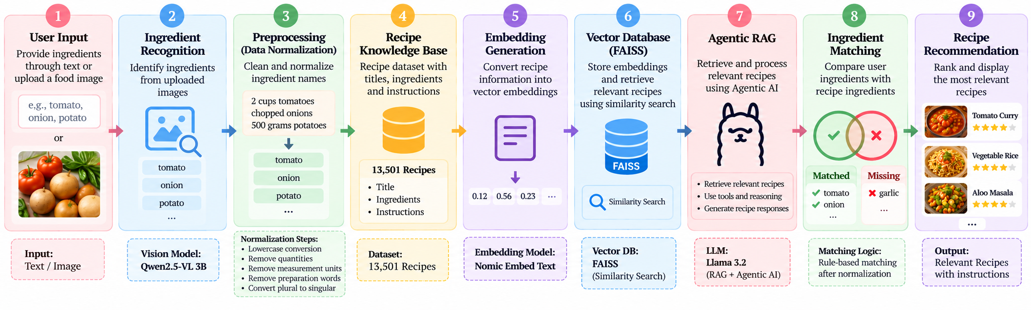
Project Title - Calibri body 18
Methodology

Slide 8
Project Title - Calibri body 18
Approach/Algorithms/Tools…. Calibri body -36
Module | Algorithm / Technique
1. Image Ingredient Recognition | Vision-Language Model – Qwen2.5-VL 3B
2. Data Preprocessing | Rule-Based Ingredient Normalization
3. Text Embedding | Nomic Embed Text
4. Recipe Retrieval | FAISS Similarity Search
5. RAG | Retrieval-Augmented Generation (RAG)
6. Agentic AI | Tool-Based Agent Routing
7. Ingredient Matching | Rule-Based Matching & Scoring
8. Recipe Ranking | Similarity + Ingredient Match Ranking

Slide 9
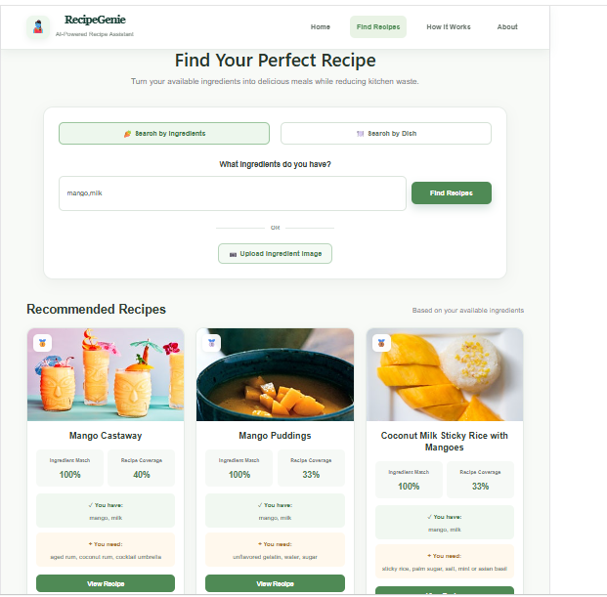
Project Title - Calibri body 18
Findings and Results

Slide 10
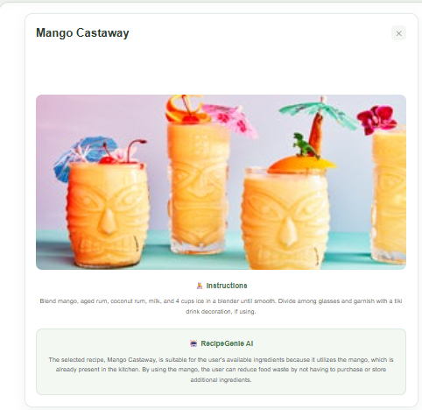
Project Title - Calibri body 18
Findings and Results

Slide 11
Project Title - Calibri body 18
Conclusion
RecipeGenie provides an AI-powered solution to reduce kitchen food waste by recommending recipes based on available ingredients.
It accepts text input and food images to identify ingredients.
Qwen2.5-VL 3B recognizes ingredients, while rule-based preprocessing
Standarize them. Nomic Embed Text, FAISS, RAG, and Agentic AI enable
Relevent recipe retrieval recommendation.Te system identifies matched
and missing ingredients, helping users utilize available food effectively.

Slide 12
Project Title - Calibri body 18
Acknowledgement
I sincerely thank LTM and L&T EduTech for providing the infrastructure, laptop, training room, ID card, and a valuable 2-month opportunity to enhance my technical skills through practical project development.
I express my special gratitude to Dr. Ganesh for his continuous guidance, valuable suggestions, and support in improving my project. I also thank the Classroom Managers for their daily monitoring, coordination, and assistance in resolving issues. Finally, my special thanks to Mr. Jayakanthan, Manager – Delivery Operations, L&T EduTech, for his encouragement, support, and for providing this valuable opportunity.

Slide 13
Project Title - Calibri body 18
Reference
[1] S. Goel et al., “Food Ingredients and Recipe Dataset with Images,” Kaggle, 2020. Kaggle Dataset
[2] Meta AI, “FAISS: A Library for Efficient Similarity Search and Clustering of Dense Vectors,” FAISS Documentation. FAISS Documentation
[3] LangChain, “Retrieval-Augmented Generation (RAG),” LangChain Documentation. LangChain Documentation
[4] Ollama, “Llama 3.2,” Ollama Documentation. Ollama
[5] Nomic AI, “Nomic Embed,” Nomic AI. Nomic AI
[6] Meta AI, “Llama 3.2 Vision,” Ollama Model Library. Llama 3.2 Vision
[7] Meta, “React – A JavaScript Library for Building User Interfaces,” React Documentation. React Documentation
[8] Sebastián Ramírez, “FastAPI – Modern, Fast Web Framework for Building APIs,” FastAPI Documentation. FastAPI Documentation

