Slide 1



L16 – Uncorrelated Track Processing
By: Kyle Galang, Aurela Broqi, Ruben Dennis, Aaron Nogues, Ezra Stone
Notes:
- FILL IN / REMOVE ALL NOTES

Slide 2
Table of Contents
UI Development Updates
UI LLM development
Overview of Configurations
Symbolic Regression Manipulation
GitHub Run Down
LLM-SRBENCH/UCT
Questions

Slide 3
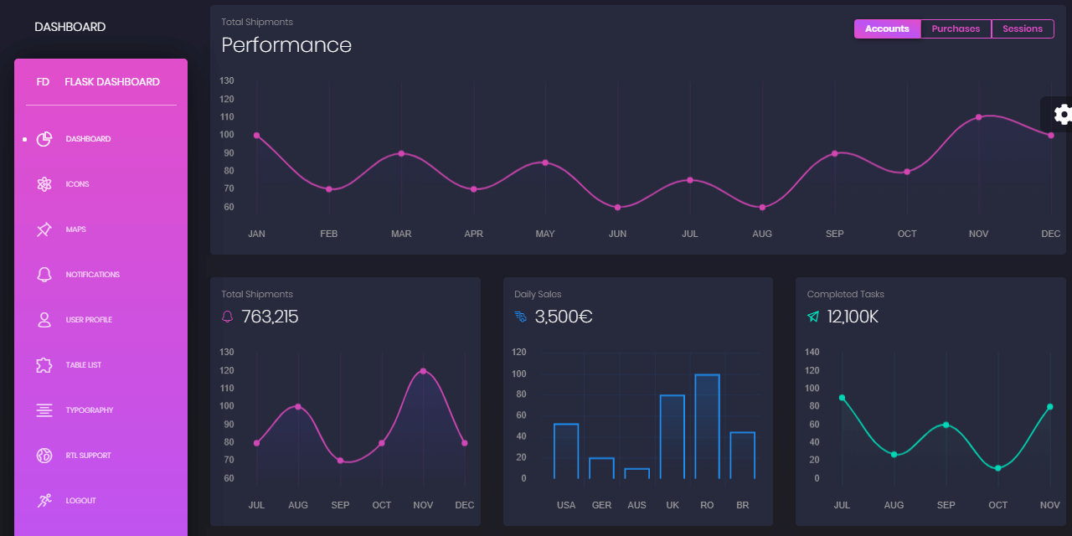
User Interface - Development Updates

Slide 4
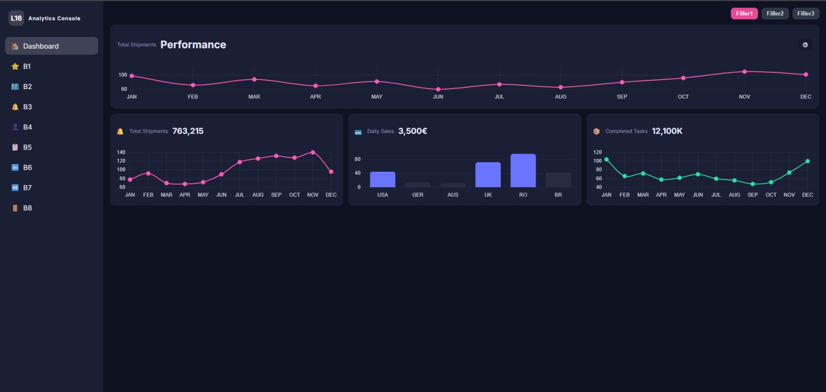
User Interface - Development Updates

Slide 5
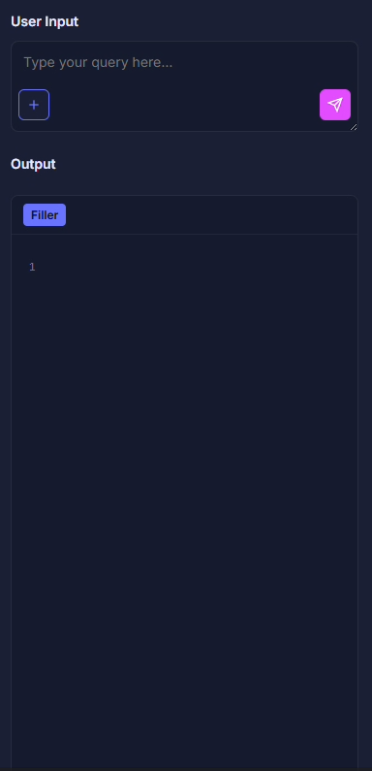
User Interface – LLM updates
LLM trained on OpenEvolve examples: Each example problem has some form of these files: I. initial_program.py II. evaluator.py
We create a user input and output to generate code from an LLM to create a basis of the code needed to create for new problems in the future.
Example problem: 1. Input a problem you want to create code for: y = mx + b 2. LLM generates initial_program function based off problem specified. 3. Prompt LLM to generate an evaluator based off metrics you want to identify.
* Won’t be perfect but it will give a head start on programming such files for future use.

Slide 6
Overview of Configurations - Parameters:Config
The configuration file is integral to Open Evolve.
The parameters of the Config file do change how open evolve operates within its bounds.
Some examples categorized by Italics.
The measurement tool for benchmarking Open Evolve will take a control problem and adjust all components of the config file.
General
Max iterations : int
Checkpoint Interval : int
Difference based evolution :bool
LLM
Temperature : float
Max tokens : int
Timeout : float
Retries :int
Prompt
System message : String
Number of top Programs : int
Number of diverse Programs : int
…

Slide 7
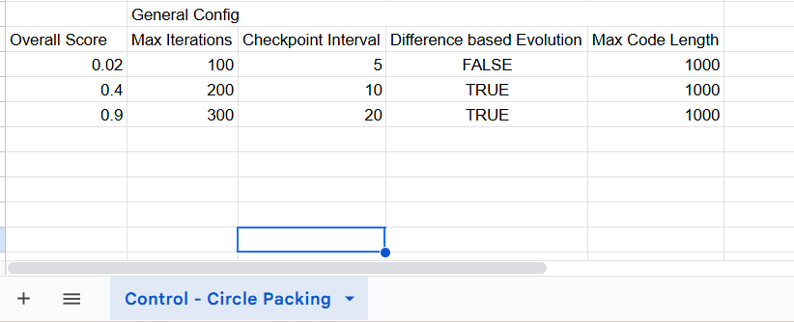

Overview of Configurations - Parameters:Evaluator
This Evaluator will be the normal evaluator for the Control Problem but also output the data into a spreadsheet format.
The Overall Score like in the UI will be used to track the parameters effect on the performance.

Slide 8
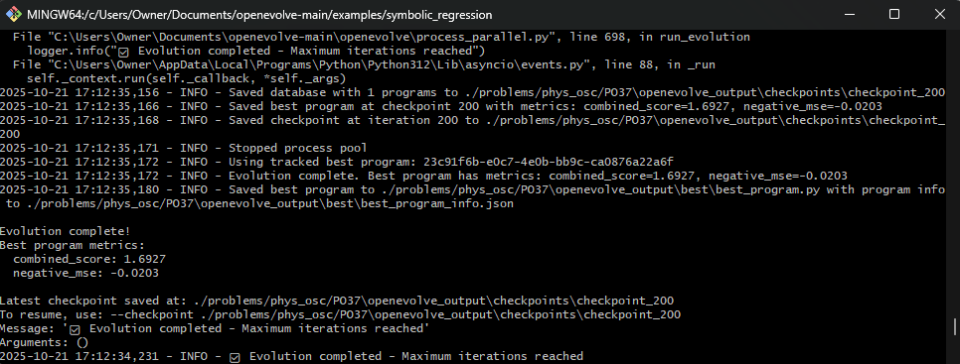
Symbolic Regression

Slide 9
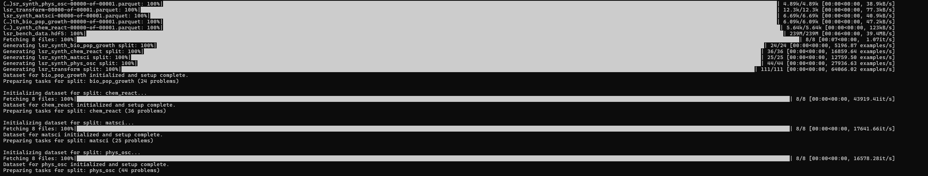

Symbolic Regression

Slide 10
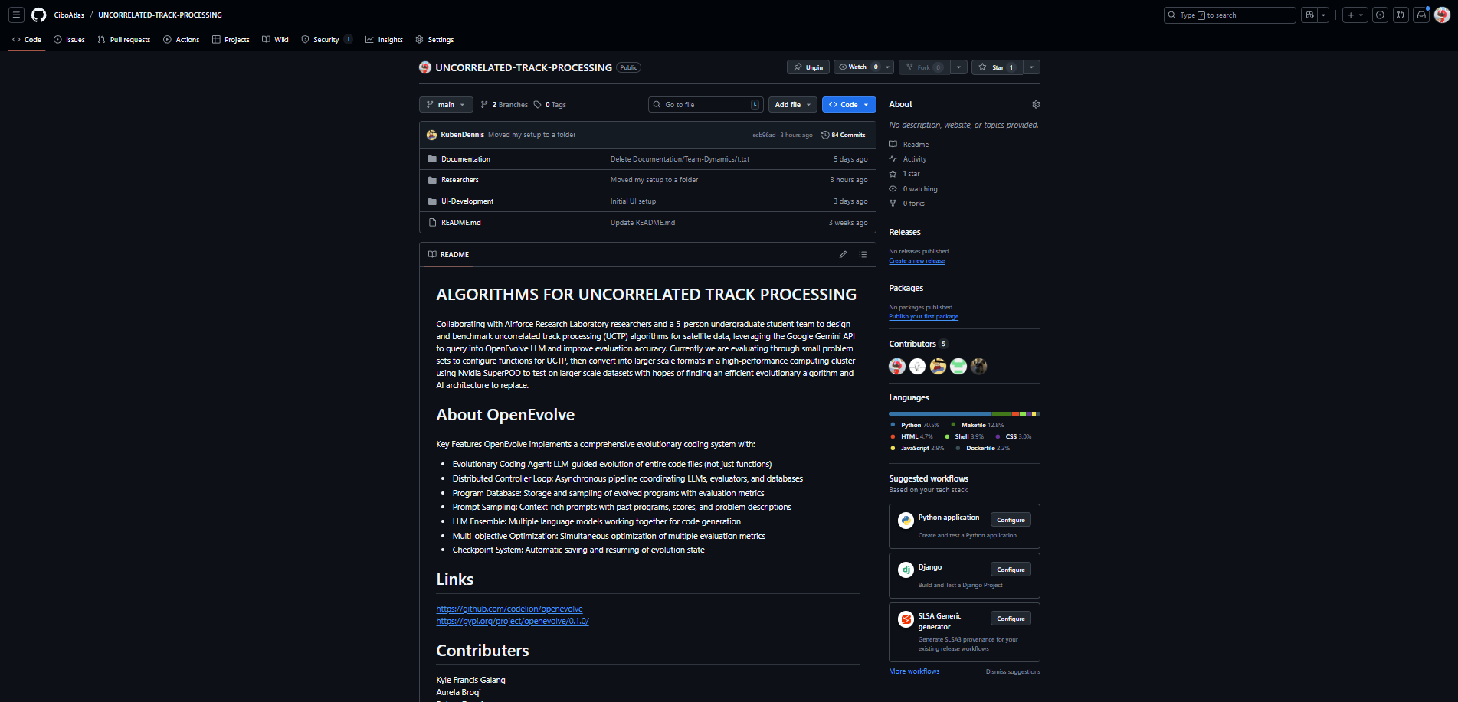
GitHub Run Down

Slide 11
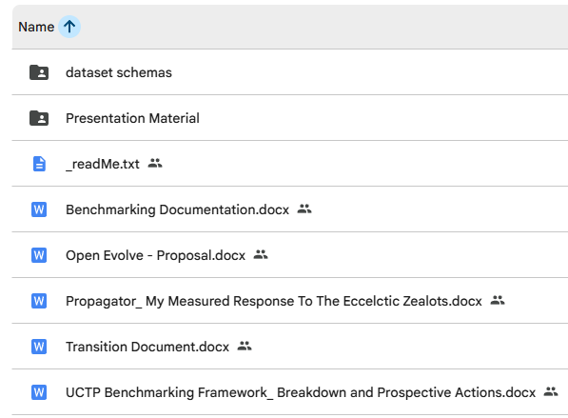
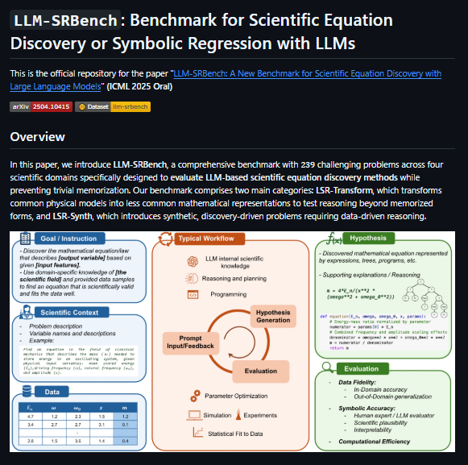
LLM-SRBENCH/UCT

Slide 12
Questions
Open discussions
Hugging face imports

