Slide 1



L16 – Uncorrelated Track Processing
By: Kyle Galang, Aurela Broqi, Ruben Dennis, Aaron Nogues, Ezra Stone
Notes:
- FILL IN / REMOVE ALL NOTES

Slide 2
Table of Contents
Research Breakdown
Project Maturation
Sprint Task Allocations
Questions

Slide 3
Research Breakdown
Nomenclature
OpenEvolve Research for UCT
Goals
Requirements
Research Topics
Poster
Distributions
Documentation
UCT
OpenEvolve
Symbolic Regression
Software Development
Aaron Nogues
Ruben Dennis
Aurela Broqi
LLM
GUI
Ezra Stone
Kyle Galang

Slide 4
Project Maturation
The following items to be discussed
Environment Setup:
GitHub Repository – mature
Open Ondemand – identified later through the access of HPC
Documentation – ongoing as we develop further into symbolic regression benchmarking example
Design level requirements:
Design Schematics – mature
Tech Stack – requirements/technology identified Development:
Graphical User Interface – connection to local host still needed
LLM development – ahead of time-line, but still in research phase
Validity environment testing – identified later when Open OnDemand gets set up

Slide 5
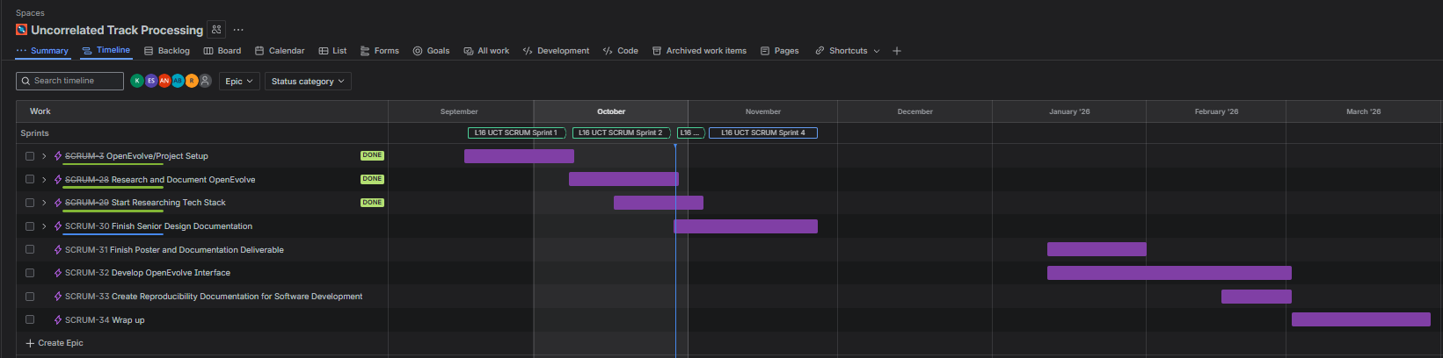
Sprint Task Allocation

Slide 6
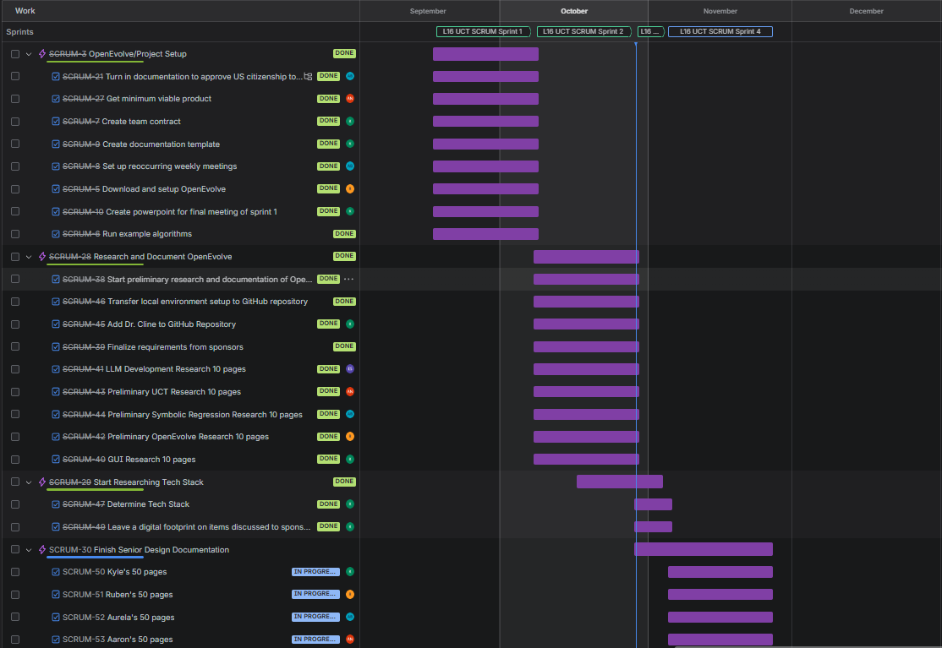
Sprint Task Allocation

Slide 7
Questions
Open discussions

