Slide 1


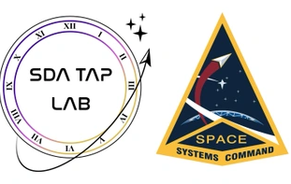


L16 – Uncorrelated Track Processing
By: Kyle Galang, Aurela Broqi, Ruben Dennis, Aaron Nogues, Ezra Stone
Notes:
- FILL IN / REMOVE ALL NOTES

Slide 2
Table of Contents
Background: What is inside a Satellite
Background: Uncorrelated Track Processing

Slide 3
Project Maturation
The following items to be discussed
Environment Setup:
GitHub Repository – mature
SDA TAP Lab & UDA access – mature
Open Ondemand – identified later through the access of HPC
Documentation – ongoing as we develop further into symbolic regression benchmarking example
Design level requirements:
Design Schematics – mature
Tech Stack – mature Development:
Graphical User Interface – mature
LLM development – development phase
Validity environment testing – identified later when Open OnDemand gets set up

Slide 4
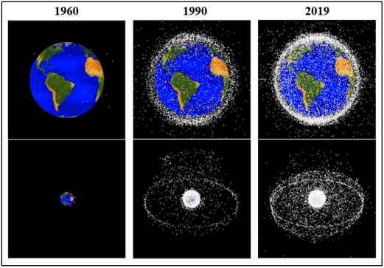
Project Maturation
The following items to be discussed
Environment Setup:
GitHub Repository – mature
SDA TAP Lab & UDA access – mature
Open Ondemand – identified later through the access of HPC
Documentation – ongoing as we develop further into symbolic regression
Design level requirements:
Design Schematics – mature
Tech Stack – mature Development:
Graphical User Interface – mature
LLM development – development phase
Validity environment testing – identified later when Open OnDemand gets set up

Slide 5
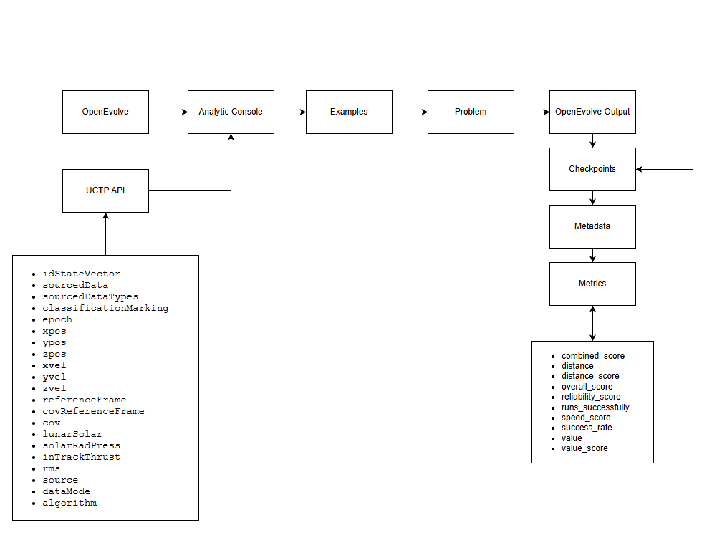
User Interface: Unified Modeling Language Diagram
function_minimization

Slide 7
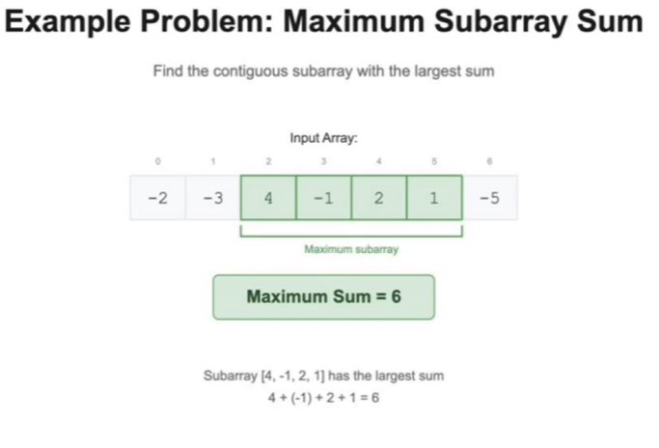
OpenEvolve: Maximum Subarray Sum
Notes:
Sliding window, where we keep iterating the left pointer by skipping negative evaluations and increasing the right pointer to do the logic. Brute force which is the worst way is doing in to n^3 but we know the optimal solution through data structures and algorithms is O(n)

Slide 8
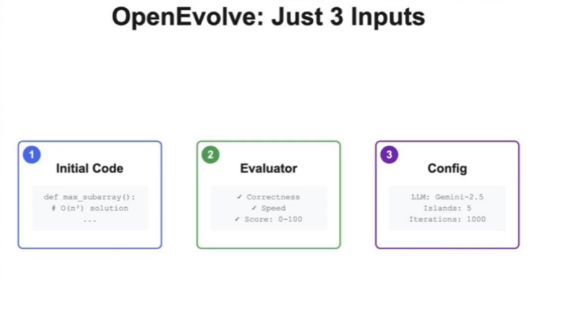
OpenEvolve: Inputs
Notes:
OpenEvolve just needs through inputs which is the initial code for the O(n^3) solution and an evaluator for speed and correctness. While also having a config to do the island based evolutionary process. Which in this talk they said how they used relatively less complex models like gemini flash and other open models and saw they can do 1.3-1.6x over the current benchmarks using openevolve

Slide 9
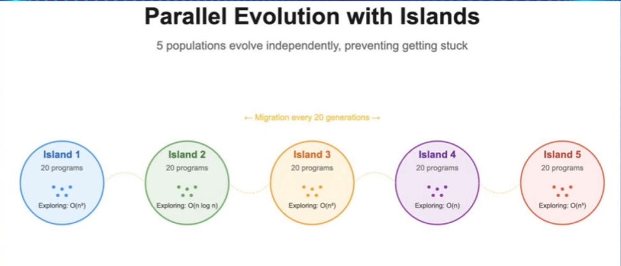
OpenEvolve: Islands
Notes:
This showcases how we have multiple islands representing our populations. Where every n generations, we do migrations where we take the best performing programs from one island and move them to another. This allows us to have fast convergence times and also allowing us to maintain diversity to allow the best solutions to spread through the migration process to prevent premature convergences and also help improve exploration and parallelism.

Slide 10
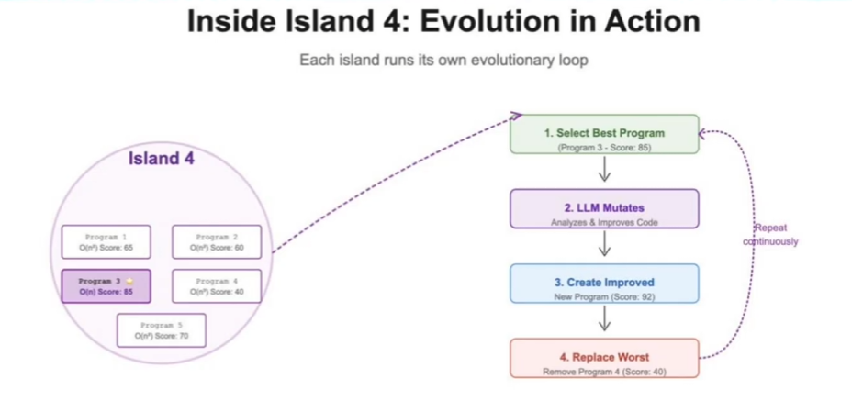
OpenEvolve: Evolutions
Notes:
This diagram shows how in each island they have their own evolutionary loops which is what we know from the current outputs of openevolve in the directory. It takes the best program, mutates it, generates it, and then replaces the worst.

Slide 11
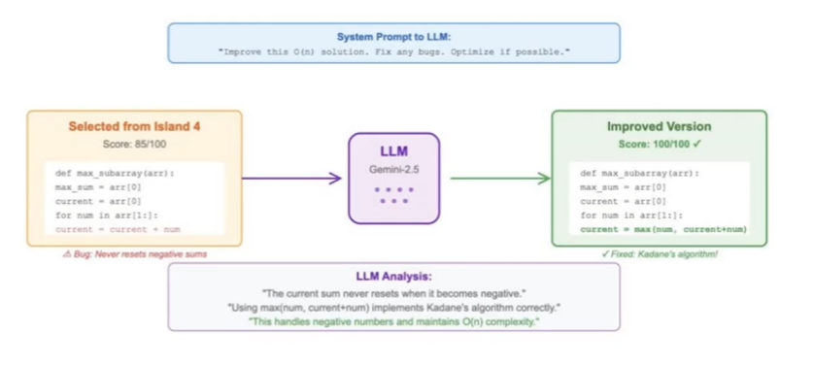
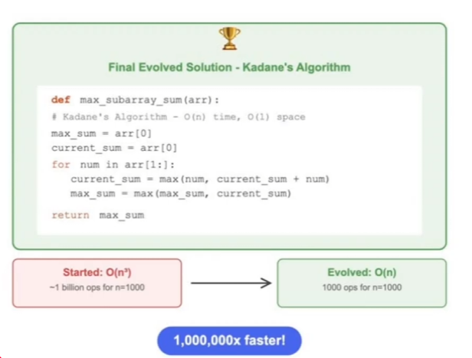
OpenEvolve: Outputs
Notes:
How they did their prompt here is just to showecase that same prompt they asked which is to improve the solution runtime is given to all the programs throughout the process.

Slide 12
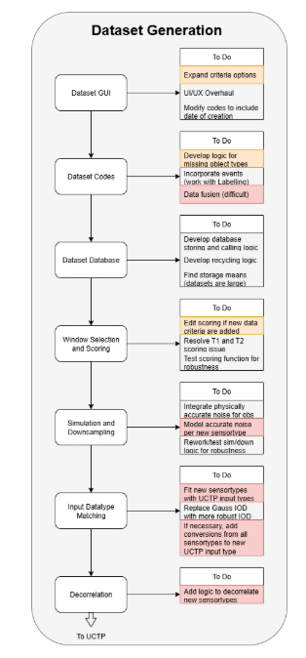
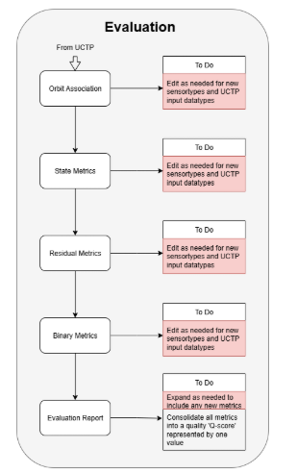
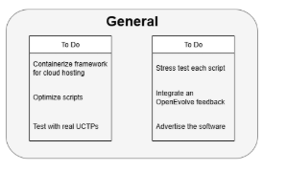
UCT: Diagram
Notes:
So when doing research on how the openevolve architecture works, one thing I’m trying to figure out is what is it that we are trying to implement into openevolve? We’ve talked about the usage of benchmarking with openevolve and so how does UCTP correlated with it?
See about integrating OpenEvolve logic using the already engineered metrics as a point of comparison. In other words, use the metrics from the Evaluation pipeline to inform possible enhancements to the providers’ algorithms via OpenEvolve. This would be a nice addition to the scope of the framework but is not necessary should time not permit; do this last. See the OpenEvolve Proposal for more details.
How does the evaluation pipeline inform possible enhancements to the providers’ algorithm?

Slide 13
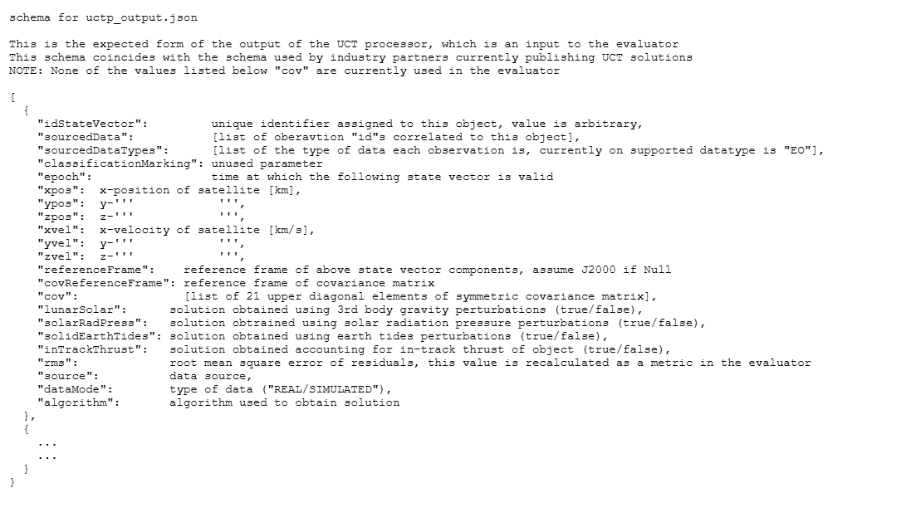
UCT: Integration
Notes:
An evaluation report will be generated and saved as a PDF file at the end of the evaluation algorithm. It contains tables that show Associated Orbits, Binary Metrics, and State results. It also contains graphs showing the residuals of both the Candidate and Reference Orbits. At the top of the PDF, there is the Dataset code so the UCTP can tell exactly what kind of data was used in their testing. The goal of this PDF is to give the UCTP a way to tell how their processor performed at a glance.
The report needs to be expanded depending on the implementation and integration of aspects above. For instance, should more metrics be added, or different stochastic sub-metrics be used, the report should reflect this. A UI/UX overhaul, may also be necessary for ease of reading. Logic to condense all of the metrics into one quality score ‘Q-score’ should be looked into. A single value score will allow for easier comparison between UCTPs, motivating possible algorithm feedback and advancement via OpenEvolve.

Slide 14
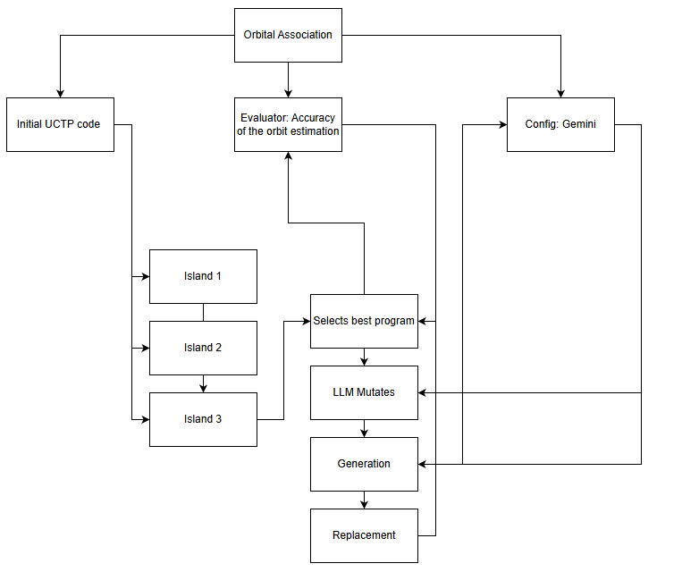
UCT: Orbital Association Metrics

Slide 15
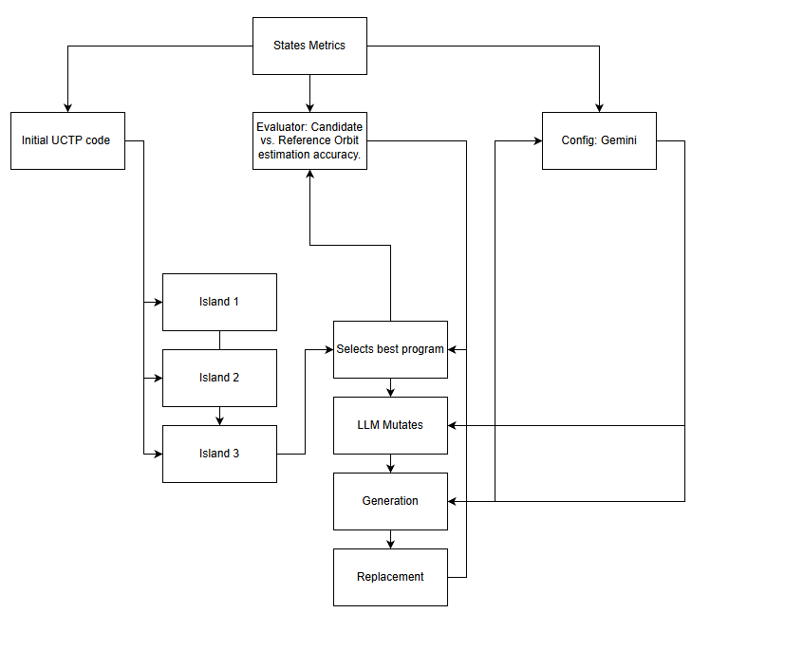
UCT: State Metrics
Notes:
State metrics refer to comparing the Candidate Orbit to the Reference Orbit (either as state vectors or TLEs) to determine the accuracy of the orbit estimation.

Slide 16
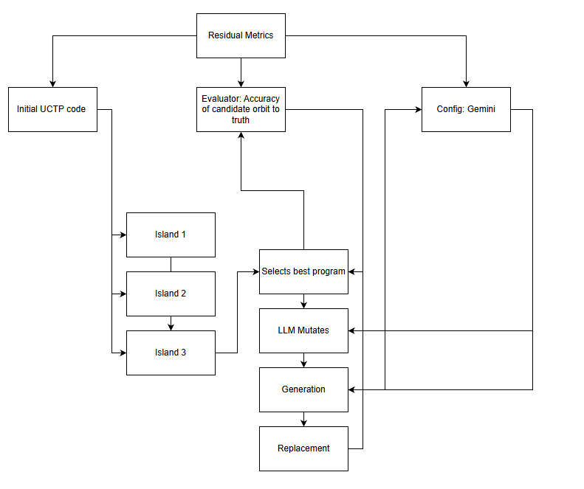
UCT: Residual Metrics
Notes:
Residual Metrics determine the unit-sphere projected great circle residuals between the actual observations or trackTLEs and the estimated observations or trackTLEs determined by propagating the Candidate Orbit to the epoch of each observation or trackTLE. Use of this function is split into two categories:
Comparison of the Reference Orbit observations or trackTLEs with the Candidate Orbit. This gives a measure of how accurate a Candidate Orbit is to the truth.
Comparison of the Candidate Orbit observations or trackTLEs with the Candidate Orbit. This gives a measure of how precise a Candidate Orbit is to its own correlation.

Slide 17
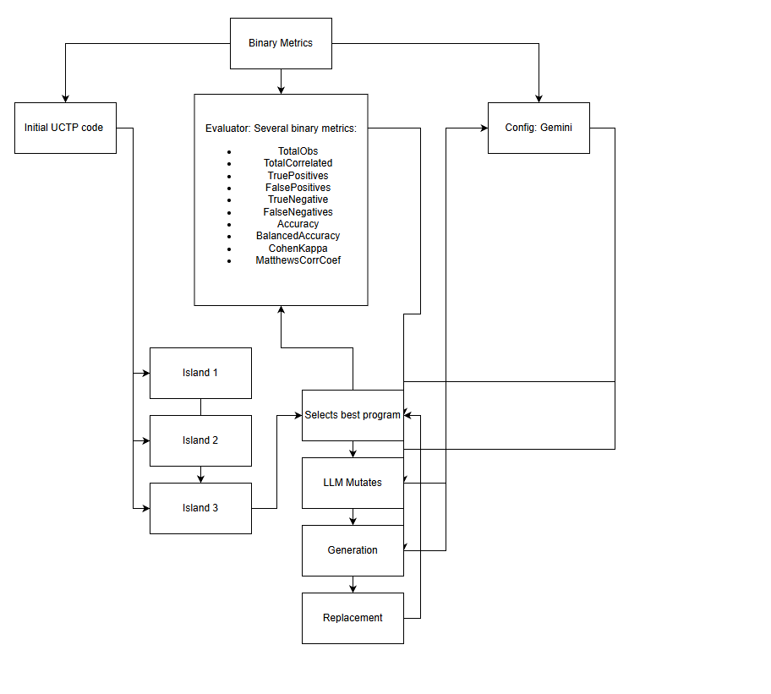
UCT: Binary Metrics
Notes:
The binaryMetrics function evaluates the binary classification performance of a UCTP. It calculates several standard binary classification metrics, assuming a reference (ground truth) dataset and a predicted association output.

Slide 18
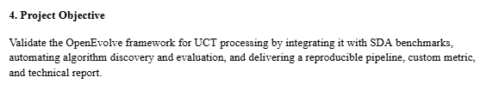
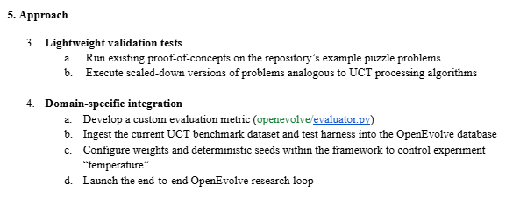
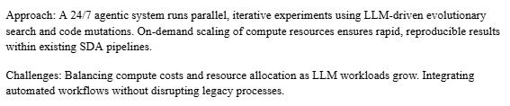
UCT: OpenEvolve Proposal
Notes:
Validate the OpenEvolve framework for UCT processing by integrating it with SDA benchmarks, automating algorithm discovery and evaluation, and delivering a reproducible pipeline, custom metric, and technical report.

Slide 19
UCT: Questions to Ponder
Are we using OpenEvolve on a small-scale where we’re already mutating from already existing algorithms used by UCTP to optimize and find better algorithms.
Are we using OpenEvolve on a larger-scale where we have a dynamic benchmarking system between OpenEvolve and UCTP as new data comes in where the algorithm is always mutating?
Notes:
Validate the OpenEvolve framework for UCT processing by integrating it with SDA benchmarks, automating algorithm discovery and evaluation, and delivering a reproducible pipeline, custom metric, and technical report.

Slide 20
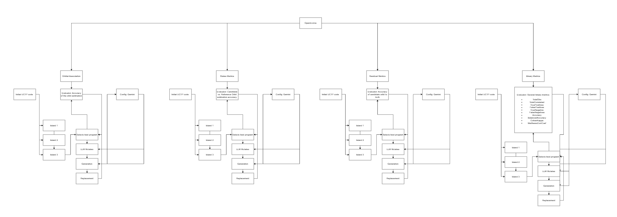
UCT: Benchmarking
Notes:
Validate the OpenEvolve framework for UCT processing by integrating it with SDA benchmarks, automating algorithm discovery and evaluation, and delivering a reproducible pipeline, custom metric, and technical report.

Slide 21
Questions
Open discussions

