Slide 1



L16 – Uncorrelated Track Processing
By: Kyle Galang, Aurela Broqi, Ruben Dennis, Aaron Nogues, Ezra Stone
Notes:
- FILL IN / REMOVE ALL NOTES

Slide 2
Table of Contents
Project Maturation
Course Finalization for Senior Design 1
Development Updates
Current Focus and Needs
UCT Diagram and Metrics
6D State Vector
Questions and Discussions

Slide 3
Project Maturation
The following items to be discussed
Environment Setup:
GitHub Repository – mature
SDA TAP Lab & UDA access – mature
Open Ondemand – identified later through the access of HPC
Documentation – ongoing as we develop further into symbolic regression benchmarking example
Design level requirements:
Design Schematics – mature
Tech Stack – mature Development:
Graphical User Interface – mature
LLM development – development phase
Validity environment testing – identified later when Open OnDemand gets set up

Slide 4
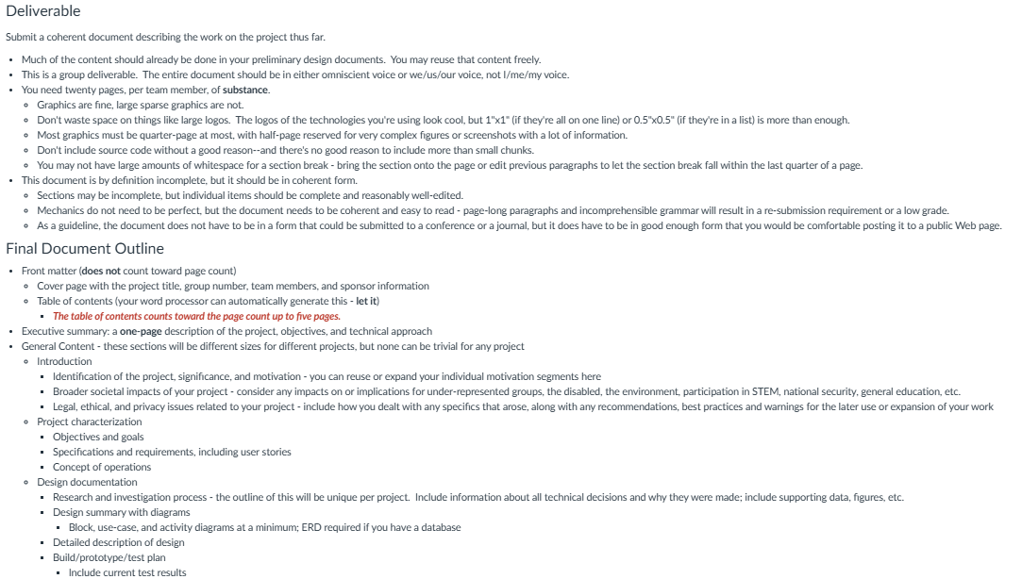
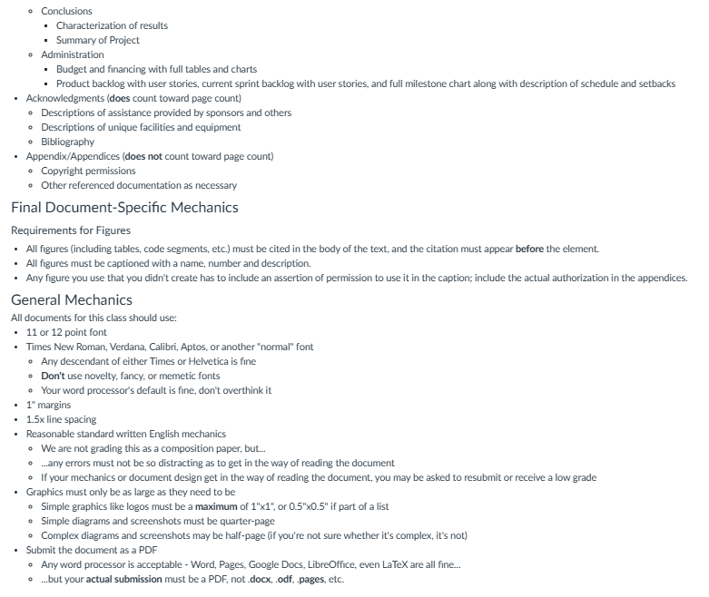
Course Finalization for Senior Design 1
Team has to deliver a 100-page document by Monday (11/24) to end Senior Design 1.
Senior Design 1 is the planning stage for our curriculum to get project scope and timelines sorted.
Being able to identify minimum viable product and project design.
Senior Design 2 is meant for strict development.
Team has already started development.

Slide 5
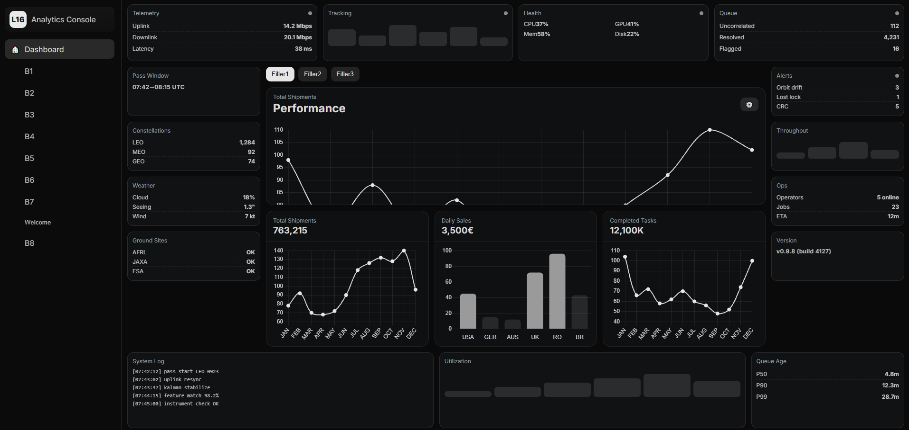
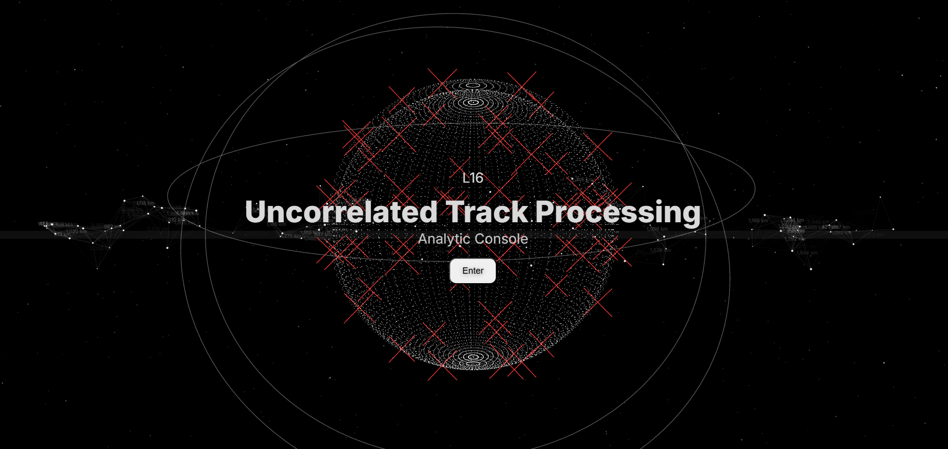
Development Updates no. 2
Analytics Console design is finished.
Currently trying to implement UCT data into different metrics of the console.
Hard stop on OpenEvolve-UCT output. (need working UCT processor to start getting outputs from OpenEvolve to understand logic of Analytics Console)
Chat bot is working for initial program/evaluator code generation but still has some bugs that we are fixing

Slide 6
Development Updates no. 2
Analytics Console design is finished.
Currently trying to implement UCT data into different metrics of the console.
Hard stop on OpenEvolve-UCT output. (need working UCT processor to start getting outputs from OpenEvolve to understand logic of Analytics Console)
Chat bot is working for initial program/evaluator code generation but still has some bugs that we are fixing

Slide 7
Current Focus and Needs
Code for UCT processor to start implementing UCT logic and metrics into OpenEvolve Architecture. - This helps continue graphical user-interface (GUI) development and LLM training. Alongside trying to solve to see if OpenEvolve and benchmark UCT.
Team members are excited now that a lot of the planning is done for the project and semester is over. (have a lot more time with development and really working with OpenEvolve and UCT)

Slide 8
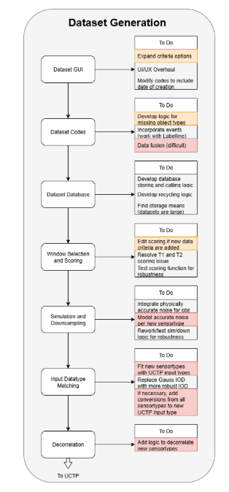
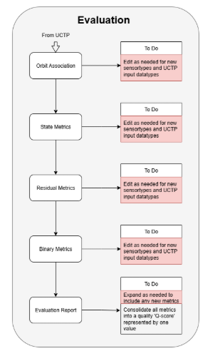
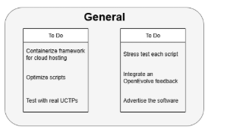
UCT: Diagram and Metrics
Notes:
So when doing research on how the openevolve architecture works, one thing I’m trying to figure out is what is it that we are trying to implement into openevolve? We’ve talked about the usage of benchmarking with openevolve and so how does UCTP correlated with it?
See about integrating OpenEvolve logic using the already engineered metrics as a point of comparison. In other words, use the metrics from the Evaluation pipeline to inform possible enhancements to the providers’ algorithms via OpenEvolve. This would be a nice addition to the scope of the framework but is not necessary should time not permit; do this last. See the OpenEvolve Proposal for more details.
How does the evaluation pipeline inform possible enhancements to the providers’ algorithm?

Slide 9
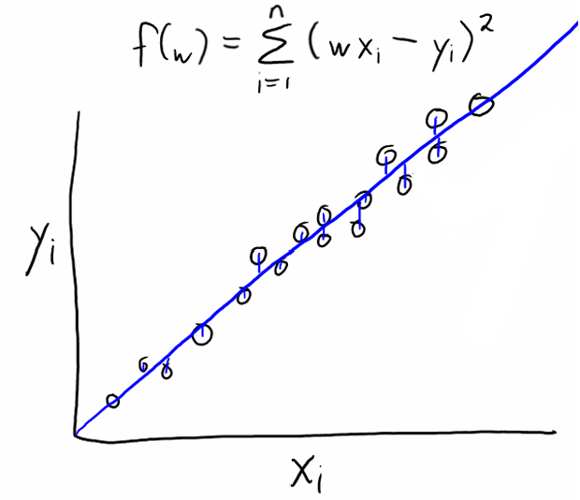
6D State Vector
Reference orbit === true orbit
Candidate === predicted orbit ‘
Reference Object Orbit Points:
"xpos": 24168.25342735169,
"ypos": 34550.56129221599,
"zpos": -857.56069973435,
"xvel": -2.51560889743236,
"yvel": 1.762620637366123,
"zvel": 0.12040900107058,
UCT is trying to minimize the distance between them
How to minimize:
We want to use least-squares optimization
Need to get from 1D to 6D
In 1D linear regression
Minimized by taking the squared difference between the predicted and true values

Slide 10
Questions and Discussions
Open discussions

