Slide 1
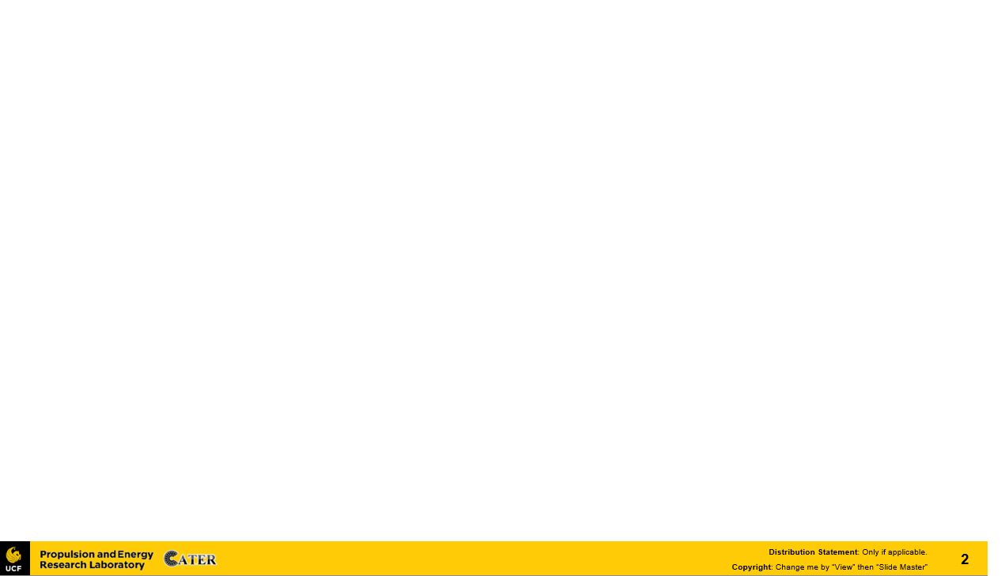


L16 – Uncorrelated Track Processing
By: Kyle Galang, Aurela Broqi, Ruben Dennis, Aaron Nogues, Ezra Stone
Notes:
- FILL IN / REMOVE ALL NOTES

Slide 2
Table of Contents
Project Maturation
UI Development
Research Breakdown
LLM Symbolic Regression Breakdown
Linear Regression
Current Documentation
Questions

Slide 3
Project Maturation
The following items to be discussed
Environment Setup:
GitHub Repository – mature
SDA TAP Lab & UDA access – mature
Open Ondemand – identified later through the access of HPC
Documentation – ongoing as we develop further into symbolic regression benchmarking example
Design level requirements:
Design Schematics – mature
Tech Stack – mature Development:
Graphical User Interface – connection to local host
LLM development – development phase
Validity environment testing – identified later when Open OnDemand gets set up

Slide 4
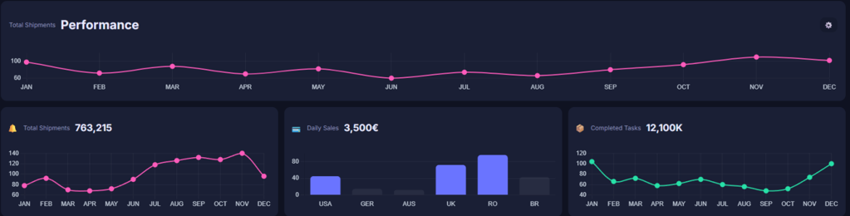
User Interface – Development Updates
Since current UCT runtimes are unknown, do we approximate the timeline based off symbolic regression timelines.
Instead of months, the line graph y-axis will be based off seconds. (metric can be changed later)
Will soon be connected to our single-truth repository which stores a clean setup of OpenEvolve where we do majority of our development in.
LLM development starts soon through training it with the example problems for code generation.

Slide 5
Research Breakdown
Nomenclature
OpenEvolve Research for UCT
Goals
Requirements
Research Topics
Poster
Distributions
Documentation
UCT
OpenEvolve
Symbolic Regression
Software Development
Aaron Nogues
Ruben Dennis
Aurela Broqi
LLM
GUI
Ezra Stone
Kyle Galang

Slide 6
LLM Symbolic Regression Breakdown
What is Symbolic Regression
Why Study Linear Regression?
A type of machine learning algorithm; predict y given x
The more data that gets stored the more trash it gets
Random data sets with unknown objects
In order to determine the orbit, which is a line in 3D space,

Slide 7
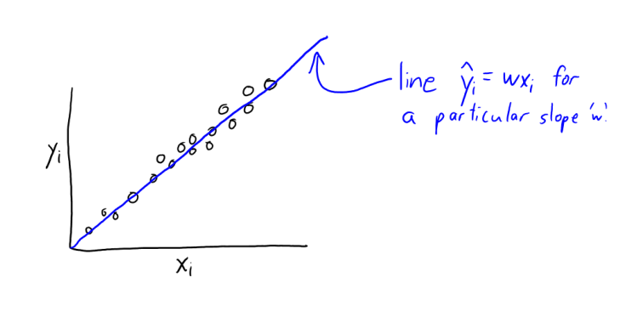
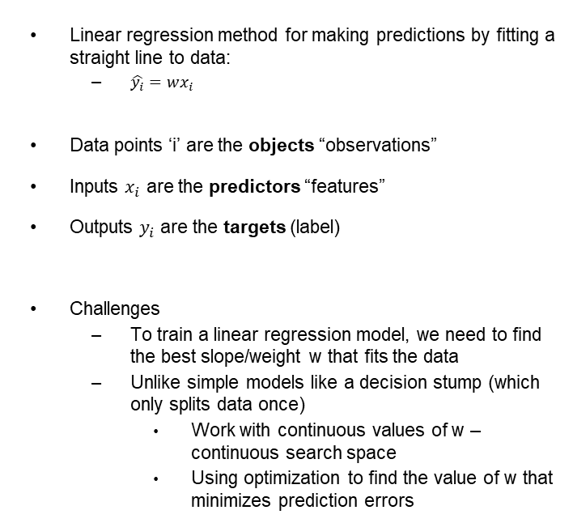
Linear Regression
What is Linear Regression
Linear regression method for making predictions by fitting a straight line to data:
$\hat{y_{i}}=wx_{i}$
Data points ‘i’ are the objects “observations”
Inputs $x_{i}$ are the predictors “features”
Outputs $y_{i}$ are the targets (label)
Challenges
To train a linear regression model, we need to find the best slope/weight w that fits the data
Unlike simple models like a decision stump (which only splits data once)
Work with continuous values of w – continuous search space
Using optimization to find the value of w that minimizes prediction errors

Slide 8
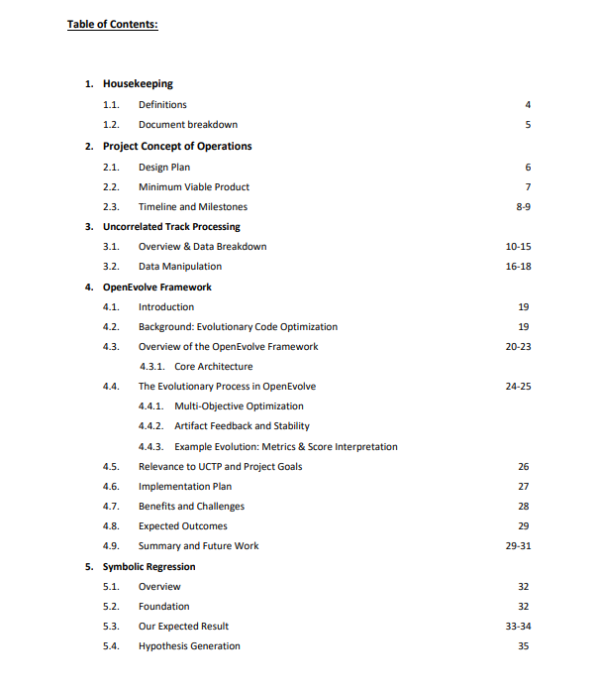
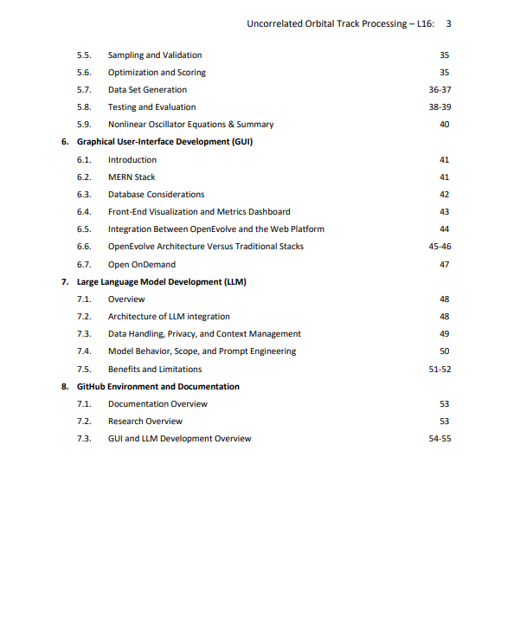
Current Documentation

Slide 9
Questions
Open discussions

