Slide 1



L16 – Uncorrelated Track Processing
By: Kyle Galang, Aurela Broqi, Ruben Dennis, Aaron Nogues, Ezra Stone
Notes:
- FILL IN / REMOVE ALL NOTES

Slide 2
Table of Contents
Project Maturation
Continuous Integration/Continuous Pipeline Development
Development Updates
Current Focus and Needs
Questions and Discussions

Slide 3
Project Maturation
The following items to be discussed
Environment Setup:
GitHub Repository – mature
SDA TAP Lab & UDA access – mature
Open Ondemand – identified later through the access of HPC
Documentation – ongoing as we develop further into symbolic regression benchmarking example
Design level requirements:
Design Schematics – mature
Tech Stack – mature Development:
Graphical User Interface – mature
LLM development – development phase
Validity environment testing – ongoing with CI/CD pipeline

Slide 4
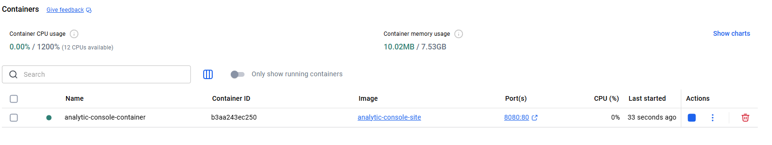
CI/CD Pipeline Development
name: Build Docker image for Analytic Console site working-directory: ./UI-Development run: | docker build -t analytic-console-site:${{ github.sha }} .

Slide 5
CI/CD Pipeline Development
Current website are still static file servers.
Docker allows us to have Python version and nginx installed when we do transfer to HPC.
Since we have a single truth repository for our website in GitHub, code being pushed in there or through local machines can be updated automatically into the website.
Following continuous integration and development for future larger scaled applications for website:
- when the website becomes dynamic, we don’t need to install dependencies, set environment variables, APIs, etc. with the usage of docker
Future work: create scripts that allow us to test the website before code changes are done in development.

Slide 6
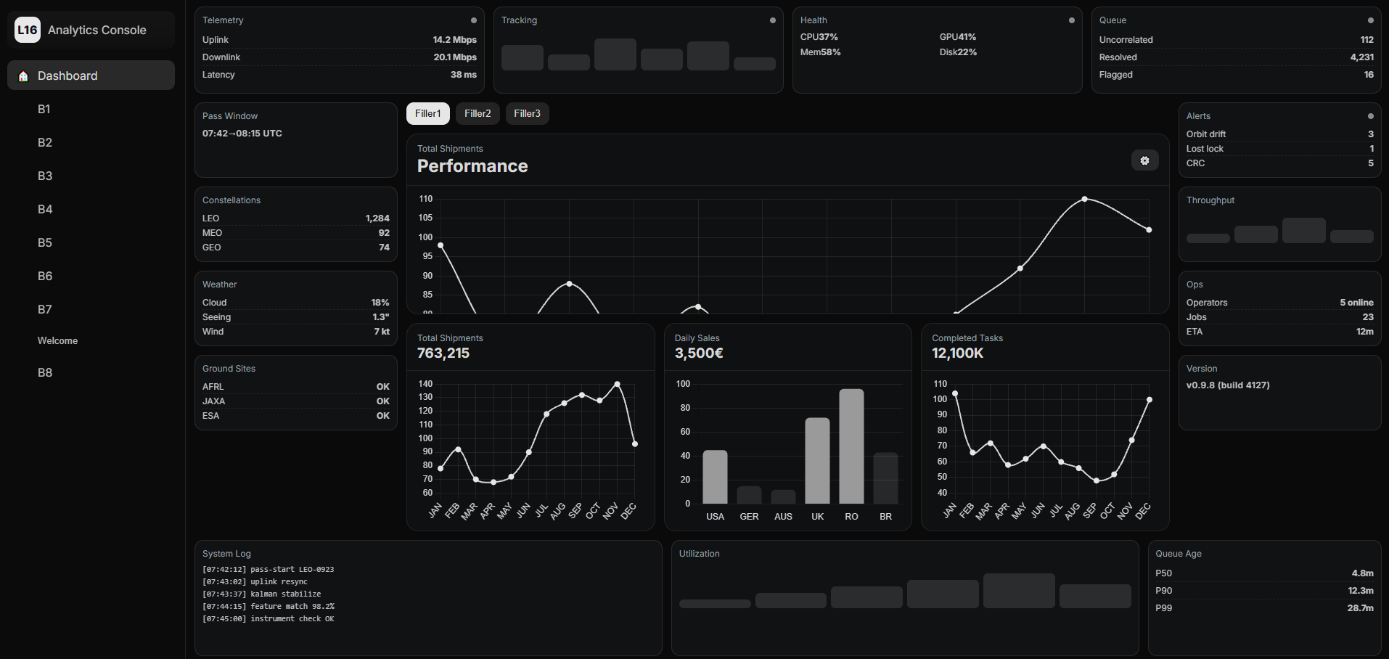
Development Updates
Currently the dashboard is still static in regard to the data coming in.
Hard stop on OpenEvolve-UCT output.
Chat bot is working for initial program/evaluator code generation but still has some bugs that we are fixing

Slide 7
Current Focus and Needs
At the moment, we understand how we pull data from OpenEvolve and give real time updates to our processes. But I am still trying to figure out how to implement UCTP into OpenEvolve.
Restructuring needed on how the data is being pulled through duckDB and parquet formats as opposed to JSON.
Current GitHub sent is creating dataset generation.
Is the processor inside that GitHub as well? I am interested in the processor so I can try to implement it into OpenEvolve architecture and see how well I can reproduce/create my own processes with OpenEvolve. (This continues analytics console development since it is at a hardstuck when it comes to data being pulled in)

Slide 8
Questions and Discussions
Open discussions

