Slide 1
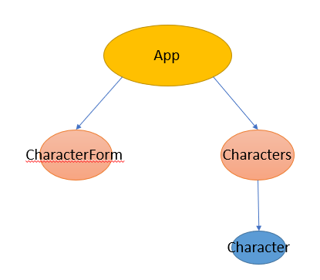
App
CharacterForm
Characters
Character

