Slide 1
Frequency-Domain Diffusion Models
Synthesizing Spectral Fingerprints for Deepfake Analysis
AUTHORS
COURSE
Francesco Malafarina
Computer Vision — Prof. Irene Amerini
Mirco Soriano
Project 6 — A.Y. 2025/26
1 / 15
Notes:
Good morning. We are Francesco Malafarina and Mirco Soriano, and this is Project 6: frequency-domain diffusion models for deepfake analysis.

Slide 2
Outline
01
Problem statement — spectral fingerprints
05
Spectral normalization and DDIM sampling
02
State of the art — detection and diffusion
06
Experimental setup — one controlled variable
03
Dataset — FFHQ at 128×128
07
Model evaluation — FID, KID, radial spectra
04
Proposed method — diffusion on the spectrum
08
Conclusions and future work
Two DDPMs are trained under identical conditions and differ only in the domain of the diffusion process: RGB pixels or the Fourier spectrum.
2 / 15
Notes:
Ten minutes, four movements: the forensic problem, the method, the setup, and what the numbers say.

Slide 3
Problem Statement
Generative models reach convincing photorealism in the spatial domain, yet they leave systematic traces in the frequency domain.
If a diffusion model is trained directly on the Fourier spectrum rather than on RGB pixels, does it reproduce the spectral statistics of real images more faithfully than an identical model trained in the spatial domain?
Those traces — periodic grid peaks and a high-frequency tail that decays too fast — are exactly what state-of-the-art deepfake detectors exploit.
3 / 15
Notes:
Generators are convincing to the eye but not to the spectrum. Detectors live on that gap. Our question is whether training in the spectrum closes it.

Slide 4
State of the Art
FORENSIC ANALYSIS
DIFFUSION MODELS
SAMPLING TRAJECTORIES
It is well established that image generation pipelines, especially those based on GANs, introduce distinct spectral fingerprints in the frequency domain due to upsampling operations. (Frank et al. (ICML 2020))
DDPM (Ho et al., 2020) defines the noise-prediction objective used here.
DDPM — stochastic, 1000 steps
DDIM (Song et al., 2021) makes sampling deterministic on a coarse timestep grid.
Every reverse step adds fresh Gaussian noise; the full grid must be traversed.
DDIM — deterministic, 50 steps
Non-Markovian: the same trained network is sampled on a coarse subsequence.
x
T
noise
x
0
image
OPEN GAP
Could generating the image directly in the frequency domain, rather than in the RGB spatial domain, mitigate the spectral fingerprint phenomenon?
4 / 15
Notes:
Three lines of work meet here: forensic frequency analysis, the DDPM (Denoising Diffusion Probabilistic Model)/DDIM (Denoising Diffusion Implicit Model) family, and frequency-domain diffusion used elsewhere for speed. The controlled comparison is missing.

Slide 5
Dataset
70k
128²
63/7
FFHQ face images (Karras et al., CVPR 2019)
resolution, RGB normalized to [−1, 1]
thousand images, train / validation seeded split, identical for both models
Aligned, homogeneous face crops keep the spectral statistics stable across the dataset, so differences in the generated spectra can be attributed to the model rather than to content variability.
The 7000-image validation split is the reference set for both FID and the spectral comparison; it is never seen during training.
5 / 15
Notes:
FFHQ (Flickr Face High Quality), seventy thousand faces, resized to 128 pixels. Faces are a good choice here: aligned, homogeneous content, and the reference domain for deepfake work.

Slide 6
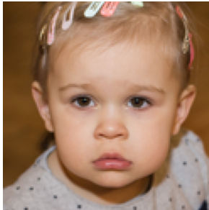
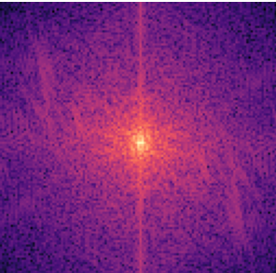
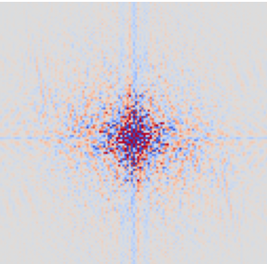
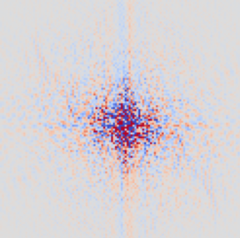
Proposed Method — Frequency Representation
FFT2 · ortho
split ‖ stack
to UNet
[B, 6, 128, 128]
6 real channels
RGB image [B, 3, 128, 128]
centred spectrum complex
real
imaginary
WHY REAL / IMAGINARY
Diffusion injects unbounded Gaussian noise at every step. Real and imaginary parts are unconstrained on the whole real line, so they stay well-behaved under that noise and under an L2 objective. Magnitude and phase are not: magnitude is non-negative and phase wraps at ±π, so neither is compatible with plain Gaussian perturbation.
6 / 15
Notes:
The spectrum is complex; the network is real. We split real and imaginary parts into six channels. Orthonormal transform preserves energy, fftshift centres the DC term so convolutions see a coherent layout.

Slide 7
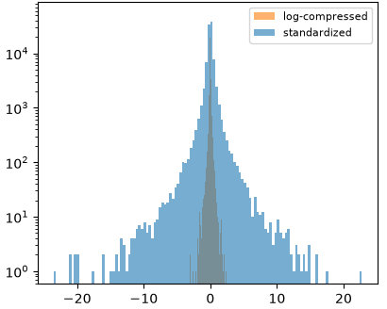
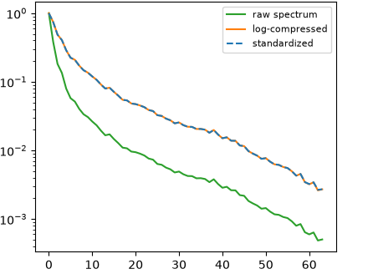
Proposed Method — Spectral Normalization
Low frequencies dominate the raw spectrum by orders of magnitude. Without symmetric log compression and per-channel standardization (statistics computed once on a batch of the training set) diffusion simply ignores the high frequencies.
Value distribution per stage
Radial decay, relative to DC
1 Signed log compression
2 Per-channel standardization
STAGE
MIN
MAX
MEAN
STD
sign(x) · log(1 + |x|)
(compress(f) − FREQ_MEAN) / FREQ_STD
input image
−0.969
+1.000
−0.005
0.443
Pulls the raw ±30 range down to ±3.5.
raw FFT
−29.430
+31.729
−0.003
0.313
Stats [6,1,1] over 30 batches (≈960 images), persisted for sampling.
compressed
−3.415
+3.488
−0.001
0.130
standardized
−23.566
+22.750
−0.010
0.879
7 / 15
Notes:
This is the central problem the assignment calls out. Raw coefficients follow a 1/f law, so a single isotropic noise schedule destroys high frequencies immediately and barely touches DC. Two stages fix it: signed log compression pulls the range from about plus or minus thirty down to plus or minus three and a half, then per-channel standardization brings the standard deviation close to one. The histogram shows both distributions stay centred at zero; the radial plot shows the relative decay across frequency is preserved, so no information is discarded.

Slide 8
Proposed Method — Network and Sampling
UNet ε_θ(x_t, t) — 11.4 M parameters
DDIM sampling, η = 0
C_in
encoder ▼ ▲ decoder
C_out
20×
128²
64
S1
▶
64
fewer network evaluations
64²
128
S2
▶
128
DDPM · 1000 steps
32²
128
S3
128
DDIM · 50 steps
▶
The 1000 training timesteps are sub-sampled to 50 uniformly spaced steps, and deterministic updates make generation reproducible.
16²
256
S4
▶
256
8²
ResBlock → SelfAttention → ResBlock · 256
ResBlock + Down ×4
Up + cat skip + ResBlock ×4
Time conditioning is implemented as a sinusoidal embedding injected as additive bias in every ResBlock; self-attention runs only at 8×8, where the attention matrix is 64×64. C_in = C_out is 3 for RGB and 6 for the frequency model — the only structural difference between the two.
8 / 15
Notes:
Textbook DDPM UNet, 11.4 million parameters, attention only at 8 by 8. The only structural difference between the two models is the number of input and output channels. DDIM with eta zero gives a twenty-fold inference speed-up.

Slide 9
Experimental Setup
SHARED CONFIGURATION
THE SINGLE CONTROLLED VARIABLE
Timesteps T, linear β
1000 · 1e-4 → 0.02
Model
Diffusion target
Ch.
DDIM steps, η
50 · 0.0
RGB baseline
pixels in [−1, 1]
3
Optimizer, learning rate
AdamW · 2e-4
Frequency model
normalized FFT spectrum
6
Batch size, epochs
32 · 100
The extra channels cost ≈3% per step — confined to the first and last convolution — so ≈4.3 min per epoch and ≈7.2 h per model, ≈15 h in total.
Seed, mixed precision
42 · fp16 (CUDA)
Hardware
RTX 5070 Ti, 16 GB
η = 0 removes the stochastic term from DDIM sampling: the reverse path becomes deterministic, so a fixed seed maps to a fixed image and the two models can be compared on the same noise.
9 / 15
Notes:
Everything is held fixed except the diffusion domain: same UNet, same split, same schedule, same optimizer, same epochs, same sampler. Ten and a half hours of training in total.

Slide 10

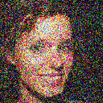



Loss Function
FORWARD PROCESS
t = 0
t = 200
t = 500
t = 800
t = 999
Closed form: any timestep is reachable in one step, so training samples t uniformly in [0, 1000).
OBJECTIVE
TWO CONSEQUENCES FOR THIS COMPARISON
The regression target is unit Gaussian noise in both domains, so the two loss curves are numerically comparable even though x_0 is a pixel tensor in one case and a normalized spectrum in the other.
But the loss is measured in the compressed, standardized spectral space. Denormalization applies an exponential, so a small spectral residual is amplified when it returns to pixels — equal loss does not mean equal image error.
Simple MSE between the injected noise and the noise predicted by the UNet — the ε-prediction form of the DDPM variational bound (Ho et al., 2020).
10 / 15
Notes:
The objective is the standard noise-prediction MSE. Two points matter here. First, the target is always unit Gaussian noise, so the two losses are numerically comparable even though the inputs live in different domains. Second, the loss is measured in the compressed, standardized spectral space, not in pixels — so equal loss does not mean equal image error, and that asymmetry is part of why the frequency samples look worse.

Slide 11
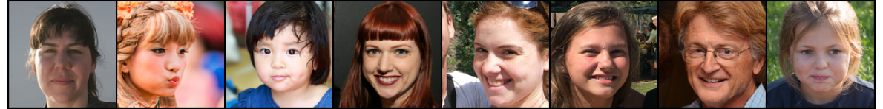
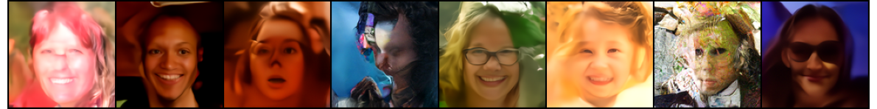
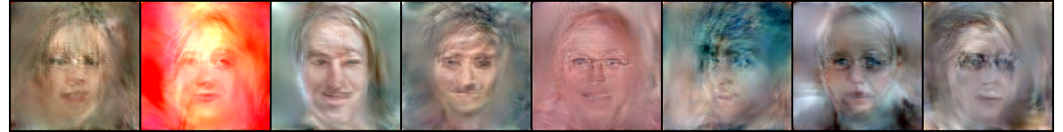
Model Evaluation — Generated Samples
Real images
FFHQ validation split
DDPM RGB
baseline, 3 channels
DDPM Frequency-domain
6 channels, spectrum
Eight samples per condition, generated with deterministic DDIM (50 steps, η = 0) from the epoch-100 checkpoints.
11 / 15
Notes:
Eight DDIM samples per condition, same seed protocol. Real on top. The RGB row is distorted but still reads as faces. The frequency row keeps a global face layout, but colours and shapes drift.

Slide 12
Model Evaluation — Visual Fidelity
RGB BASELINE
FREQUENCY MODEL
Fréchet Inception Distance (FID) and Kernel Inception Distance (KID) both measure how far the set of generated images is from the set of real ones, comparing features extracted by a pretrained Inception network. Lower is better, zero means indistinguishable. KID is the unbiased variant, reported with its standard deviation, so it stays reliable on small sample sizes.
84.41
FID ↓
174.02
FID ↓
0.0543 ± 0.0020
KID ↓
0.1590 ± 0.0024
KID ↓
Computed with torchmetrics on 5000 generated images against the 7000-image validation split.
WHY THE GAP IS THIS LARGE
Both models share the same limited budget: 100 epochs, 11.4 M parameters and 50 DDIM steps, so neither output is accurate.
In RGB the residual error stays local — faces come out distorted, but they still read as faces.
In the spectrum every coefficient contributes to every pixel, so a small error spreads over the whole image: wrong colours, unrecognisable shapes.
12 / 15
Notes:
On perceptual metrics the baseline wins clearly: FID 88 against 181. But read the gap carefully: with 100 epochs and 50 DDIM steps neither model is accurate. In RGB an error stays local, so we still get recognisable faces. In the frequency domain every coefficient touches every pixel, so a tiny error in the spectrum becomes a global one. FID here is on two thousand images, so treat it as relative.

Slide 13
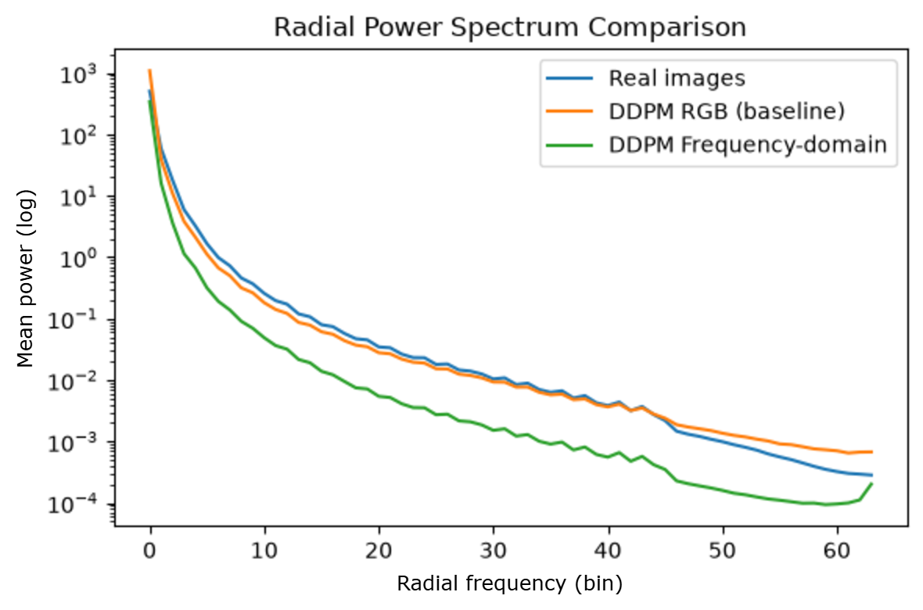
Model Evaluation — Radial Power Spectrum
Power spectra azimuthally averaged into 64 radial bins, 256 images per condition, log scale.
The RGB baseline follows the real curve closely over the informative range and shows no regular grid peaks.
The frequency model sits roughly an order of magnitude below the real curve at every radius and falls further in the high-frequency tail: it under-generates spectral energy rather than matching it.
Diffusing on the spectrum did not improve spectral realism under an identical training budget.
13 / 15
Notes:
This is the forensic core. The RGB curve tracks the real one almost exactly; the frequency curve sits about an order of magnitude below across the whole range and drops further in the tail. So the hypothesis is not confirmed: training in the spectrum did not improve spectral realism.

Slide 14
Conclusions
FINDINGS
FUTURE WORK
A DDPM can be trained end-to-end on the Fourier spectrum once the 1/f dynamic range is compressed and standardized, at ≈3% extra cost per step.
Remove the redundancy with a half-spectrum (rfft2) or magnitude/phase parameterization.
Add EMA weights, which diffusion models normally benefit from and which was omitted to keep the two pipelines identical.
Under an identical budget it is worse than the spatial baseline on both perceptual quality and spectral fidelity.
Train a fuller DDPM before judging the domain: many more epochs and a wider network, since error in the spectrum is global and needs a more accurate generator.
The likely cause is Hermitian redundancy: the real/imaginary parameterization carries ≈2× redundant information and the inverse transform discards the residual imaginary component, so part of the capacity is spent on an output that is thrown away.
14 / 15
Notes:
Negative result, but a clean one, and we can name two causes: Hermitian redundancy, and the fact that the frequency model is far less tolerant of an inaccurate generator, because every spectral error is global. A fuller DDPM — more epochs, a wider network — is the first thing to try before drawing a conclusion about the domain.

Slide 15
References
Ho, J., Jain, A., Abbeel, P. — Denoising Diffusion Probabilistic Models. NeurIPS 2020.
Song, J., Meng, C., Ermon, S. — Denoising Diffusion Implicit Models. ICLR 2021.
Frank, J., et al. — Leveraging Frequency Analysis for Deep Fake Image Recognition. ICML 2020.
Implementation: PyTorch 2.14, torchmetrics for FID and KID. Dataset via the Kaggle FFHQ mirror.
15 / 15
Notes:
References and the dataset source. Thank you — happy to take questions.

