Slide 1

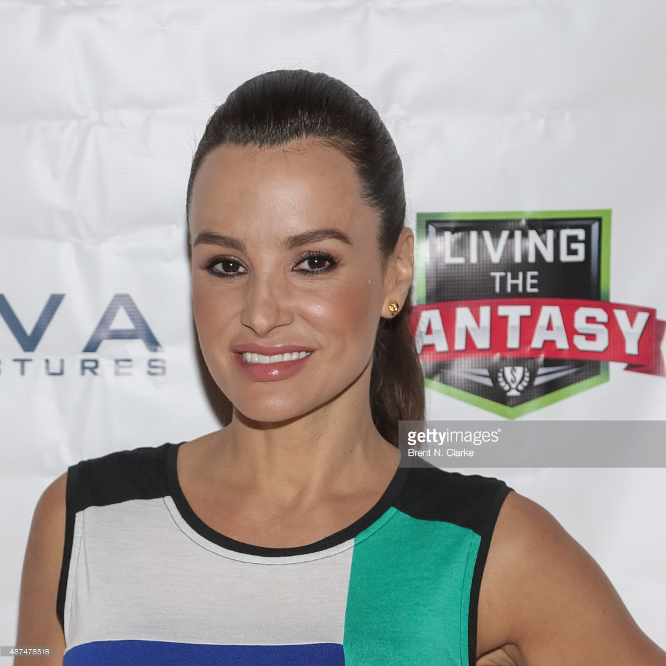
BritishFanta🇬🇧
a management for the fantapremier
Coordinatori:
Prof.ssa G. Tortora;
Prof. M. Risi
Candidati:
Francesco Vicidomini,
Antonio Pizza
Notes:
Salve siamo il team di sviluppo del progetto BritishFanta che è un sys per ….

Slide 2


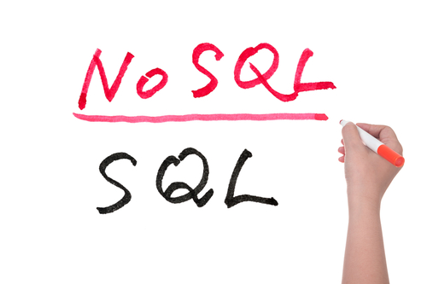
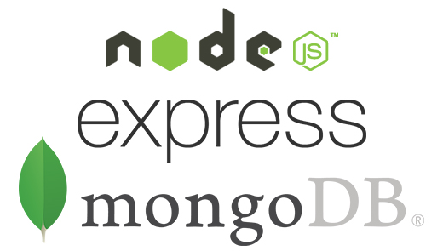
Introduction
Used technologies
Our Data
Our Services

Slide 3
Introduction

Slide 4

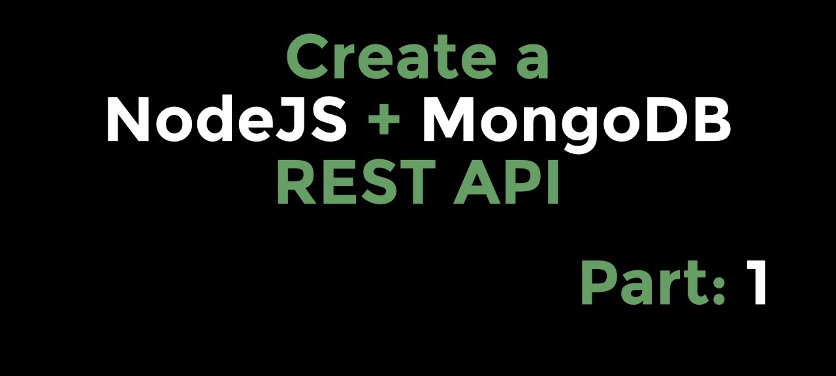
Our Vision & Mission
Our Vision
Our Mission
Build a manager for Fantapremier.
Build a system with NOSQL & REST WebServices
Notes:
Our Misson: il nostro obiettivo è stato quello di costruire una piattaforma web utilizzando una architettura REST che usa un dbms NOSQL (MongoDB)

Slide 5
Used technologies
Notes:
ciccio

Slide 6



Used technologies
Database
Server
Client
MongoDB
NodeJs
Bootstrap

Slide 7




Client
Application
Server
Business
Storage Tier
Storage

Slide 8


Why those technologies?
Advantage
Disadvantage
Advantage
Disadvantage
Easy to replicate
Scalable
Easy to import data in CSV or JSON
Does not guarantee the ACID property
Not very verbose
It is easy to create a REST architecture
Is mono thread and asynchronous
The callback hell problem
😈

Slide 9
Our Data

Slide 10

Our Data
Collections
DBPL
Players
Giornatas
Rosas
Users

Slide 11
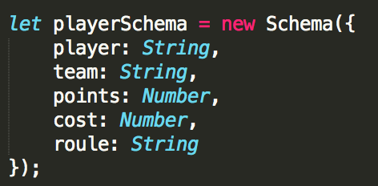
Our Data
Players

Slide 12
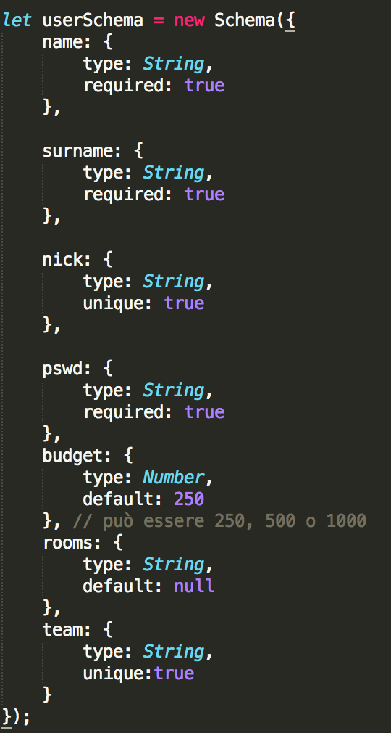
Our Data
Users

Slide 13
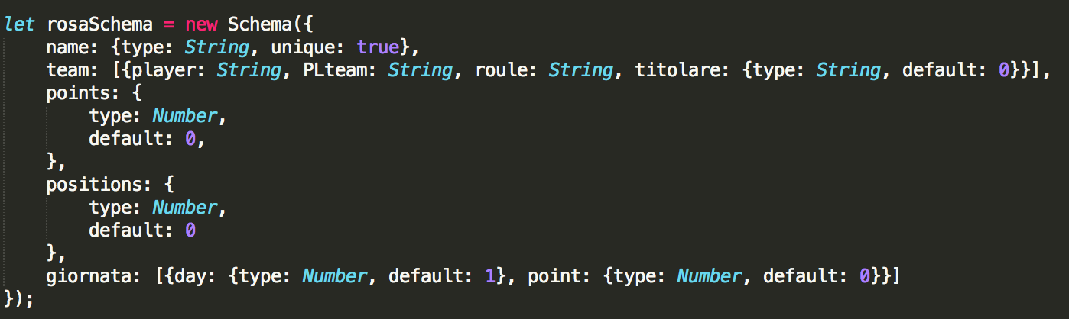
Our Data
Collections
Rosas

Slide 14
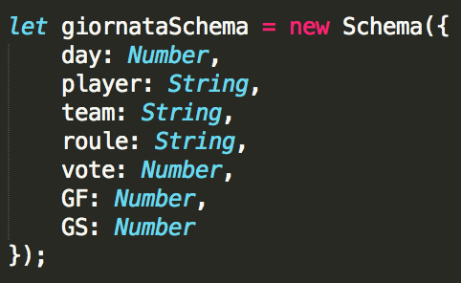
Our Data
Collections
Giornatas

Slide 15
Let’s see the system

