Slide 1
PROJECT TEAM
SimCLR Ablation Study
SHARED SETUP
CIFAR-10
ResNet-18 encoder
Frozen linear evaluation
Understanding which contrastive-learning components improve representations.
Weiyi Jiang
Runs a controlled ablation across baseline, no_blur, no_color_jitter, and no_grayscale.Shows that removing grayscale or blur helps transfer, while removing color jitter hurts it.
Data augmentation ablation
uxxxxxx
Chengbo Yan
Tests whether SimCLR pretraining is useful when only 1%, 10%, or 100% of labels are available. TODO: Add more here.
Low-label evaluation
uxxxxxx
Guochen Wang
Analyzes whether a nonlinear projection head improves transfer, and how batch size changes negative samples and optimization.
Projection head + batch size u7663394
COMP3242 Group Project - SimCLR Ablation Study
01
Notes:
Opening cue: Introduce the project title, then introduce each member and their contribution. Keep the focus on the team structure and the shared experimental setup: CIFAR-10, ResNet-18, and frozen linear evaluation.

Slide 2
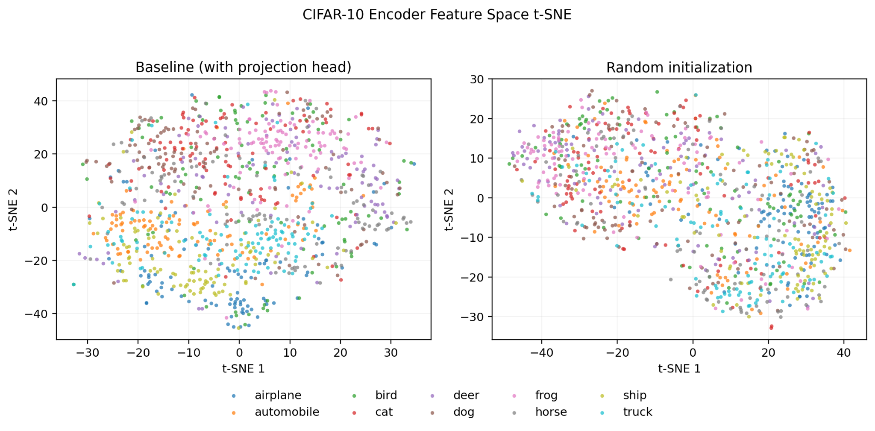
METHOD / EVALUATION CONTRACT
We judge representation quality after freezing the encoder.
This keeps the downstream classifier simple, so accuracy mainly reflects the pretrained feature space.
CONTRASTIVE PRETRAINING
two views
NT-Xent
CIFAR-10
encoder f
projection g
crop, jitter, blur
positive/negative pairs
unlabeled images
ResNet-18 feature h
MLP maps h to z
LINEAR EVALUATION
CONTROLLED
test accuracy
linear classifier
frozen encoder h
same dataset, backbone, checkpoint protocol, and frozen evaluation
representation metric
train only this layer
512-dimensional features
COMP3242 Group Project - SimCLR Ablation Study
02
Notes:
Method cue: Explain the two phases. The top row is contrastive pretraining. The second row is evaluation and intentionally reads from right to left: frozen encoder features, linear classifier, then test accuracy. This makes clear that the projection head is not used for the final linear evaluation.

Slide 3
WEIYI / DATA AUGMENTATION
Removing grayscale or blur helped transfer; removing color jitter hurt it.
Test accuracy ranking: no_grayscale 44.92 > no_blur 44.56 > baseline 43.57 > no_color_jitter 42.07.
No ColorJitter
No Blur
No Grayscale
63.23 contrastive top-1
44.56% test acc (+0.99)
44.92% test acc (+1.35)
42.07% test acc (-1.50)
Blur was not necessary here
Best downstream result
KEY TAKEAWAY
Best pretraining metrics did not produce the best downstream representation.
COMP3242 Group Project - SimCLR Ablation Study
03
Notes:
Weiyi cue: State the ranking first: no_grayscale is best at 44.92%, no_blur is second at 44.56%, baseline is 43.57%, and no_color_jitter drops to 42.07%. Emphasize the counterexample: removing ColorJitter makes SimCLR training metrics look much better, but it hurts downstream transfer.

Slide 4
PLACEHOLDER / CHENGBO
Low-label section: add slides from here.
Add Subtitle Here.
Method
1% labels
10% labels
100% labels
SimCLR + linear
TBD
TBD
TBD
Supervised baseline
TBD
TBD
TBD
TO FILL
Use one conclusion: where does SimCLR beat direct supervised learning most clearly?
COMP3242 Group Project - SimCLR Ablation Study
04
Notes:
Placeholder cue for Chengbo: Replace this slide with the final low-label comparison. The strongest story would show whether SimCLR gives the biggest advantage at 1% or 10% labels, then compare against the full-label setting.

Slide 5
GUOCHEN / PROJECTION HEAD
The projection head gives SimCLR two spaces with different jobs.
NT-Xent shapes the projected vector z, while linear evaluation reads the encoder feature h.
WITH PROJECTION HEAD
Two spaces, two objectives
encoder h
MLP head g
NT-Xent
h-space
512-dimensional feature
512 -> 512 -> 128
on z: contrastive space
kept for downstream semantics
linear eval
z-space
optimized for contrastive separation
downstream reads h
WITHOUT PROJECTION HEAD
encoder h
NT-Xent directly on h
+1.43 %
Result preview
same feature
one space carries both jobs
best-accuracy gain
63.59% with head vs. 62.16% without
COMP3242 Group Project - SimCLR Ablation Study
05
Notes:
Guochen cue: Explain that the projection head creates a separate z-space for the contrastive objective. The encoder feature h is still the feature used by the downstream linear classifier. Without the projection head, h has to satisfy both the pretext objective and downstream representation needs.

Slide 6
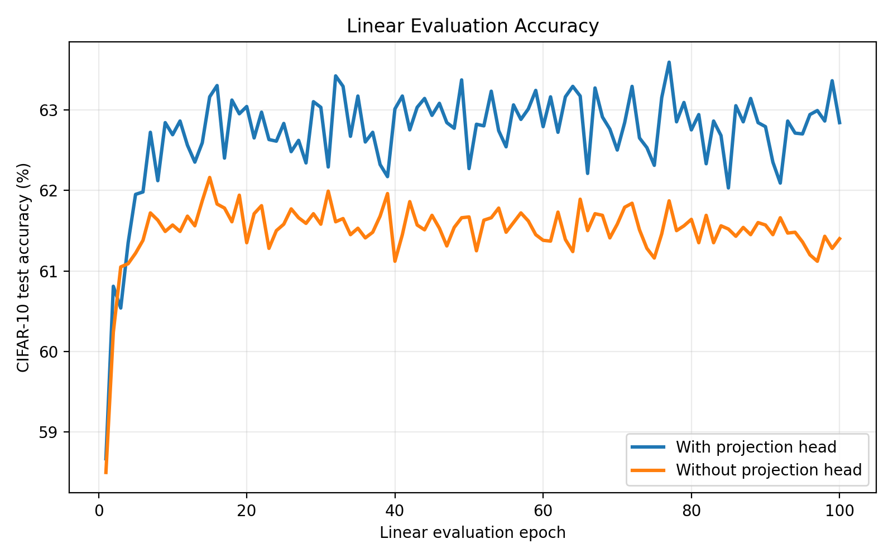
GUOCHEN / PROJECTION HEAD RESULT
Using the projection head improves best linear accuracy by 1.43%.
The gain is small but consistent across best and final accuracy, which supports the separate-space interpretation.
Linear-evaluation accuracy on frozen CIFAR-10 features
64
63.59%
62.84%
62.16%
61.40%
60
with head
without
with head
without
best epoch 77
best epoch 15
final
final
63.59%
62.16%
best accuracy with head
best accuracy without
Source: feature_eval/projection_head_ablation/summary.csv
COMP3242 Group Project - SimCLR Ablation Study
06
Notes:
Guochen cue: State the result first. With the projection head, best accuracy is 63.59%; without it, best accuracy is 62.16%, so the improvement is 1.43 percentage points. The final accuracy also improves from 61.40% to 62.84%.

Slide 7
GUOCHEN / BATCH SIZE RESULT
More negatives did not monotonically improve in our setting.
Batch size changes the number of negatives, but it also changes optimization behavior under a fixed training schedule.
Best linear-evaluation accuracy by pretraining batch size (axis: 56-64%)
INTERPRETATION
256 gives the best balance in this lightweight setup.
64
62.54%
63.47%
60.89%
The largest batch has more negatives, but not necessarily better representation quality.
57.56%
56
510
2046
128
256
512
1024
254 negatives
510 negatives
1022 negatives
2046 negatives
negatives per anchor at B=256
negatives per anchor at B=1024
Likely factors: fewer updates per epoch, unchanged learning-rate schedule, and more false negatives in a 10-class dataset.
Source: feature_eval/batch_size_ablation/summary.csv
COMP3242 Group Project - SimCLR Ablation Study
07
Notes:
Guochen cue: Link batch size to negatives: each anchor has 2B minus 2 negatives. Then state the result: B=256 performs best, while 512 and 1024 drop. This does not mean negatives are useless; it means batch size is tied to optimization.

Slide 8
CLOSING / TAKEAWAYS
SimCLR performance depends on both representation design and training details.
The final report carries the details.
Component
Finding
Interpretation
Projection head
+1.43% best accuracy
Separating contrastive space from encoder space helps transfer.
Batch size
B=256 best in our runs
More negatives help only when optimization remains matched.
Data augmentation
no_grayscale +1.35; no_color_jitter -1.50
Contrastive metrics alone were misleading; ColorJitter mattered most for transfer.
Low-label eval
Chengbo to fill
TODO.
LIMITATIONS
single seed, CIFAR-10/ResNet-18 only, epoch-fixed runs, no batch-size-specific retuning
COMP3242 Group Project - SimCLR Ablation Study
08
Notes:
Closing cue: Summarize the full group story. For augmentation, highlight that no_grayscale and no_blur outperform baseline, while no_color_jitter is the key counterexample: best pretraining metrics but worst downstream accuracy. Then connect to projection head, batch size, and the limitations.

