Slide 1
Intermediate Assignment

Slide 2
Import File
(There are two files that needed to be uploaded in google collab, “user” and “daily user”)
sheet_user = 'https://docs.google.com/spreadsheets/d/1VteJSz1c1SgrXshJ_Q9d3t4KKvQSTU68ba_6zh-cd0M/edit#gid=269959454'
sheet_daily_user = 'https://docs.google.com/spreadsheets/d/1CkErQmS0Pk8ZG9i-sTu5ucSr8U7SKDpFFjKGE5lbPrE/edit#gid=1016084643'
Link: https://colab.research.google.com/drive/1WLg4l5vmdxKjl1iQMenZfrpsAys-2nh3?usp=sharing

Slide 3
Milestone 1

Slide 4
Data Cleaning

Slide 5
Check null values
→ only referral_code_used who has null values.We fill the null values instead of remove it
Fill the blank or null row in referral_code_used with ‘not used referral’ value
Checking if there is a typo
→ there are no typos
Finding data duplicate
→ there are no data duplicate
Convert data type
Remove outlier
→ using boxplot, Q1, and Q3
Sheet_user

Slide 6
Check null values
→ there are so many columns who has null values. But Campuran_AUM, Campuran_invested_amount, Campuran_transaction_amount have too much null values (96,6%), so we decided to drop these columns
For other columns who have null values, we choose to fill it with 0 value instead of remove it
Checking if there is a typo
→ there are no typos
Finding data duplicate
→ there are some data duplicate and we choose to remove it
Convert data type
Remove outlier
→ using boxplot, Q1, and Q3
Sheet_daily_ user

Slide 7
EDA

Slide 8
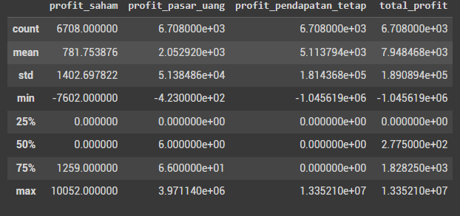
Describe
From the table above we can know that mean>median = data skew to the right, so it means the data set has lower boundary

Slide 9
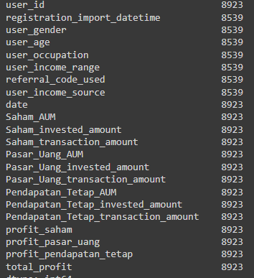
Total user
There are total 8923 users using this application from 29 August 2021 until 26 September 2021

Slide 10
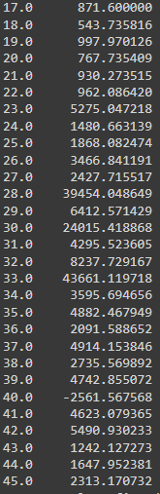
Age
Users who are 33 years old tend to invest more than other ages. Likewise, with other users in the adult age group (26-35 years). Although the users of this application are not dominated by users of adult age but are dominated by the adolescent age group. This can be influenced by incomes that increase with age
Suggestion: It is necessary to carry out a campaign focused on adult age-group users to invest. The campaign can be in the form of sending a newsletter about the importance of investing and advice related to investment. Ideally, people should invest 20% of their income

Slide 11
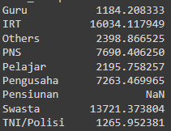
Occupation
People who worked as IRT invested more than any other job. Although the users of this application are dominated by students and private workers. This can be influenced by incomes.
Although housewives do not work, the income used for investment is estimated to be from their husband or family

Slide 12

Gender
The table shows that female invest more than men. Even though male dominate the users of this application
Suggestion: According to research, it is stated that males than females make more investments. This condition is different from the users of this application. Therefore, it can be assumed that we can still attract more male users, so it is necessary to carry out a campaign focused on attracting male users to invest

Slide 13
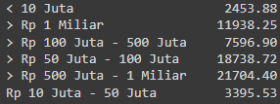
Income
Users with earnings Rp 500 million - 1 billion invest more than users with other incomes. This condition tends to be theoretically appropriate. Where the higher the income, the higher the investment will also be

Slide 14

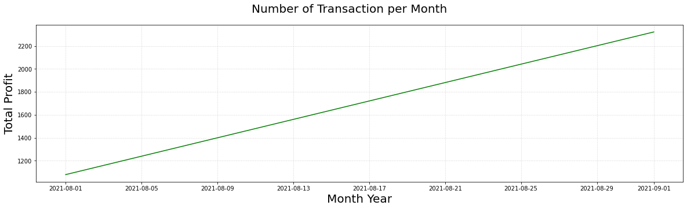
Profit per month
There is increasing profit by month. It shows good results

Slide 15
One of the problems with the condition is the lack of users in the adult age group. In contrast, it can be assumed that users of the adult age group will invest more than other age groups, so we need to carry out a campaign focused on the adult age group. The high number of adolescent users is estimated to be due to the robo-investing feature so that adolescent users feel more courageous and safe to invest. And adult age group prefers using other applications. From this, we need to check the application, what causes the user to choose other competitor applications to invest in than our application.
Therefore while conducting a campaign that focuses on attracting adult age group users, we need to maintain highlighting the robo-investing feature

Slide 16
Milestone 2

Slide 17
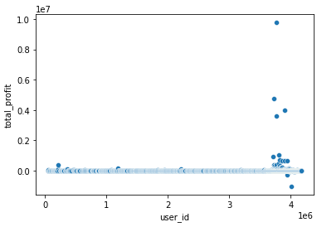
Income and total profit
This is raw data before clustering. We can tell that there are some outliers, and users tend to stack on 1 cluster

Slide 18
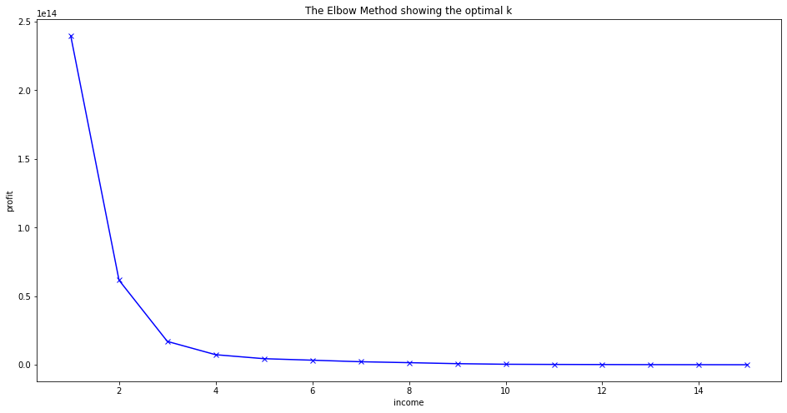
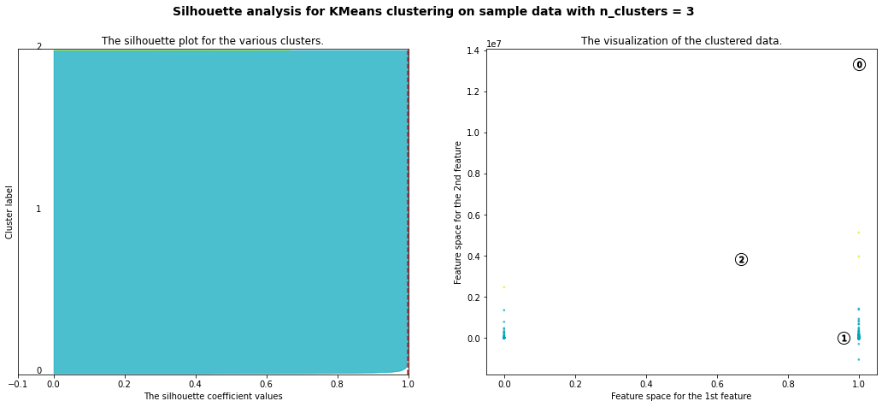
We use both elbow method and silhouette analysis. From the two methods above, we know there is only 1 cluster. People with high incomes also have big profits in investing and vice versa. From EDA, it can be known that most users of this application have low incomes. We recommend campaign to focus on people who got low profits, although they might lack income. We should highlight the robo-investing feature so that people can profit significantly with minimum effort. We also need to maintain the app so that people who make big profits can feel comfortable using our app

Slide 19
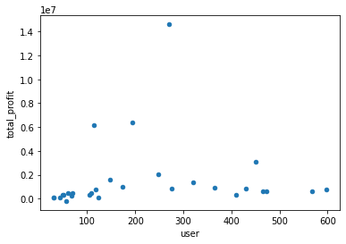
User and total profit
This is raw data before clustering. We can tell that there are some outliers

Slide 20
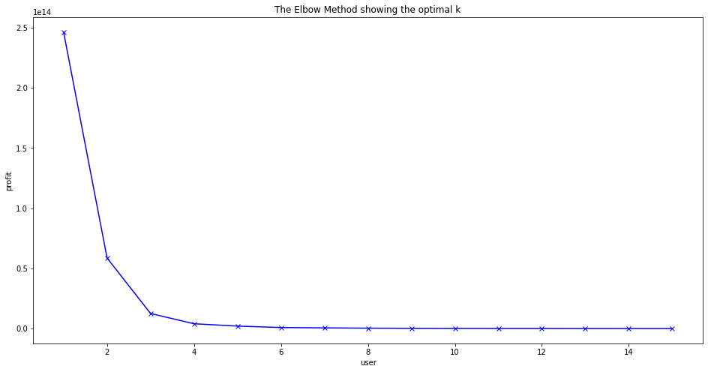
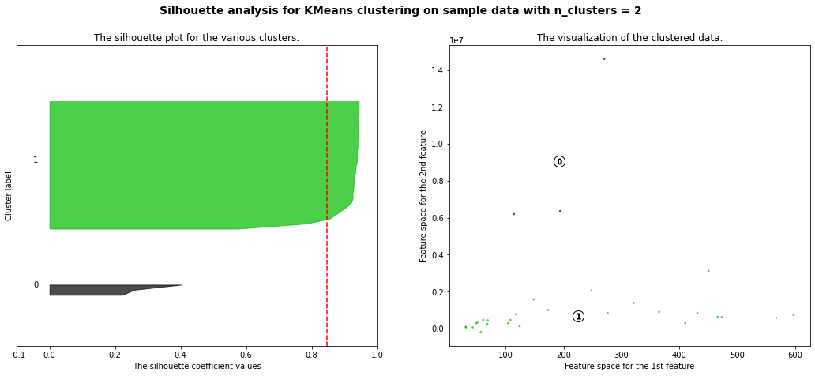
We use both elbow method and silhouette analysis. From the two methods above, we know that there are 2 clusters. Users who have big profits in investing and those who have low profits in investing. Users who get low profits are more than those who have big profits. We recommend campaign to use and how to use the robo-investing feature so that people can profit significantly with minimum effort and their investing will be more secure

