Slide 1
Intermediate Assignment
By: Cicilia Parastita Ningrum

Slide 2
Content
Table scheme
Q1: create a query to get the number of unique users, number of orders, and total sale price per status and month
Q2: create a query to get frequencies, average order value and total number of unique users where status is complete grouped by month
Q3: find the user id, email, first and last name of users whose status is refunded on Aug 22
Q4: get the top 5 least and most profitable product over all time
Q5: create a query to get month to date of total profit in each product categories of past 3 months (current date 15 august 2022), breakdown by month and categories

Slide 3
Overview
This query using dataset ‘thelook_ecommerce’ who contains about customers, products, orders, logistics, web events, and digital marketing campaign. This dataset contains 7 table, there are distribution_centers, events, inventory_items, order_items, orders, products, and users

Slide 4
Table used
There are 4 tables used in this assignment, they are:
products table
orders table
order_items table
users table

Slide 5
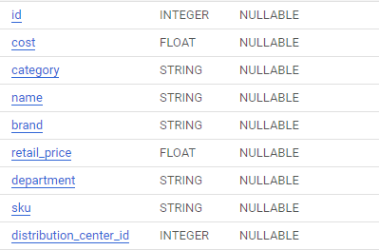
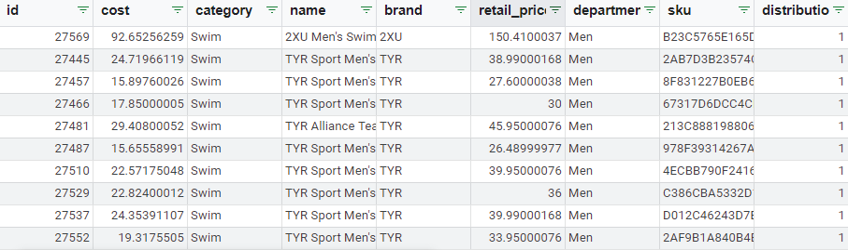
Products

Slide 6
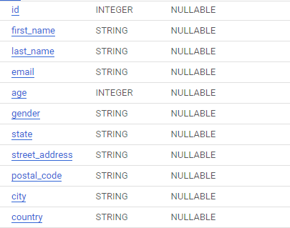
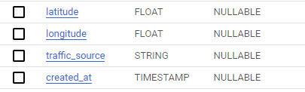
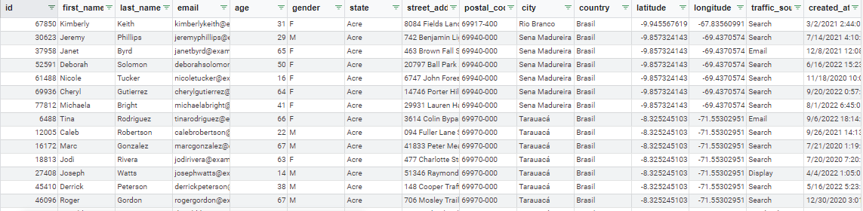
Users

Slide 7
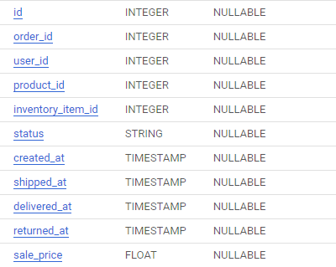
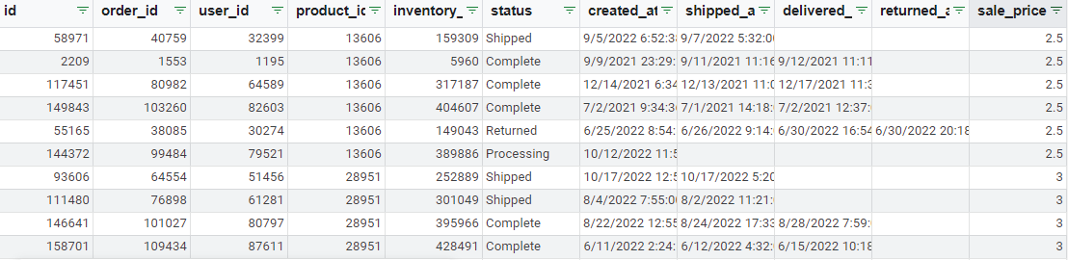
Order_items

Slide 8
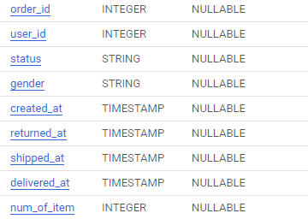
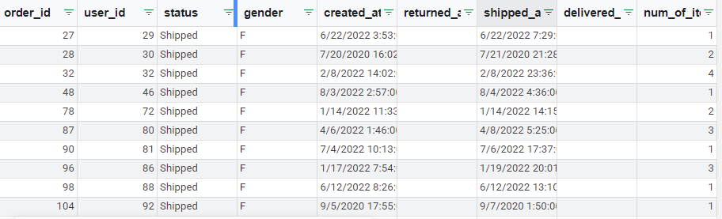
Orders

Slide 9
Answer
Link: https://bit.ly/3CV18yy

Slide 10

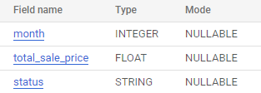
Q1
Create a query to get the number of unique users, number of orders, and total sale price per status and month
Scheme (number of unique users and number of orders)
Scheme (total sale price per status and month)

Slide 11
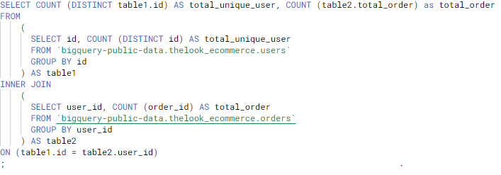

Number of unique users and number of orders
Query
Result

Slide 12
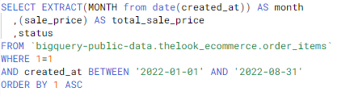
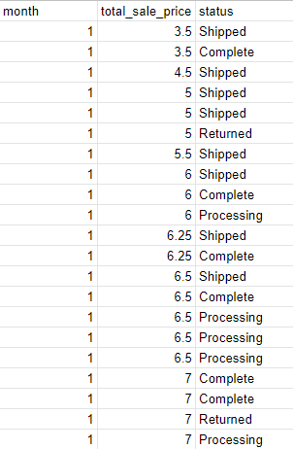
Total sale price per status and month
Query
Result

Slide 13
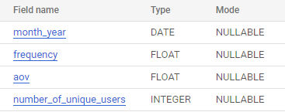
Q2
Create a query to get frequencies, average order value and total number of unique users where status is complete grouped by month
Scheme

Slide 14
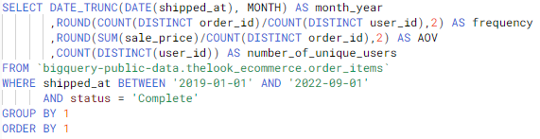
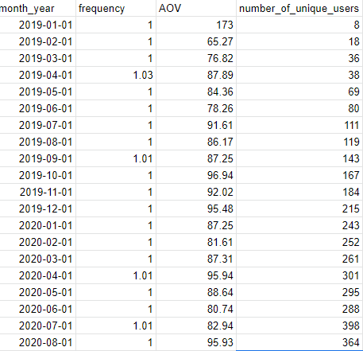
Query
Result

Slide 15
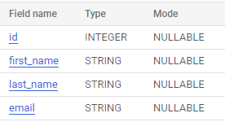
Q3
Find the user id, email, first and last name of users whose status is refunded on Aug 22
Scheme

Slide 16
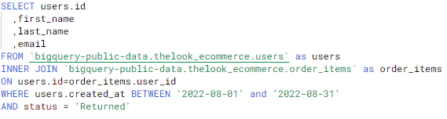
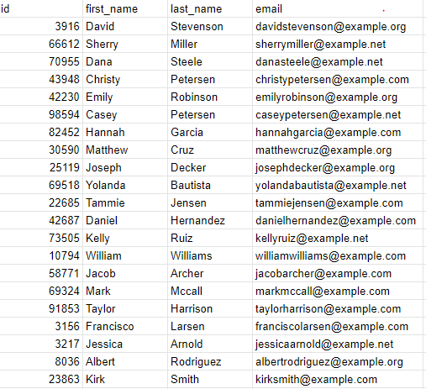
Query
Result

Slide 17
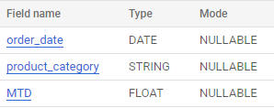
Q4
Get the top 5 least and most profitable product over all time
Scheme

Slide 18
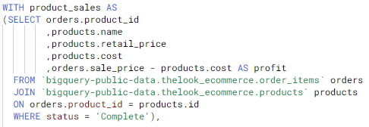
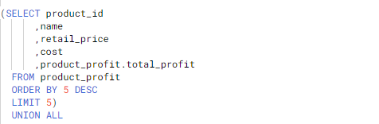
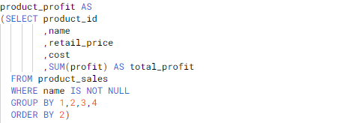
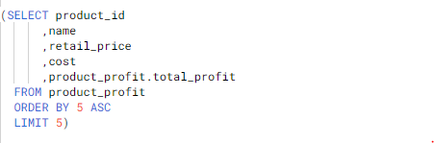
Query
1.
2.

Slide 19
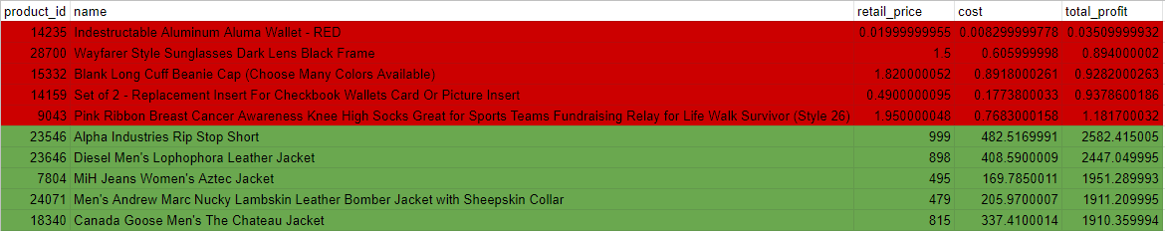
Result

Slide 20
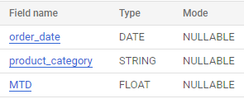
Q5
Create a query to get month to date of total profit in each product categories of past 3 months (current date 15 august 2022), breakdown by month and categories
Scheme

Slide 21
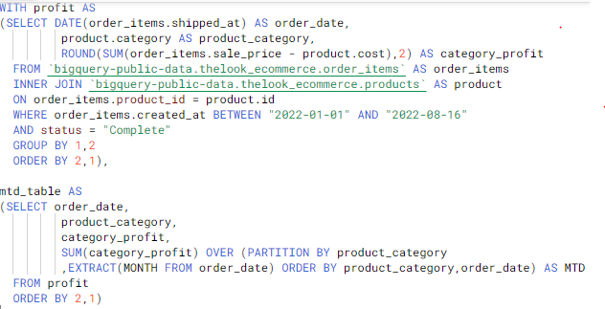
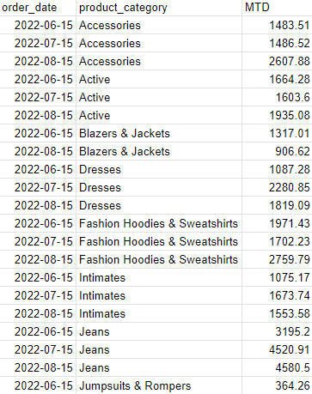
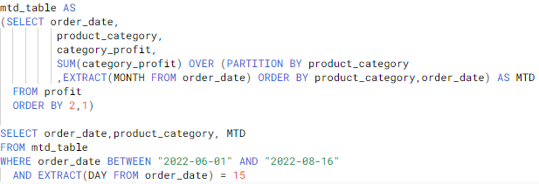
Query
Result

