Slide 1
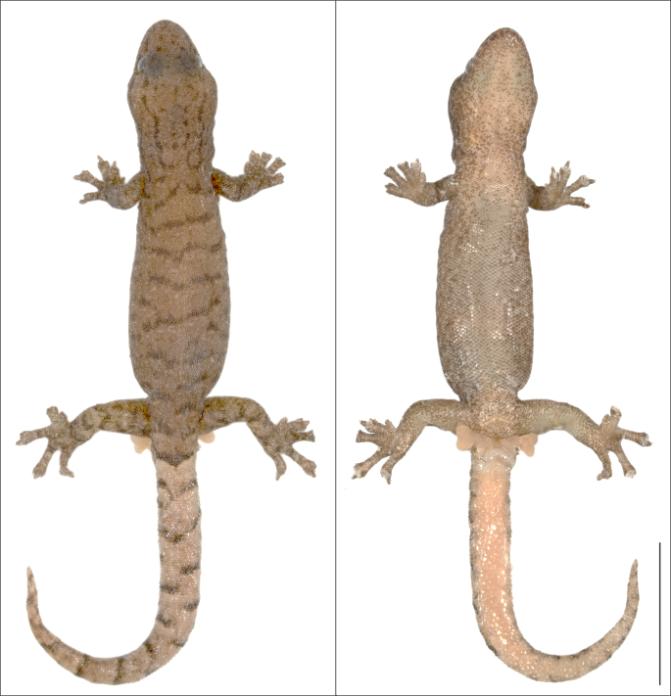
SVL
HH
Lun
Ltb
HW
Lhu
Lfe
TL
HL

