Slide 1
PGAS for High-Level Languages
Michael Driscoll, Yili Zheng, Amir Kamil,
Shoaib Kamil, Kathy Yelick,
and the UPC Group
https://github.com/mbdriscoll/pygas
Notes:
----- Meeting Notes (7/9/12 16:00) -----
+ UPC Group

Slide 2
Design Goals
Minimize time to solution by:
Maximizing productivity gains from
High-level languages (HLLs)
SPMD execution model
PGAS memory model
Maintaining reasonable performance relative to efficiency-oriented languages.
Maintain interoperability with existing tools like numerical, graph, plotting, and I/O packages.
Avoiding modification of HLL interpreters for maximum portability.
Notes:
----- Meeting Notes (7/9/12 16:00) -----
- Python interp, + portable, ubiqu, interop

Slide 3
PyGAS -- Why Python?
Popular in scientific community.
Powerful scientific libraries: SciPy, NumPy, NetworkX, Orange, Matplotlib.
Interactive (if desired).
Expressive syntax (esp. slicing n-dim arrays).
High-level data structures (sets, associative arrays, etc.)
10x-1000x slower than C.
Unless you’re using optimized libraries.
Difficult to write shared memory programs.
Global Interpreter Lock hinders multithreading.
Libraries can be multithreaded internally.
Notes:
----- Meeting Notes (7/9/12 16:00) -----
hard to write shared mem programs.
propose how to address problems.
mention explicit locatily
build objects that manage locality

Slide 4
PyGAS – PGAS for Python
What does PGAS mean in a Python context?
Unlike previous PGAS languages, Python has
no language-level notion of addresses.
no type qualifiers (like “shared”).
dynamic typing, specifically duck typing.
Example. In the assignment:
name = value
name is just an entry in an interpreter namespace.
value is a Python object (which defines its own type).
It’s not always possible to intercept assignments to namespaces.
We need a way to express shared types in Python.

Slide 5
Shared Python Objects
Idea: distribute “proxy” objects that act on original:
Inspired by PyRO (Python Remote Objects).
Intercept reads/writes and execute them on the original object.
Like a shared pointer:
(owner_tid, address, <intercept_logic>)
# PyGAS Proxy Example
c = share(1+2j, from_thread=0) # 1. broadcast a proxy
c.real = 3 # 2. remote write: c.setattr(“real”, 3)
print c.imag # 3. remote read: c.getattr(“imag”)
Notes:
----- Meeting Notes (7/9/12 16:00) -----
format bottom
pygas example in bottom

Slide 6
Function Call Semantics
Given a remote object ro and a call to a function f on the current thread, where does f execute?
ro.f(x,y)
Locally – “Caller-computes” | Remotely – “Remote method invocation”
+ Easier to load-balance | - More difficult to load-balance
- Less object-oriented | + More object-oriented
- Inhibits dynamic code generation | + Supports dynamic code generation
Mirrors UPC/Titanium | Mirrors parallel OO languages
Efficient if arguments are local | Efficient if arguments are on f’s thread
Notes:
----- Meeting Notes (7/9/12 16:00) -----
"Caller computes"

Slide 7
PyGAS Prototype
Built as Python module on GASNet.
Benchmarked on NERSC’s Carver machine:
(IBM iDataPlex, Infiniband, 1 2.67GHz Nehalem node, 2 GASNet threads)
O(10) microsecond latency for synchronous remote reads.
Compare to O(10) nanoseconds for equivalent UPC program.
About 1000x greater latency than UPC.
Missing optimization to avoid serialization of contiguous-in-memory Python objects (50% time).
Could tune interpreter parameters to reduce async call delay. (10% time).
Lots of room for improvement.
Bandwidth performance numbers forthcoming.

Slide 8
Common HLL-GASNet Layer
Build a common runtime layer on GASNet for PGAS implementations of HLLs. Might include:
Wire protocol for remote object interactions, including copying, attribute retrieval, remote method invocation.
Active message dispatching in HLL for rapid development of HLL runtimes. Can be “lowered” to C later for performance.
Unified task queue for ensuring progress of “big lock” interpreters when blocked in GASNet (also useful in Phalanx).
Variable-length collectives.
Support for HLL reduction and prefix operators.
Distributed garbage collection.
Notes:
----- Meeting Notes (7/9/12 16:00) -----
share progress loop with language runtime
fix semantic mismatch between python and lll
--registration system--
unified task queue (useful in phalanx)
wire protocols for dynamically typed objects
explain protocol use. copy, deep copy, rmi, etc.
----- Meeting Notes (7/10/12 11:31) -----
common with chapel too
open collab (comm) runtime

Slide 9
Backup Slides

Slide 10
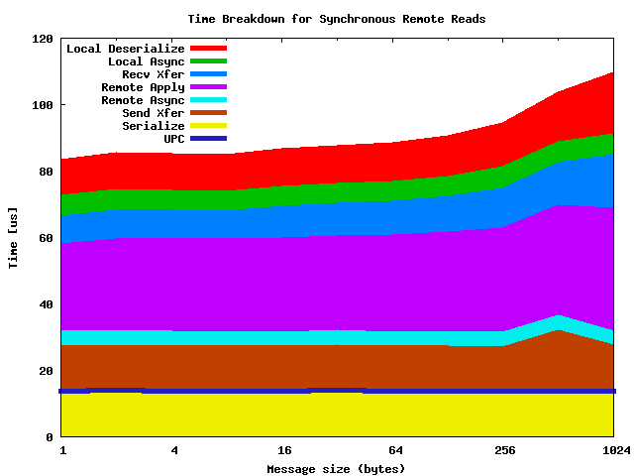
Notes:
----- Meeting Notes (7/9/12 16:00) -----
show, and say what parts of my work will reduce each
memoryview serialization optimizations

Slide 11
Numpy vs. Python FFI vs. C (sgemm, 16 GHz peak, vendor BLAS)

