Slide 1

Deep Reinforcement Learning for Competitive Multi-Agent Systems
First Year Master’s Project
Lucien.drescigh@student.umons.ac.be

Slide 2
Plan of the Presentation
Reinforcement Learning
Deep Q-learning
Agar.io game
Experimental Setup & Results
Pellet Eating
4 players
Curriculum learning
Agents vs bots

Slide 3

Reinforcement Learning
Reinforcement Learning | Deep Q-learning | Agar.io | Experimental Setup | Pellet Eating | 4 Players | Curriculum Learning | Agents vs Bots
Reinforcement Learning Illustration [1]
[1] Shanika Perera. An introduction to Reinforcement Learning.
URL: https:// towardsdatascience.com/an-introduction-to-reinforcement-learning-1e7825c60bbe

Slide 4
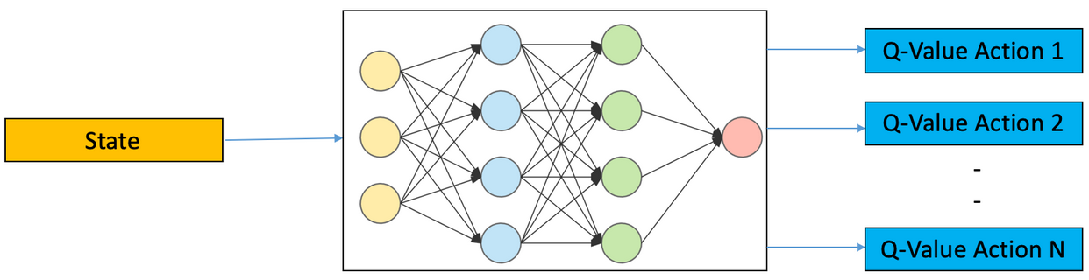
Deep Q-Learning
Reinforcement Learning | Deep Q-learning | Agar.io | Experimental Setup | Pellet Eating | 4 Players | Curriculum Learning | Agents vs Bots
Deep Q-Learning Illustration [2]
[2] Ankit Choudhary. A Hands-On Introduction to Deep Q-Learning using OpenAI Gym in Python.
URL: https://www.analyticsvidhya.com/blog/2019/04/introductiondeep-q-learning-python/.

Slide 5
Deep Q-Learning
Reinforcement Learning | Deep Q-learning | Agar.io | Experimental Setup | Pellet Eating | 4 Players | Curriculum Learning | Agents vs Bots
Exploration / Exploitation
ε-greedy algorithm
ε is set to 1 at the beginning (pure exploration) and decreases all along the training towards a value close to 0 (pure exploitation).
Experience Replay
The memory stores the state, the action, the reward and the next state.
At each training step, a batch of random experiences is sampled to train the network.

Slide 6
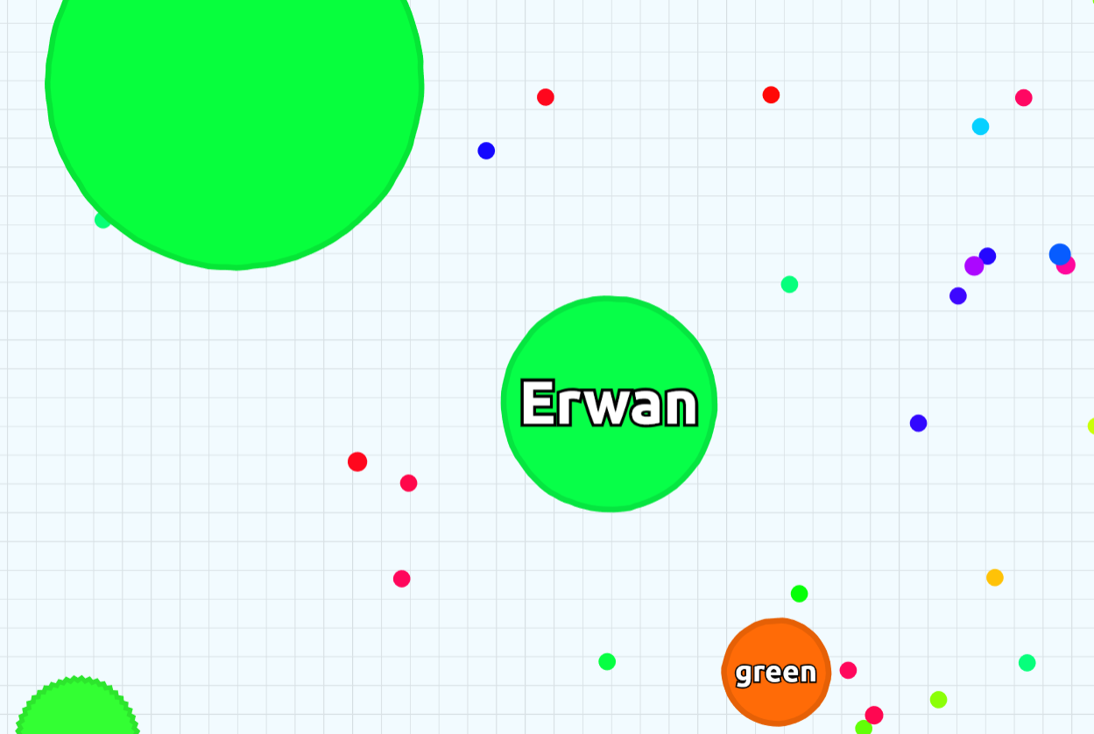
Agar.io game
Reinforcement Learning | Deep Q-learning | Agar.io | Experimental Setup | Pellet Eating | 4 Players | Curriculum Learning | Agents vs Bots
Multiplayer Online game.
The player controls a circular cell.
Goal: grow as big as possible by eating pellets or opponents.
Small loss of mass every second.

Slide 7
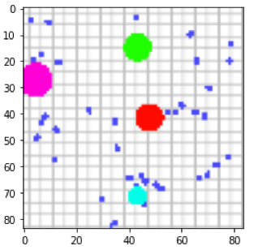
Experimental Setup
Reinforcement Learning | Deep Q-learning | Agar.io | Experimental Setup | Pellet Eating | 4 Players | Curriculum Learning | Agents vs Bots
Trainings
Pellet Eating
4 Players
Curriculum Learning
State Representations
RGB
Grayscale
Neural network input:

Slide 8
Experimental Setup
Reinforcement Learning | Deep Q-learning | Agar.io | Experimental Setup | Pellet Eating | 4 Players | Curriculum Learning | Agents vs Bots
4 actions possible: move left, right, up, down.
Replay buffer size: 30,000 (pellet eating) and 15,000 (4 players).
2500 episodes of 1000 steps each.
Environment is reset at the beginning of every episode.
ε starts at 1 and decreases by a factor of 0,999 every episode.

Slide 9
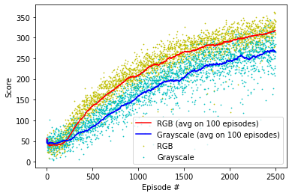
Pellet Eating
Reinforcement Learning | Deep Q-learning | Agar.io | Experimental Setup | Pellet Eating | 4 Players | Curriculum Learning | Agents vs Bots
350x350 pixels grid
150 Pellets
Reward system:
+1 if the player eats a pellet;
-0,01 else.

Slide 10
Pellet Eating
Reinforcement Learning | Deep Q-learning | Agar.io | Experimental Setup | Pellet Eating | 4 Players | Curriculum Learning | Agents vs Bots
See video « solo V2 »

Slide 11
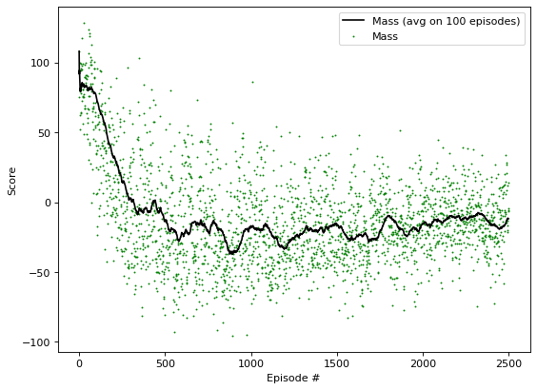
Multi-Agent
Reinforcement Learning | Deep Q-learning | Agar.io | Experimental Setup | Pellet Eating | 4 Players | Curriculum Learning | Agents vs Bots
Mass Related Reward System:
Reward = new mass – previous mass

Slide 12
Mass Related Reward
Reinforcement Learning | Deep Q-learning | Agar.io | Experimental Setup | Pellet Eating | 4 Players | Curriculum Learning | Agents vs Bots
See video « 4 palyers mass reward»

Slide 13
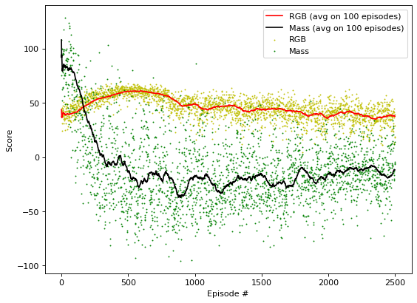
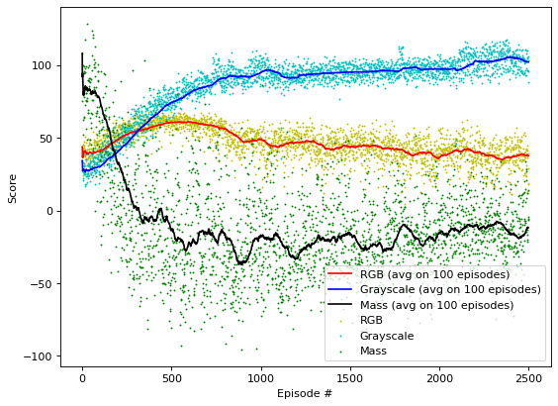
Multi-Agent
Reinforcement Learning | Deep Q-learning | Agar.io | Experimental Setup | Pellet Eating | 4 Players | Curriculum Learning | Agents vs Bots
Custom Reward System:
+1 if the agent eats an opponent;
+0,4 if the agent eats a pellet;
-0,5 if the agent gets eaten;
-0,01 else.

Slide 14
Custom Reward
Reinforcement Learning | Deep Q-learning | Agar.io | Experimental Setup | Pellet Eating | 4 Players | Curriculum Learning | Agents vs Bots
See video « 4 players grayscale »

Slide 15
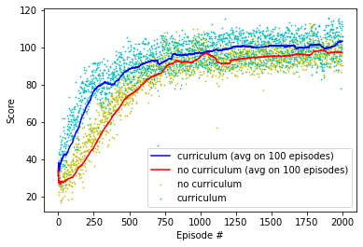
Curriculum Learning
Reinforcement Learning | Deep Q-learning | Agar.io | Experimental Setup | Pellet Eating | 4 Players | Curriculum Learning | Agents vs Bots
Use of the pellet-eating model as a training base
Starting value of ε set to 0,5 to allow more exploitation

Slide 16
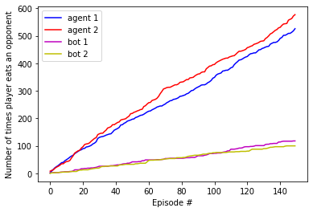
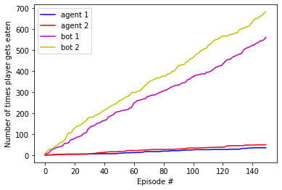
Agents vs Bots
Reinforcement Learning | Deep Q-learning | Agar.io | Experimental Setup | Pellet Eating | 4 Players | Curriculum Learning | Agents vs Bots
2 agents vs 2 bots, over 150 episodes of 1000 steps each

Slide 17
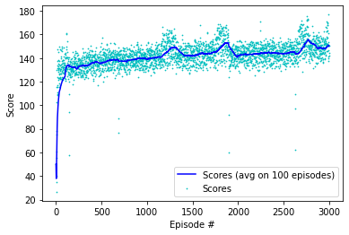
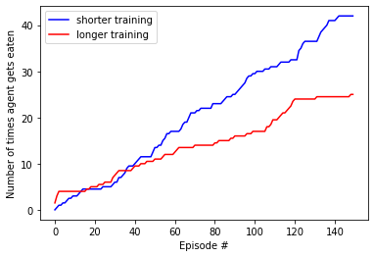
Long Training
Reinforcement Learning | Deep Q-learning | Agar.io | Experimental Setup | Pellet Eating | 4 Players | Curriculum Learning | Agents vs Bots
The model trained with curriculum learning was re-used as a basis for a training of 3000 episodes, of 1500 steps each.

Slide 18
Conclusion
Deep Q-learning algorithm implemented in a discretised Agar.io environment.
The reward system linked to the mass appears ineffective. The RGB custom reward system takes useless parameters into account. The Grayscale custom reward system is successful.
As expected, curriculum learning provides better results faster.

Slide 19
Bibliography
Mnih V. et al. “Playing Atari with Deep Reinforcement Learning”. In: arXiv preprint arXiv:1312.5602 (2013). URL: https://www.cs.toronto.edu/vmnih/docs/dqn.pdf.
Guillaume Lample and Devendra Singh Chaplot. Playing FPS Games with Deep Reinforcement Learning. School of Computer Science, Carnegie Mellon University. URL: https://arxiv.org/abs/1609.05521.
V. Mnih et al. “Human-level control through deep reinforcement learning”. In: Nature (518 2015), pp. 529–533. URL: https : / /web. stanford . edu / class / psych209 /Readings / MnihEtAlHassibis15NatureControlDeepRL.pdf.
Stolt Anso Nil et al. Deep Reinforcement Learning for Pellet Eating in Agar.io. Bernoulli Institute, Department of Artificial Intelligence, University of Groningen and ITLearns.Online, Utrecht, Netherlands, 2019. URL: https://www.ai.rug.nl/mwiering/GROUP/ARTICLES/RL AGARIO.pdf.
Shanika Perera. An introduction to Reinforcement Learning. URL: https : / / towardsdatascience . com / an introduction-to-reinforcement-learning-1e7825c60bbe.

Slide 20

Questions ?

