Slide 1






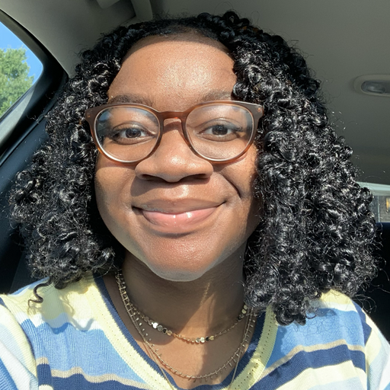
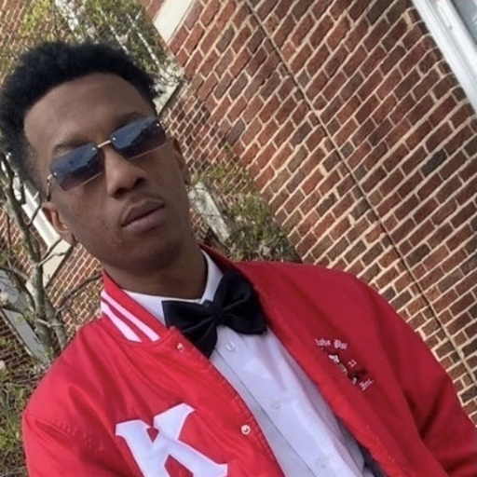

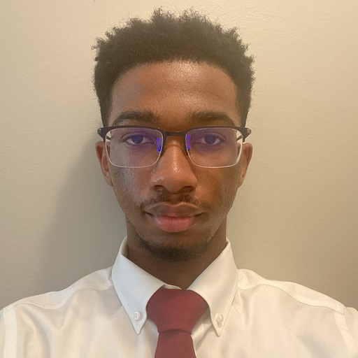

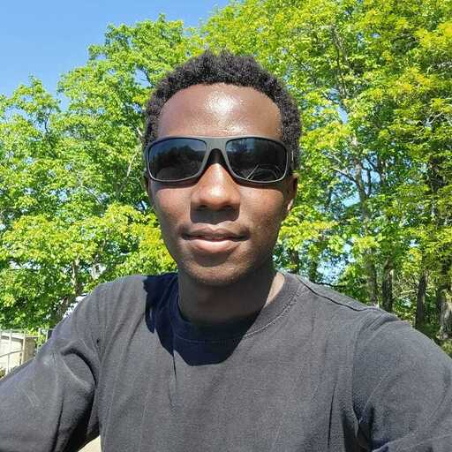
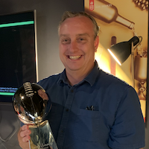
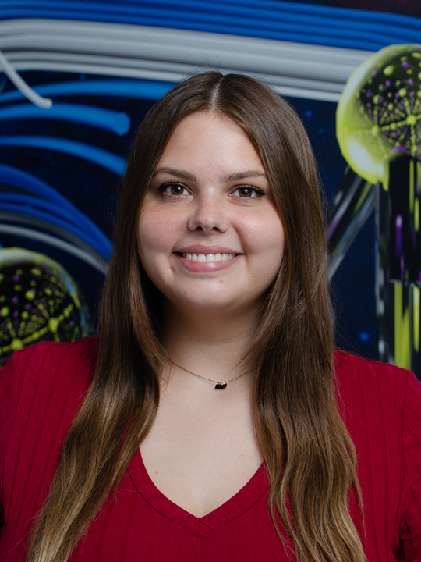
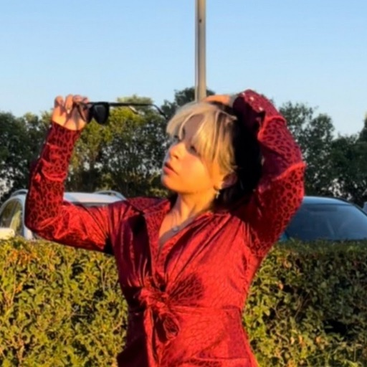
BUG BUSTERS
Technologies Used
Resources
Supporters
Identified Issues
GitHub
Visual studio
Navigating the pre-organized template
Github deployment issues
Reverting changes in github to restore our project
HackHPC Events | Provided Ideas and Guides
HackHPC Website | Existing code for new website
HTML CheatSheet | Used to implement specific colors
Hugo | Fast Website Building
Visual Studio Code | Auto-fill & cross-platform support
Team Memebers and Mentors
Cierrah Yamonta Seth Gerrick Justin Ronny
Washington Gaines Mack Jones Davis Kiprono
Boyd Wilson Emma Bukowski Joselyn

