Slide 1
WIREFRAMES
UX

Slide 2
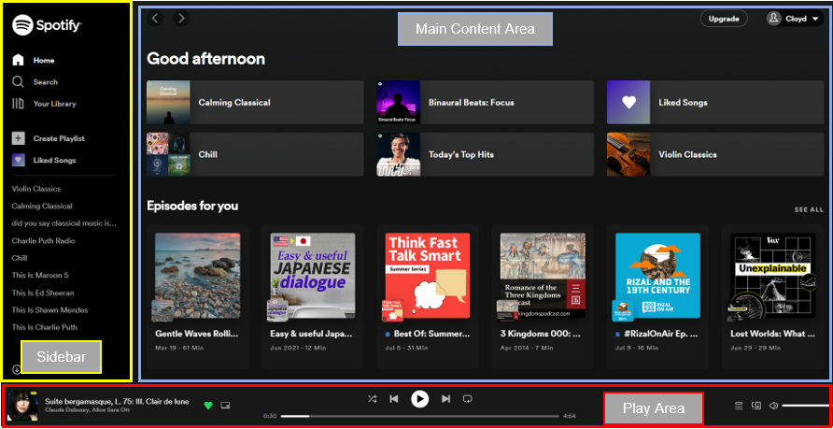
Reference || Spotify
“It is where we try to take inspiration based on its monochromatic black theme”

Slide 3
HEADER
“ PAGE/SCREEN/CONTENT TITLE ”
LOGO
Music Library
View Albums
Add Songs
MAIN CONTENT AREA
SIDEBAR/NAVBAR
playButton.isClicked()
ALBUM PIC
Now Playing….<music_title>
View Lyrics
Music..Stopped

Slide 4
Music Library
This is where most of the general listing of music is located.
Music has attributes of: music_title, music_artist, and music_album

Slide 5
Music Library ||List of Music title, Music artist, Music album
“This is where the lists of all music is located along with some attributes of Music”
This entire row can be clickable to play that music only
“MUSIC LIBRARY”
LOGO
TITLES
ARTISTS
ALBUMS
Music Library
Country Roads | John Denver | Poems, Prayers & Promises
Song 2 | Artist 2 | Album 2
Song 3 | Artist 3 | Album 3
Song 4 | Artist 4 | Album 4
Song 5 | Artist 5 | Album 5
View Albums
Add Songs
Scrollable Content
SIDEBAR/NAVBAR
ALBUM PIC
Now Playing…Country Roads
View Lyrics
When music is playing, this button changes to stop

Slide 6
Music Library ||List of Music title, Music artist, Music album
“This is where the lists of all music is located along with some attributes of Music”
“MUSIC LIBRARY”
LOGO
TITLES
ARTISTS
ALBUMS
Music Library
Country Roads | John Denver | Poems, Prayers & Promises
Song 2 | Artist 2 | Album 2
Song 3 | Artist 3 | Album 3
Song 4 | Artist 4 | Album 4
Song 5 | Artist 5 | Album 5
View Albums
Add Songs
Scrollable Content
SIDEBAR/NAVBAR
ALBUM PIC
Music…Stopped
View Lyrics
When music is stopped, it changes to play button

Slide 7
Viewing Lyrics
The Main Content Area will change to display a plain text of lyrics once the ‘view_lyrics’ button is clicked.

Slide 8
Viewing Lyrics||What happens when user clicks View Lyrics button
“Display the lyrics in simple way like text plain”
“MUSIC LIBRARY”
LOGO
Almost heaven, West Virginia
Blue Ridge Mountains, Shenandoah River
Life is old there, older than the trees
Younger than the mountains, growin' like a breeze
Country roads, take me home
To the place I belong
West Virginia, mountain mama
Take me home, country roads
All my memories gather 'round her
Miner's lady, stranger to blue water
Dark and dusty, painted on the sky
Misty taste of moonshine, teardrop in my eye
Music Library
View Albums
Add Songs
Scrollable Content
SIDEBAR/NAVBAR
ALBUM PIC
Now Playing…Country Roads
Close Lyrics
Changes the label to…”Close Lyrics”

Slide 9
So, when the close lyrics button is clicked.
The Main Content Area simply goes back to view the panel for containing the music library

Slide 10
Viewing Albums
This is simply a list of albums where we can at least display the image of an album cover.
It contains the name of albums we have from the library.

Slide 11
View Albums||Album names and its album photo cover
This is clickable, and when clicked. It will redirect to a panel where it contains that album
“This is where the lists of all music is located along with some attributes of Music”
“VIEWING ALBUMS”
LOGO
LIST OF ALBUMS
Music Library
Poems, Prayers & Promises
Album 2
Album 3
Album 4
Album 5
View Albums
Add Songs
Scrollable Content
SIDEBAR/NAVBAR
ALBUM PIC
Music…Stopped
View Lyrics

Slide 12
View Albums||Album names and its album photo cover
“This is where the lists of all music is located along with some attributes of Music”
“MUSIC LIBRARY”
LOGO
Poems, Prayers & Promises
Music Library
BY JOHN DENVER
ALBUM PIC
View Albums
Add Songs
TITLES
Country Roads
Song 2
Song 3
Song 4
Song 5
Scrollable Content
SIDEBAR/NAVBAR
ALBUM PIC
Music…Stopped
View Lyrics

Slide 13
Add Songs
This is like a form where a user can add their own music to the music_dir of the app directory.
The music_dir directory is located on the client side on their own folder.

Slide 14
Add Songs||It is where user can add their own songs to the music library
“This is like a field form where user fills out details”
“ADD YOUR OWN SONG”
LOGO
Enter Music Title
Music Library
View Albums
Enter Artist
Add Songs
Enter Album
Enter Music Path
Scrollable Content
SIDEBAR/NAVBAR
Save Changes
ALBUM PIC
Music…Stopped
View Lyrics

