Slide 1


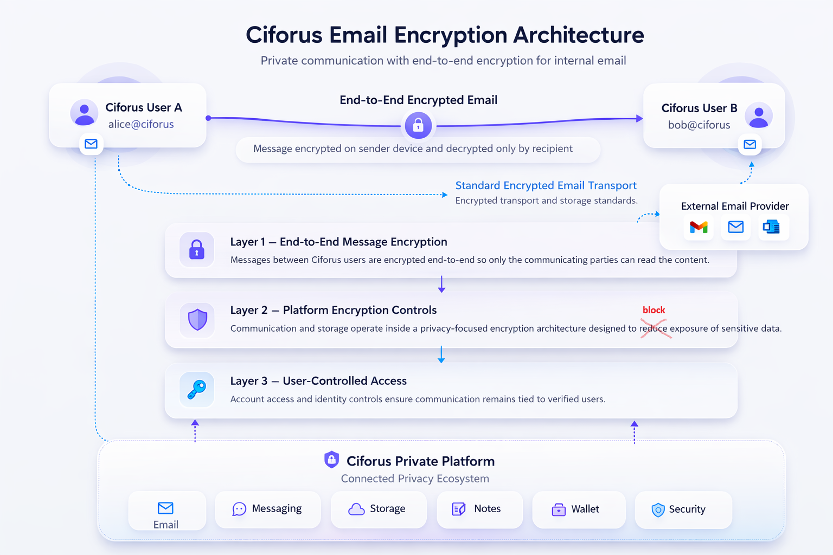
Private digital infrastructure for crypto-native users
A privacy-first platform unifying communication, storage, identity, security, and crypto-native payments in one environment.
Private communication
Secure identity
Token-aligned ecosystem
1

Slide 2
THE PROBLEM
Crypto users operate in a fragmented and exposed digital stack
Privacy failures do not come from one weak app alone. They come from disconnected identity, communication, storage, recovery, and billing layers.
Wallet-native users are still forced to work through mainstream tools designed around convenience, readable infrastructure, and provider control.
The result is a high-value user with a low-coherence privacy stack.
Sensitive notes reveal strategy long before anything is public.
Weak recovery flows can compromise the strongest encryption claims.
Billing and identity rails can undo privacy at the final step.
Every extra surface increases the attack and impersonation map.
Fragmented identity
Privacy illusion
Email, messaging, notes, files, and payments all live in different trust environments.
Metadata and billing exposure often survive even when content claims sound secure.
No real ownership
Crypto-native gap
Platforms still control access, recovery, visibility, and operating rules.
A wallet can prove ownership, but it does not create a private operating layer by itself.
Privacy is not a feature gap. It is an infrastructure gap.
2

Slide 3
WHY NOW
The market is moving toward higher-stakes privacy
Attack pressure is rising at the same time crypto users are becoming more operationally sophisticated.
Why Ciforus matters now
Attack surfaces are multiplying
Serious crypto users should not have to choose between usability and privacy every time they send a message, protect a file, verify an identity, or accept a payment.
Wallets, admin access, founders, and operators are all increasingly targeted.
Trust-sensitive workflows carry value
Communication and planning now move money, governance, partnerships, and launches.
Privacy is shifting from preference to operational requirement.
Identity exposure is becoming more costly across the crypto stack.
The category is ready for a product-first private operating layer.
Mainstream tools optimize for convenience
Indexing, provider control, and readable infrastructure remain normal defaults.
Context sources used in the whitepaper and litepaper include official materials from IBM, Microsoft, Chainalysis, Proton, Signal, Google, Apple, and Telegram.
3

Slide 4
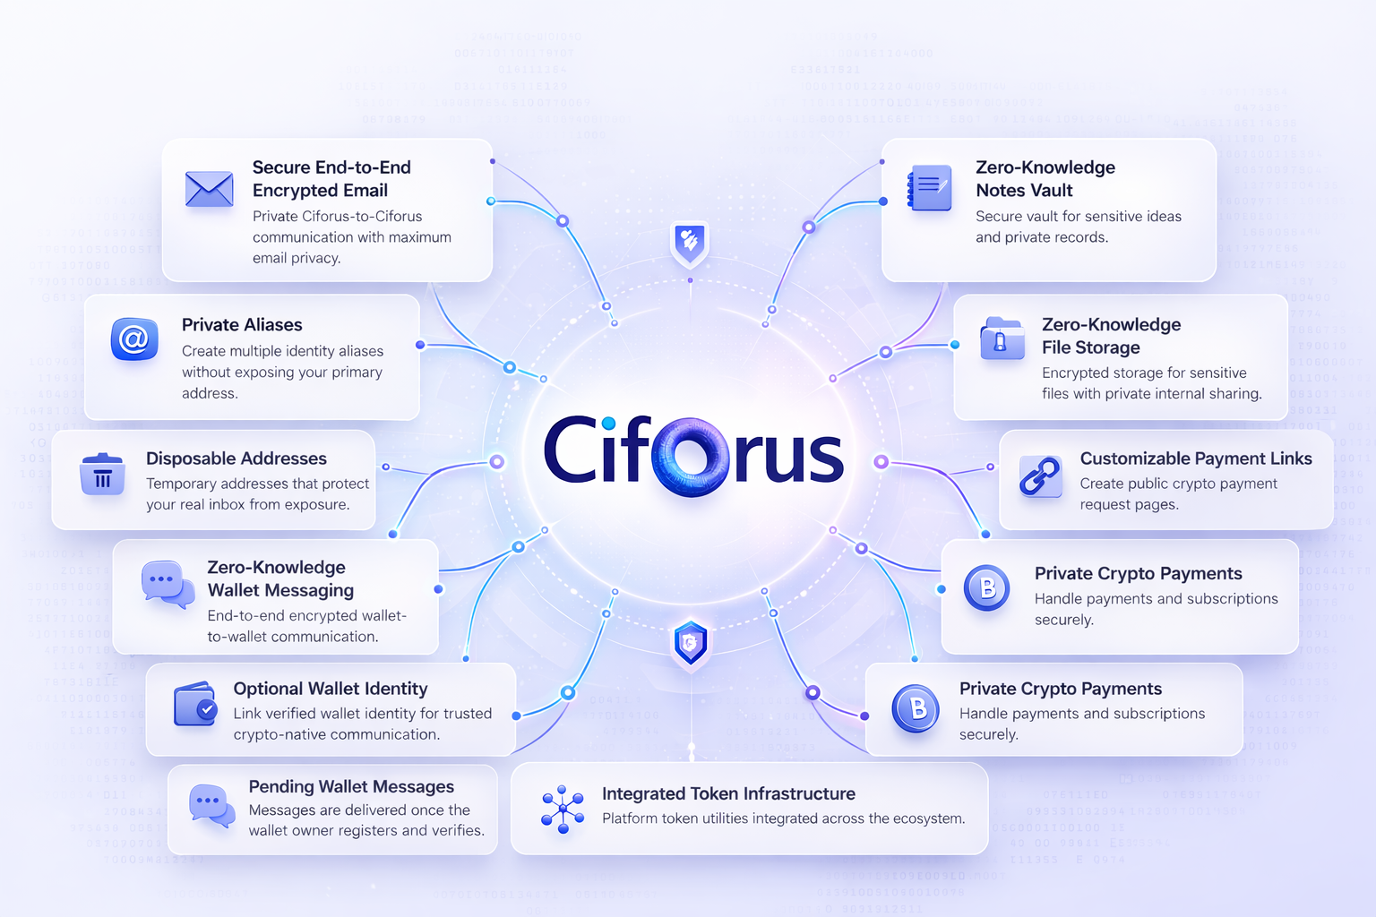
THE SOLUTION
One connected privacy ecosystem instead of six disconnected tools
Ciforus unifies communication, storage, identity, security, and crypto-native payment workflows under one privacy philosophy.
Premium @ciforus.com Email identity
Wallet Messaging anchored in verified ownership
Secure Storage and encrypted Notes for sensitive working material
Security Center with recovery, 2FA, and session control
Pay Links and wallet-linked billing inside a privacy-first environment
Ciforus is not a single app. It is a private digital environment.
Email
Messaging
Storage
Notes
Wallet
Security
Pay Links
4

Slide 5
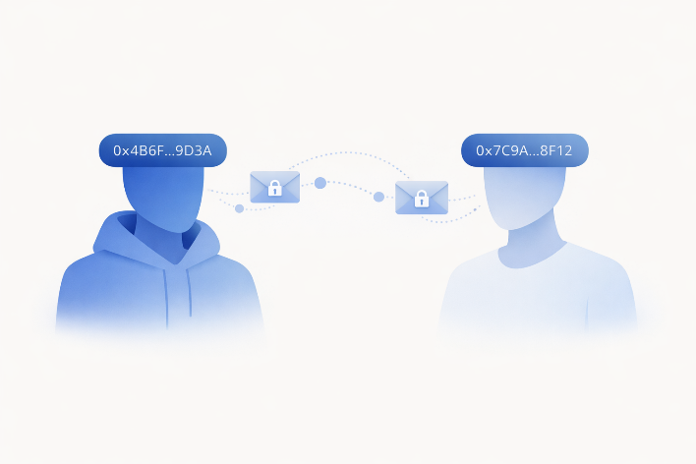
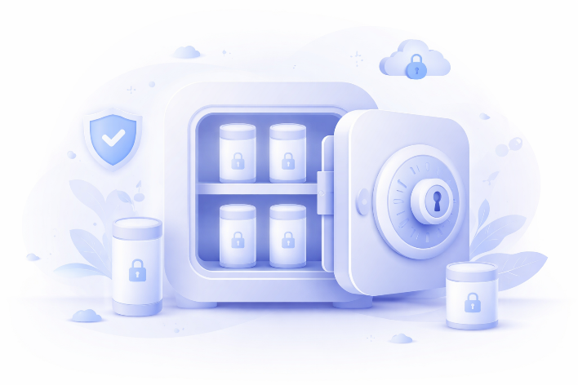

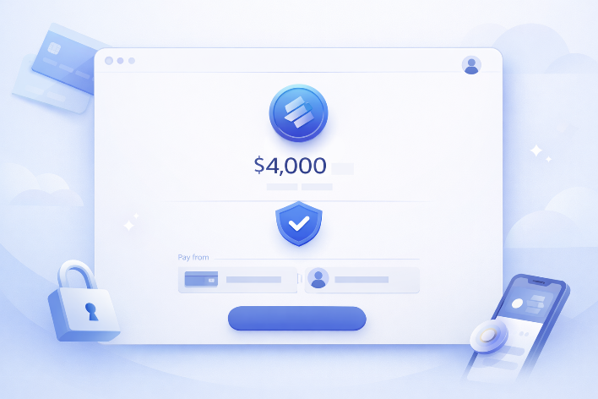
PRODUCT STACK
Built as a modular system with real user-facing utility
Each module solves a practical workflow problem, and together they create a higher-retention ecosystem than a standalone privacy tool.
Email as identity
Premium @ciforus.com presence rather than a generic inbox.
Notes and storage
Wallet Messaging
Secure Storage
Sensitive knowledge and files stay inside stronger confidentiality boundaries.
Security Center
Recovery, TOTP, sessions, and wallet verification are first-class product layers.
Wallet Identity
Pay Links
Pay Links
Crypto-native payment requests extend the platform outward without becoming a custody wallet.
5

Slide 6
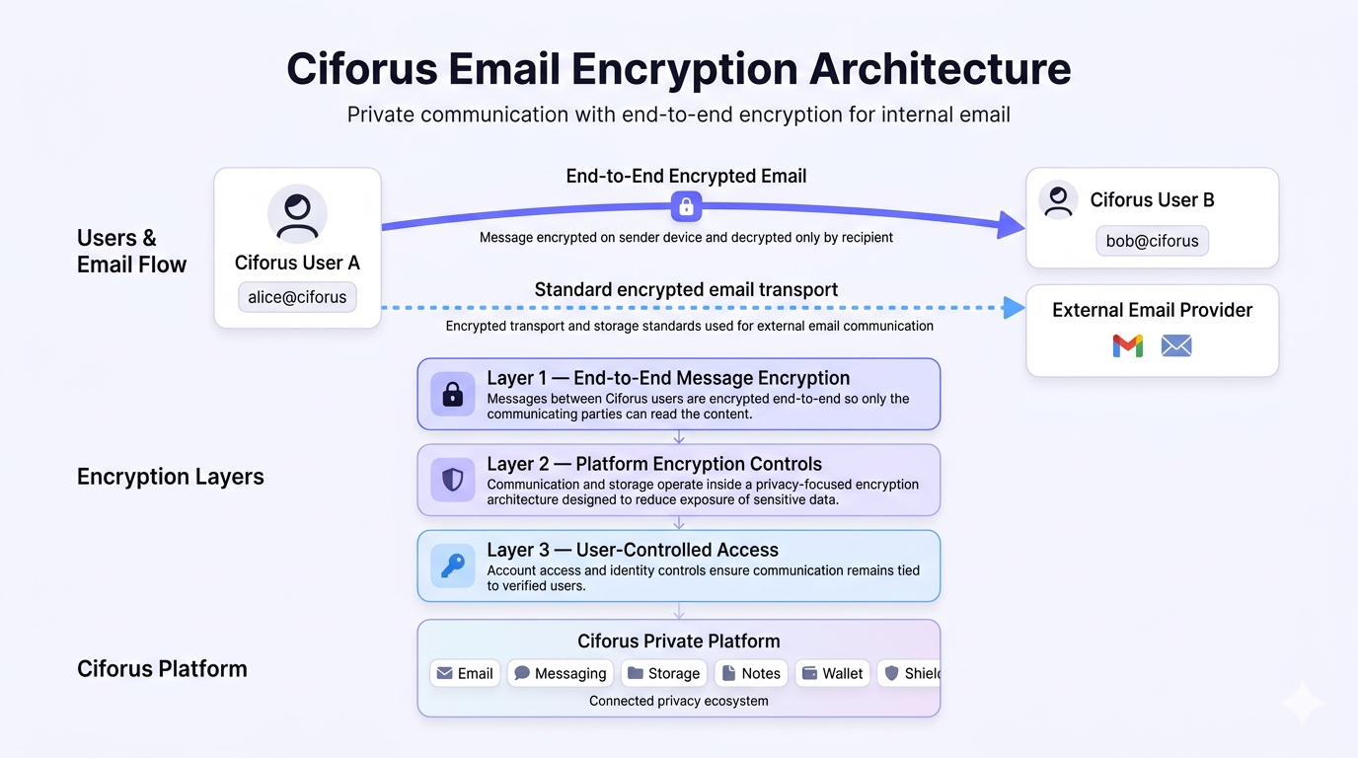
SECURITY ARCHITECTURE
A privacy model designed as architecture, not marketing
Ciforus differentiates through consistency across communication, storage, identity, recovery, and access.
High-value security claims supported by the current product narrative
Custom three-layer protection model
End-to-end encryption on native Ciforus communication paths
Zero-knowledge principles and reduced readable infrastructure surfaces
Secure gateway architecture for Email isolation
AES-CTR plus HMAC for file protection and AES-256-GCM for protected app data
Wallet verification, TOTP, session hardening, and BIP39-linked recovery reinforcement
The moat is not one claim. It is system-wide alignment.
6

Slide 7
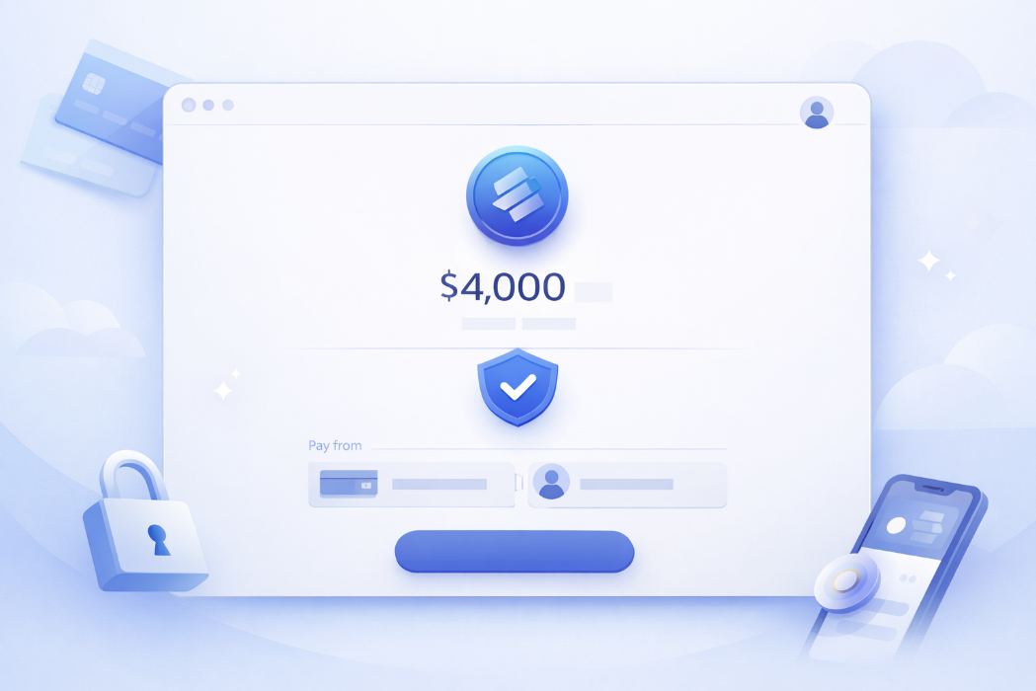
BUSINESS MODEL
Public pricing, premium upgrades, privacy-first billing
Ciforus uses a serious free tier, premium capacity expansion, and crypto-native billing that stays aligned with the product privacy thesis.
Billing philosophy
Crypto checkout happens inside the app, not on the marketing site.
Card payments are intentionally excluded to reduce identity exposure.
Accepted currencies include USDT, USDC, ETH, BNB, and CIFORUS.
Free
Pro
Elite
$0.00
Annual equivalent per month
$4.99
Annual equivalent per month
$9.99
Annual equivalent per month
Unlimited notes
100 MB storage
2 verified wallets
3 aliases
500 MB storage
3 active invoice links
5 aliases
1000 MB storage
10 active invoice links
7

Slide 8

TOKEN ROLE
Ciforus is the product. CIFORUS is the economic engine.
The token is designed to coordinate the platform economy, not to replace the product thesis.
Upgrades
Staking
Why the token matters
Native plan activation and discounted payments
Alternative tier access for long-term holders
Tier upgrades and native discounts
Staking-based tier activation
Reward alignment and ecosystem participation
Future utility across storage, identity, messaging, and governance
A direct bridge between product usage and ecosystem economics
Rewards
Expansion
Ecosystem incentives and upgrade-credit programs
Future sinks across features and governance
Optional at checkout. Required for the ecosystem economy.
8

Slide 9
TOKENOMICS SNAPSHOT
Fixed supply, utility-first structure, disciplined allocation
CIFORUS is a fixed-supply ERC-20 on Ethereum mainnet with no minting, no inflation, and no hidden taxes.
Supply allocation
Presale structure
Presale
35%
Round
Allocation
Price
Raise
Stage 1
8M
$0.025
$200K
Ecosystem / Rewards
20%
Stage 2
15M
$0.035
$525K
Stage 3
12M
$0.05
$600K
Treasury / Operations
20%
Team
15%
Max raise: $1.325M | Final stage reference FDV: $5.0M
Liquidity
10%
Contract facts
ERC-20 on Ethereum mainnet
No minting after deployment
No transfer tax, pause, or blacklist controls
Burns executed via dead-wallet transfers rather than privileged burn function
Total supply: 100,000,000
Deployed on Ethereum mainnet and publicly verifiable.
9

Slide 10

DEFLATION MODEL
Usage-linked deflation instead of narrative scarcity
The token model is designed to tie real platform usage to transparent supply reduction over time.
Eligible platform token spend is split into three streams
40%
Burned
Permanent removal through transfer to a dead wallet.
40%
Treasury
Supports infrastructure, audits, and operational runway.
20%
Liquidity
Supports market depth and healthier trading conditions.
Weekly burn cadence creates a visible on-chain deflation rhythm linked to actual use
10

Slide 11
ROADMAP
From foundation to ecosystem scale
The project has already moved beyond concept and is progressing toward launch, growth, and deeper ecosystem utility.
PHASE 1
PHASE 2
PHASE 3
Foundation
Product Build
Public Launch
Q4 2024 and 2025
Vision, architecture, privacy model, modular system, token framework.
Q1 2026
Core platform build, secure email gateway, token deployment, launch infrastructure.
Q2 2026
Platform launch, presale, token utility activation, launch refinement.
PHASE 4
PHASE 5
PHASE 6
Growth
Expansion
Scale
Q3 2026
Messaging, storage, email expansion, UX polish, early adoption growth.
Q4 2026
Partnerships, liquidity expansion, Pay Links growth, stronger identity layer.
2027
Advanced utility, multichain direction, API layer, governance exploration.
11

Slide 12
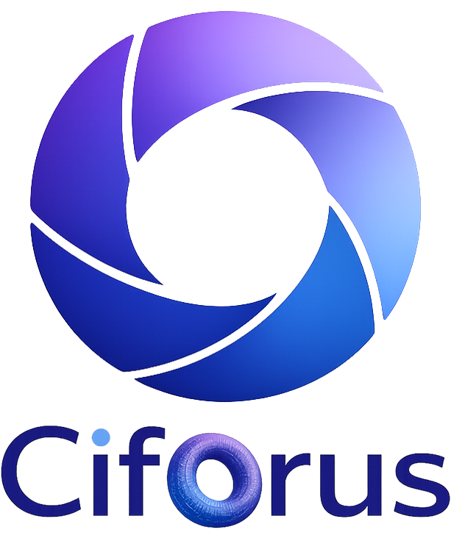
CLOSING
Ciforus is building the privacy layer serious crypto users still do not have
The opportunity sits at the intersection of privacy demand, crypto-native identity, and an integrated product stack with aligned economics.
Solves a real infrastructure problem rather than a cosmetic pain point.
Combines multiple high-retention modules into one coherent environment.
Security architecture is a strategic differentiator, not a slogan.
Token economics connect ecosystem growth to product usage.
Launch timing benefits from rising security awareness and crypto-native demand.
Private communication. Secure identity. Encrypted storage. Crypto-native infrastructure.
Product source docs: whitepaper, litepaper, and deck outline are all available online
12

